Slide 1



FLASHES
Energy
Storage
Microgrid Incentive Program & Development Reimbursement Agreements
Fire
Benjamin Rickelman
County of Lake
Deputy County Administrative Officer
Michael Day
Trane
JUNE 23, 2026

Slide 2




PROGRAM OVERVIEW
The Microgrid Incentive Program (MIP)
A PG&E ratepayer-funded program, originating from Senate Bill 1339 and implemented under CPUC Decision 23-04-034, that funds community microgrids delivering enhanced resilience to vulnerable populations and critical facilities.
24-hour islanding requirement
The microgrid must be able to operate in island mode for a minimum of 24 consecutive hours.
Milestone-based reimbursement
Funds are disbursed against eligible project costs as each 10% milestone is reached — not paid up front.
2

Slide 3




THE PROJECT
What is FLASHES?
Firemain Linked Auxiliary Supply / Hydraulic Energy Storage
A multi-use renewable energy, pumped-storage hydro, microgrid, and firefighting asset that could be developed primarily on County land, adjacent to the Northwest Regional Wastewater System.
Renewable Energy
Pumped-Storage Hydro
Community Microgrid
Wildfire Firemain
Pairs on-site solar (PV field) with the grid to shift clean power to peak demand.
Pumps water uphill off-peak; releases it through turbines to generate at peak.
Can island and serve critical local loads during grid outages and emergencies.
Stored water doubles as a dedicated firemain supply for wildfire response.
TWO CO-LOCATED FACILITIES
10 MW
Hartley facility
20 MW
Lucerne facility
3

Slide 4
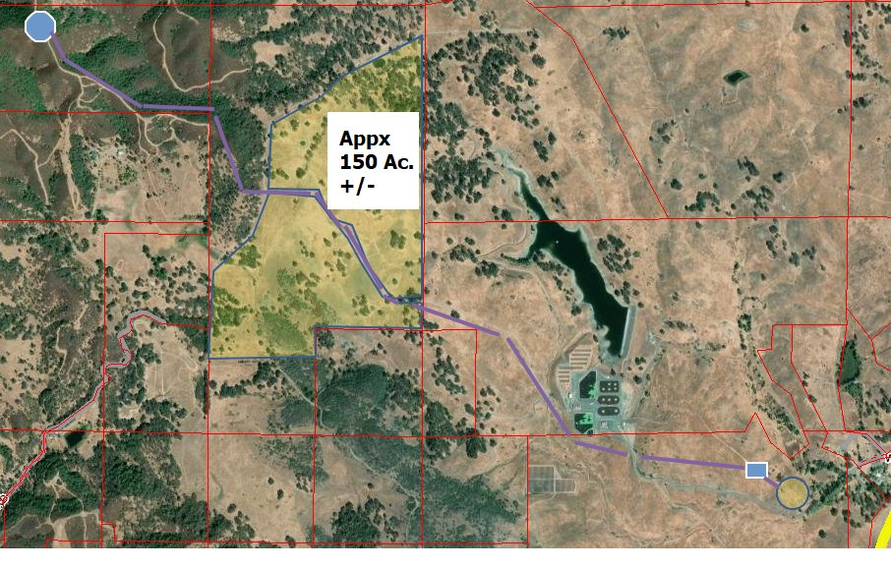

CONCEPT & SITE
How FLASHES Works
DRAFT GENERAL LAYOUT CONCEPT
A dual-use cycle
1. Pump (off-peak)
Surplus or off-peak renewable generation pumps water from the lower tank to an elevated upper tank.
2. Store
Water is held in elevated storage — simultaneously serving as a dedicated wildfire firemain supply.
Upper Tank
PV Field (≈150 ac)
3. Generate (peak)
Turbines & Lower Tank
Pipeline
During peak demand the water is released through turbines to generate clean electricity.
Near Poe Mountain – Northwest of Lakeport
4

Slide 5


PROJECT SCALE
Projected Size of FLASHES
Both tanks (Upper and Lower) are projected to be approximately:
75–80 ft
ILLUSTRATIVE CROSS-SECTION — EACH TANK
PROJECTED HEIGHT · each tank
400 ft
TANK
≈ 75–80 ft
PROJECTED WIDTH · each tank
below grade
≈ 12,000 ft
PIPES · between upper and lower tank
≈ 400 ft
Preliminary estimate. Exact dimensions — and how much of each tank sits below ground — will be set during predevelopment engineering and site analysis.
≈ 7–8 stories tall
Wider than a football field

Slide 6
ROLE & SCOPE
What Approval Today Would Do — and Wouldn’t
These agreements fund predevelopment only. The County is positioning FLASHES for a future third-party developer — it is not committing to build or own the facilities itself.
1
A Third-Party Developer
2
$150M+ to Build
3
Predevelopment Only
Builds, finances, and owns the facilities. The County's role is to fund and de-risk predevelopment — not to construct or operate FLASHES.
Combined construction of the Hartley and Lucerne facilities could exceed $150 million — well above the County's fiscal capacity.
Today's approval funds ~2 years of predevelopment and validation work. It does not commit the County to building the projects.
Attractive to a developer: FLASHES would generate energy a developer could sell on the grid, making it a financially attractive, revenue-producing asset.
Entitlement still required: Even if FLASHES advances to construction, the projects will still need separate planning approval from the County before any development could proceed.

Slide 7

THE ASK
Four Agreements, One Sequence
MIP Agreements · Prerequisite
Reimbursement Agreements Enabled by MIP Agreements
MIP Grant Agreements
Hartley MIP Agreement
Lucerne MIP Agreement
Between PG&E and the County
Establishes the County as MIP Awardee and sets the milestone-based incentive funding.
Funds flow to the County as eligible costs are reimbursed.
Must be executed first — it enables Development Reimbursement Agreements.
Development Reimbursement Agreements
Hartley Reimbursement Agreement
Lucerne Reimbursement Agreement
Between Trane and the County
Engages Trane to perform ~2 years of predevelopment & validation work.
Nine categories of service scoped for predevelopment of project.
FLASHES predevelopment costs are expected to be covered up to $3,753,142 by MIP funds.
Bridge financing: Because PG&E only approves payment once the next 10% milestone is reached, RCRC is offering a $200,000, 0% loan so the County can stay ahead on reimbursements.
5

Slide 8
WHAT THE MIP FUNDS
Predevelopment Scope of Work
Trane will perform nine categories of predevelopment and validation services across both the Hartley and Lucerne sites (June 2026 – June 2028). MIP funds the engineering, environmental, and interconnection work that de-risks the project for a future developer.
1.1
Real Estate – Land Options
Site control & options for both sites
1.6
Environmental / Draft EIR
Bio surveys, CEQA review, outreach
1.2
Civil & Mechanical Feasibility
Survey, geotech, site plans, cost estimates
1.7
Interconnection Assistance
CAISO interconnection support
1.3
Electrical Engineering Feasibility
Preliminary electrical design
1.8
CAISO Application
CAISO Full Capacity Deliverability Study
1.4
Hydrologic Study
Test well & pump test for water availability
1.9
Project Administration
Subconsultant mgmt, billing, reporting
1.5
FERC – Notice of Intent
FERC NOI process for both facilities
6

Slide 9
COST & FUNDING
Reimbursement Agreements Budget
ALLOCATION BY SITE
TOTAL AGREEMENTS BUDGET
 | 10 MW Hartley | 20 MW Lucerne
Contractor (Trane) | $1,132,380 | $2,366,361
County compensation | $101,734 | $152,667
Site total | $1,234,114 | $2,519,028
$3,753,142
Covered by MIP funds
$3,498,741
Contractor (Trane)
Nine scope categories across both sites
Why this matters for the County
Both contractor and County costs are reimbursed through the MIP Grant Agreement.
Trane's monthly invoices are structured to support County progress billing to PG&E, and the RCRC 0% bridge loan covers the timing gap between milestones.
$254,401
County Compensation
CAISO fees, CEQA augmentation, staff time
7

Slide 10
RECOMMENDED ACTION · JUNE 23, 2026
Approve the Four Agreements
Approve the MIP Grant Agreements (Hartley + Lucerne)
Between Pacific Gas and Electric Company and the County of Lake — the prerequisite that unlocks milestone-based incentive funding.
1
2
Then approve the Development Reimbursement Services Agreements
(Hartley + Lucerne)
Between Trane and the County — engaging ~2 years of predevelopment work to advance and de-risk FLASHES, funded up to $3,753,142 through the MIP agreements.

Slide 11
Energy
FLASHES
Storage
Microgrid Incentive Program & Development Reimbursement Agreements
Fire
Benjamin Rickelman
County of Lake
Deputy County Administrative Officer
Michael Day
Trane
JUNE 23, 2026

