Slide 1
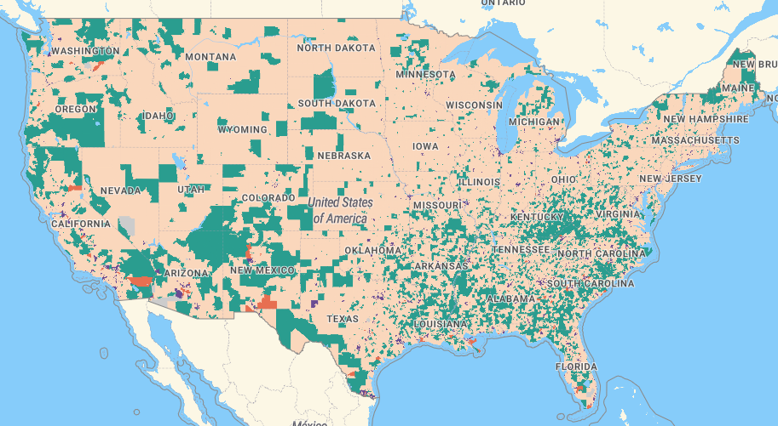
Opportunity Zones
Utilizing the Federal Tax Code to Catalyze Investment
March 10, 2026, Update

Slide 2
Opportunity Zones Program Overview
Governors Can Send List of Preferred Opportunity Zones to US Department of the Treasury starting July 1, 2026
Governors List of Preferred Opportunity Zones are Due to Treasury September 29, 2026
New Designations Take Effect January 1, 2027
Program Made Permanent. New Designations Every Ten Years
Current Opportunity Zones Expire December 31, 2028. Current and Future Opportunity Zones Will Overlap for Two Years

Slide 3
Major Features of Opportunity Zones 2.0
Tax Free Appreciations
Permanent Exclusion (Federal Capital Gains)
If Qualified Investments are Held for at Least 10 Years
  No Depreciation Recapture
Partial Exemption
  New Rural Investments 30% Basis Step-Up After 5 Years
Capital Gains Tax Deferral
  New rolling five-year deferral period from date of investment
50% Rural Substantial Improvement Threshold

Slide 4
Prioritizing Opportunity Zones 2.0 Advocacy
  Six Eligible Census Tracts Listed as High Priority in Joint Letter
    402, 501, 702, 703, 801, 802
  Preference Given to Census Tracts Where it is Estimated There is a Higher Chance of Large-Scale Development That Could Attract OZ Fund Capital
  Three Other Eligible Lake County Census Tracts Listed as Additional Priority in Letter
  601, 704, 1000
  Consulted with the City of Lakeport and the City of Clearlake

Slide 5
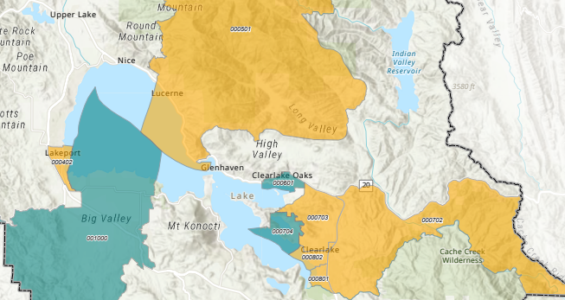

Slide 6
Next Steps
Joint Letter from County, City of Lakeport, and City of Clearlake to Governor’s Office Advocating Eligible Census Tract Selection for Opportunity Zones 2.0 Selection
City of Lakeport and City of Clearlake Still Need to Approve Joint Letter

Slide 7
Opportunity Zones
Utilizing the Federal Tax Code to Catalyze Investment
March 10, 2026, Update

