Slide 1


Analysis of the Community Development Department
Presentation to the Board of Supervisors
January 13, 2026

Slide 2

Grant / Program Funded Positions
Building Division
Code Enforcement
Planning Division
No grant funded positions
CDBG Grant: 2 positions
COPTR Program: 2 positions
Prop 64 Cannabis: 3 positions
Geothermal: Resource Planner

Slide 3
Planning Division Revenue

Slide 4
Planning Division Revenue vs. Expenses

Slide 5
General Fund Usage by Planning Division

Slide 6
Building Division Revenue

Slide 7
Building Division Revenue vs. Expenses

Slide 8
Code Enforcement Division Revenue vs. Expenses

Slide 9
Cash Transfers from Building Division

Slide 10

Building Division Reserve

Slide 11
Building Division Loan Repayment Options
Option 1: 1 Yr Repay
  $390,000 by June 30, 2026 (full year is in November)
  The only way to make this option happen is through staff reduction
Option 2: 2 Yr Repay
  $195,000 each year for 2025/2026 and 2026/2027
  Staff reduction and cost recovery analysis for staff time
Option 3: 3 Yr Repay
  $130,000 each year for 2025/2026, 2026/2027 and 2027/2028
  Staff reduction, cost recovery and reorganization analysis

Slide 12
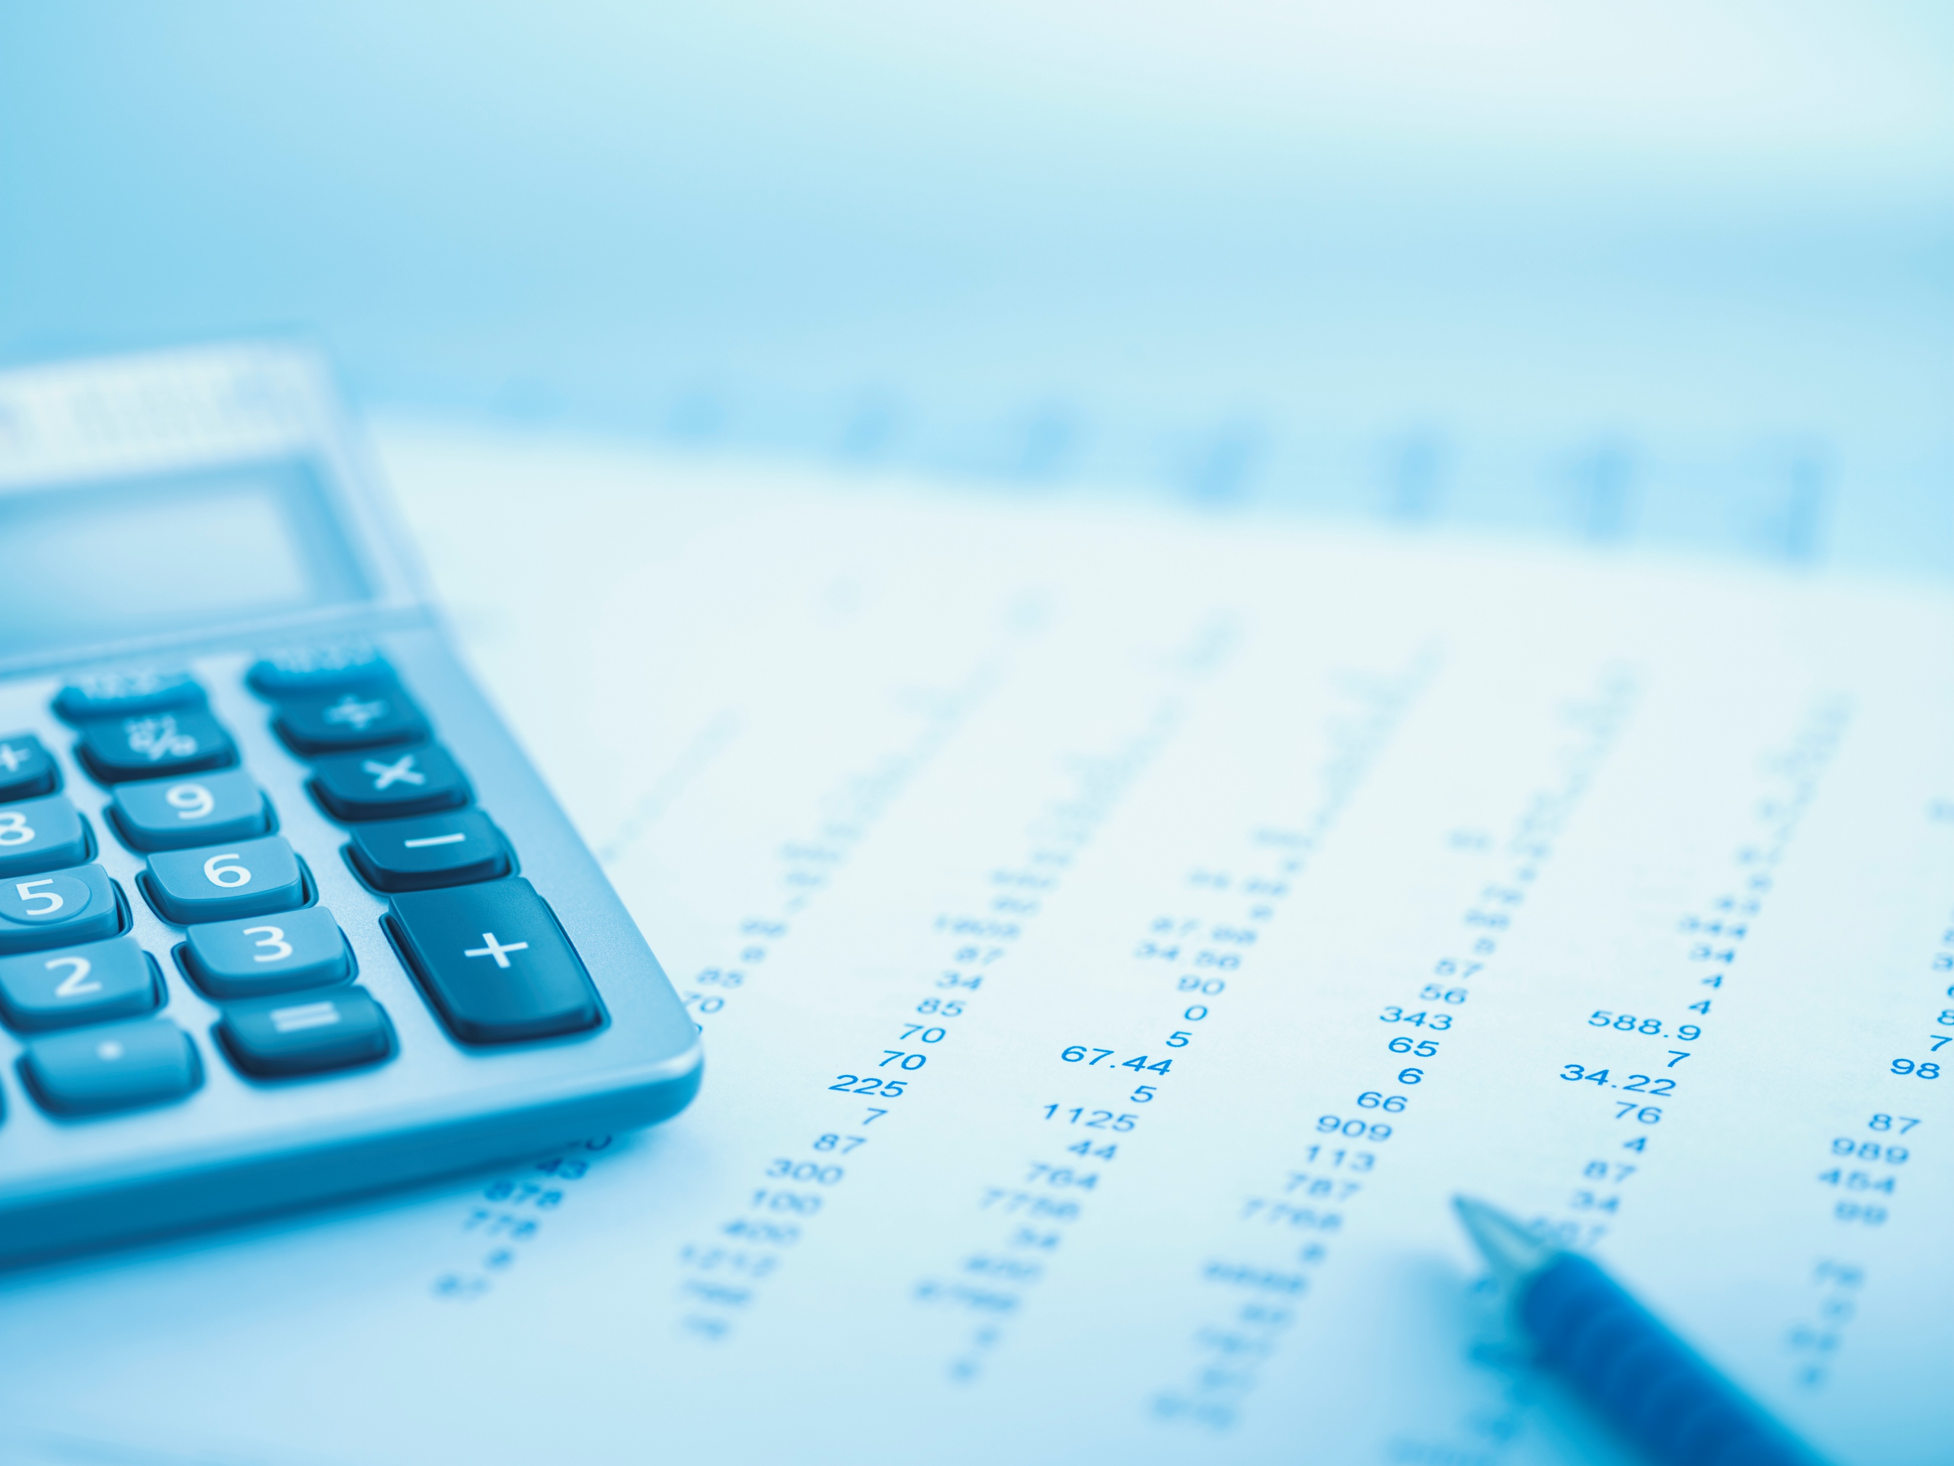
Memorandum of Understanding Increases across Divisions as of 7/1/2025
Building Division - $63,752.00
Code Enforcement - $95,347.20
Planning Division - $105,705.60
Total increase across all 3 divisions= $264,804.80

Slide 13
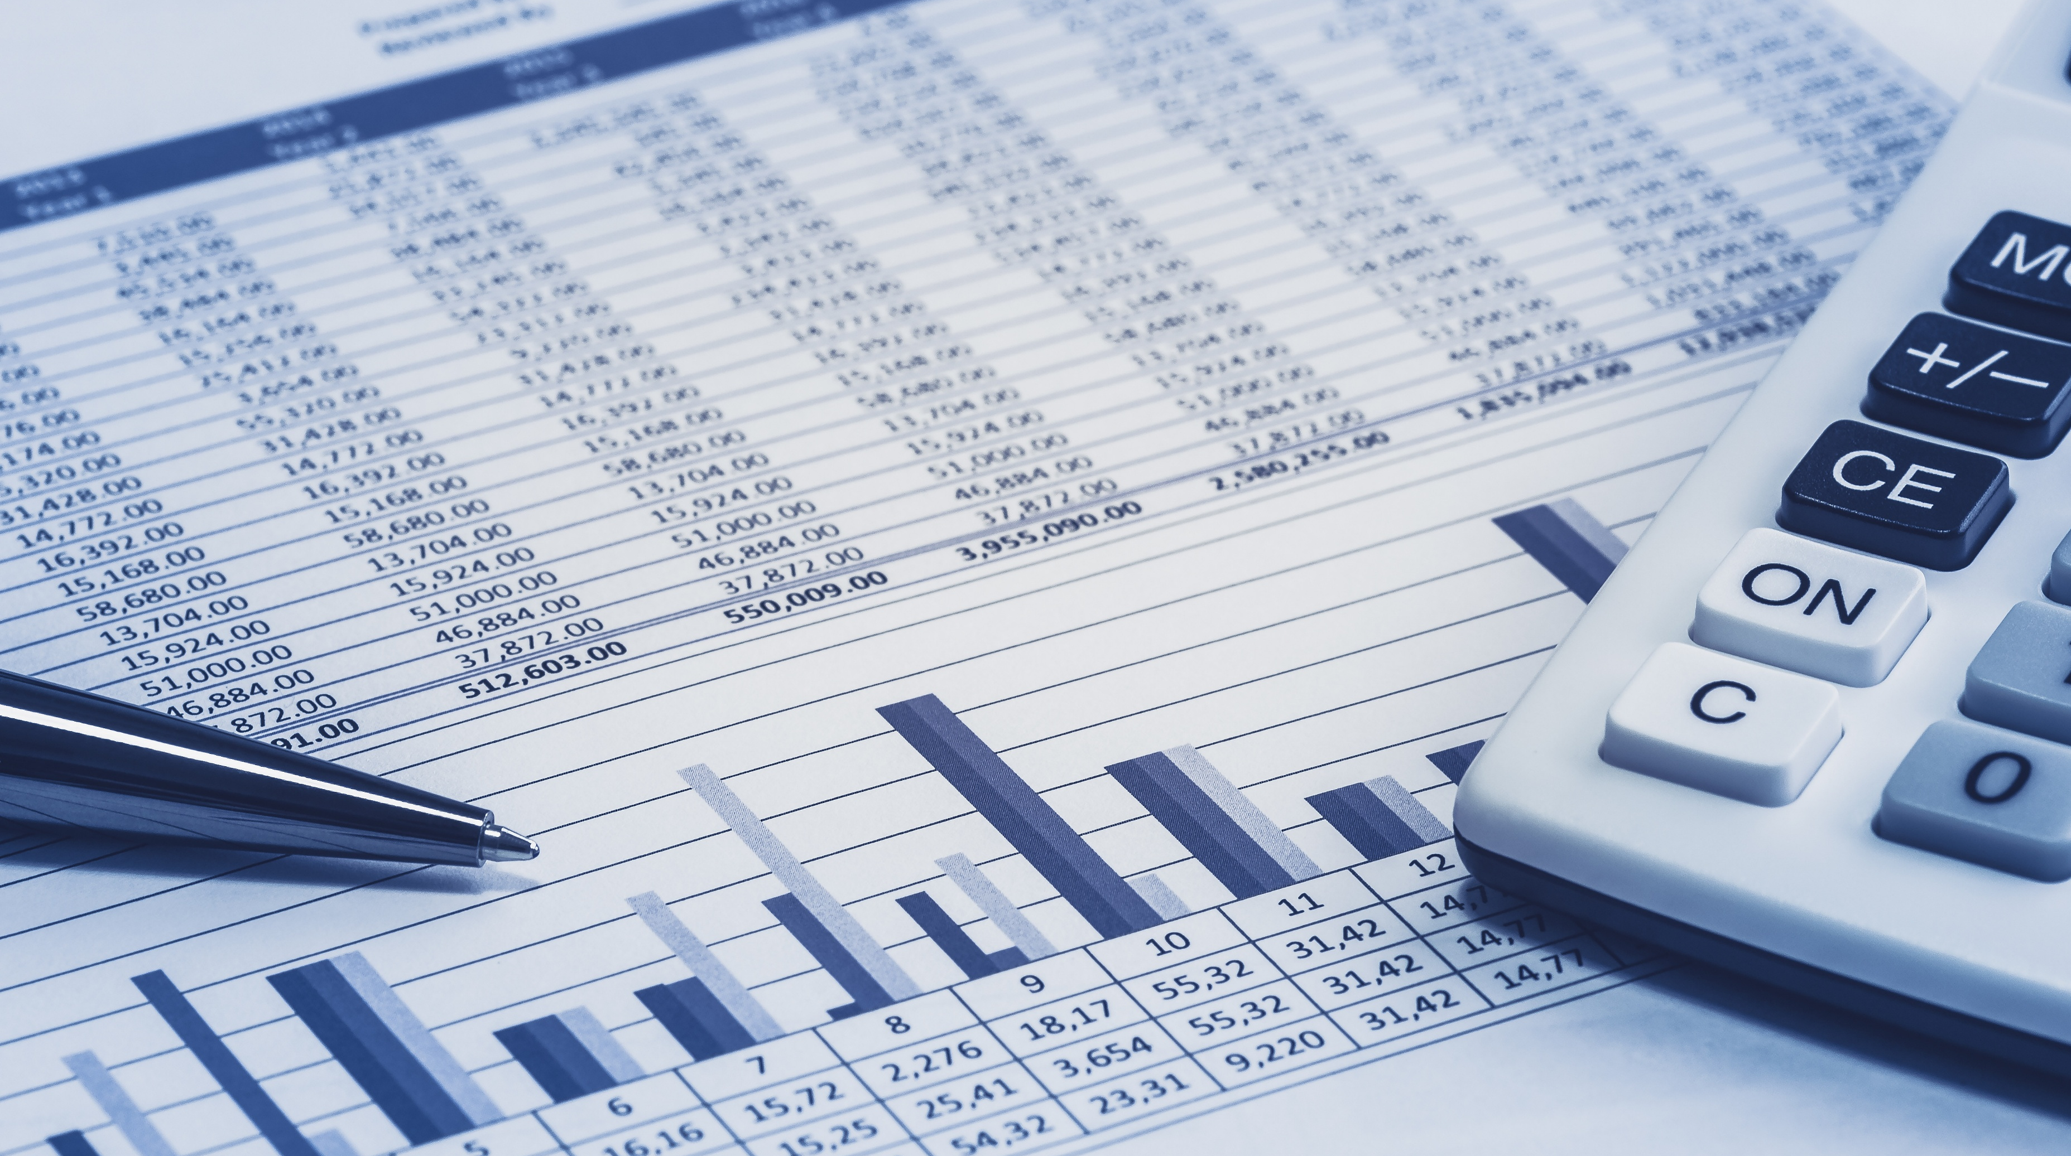
Calculation for Hourly Rate
DIRECT COST
OVERHEAD
HOURLY RATE
DIVIDED BY BILLABLE HOURS

Slide 14

Proposed Staff Recommendations
REDUCE STAFF
  Per MOU 3,4,5 Initial probationary employees are the first to be laid off followed by seniority.
  Talk to other departments to see if they have an opening for a lateral position
2
1
HOURLY RATE
Include MOU increases and unfunded mandates/projects in the Master Fee Schedule
BUDGET CREATION
Create a more conservative budget which can be expanded as revenues increase
POSITION ORGANIZATION
Look at restructuring positions within budgets
3
4

Slide 15
Any Questions?

