Slide 1


Information About Joining
Sonoma Clean Power
Lake County Board of Supervisors
July 8, 2025

Slide 2


Today’s Presentation
Overview of SCP
Progress toward offering service to Lake County
Details on how SCP is organized and operates
Benefits and risks of joining SCP
Process for joining SCP
Q&A

Slide 3

1. Overview of SCP

Slide 4
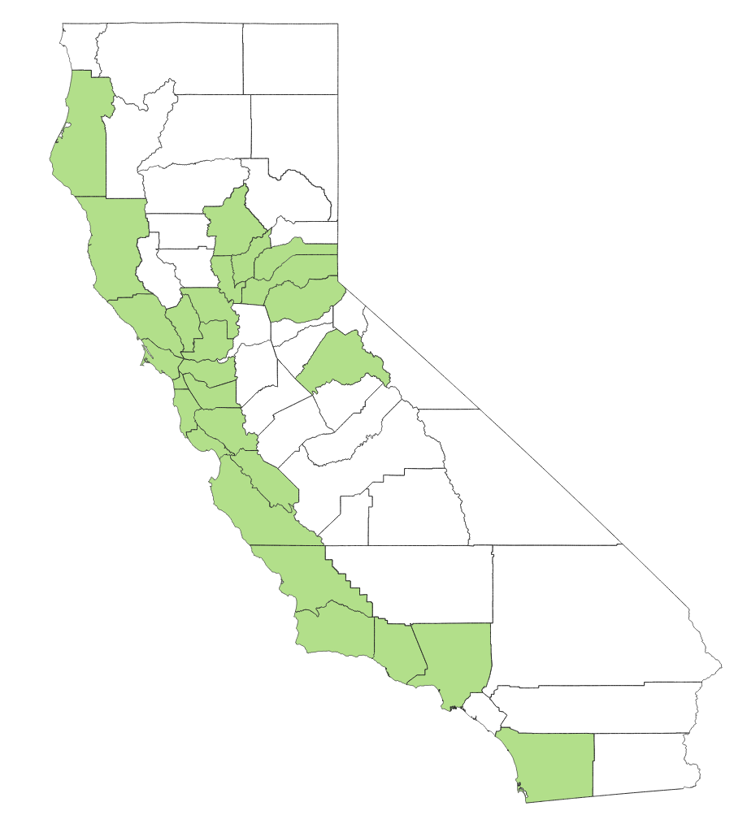
Overview of SCP
SCP is a “CCA” – Community Choice Aggregation
25 operating CCAs all around California
CCAs replace utility power sources, build new renewable energy and trim rates whenever possible
CCAs do NOT replace PG&E. PG&E still:
  Sends out the utility bill
  Maintains the poles and wires of the grid

Slide 5
Overview of SCP
SCP introduces a choice that customers currently do not have:
Who do you want generating your electricity?
Default service is SCP, the public power provider.
But customers can choose for themselves:
  PG&E (investor-owned utility)
  SCP (local agency operated by cities and counties)

Slide 6
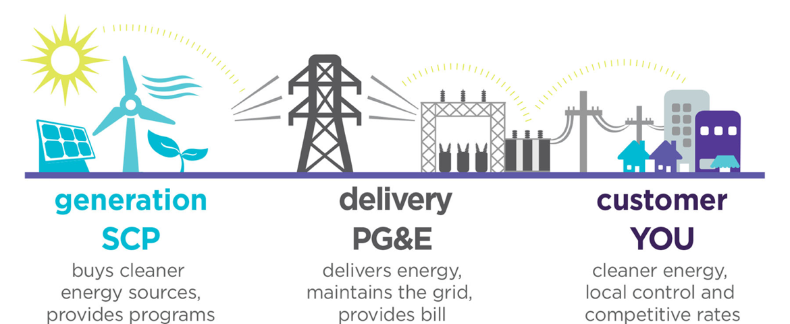
Overview of SCP

Slide 7
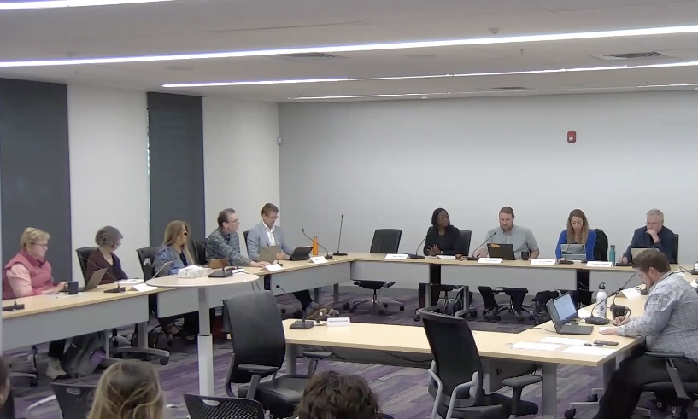
Overview of SCP
Started service in 2014
Public agency generates power for 87% of all homes and businesses in Sonoma and Mendocino Counties
Self-funded through revenues – no tax dollars
Working to improve oversight, lower rates, cut pollution, invest locally and help customers

Slide 8


Slide 9
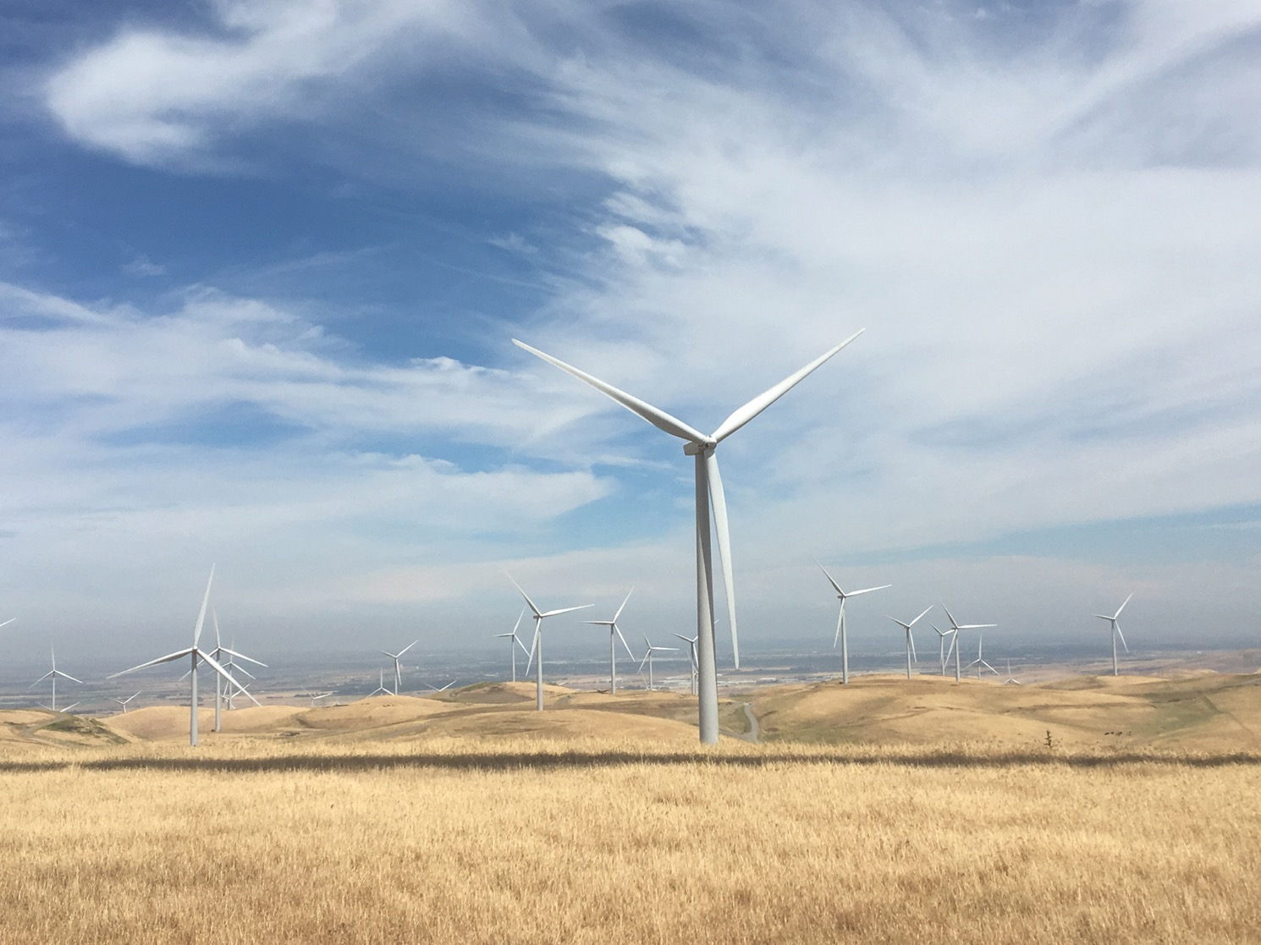
Notes:
Golden Hils in Altamont Pass

Slide 10
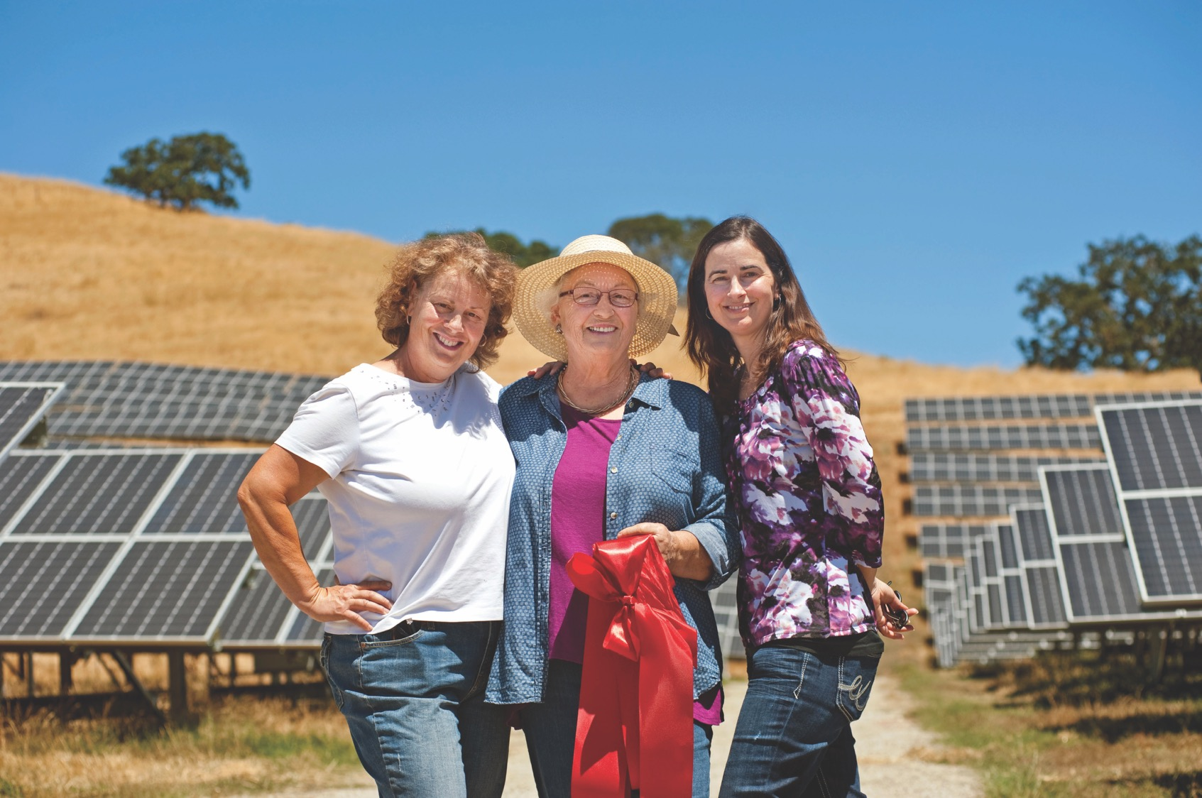

Slide 11
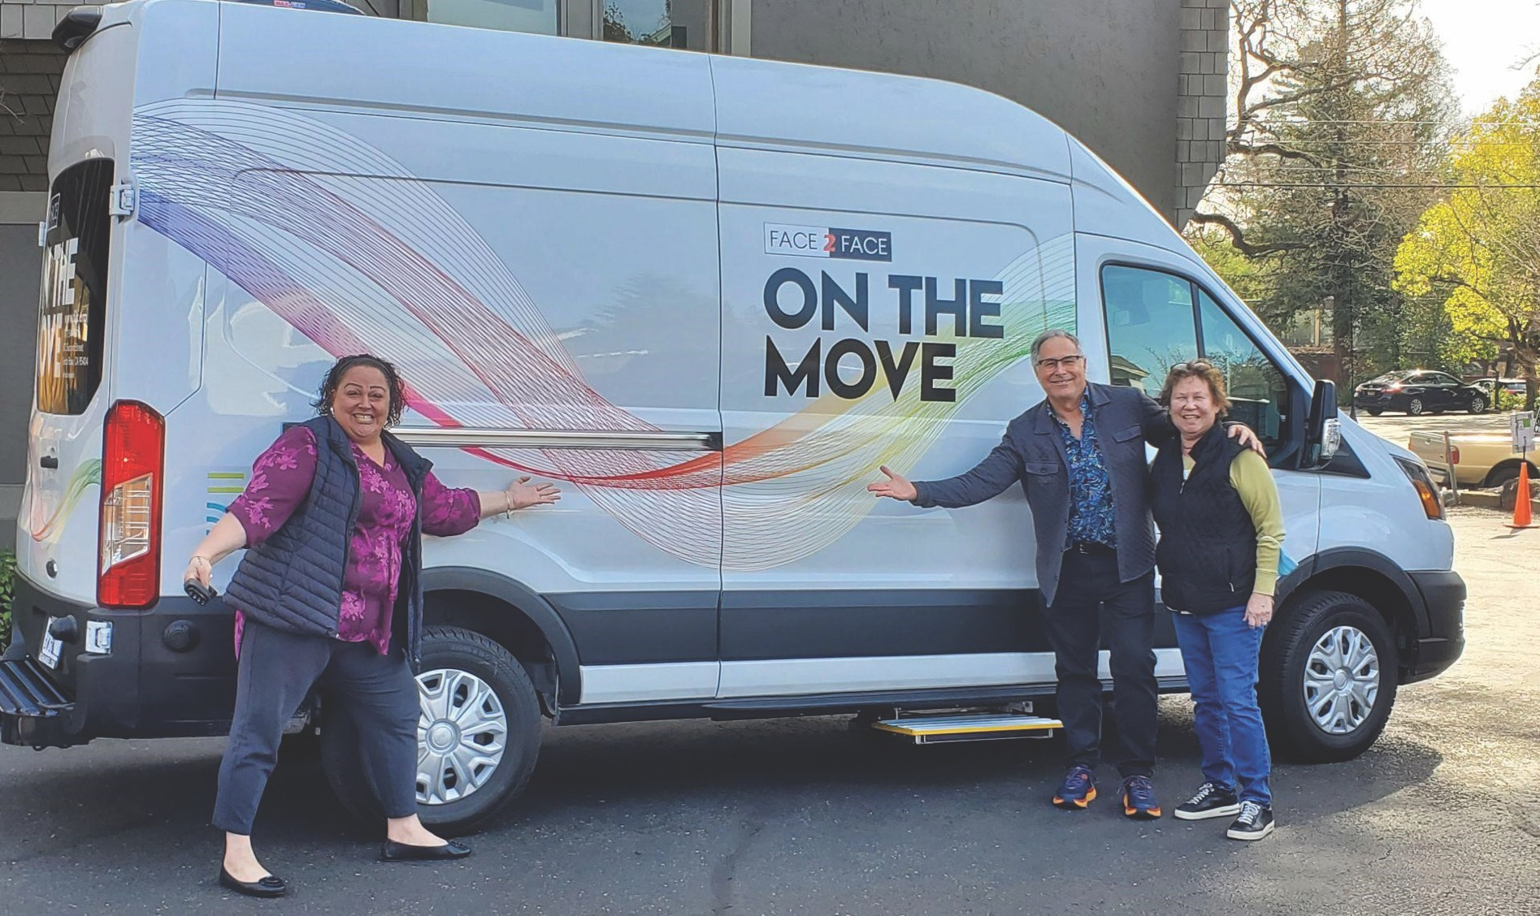

Slide 12
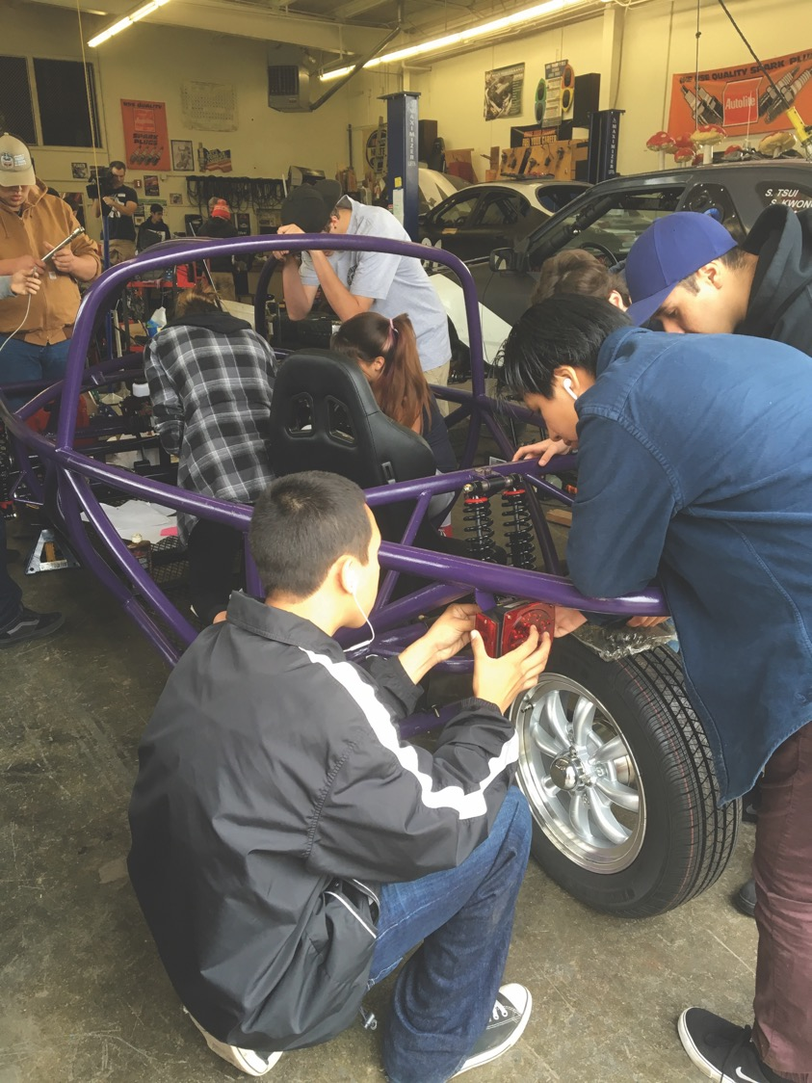

Slide 13
2. Progress Toward Offering Service

Slide 14
Progress
UPDATE:
On June 26, 2025, the CPUC voted to delay financial credits PG&E owes to CCA customers by up to 4 years. This means that SCP customers will be required to loan millions of dollars to PG&E interest free in 2026.
This decision will create more volatility in electric bills, increasing the risk of years with higher total bills.
In May 2025, SCP completed a feasibility study and found that extending service to all of Lake County likely would:
Create no new cost increases for SCP’s existing customers; and
Provide total bill savings to Lake County customers under regulatory and market conditions in April 2025.

Slide 15
Progress
The SCP Board of Directors voted on June 5, 2025 to begin a 60-day period to discuss expanding service to Lake County with an intention to make a formal offer in August.
Scheduled similar presentations to the City of Lakeport on July 15 and the City of Clearlake on July 17.
Asked to share the importance of confirming alignment on the value of geothermal energy, including developing more geothermal resources.

Slide 16
3. Details on How SCP Operates

Slide 17
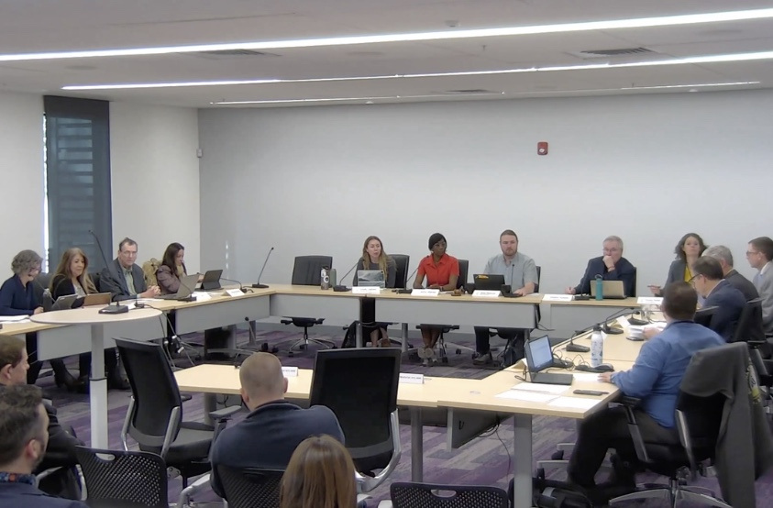
What is SCP?
A joint powers authority having as participants Sonoma and Mendocino Counties plus all the cities in those counties except the two munis in Ukiah and Healdsburg.
11-member Board of Directors, appointed by the participating jurisdictions
Staff of 55 people

Slide 18
SCP Board of Directors – Key Roles
Approves annual budget
Sets customer rates
Hires and reviews the CEO
Approves policies and plans that govern how power resources are purchased and built
Approves non-energy contracts above CEO’s spending authority

Slide 19
Why a JPA?
Most of California’s 25 operating CCAs operate under the joint powers authority structure to ensure a financial firewall exists between the individual members and the CCA itself.
This means:
  SCP’s liabilities are not the liabilities of the participating cities and counties.
  SCP cannot provide funds to its member cities and counties to meet other needs.

Slide 20
Why Did SCP Form?
Reduce greenhouse gas emissions
Provide electric power to customers at competitive cost
Help customers reduce total energy consumption
Invest locally to stimulate the economy
Develop local energy resources
Promote long-term rate stability, energy security, reliability and resilience

Slide 21
Default Service
When CCAs form, California requires that they operate as the default provider for all customers. This means SCP replaced all of PG&E’s power sources with its own.
Individual residential and commercial customers can “opt out” and choose PG&E to continue to produce their power.
Every customer will receive 5 notices in the mail over a 5 month period. During that time there is no fee to opt out. A residential customer opting out after that period will pay $5. A commercial customer will pay $20.

Slide 22
What Customers Would Experience
April-Oct 2026 About 20 community presentations to introduce SCP
March 2027 First mailed notices to all homes and businesses
March 2027 Second mailed notice
April-July 2027 About 10 more community presentations
May 1-31, 2027 Enrollment month, customers default into SCP service. Third mailed notice to all homes and businesses.
June 2027 Fourth mailed notice to all homes and businesses
July 2027 Fifth and final mailed notice to all homes and businesses

Slide 23
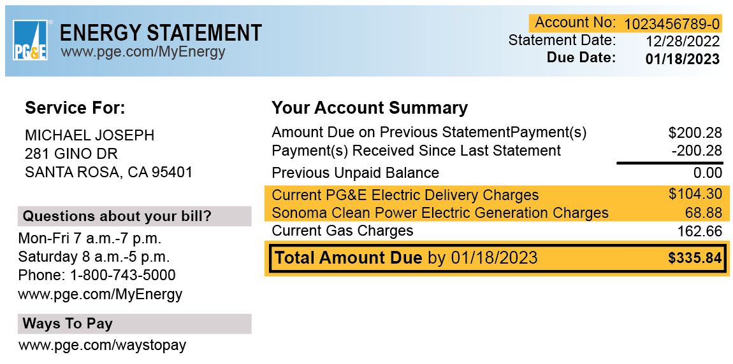
Combined Power Bill with PG&E

Slide 24
4. Benefits and Risks of Joining SCP

Slide 25
Benefits and Risks of Joining SCP
Customers would get a new option for power provider
Investments into local energy resources
Funding for scholarships and local non-profit organizations
Cut California’s air pollution and emissions
New advocate at the CPUC and in Sacramento
Lower rates for power generation when possible

Slide 26
History of Total Electric Bills
NOTE:
SCP Cannot Promise Cost Savings
PG&E is
cheaper
SCP is
cheaper

Slide 27
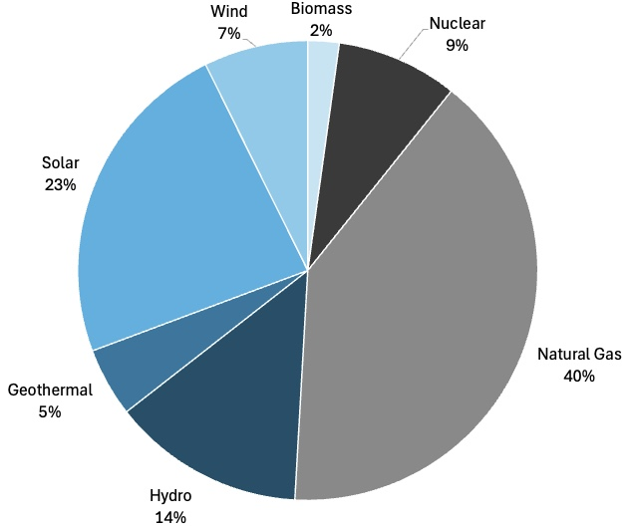
California’s Annual Power Sources 2024

Slide 28
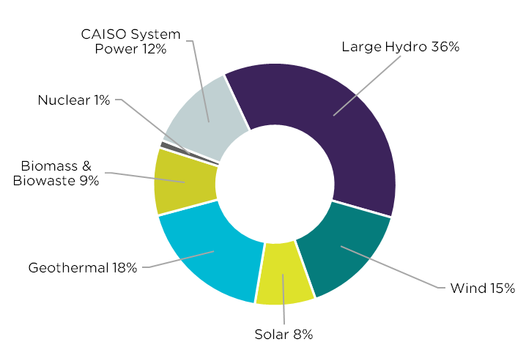
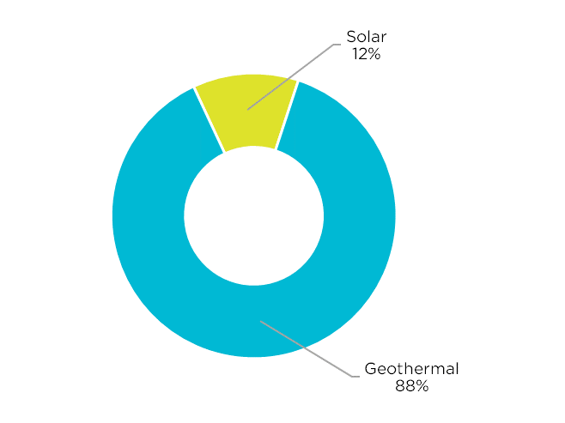
SCP Power Sources
Default
Local 24/7

Slide 29
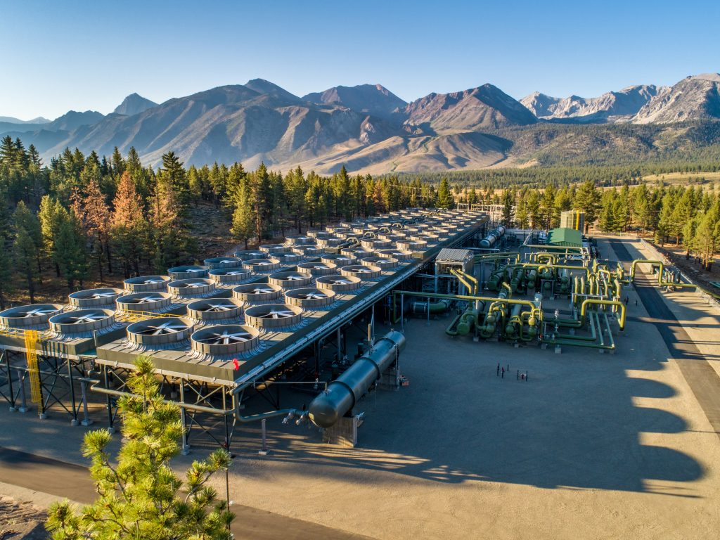
Driving Geothermal Expansion
SCP is committed to increasing local access to geothermal power and lowering long-term energy costs.
SCP aims to attract local investment and drive development that aligns with local values and creates well-paid, highly skilled local jobs.
California has already ordered 2,000 MW of new geothermal construction.
New technologies expand opportunities beyond current geologic, land, and water constraints.

Slide 30
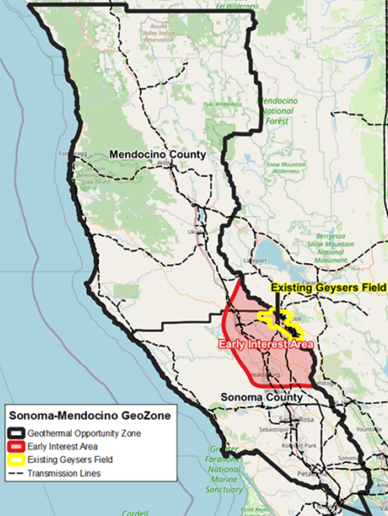
Geothermal Opportunity Zone
SCP has led the formation of the “GeoZone” across Sonoma and Mendocino Counties.
Goal is to build 600 MW of local clean power that meets established community criteria.

Slide 31
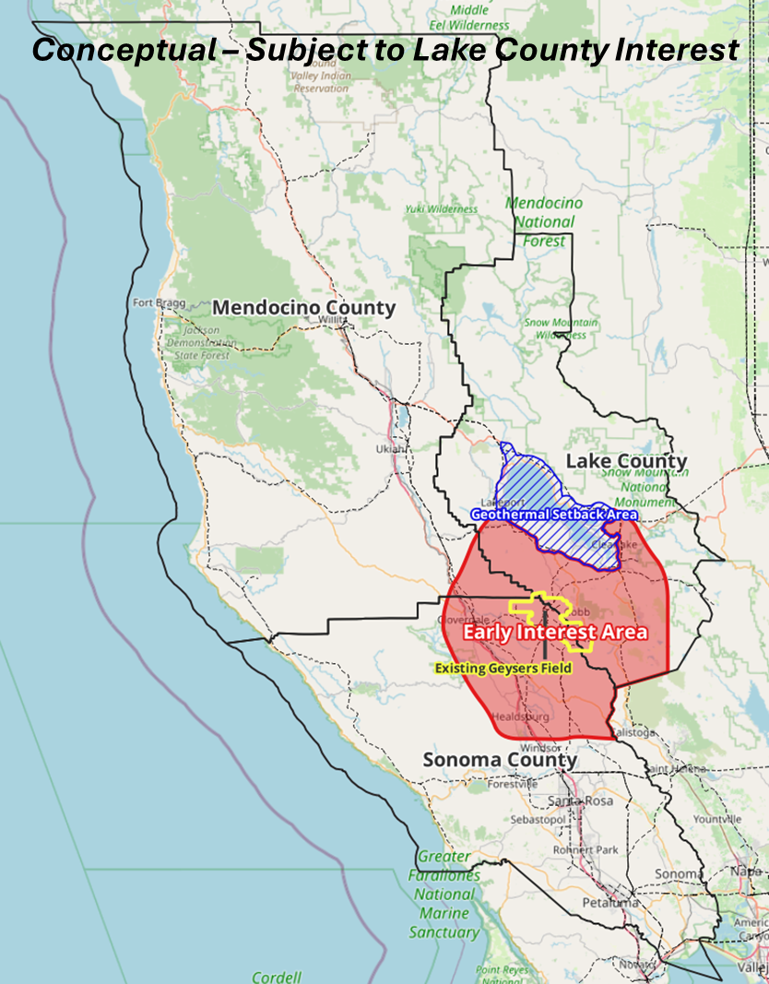
If Lake County Joins SCP
Lake County joining SCP and the GeoZone would help ensure that benefits from local geothermal energy flow to local customers first and foremost.
SCP understands Lake County’s Geothermal Setback Area and long history with local geothermal power.

Slide 32
Risks of Joining SCP
Very long-term commitment.
Individual customers can opt out of service, but cities and counties cannot force their residents and business to leave SCP unless:
They provide extremely long-term advance notice (potentially as long as 20 years); or
They pay the costs on power supply contracts to ensure other customers do not experience rate increases.

Slide 33
Risks of Joining SCP
SCP cannot guarantee lower total rates. It is likely that some of the time, SCP customers will have higher rates.
SCP cannot guarantee lower total rates because:
  Changes in regulation are frequent
  PG&E fees on SCP customers can change dramatically from year to year
  Energy markets are volatile

Slide 34
5. Process for Joining SCP

Slide 35
Process for Joining SCP
July – August 2025
Due diligence on benefits and risks, legal issues, etc.
August 7, 2025
SCP Board to vote on extending a formal offer to serve Lake County
August - October 2025
Lake County and cities to consider passing ordinances to satisfy CPUC requirement and resolutions agreeing to:
  Join SCP
  Abide by the terms of the JPA
  November 2025
  SCP to file an implementation plan with the CPUC for a start date of May 2027.

Slide 36
Timeline for Earliest Service
Feasibility Study
Review Period
60 days
Implementation Plan
Before January 1, 2026
SCP Board Invitation
New Member Ordinance Approval
Start of Service
Likely May 1, 2027

Slide 37
6. Questions

