Slide 1
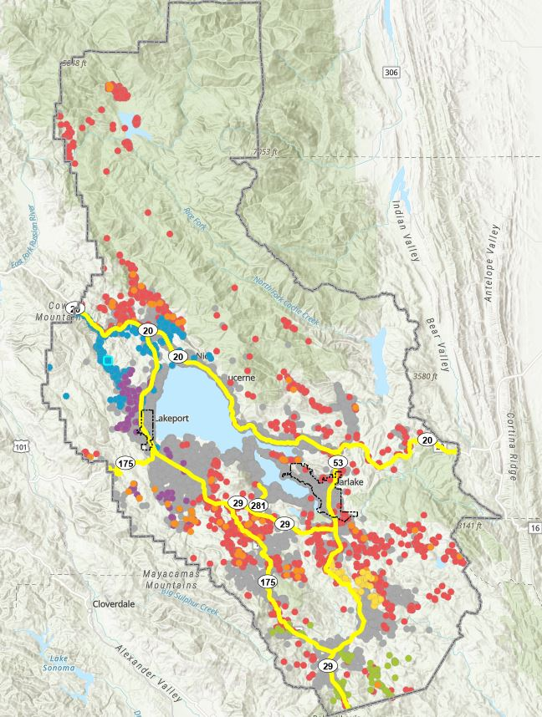
Broadband Infrastructure Update
BEAD · Federal Funding Account · State Middle-Mile Network
Lake County Board of Supervisors · August 18, 2026
Benjamin Rickelman, Deputy County Administrative Officer
Informational only — no action requested
BEAD-served locations by subgrantee, Lake County
Notes:
Informational update only. Three programs now committed to Lake County: BEAD, the state Last Mile Federal Funding Account, and the State Middle-Mile Broadband Network. No action requested today.

Slide 2
Three Programs, One Buildout Picture
All three have cleared their federal approval milestones.
BEAD
Last Mile FFA
State Middle-Mile
Broadband Equity, Access & Deployment
CPUC Resolution T-17873
Open-access backbone network
$1.5B+ of California's allocation goes to deployment
2,228 Lake County locations; 6 subgrantees
NTIA approved the state proposal July 17, 2026
Up to $14,648,581 awarded to Lake County
2,161 unserved locations; 3 fiber projects
Awarded January 30, 2025; all pre-construction
State-funded backbone routed through Lake County
Open-access capacity for last-mile builds
Construction underway on mapped segments
Awaiting CPUC final approval — expected Sept. 17, 2026
Funded — permitting must finish before construction
Funded — construction underway
Notes:
Key framing: the money is settled; what remains is regulatory approval and permitting. BEAD needs CPUC sign-off around September 17. FFA is funded but cannot break ground until permitting is complete; middle-mile construction has already commenced.

Slide 3
BEAD, Restructured
NTIA's restructuring policy changed how projects were selected — the dollars to California did not change.
Requirements removed
How projects were scored
Labor and workforce development standards
Climate resilience requirements
Open access and net neutrality conditions
Middle-class affordability plan
Local coordination requirements
State-prescribed low-cost rates
Technology-neutral: fiber, cable, fixed wireless and satellite judged against the same 100/20 Mbps test
Scoring driven by a single primary criterion — minimal BEAD program outlay
41%
44%
went to fiber statewide
of California's BEAD locations went to satellite providers
Notes:
The allocation to California was unchanged — roughly $1.86 billion, with more than $1.5 billion for deployment. What changed is the selection framework: non-statutory requirements were stripped and cost containment became the driving criterion, which pushed a large share of locations to satellite statewide and even more so in Lake County.

Slide 4
BEAD in Lake County: By the Numbers
2,228
89.3%
~70%
6
Subgrantees
BEAD-served locations of 33,834 in the FCC Fabric
classified unserved (1,989); 239 underserved
of local BEAD locations served by satellite
BEAD locations by subgrantee
Notes:
Two thirds of BEAD locations in Lake County are a satellite subscription, not a wire in the ground. The BEAD subsidy for satellite is a fixed per-location capital subaward — roughly $1,096 per location for Amazon and about $1,370 for Starlink — covering terminal, installation and reserved capacity at a named location, not an ongoing rate subsidy.

Slide 5
Who Is Building What, and Where
Map legend — BEAD subgrantees
Amazon
Satellite
Starlink
Satellite
Habematolel Pomo of Upper Lake
Licensed fixed wireless
Valley Internet
Unlicensed fixed wireless
Trellis Communications
Unlicensed fixed wireless
AT&T
Fiber to the premises — Middletown area
All Lake County 2,228 BEAD locations against the 33,834 Fabric locations
Notes:
The map shows where BEAD is landing and, just as importantly, where it is not. AT&T's Middletown project is the only fiber-to-the-premises BEAD build in the county. The viewer lets staff and the Board filter by subgrantee, technology, or unserved/underserved status.

Slide 6
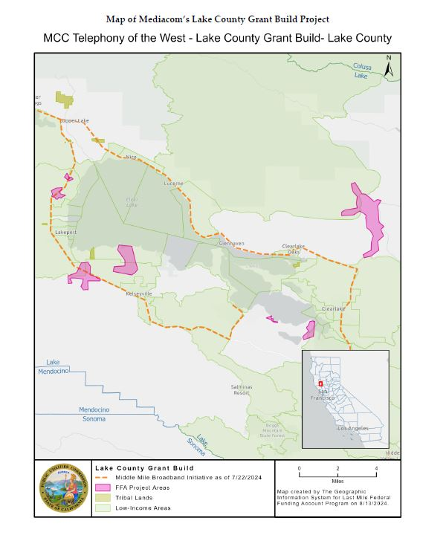
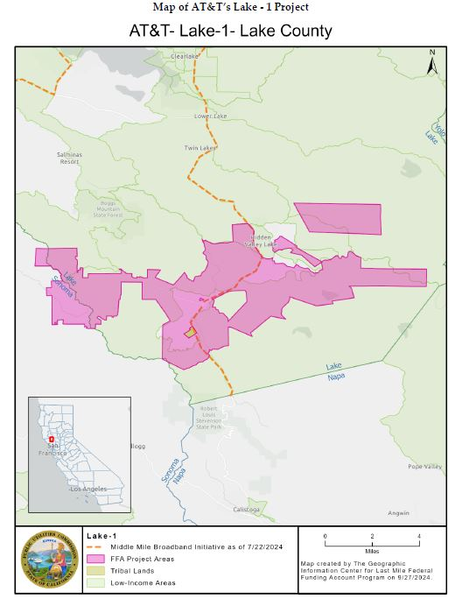
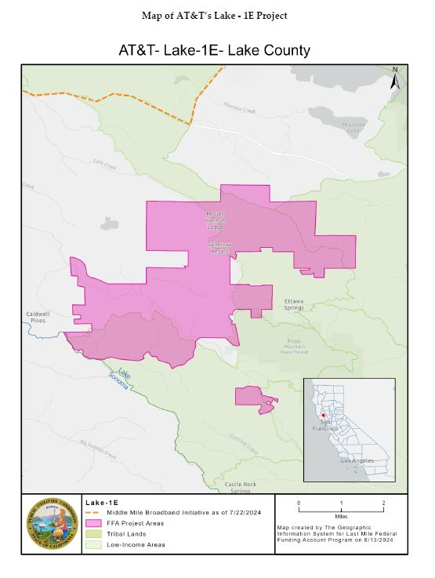
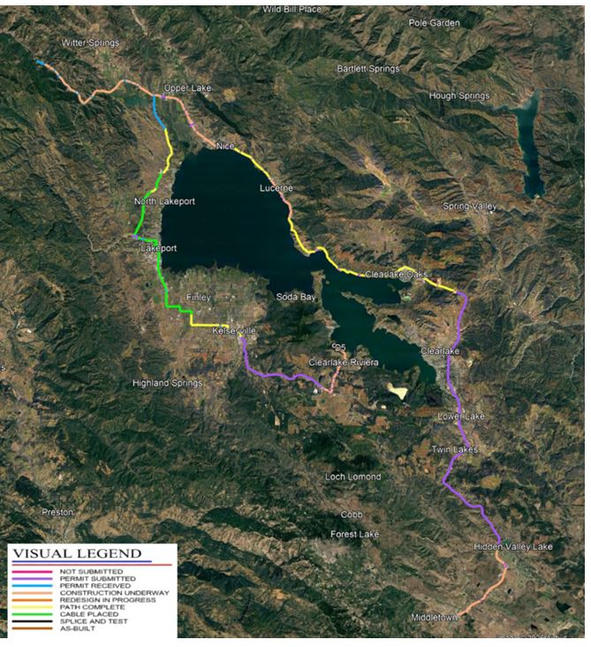
FFA & Middle-Mile: Funded and Moving Forward
Three FFA fiber projects — $14.6M, 2,161 locations
State Middle-Mile Network
Mediacom — 1,037 locations
AT&T Lake-1 — 620 locations
AT&T Lake-1E — 504 locations
Resolution T-17873 (Jan. 30, 2025): FFA areas were treated as enforceable commitments and excluded from BEAD, so the two programs should not overlap — roughly 4,389 committed locations in all.
Construction has commenced. Segment status ranges from permit submitted through as-built.
Notes:
FFA does not require grantees to enumerate locations by Fabric ID at award, so we know project geography and counts but not which addresses will be connected until engineering is done. The middle-mile network is now in construction, with segments at every stage from permit submitted to as-built; FFA remains in permitting.

Slide 7
Affordability Obligations and What Comes Next
BEAD — rate set by the subgrantee
FFA — prices locked in the award
At least one low-cost plan of 100/20 Mbps or better, held for the full 10-year federal interest period
NTIA barred the CPUC from setting the price — locally it ranges from $30 to $80 per month
Eligibility tracks federal Lifeline rules (income at or below 135% of poverty guidelines, or program participation)
AT&T: Access from AT&T at $30 per month for 100/100 Mbps
Mediacom: Connect2Compete at $14.95 per month, plus a $40 per month 100/20 Mbps plan held for 10 years
Eligibility reaches households up to 200% of poverty guidelines and school-lunch participants
What comes next
Now
Sept. 17, 2026
After approval
Middle-mile construction underway; FFA permitting continues
CPUC expected to give BEAD its final state approval
BEAD subgrantees move into permitting, then construction
Notes:
Affordability is where the two programs differ most: BEAD guarantees a low-cost plan exists but not what it costs, while FFA locks specific prices into the award. On timing, middle-mile construction is already underway; the County's own role is permitting — the sooner encroachment and land-use reviews clear, the sooner the remaining builds begin.

Slide 8
Broadband Infrastructure Update
BEAD · Federal Funding Account · State Middle-Mile Network
Lake County Board of Supervisors · August 18, 2026
Benjamin Rickelman, Deputy County Administrative Officer
Informational only — no action requested
BEAD-served locations by subgrantee, Lake County
Notes:
Informational update only. Three programs now committed to Lake County: BEAD, the state Last Mile Federal Funding Account, and the State Middle-Mile Broadband Network. No action requested today.

