Slide 1
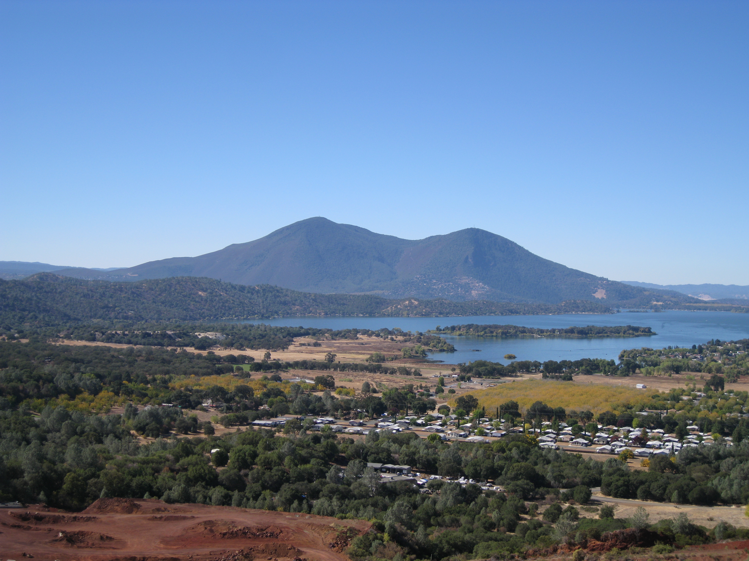
Lake County Air Quality Management District
We Love Clean Air!

Slide 2
Workshop and Initial Hearing
The Lake County Air Quality Management District (District) is proposing minor changes to several rules that are necessary as a result of changes in process since the rules were adopted around 30 years ago. Several rules are being proposed to be repealed due to Federal mandate. Additionally the District Fee rule is being proposed to be repealed and replaced in it’s entirety due to major structural changes in the rule, which has not had structural change since it was originally adopted in 1975.

Slide 3
Process
This workshop and hearing is intended to comply with California Health and Safety Code 42311. This is a workshop and hearing to present the proposed rule changes and new fee rules, accept public comment, and receive direction from the Board of Directors prior to submitting a final draft of each rule to the California Air Resources Board and Environmental Protection Agency (EPA) for review and consideration by this Board for approval.

Slide 4
Rule Update: 208.2
This rule change is being proposed to clarify agricultural and non-agricultural burn hours.
Add reference to Rule 1105 for agricultural burn hours.
Optional rule change tied to Rule 226.5. Define specific holidays as no burn days as an offset for rule equivalency.

Slide 5
Rule Update: 226.5
This rule change is being proposed to revise the requirements for lifting of the annual burn ban. Currently the fire season burn ban is in effect until CalFire declares an end to fire season. CalFire will no longer declare an end to fire season. The District reviewed 20 years of end of fire season declarations, November 15 was the average end of fire season date.
Change the lifting of the burn ban to November 15 of each year.
Alternate recommendation: Change the lifting of the burn ban to November 1 of each year, and offset the impacts by defining specific holidays as no burn days (Rule 208.2).

Slide 6
Rule Update: 433.5
This rule change is being proposed to clarify the issuance of residential exemption permits. The current rule states in part that the permit is to be signed by the Fire Chief. The Fire Chiefs Association has notified the District that they will no longer be participating in issuance of burn permits.
Remove the requirement for Fire Chief or authorized fire agency staff to sign the permit.

Slide 7
Rule Update: 631
This rule is proposed to be repealed and replaced. This is a fee based rule that is not included in the fee rule sections.
Rule 631 will be repealed and the duplicate permit fee is proposed to be replaced by Rule Section 660.50

Slide 8
Rule Update: 660-662
The District is primarily funded through permit fees, State subvention, penalties, and interest. The District does not receive any tax dollars or general fund dollars from the County or Cities. These Rule Sections make up the District’s Fee Rules. The District has only received CPI adjustments since 1996. The current fee structure has not changed since it was adopted in 1975.
The District is proposing a major fee restructuring.
Repeal the current fee rules and replace them in their entirety.
The structural changes proposed brings the District closer to a full cost recovery model.

Slide 9
Rule Update: 660-662 Cont’d
The proposed fee rules are primarily based on actual staff time to evaluate sources, issue permits, perform inspections, emissions inventory, State and Federal reporting, costs associated with air monitoring, source testing, and other program related costs.
Emissions fees are lower for cleaner technologies as the monitoring and inspection costs are lower.
Fee categories include CEQA reviews, pre-application reviews, indirect source rule (ISR), and other assorted administrative and pass-through fees.

Slide 10
Rule Update: 1002
This rule change is being proposed to clarify the issuance of burn permits. The Fire Chiefs Association has notified the District that they will no longer be participating in the issuance of burn permits.
The proposed rule removes the list of designated agencies, and adds a process for Fire Agencies to enter into an agreement with the District should they wish to participate in the burn program in the future.

Slide 11
Rule Update: 1105
This rule change is being proposed to clarify burn hours for Agricultural burning. The current rule does not clearly define all the burn hour options for agricultural burning.
The proposal provides clear definitions of permissive (limited) burn days, extended burn days, and burn hours for grass, leaf, and field crops.
The definitions already exist, but are spread throughout the rules. This change will bring the definitions together so the burn hours for Agricultural operations are easy to find and understand.

Slide 12
Rule Repeal: 12.450 & 12.640
These rules are part of the Title V major source rules of the District, required by EPA under our delegation for the program. These rules relate to Emergency Events.
EPA has repealed the regulation that these rules were based on. The District is required by EPA to repeal these rules.

Slide 13
Conclusion
The District is proposing these rule updates to clarify issues, update the fee rule, correct rules to comply with current operational requirements, and to repeal rules that are mandated to be repealed. The proposal incorporates only necessary updates at this time. Clarification and revision of other rules will be processed at a later date on when staff time allows.

Slide 14
Questions / Comments

Slide 15
Rule 208.2
Section 208.2 Current: Burn Day or Permissive Burn Day means a day on which burning is allowed and is not prohibited pursuant to these rules and regulations, the California Health and Safety code, or by other agencies having jurisdiction. Hours of burning are limited to 9 AM to 3 PM unless the day is designated an extended burn day. On extended burn days open burning is allowed during the period of the day from sunrise to sunset.
Section 208.2 Proposed: Burn Day or Permissive (Limited) Burn Day means a day on which burning is allowed and is not prohibited pursuant to these rules and regulations, the California Health and Safety Code, or by other agencies having jurisdiction. Hours of burning are limited to 9 AM to 3 PM. Agricultural burn hours are defined in Rule Section 1105.
Section 208.2 Alternative: Burn Day or Permissive (Limited) Burn Day means a day on which burning is allowed and is not prohibited pursuant to these rules and regulations, the California Health and Safety Code, or by other agencies having jurisdiction. Hours of burning are limited to 9 AM to 3 PM. Agricultural burn hours are defined in Rule Section 1105. The following Holidays shall be no burn days: Veterans Day, Thanksgiving Day, Christmas Eve, Christmas Day, New Years Eve, New Years Day, Marin Luther King Day, Presidents’ Day, and Easter Sunday.

Slide 16
Rule 226.5
Section 226.5 Current: Fire Season Burn Ban means that period of each year from May 1 to the end of fire season, as proclaimed by the Director of the California Department of Forestry and Fire Protection or, in the event that fire and meteorological conditions in the Air Basin differ from those prevailing elsewhere within the California Department of Forestry, Region 1, as proclaimed by the Lake County Board of Supervisors (see applicable Lake County Ordinances for proclamation procedure).
Section 226.5 Proposed Equivalent: Fire Season Burn Ban means the period of each year from May 1 to November 15. In the event that fire and meteorological conditions in the Air Basin warrant, the Lake County Board of Supervisors or Lake County Air Quality Management District Board of Directors may request the District declare No Burn Days.
Section 226.5 Propose Alternative (Requires Rule 208.2 Alternative): Fire Season Burn Ban means the period of each year from May 1 to November 1. In the event that fire and meteorological conditions in the Air Basin warrant, the Lake County Board of Supervisors or Lake County Air Quality Management District Board of Directors may request the District declare No Burn Days.

Slide 17
Rule 433.5
Section 433.5 Current: An exemption to the lot size and distance restrictions contained in Section 433 may be granted by written exemption permit, signed by the Fire Chief, or authorized Fire Protection Agency, USFS or CDF employee for the rare occasion when fire hazards exist, or circumstances warrant, and there is no reasonable available alternative to burning. The particular circumstances warranting the exemption shall be stated on the exemption permit. The exemption permit issued pursuant to Section 1002 shall incorporate all reasonable restrictions to avoid smoke nuisance and require compliance with all other open burning regulations. Upon issuance, a copy of the exemption permit shall be immediately filed with the AQMD, by fax or other acceptable record transfer method, by the approving official.
Section 433.5 Proposed: An exemption to the lot size and distance restrictions contained in Section 433 may be granted by written exemption permit for the rare occasion when fire hazards exist, circumstances warrant, and there is no reasonable available alternative to burning. The particular circumstances warranting the exemption shall be stated on the exemption permit. The exemption permit issued pursuant to Section 1002 shall incorporate all reasonable restrictions to avoid smoke nuisance and require compliance with all other open burning regulations.

Slide 18
Rule 631
Repeal: Section 631 Current: Duplicate Permit A request for a duplicate Permit to Operate or Authority to Construct shall be made in writing to the District within ten (10) days after the destruction, loss or defacement of a Permit to Operate or an Authority to Construct and shall contain the reason a duplicate permit is being requested. A fee of ten dollars ($10.00) shall be paid for a duplicate Permit to Operate or Authority to Construct.

Slide 19
Rule 1002
Section 1002 Current: Agencies Authorized to Issue Burning Permits: The agencies listed in Table 8 are hereby designated by the District as having authority to issue non-agricultural and agricultural burn permits pursuant to District Rules and Regulations. Designated Agencies issuing burn permits in their respective jurisdictions or spheres of influence are authorized to collect and retain the fee listed in Section 660, Table 6.4 for Category A and B burning permits. Cooperating and delegated agency burning for fire prevention, vegetation management and fuel load reduction and as authorized in Section 432 of these rules shall not be subject to permit or smoke management plan fees. Procedural guidelines as agreed to by the APCO and ratified by the Lake County Fire Chiefs Association shall be utilized for delegated permit agency issuance.
Table 8: AGENCIES DESIGNATED TO ISSUE BURNING PERMITS
1.*California Department of Forestry; Middletown
2.*California Department of Forestry; Kelseyville/Cobb
3. California Department of Forestry; Clearlake Oaks
4. Clearlake Oaks Fire Protection District
5. Kelseyville Fire Protection District
6. Lakeport Fire Protection District
7. Lake County Fire Protection District; (Clearlake, Lower Lake)
8. South Lake County Fire Protection District
9. Upper Lake Fire Protection District
10. Nice Community Service District (Fire Protection Agency)
11. Lucerne Recreation and Park District (Fire Protection Agency)
12. Northshore Fire Protection Authority
13. United States Forest Service (Upper Lake)
*Supervision and control of these offices are at the Sonoma-Lake-Napa Unit Headquarters, St. Helena.

Slide 20
Rule 1002 Cont’d
Section 1002 Proposed: Agencies Authorized to Issue Burning Permits: Fire Agencies that are responsible for fire protection within Lake County, may enter into an annual agreement with the District for non-agricultural and agricultural burn permits issuance. The agreement will define guidelines and requirements for permit issuance pursuant to District Rules and Regulations and applicable State and Federal requirements.

Slide 21
Rule 1105
Section 1105 Current: Burning Hours: Burning hours for agricultural purposes in the Lake County Air Management District are as follows:
  A. Fire season, as defined in Section 226.5, 8 AM through 12 noon unless other hours are authorized by the
  responsible Fire Agency and District; and
  B. Non-Fire Season, 9 AM through 3 PM, except for grass, leaf or field crops which shall be 11 AM
  through 3PM unless other hours are specified in the issued permit.
Section 1105 Proposed: Burning Hours: Burning hours for agricultural purposes in the Lake County Air Basin are as follows:
  A. Fire Season, as defined in Section 226.5; Burn hours are 8:00 AM through 12:00 PM (Noon) unless
  other hours are authorized; and
  B. Non-Fire Season, Burn hours are as follows:
  1. Permissive (limited) burn day: 9 AM through 3 PM;
  2. Extended burn day: sunrise to sunset as defined by the National Oceanic and Atmospheric
  Administration’s solar calculator; and
  3.Grass, leaf, or field crops: 11 AM through 3PM unless other hours are authorized.

Slide 22
Rule 12.450
Repeal Section 12.450: Emergency Events
(a) The permittee shall comply with the requirements of Chapter III, Article II and the emergency provisions
contained in all applicable federal requirements;
(b) Within two working days of the emergency event, a responsible official shall provide the District with a written
description of the emergency and any mitigating or corrective actions taken;
(c) Within two weeks of an emergency event, the responsible official shall submit to the District a signed
contemporaneous log or other relevant evidence which demonstrates that:
(1) An emergency occurred;
(2) The permittee can identify the cause(s) of the emergency;
(3) The facility was being properly operated at the time of the emergency;
(4) All steps were taken to minimize the emissions resulting from the emergency; and
(5) Within two working days of the emergency event, the permittee provided the district with a description
of the emergency and any mitigating or corrective actions taken;
(d) In any enforcement proceeding, the permittee has the burden of proof to establish that an emergency occurred.
[Reference: 40 CFR 70.6(g)]

Slide 23
Rule 12.640
Repeal Section 12.640: Emergency Provisions A permit issued pursuant to Chapter XII shall include a condition requiring compliance with the provisions of Section 12.450. The permit shall state that in any enforcement proceeding, the permittee has the burden of proof to establish that an emergency occurred.
[Reference: 40 CFR 70.6(g)]

Slide 24
Rule 660 (Current)
Section 660 Current: Section 660: The District Board shall provide, by resolution, a schedule of annual fees (see Table 6) to be paid for the evaluation, issuance and renewal of permits to cover the cost of District programs related to permitted stationary sources authorized or required under the provisions of this chapter that are not otherwise funded. Every person applying for or renewing a permit shall pay the fee required by the schedule. Beginning July 1, 1986, the fee schedule shall be adjusted annually in accordance with the California Health and Safety Code 42311 and Section 2212 of the Revenue and Taxation Code to account for changes in the California Consumer Price Index for the preceding year. Any revenues received by the District pursuant to the fees, which exceed the cost of the programs, shall be carried over for expenditure in the subsequent fiscal year, and the schedule of fees shall be changed to reflect that carryover. Unless otherwise specified by a separate renewal fee schedule, renewal fees for the Authority to Construct Permits and Permits to Operate shall be the same as the initial application fee. Said permit renewals shall extend for the same duration as the initial permit and the fee shall be prorated if the renewal permit is needed for less time than the initial permit. In no event shall the fee required of a major source, as defined in Table 6 below, be less than $29.26 per ton of actual regulated pollutant emissions adjusted annually starting on October 1, 1994, using the Consumer Price Index as defined in Title V, Sec. 502, or such other amount established as a minimum permit fee by the Clean Air Act Amendments of 1990.
TABLE 6
SCHEDULE OF FEES FOR PERMITS
(Adjusted Annually for CCPI, Starting July 1, 1993,
Values shown are adjusted for June 2006)*
Category I - Insignificant Sources
Operations estimated by calculation and/or analysis which conform to the insignificant sources as commercial or industrial operations producing essentially no detectable emissions, will not necessarily require a Permit to Operate.
Examples: Markets, small subdivisions, stores, etc.
Authority to Construct Fee: None
Permit to Operate Fee: None
Category II - Sources Potentially Emitting Less Than 25 Tons/Year
Operations estimated by calculations and/or analysis to be below twenty-five (25) tons/year potential pollution emissions or which have potential air emittants capable of causing an unusually high nuisance or health impact.
Examples: Hospitals with approved incinerators, bulk oil plants, small gravel operations, etc.
Authority to Construct Fee: $ 199.49
Permit to Operate Fee: $ 99.75

Slide 25
Rule 660 (Current) cont’d
Category III - Sources Potentially Emitting 25-100 Tons/Year
Operations judged by calculation and/or analysis which potentially produce pollutant emissions between twenty-five to one hundred (25-100) tons/year.
Examples: Asphalt plants, large gravel operations, concrete batch plants, etc.
Authority to Construct Fee: $ 698.21
Permit to Operate Fee: $ 398.99
Category IV - Sources Potentially Emitting More Than 100 Tons/Year and Geothermal Wells
Operations judged by calculation and/or analysis which potentially produce pollutant emissions exceeding one hundred tons/year
Authority to Construct
Application Fee: $1,994.90
Renewal Fee: $1,496.18
Permit to Operate Fee: $ 997.45
Category V - Geothermal Fluid Transmission Lines
A. Less than four (4) wells attached:
Authority to Construct
Application Fee: $1,595.92
Renewal Fee: $ 997.45
Permit to Operate Fee: $1,595.92
B. Four (4) to sixteen (16) wells attached:
Authority to Construct
Application Fee: $1,994.90
Renewal Fee: $1,496.18
Permit to Operate Fee: $1,994.90
C. More than sixteen (16) wells attached:
Authority to Construct
Application Fee: $2,493.63
Renewal Fee: $1,994.90
Permit to Operate Fee: $2,493.63

Slide 26
Rule 660 (Current) cont’d
Category VI - Major Sources and Geothermal Power Plants
Operations judged by calculation and/or analysis with pollutant emissions exceeding one hundred (100) tons/year.
A. Geothermal Power Plants equal to or less than ten (10) GMW:
Authority to Construct
Application Fee: $4,987.25
Renewal Fee: $2,992.35
Permit to Operate Fee: $4,987.25
B. Major Sources and Geothermal Power Plants with Emissions
Greater than ten (10) GMW:
Authority to Construct
Application Fee: $11,969.41
Renewal Fee: $ 3,989.81
Permit to Operate Fee: $11,969.41
Category VII - Exempt Public Operation
When a Lake County or city agency within the County constructs a facility which has a potential air pollution emissions problem, no fee will be charged.
Although Lake County and city agencies are exempt from permit fees, these public operations are required to conform to customary pollution abatement standards.
Category VIII - Gasoline Retail Service Stations
A. Facilities requiring Phase II vapor recovery systems or having an estimated annual throughput; of 440,000 gallons or more of gasoline.
Authority to Construct; or Modify and Permit to Operate Fee:
Application Fee: $169.87 + $33.98 Per Nozzle
Renewal Fee: $169.87 + $16.98 Per Nozzle
B. Gasoline Retail Service Stations exempt from Phase II Vapor Recovery
Authority to Construct or Modify and Permit to Operate Fee:
Application Fee $169.87
Renewal Fee $84.93

Slide 27
Rule 660 (Current) cont’d
Category IX - Asbestos Control
A. For each demolition and renovation project subject to a notice, plan, or permit application requirements of Section 467, where RACM is present but less than 260 linear feet, 160 square feet or 35 cubic feet, the owner or operator shall pay a fee of $147.28, for amounts exceeding these quantities a fee of $294.55 shall be paid.
B. For each Asbestos-Dust-Hazard Mitigation Plan submitted pursuant to the requirements of Section 467, a fee of $73.64 shall be paid. This fee shall not apply to projects if exempted pursuant to Part V, D, 4.
Notwithstanding other District requirements, annual permit fees (Category VIII) shall be due and payable on March 1 of each year and based on the previous calendar year gasoline throughput. Provisions of Section 660 (CCPI Adjustment) shall apply to fees.
Note: *Section 660 requires annual fee adjustment of Table 6 to reflect CCPI. All permits are subject to yearly renewal. (Values shown are adjusted for June 2006).
Section 660.1: Permit Fee Penalty The Air Pollution Control Officer shall annually notify permit holders by invoice/letter of fees due for renewal of current permits. If the fee is not paid within sixty (60) days of the invoice mailing date, the fee shall be increased by one-half the amount thereof and the Air Pollution Control Officer shall thereupon promptly notify the permit holder of the increased fee by mail. If the increased fee is not paid within ninety (90) days of the original invoice mailing date, the permit shall be deemed withdrawn and suspended. The Air Pollution Control Officer shall notify the permit holder by mail, and the permit shall be void. Any suspended permit may be reinstated only upon payment in full of all accrued fees and penalties or by filing a new application complete with initial fee. Annual renewal fees will continue to be required until such time as the Authority to Construct and/or the Permit to Operate cancellation or denial becomes final and all operations involving the stationary source have ceased.
TABLE 6.4
SCHEDULE OF FEES FOR OPEN BURNING PERMITS
Category A – SIMPLE BURNS: Residential and Agricultural Burns that do not have a significant smoke impact potential, do not involve a substantial amount of material and will be completed during permitted burn hours are simple burns. Burns must be manned at all times until material is consumed.
Examples of Simple Burns: Agricultural: Pear or walnut brush, diseased wood, grape vine prunings, grass, thistle and forest slash piles.
Residential: Dried non-green vegetation in piles of less than 8 feet in height and width, and which do not include poison oak or oleander.
Specifically Excluded from Simple Burns: 1) Any burn that has a high potential to cause smoke impact on the public because of location, size, amount or type of emissions released, or fire hazard, or that may produce appreciable smoke overnight; 2) Agricultural: piled or wind-rowed trees or vines containing larger than 6” diameter material from more than one acre; green or live vegetation; standing brush or tule; forest broadcast or understory burns; and multi-day burns; and 3) Residential: green or live vegetation; poison oak, oleander; or other toxic smoke producing vegetation; and, residential or commercial land development clearing as described in Category B below.
Annual Fee: $20.00

Slide 28
Rule 660 (Current) cont’d
Category B – Residential/Commercial Lot Clearing / Land Development:
Single purpose Land Development burning pursuant to Non-Agricultural Burn Regulation 436.5 located within 300 feet of a building, or sensitive receptor, or fire hazard, or located in a developed subdivision shall require a Category B permit. Category B burns may include hand or machine piled brush. A delegated agency may, when they determine it necessary, refer any applicant to the AQMD to obtain a smoke management plan as an alternative to a Category B permit.
Annual Fee: $60.00
Category C – Smoke Management Plans (SMP): A Smoke Management Plan is required for any burn that has a high potential to cause smoke impact on the public because of location, size, amount or type of emissions released. Category C includes, but is not limited to, burns which: 1) require a smoke management plan pursuant to these regulations; 2) require an inspection or meteorological review and specific date and time authorization prior to burning; 3) consume standing brush or tules; 4) are located in close proximity to the public for the amount of material to be burned or have a fire hazard potential; or 5) are at a location, or by a responsible party having a history of violation or public complaint.
Examples: Standing brush or forest management burns requiring a Smoke Management Plan, land clearing requiring the burning of entire trees, orchard or vineyard removal over one acre, burns referred by a designated agency to the AQMD for a smoke management plan, ranches/farms/large landholdings under a single ownership incorporating multiple parcels by request, or burning tules in close proximity to the public require a SMP.
Initial Fee: $20.00
Annual Renewal Fee: $20.00
*Table 6.4 fees shall be adjusted annually, starting July 1, 2006, to reflect the change in the California Consumer Price Index, but shall only be adjusted when a cumulative $1.00 increment increase has occurred.
Section 660.2: Cancellation or Denial If an application for an Authority to Construct or a Permit to Operate is cancelled, or if an Authority to Construct or a Permit to Operate is denied and such denial becomes final, the initial application fee required herein shall not be refunded nor applied to any subsequent application.
Section 660.3: Miscellaneous Charges Information, circulars, reports of technical work, and other reprints prepared by the Air Quality Management District, when supplied to other governmental agencies or individuals or groups requesting copies of same, may be charged for by the District in a sum not to exceed the cost associated with reproduction and delivery of such documents. All monies collected shall be deposited to the District treasury to the credit of the District.
Section 660.4: Ownership Permit Transfer, Every person submitting an application for modification to account for a Change of Ownership of any District Authority to Construct or Permit to Operate, shall include with the application, a fee equal to the greater of twenty-five dollars ($25.00) or an amount equal to twenty (20) percent of the current application fee for said Authority to Construct or Permit to Operate.

Slide 29
Rule 660 (Current) cont’d
Section 661: Analysis Fee Whenever the Air Pollution Control Officer finds that an analysis of the emissions from any source is necessary to determine the extent and amount of pollutant being discharged into the atmosphere which cannot be determined by visual observation, he may order the collection of samples and an analysis made by the District or other qualified personnel approved by the Air Pollution Control Officer. The time and materials required for collecting samples, making the analysis and preparing the necessary reports, but excluding the time required in going to and from such premises shall be charged against the owner or operator of said premises in a sum to be determined by the Air Pollution Control Officer (see Table 7). Said sum shall not exceed the actual cost of the work performed and supplies and equipment used.
Section 662: "Air Toxics Hot Spots Information and Assessment Act of 1987" (Act) Fee The District shall annually collect from the operators of facilities subject to Health and Safety Code (H&SC) Section 44320, fees reasonably expected to: (a) Recover the anticipated costs to be incurred by the California Air Resources Board (ARB) and Department of Health Services (DHS) to implement and administer the Act as set forth in Health and Safety Code Section 44380; and (b) Recover the anticipated costs incurred by the District to implement and administer the Act including but not limited to the cost of reviewing or preparing the emissions inventory plans, review inventory data, review risk assessments, verify plans and data and prepare facilities prioritization.
The District shall notify and assess the operator of each facility subject to this rule pursuant to the H&SC in writing of the fee due. The fee shall be calculated from the amount determined by the ARB and DHS as their incurred costs plus actual District cost for staff time in accordance with the schedule annually adopted by the state board, unless such other fee specific fee schedule is enacted by the District Board. The fee shall be as indicated below for the 1992 fiscal year, and shall be due by 12/15/92, or as specified on the notice of fees due.
A. Sources with estimated actual emissions equal to, or greater than, ten tons per year for air emissions, as determined to be affected criteria air pollutants by the ARB, to include methane, or identified as a toxic air pollutant pursuant to H&SC 44320; $16.20 per ton of annual emissions.
B. Sources subject to H&SC 44320 with estimated actual emissions less than ten tons per year for pollutants which are determined to be criteria air pollutants by the California Air Resources Board or identified as a toxic air pollutant; $100.00. The fee may be reduced to one half this amount if an industry wide survey is completed, or as part of the air toxics inventory the source is placed under permit or is already under a district permit. The source owner shall remit the fee to the District within 60 days after receipt of the notice stating the amount of the fee due or the fee will be considered past due. If the source fails to pay the fee within 60 days of this notice, the District shall assess a penalty of 100 percent of the assessed fee. If the operator fails to pay the fee within 120 days after the receipt of the notice, the District may initiate permit revocation proceedings or other legal actions to require the fee be paid and permit application made. Subsequent to fiscal year 1992, the fee and billing shall be incorporated into the normal permit billing.

Slide 30
Rule 660 (Current) cont’d
TABLE 7
SCHEDULE OF FEES FOR SOURCE EVALUATION
The following fees may be applied to sources where it becomes necessary or desirable for the District to perform evaluations, health risk assessments, assist in preparing reports, source emissions evaluation or testing, prepare required toxics reports or plans, or repeatedly monitor a source in response to complaints or violations.
The actual cost of staff time plus reasonable overhead charges for equipment and facilities as determined by the Lake County Auditor.
The actual cost of laboratory analysis when utilizing a laboratory service as billed by that service.
C. The reasonable costs associated with travel, equipment rental and materials consumed in any test.

Slide 31
Rule 660 (Proposed)
Section 660: The District Board annually may provide a fee schedule for the evaluation, issuance and renewal of permits, air monitoring, emissions inventory and any required reporting, to cover the cost of District programs related to, authorized by, or required under the provisions of this chapter that are not otherwise funded. Every person applying for or renewing a permit shall pay the fees required by the Schedule of Fees. Fees shall be per Permit Type or process listed in the Schedule of Fees, unless otherwise noted. Multiple similar permit types or processes at the same facility shall pay a fee for each singular Permit Type (equipment unit or process). All fees shall be rounded up to the nearest whole dollar. Beginning July 1, the fee schedule shall be adjusted annually in accordance with the California Health and Safety Code (H&SC) 42311 and Section 2212 of the Revenue and Taxation Code to account for changes in the Bay Area Region Consumer Price Index (CPI) for the preceding year. The District Board may adopt, by resolution, a multiplier greater than the annual CPI for costs not covered by the annual CPI increase. The District Board may adopt, by resolution, an increase in the District hourly rate including all overhead costs and the District Fee schedule shall be adjusted to incorporate such. Any revenues received by the District pursuant to the permit fee schedule, which exceed the cost of District programs, may be carried over for multi-year projects, placed in reserves for future expenditure, and/or be carried over for expenditure in the subsequent fiscal year and the applicable fees shall be adjusted for that year to reflect that carryover.
All new Authority to Construct (A/C) or Permit to Operate (P/O) permits issued shall be valid until the next annual renewal date for permits. Permit renewals issued shall be valid for a maximum of 12 months (H&SC 42300). All permits, plans, and notifications shall be renewed annually and pay the fees required by the Schedule of Fees. Annual authority to construct permit or permit to operate renewal fee increases shall not exceed 15% in any one year, per CA Health and Safety Code 41512.7(b). In no event shall the fee required of a major source, as defined by the United States Environmental Protection Agency, District Rules and Regulations, and Rule Section 660.27 and 660.31, be less than $64.17 per ton of actual regulated pollutant emissions adjusted annually on July 1, using the CPI as defined in Title V, Sec. 502, or such other amount established as a minimum permit fee by the Clean Air Act Amendments of 1990.

Slide 32
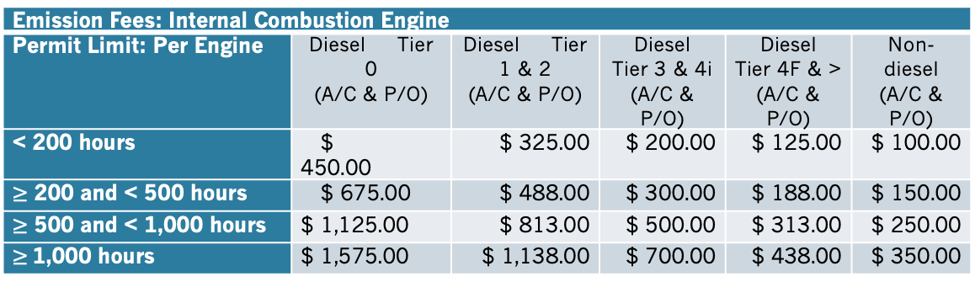
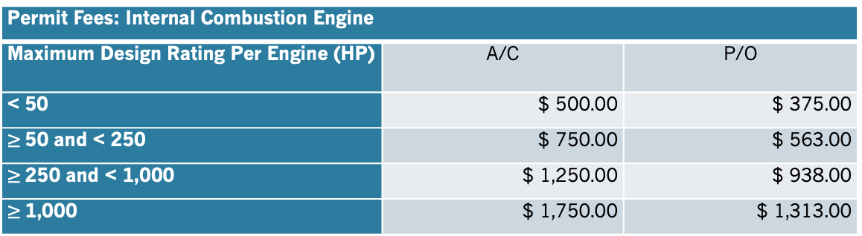
Rule 660.01A&B (Proposed)
SCHEDULE OF FEES
(Fees are Adjusted Annually for CPI, Starting July 1, 2026,
Values shown below shall be implemented on January 1, 2025)
Section 660.01A: Category I(A) - Internal Combustion Engine Permit Fees
Installation and operation of internal combustion engines, including diesel, propane, and gasoline engines. Permit Fee is per engine. All diesel engines require a permit. Non-diesel residential engines may require a permit and will be evaluated for toxic emissions, health risk, nuisance, or other State or Federal requirements.
Section 660.01B: Category I(B) - Internal Combustion Engine Emission Fees
Emission Fees are based on permitted hours of operation limits, emissions certification (EPA Tier level), and fuel type. Emission Fee is per engine.
Permit Fees: Internal Combustion Engine
Maximum Design Rating Per Engine (HP) | A/C | P/O
< 50 | $ 500.00 | $ 375.00
$≥$50 and < 250 | $ 750.00 | $ 563.00
$≥$250 and < 1,000 | $ 1,250.00 | $ 938.00
$≥$1,000 | $ 1,750.00 | $ 1,313.00
Emission Fees: Internal Combustion Engine
Permit Limit: Per Engine | Diesel Tier 0 (A/C & P/O) | Diesel Tier 1 & 2 (A/C & P/O) | Diesel Tier 3 & 4i (A/C & P/O) | Diesel Tier 4F & > (A/C & P/O) | Non-diesel (A/C & P/O)
< 200 hours | $ 450.00 | $ 325.00 | $ 200.00 | $ 125.00 | $ 100.00
$≥$ 200 and < 500 hours | $ 675.00 | $ 488.00 | $ 300.00 | $ 188.00 | $ 150.00
$≥$ 500 and < 1,000 hours | $ 1,125.00 | $ 813.00 | $ 500.00 | $ 313.00 | $ 250.00
$≥$1,000 hours | $ 1,575.00 | $ 1,138.00 | $ 700.00 | $ 438.00 | $ 350.00

Slide 33
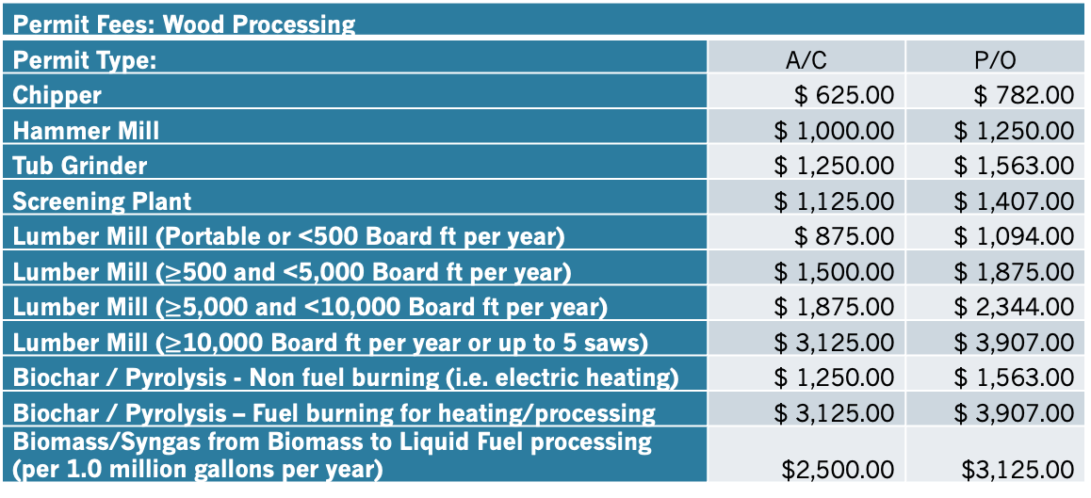
Rule 660.02A (Proposed)
Section 660.02A: Category II(A) - Wood Processing Permit Fees
Operations including, but not limited to: chipper, hammer mill, tub grinder, screening plant, lumber mill, or portable mill. Permit Fee is for the wood processing portion of the unit. Fuel burning engines powering the unit are permitted separately.
Permit Fees: Wood Processing
Permit Type: | A/C | P/O
Chipper | $ 625.00 | $ 782.00
Hammer Mill | $ 1,000.00 | $ 1,250.00
Tub Grinder | $ 1,250.00 | $ 1,563.00
Screening Plant | $ 1,125.00 | $ 1,407.00
Lumber Mill (Portable or <500 Board ft per year) | $ 875.00 | $ 1,094.00
Lumber Mill ($≥$500 and <5,000 Board ft per year) | $ 1,500.00 | $ 1,875.00
Lumber Mill ($≥$5,000 and <10,000 Board ft per year) | $ 1,875.00 | $ 2,344.00
Lumber Mill ($≥$10,000 Board ft per year or up to 5 saws) | $ 3,125.00 | $ 3,907.00
Biochar / Pyrolysis - Non fuel burning (i.e. electric heating) | $ 1,250.00 | $ 1,563.00
Biochar / Pyrolysis – Fuel burning for heating/processing | $ 3,125.00 | $ 3,907.00
Biomass/Syngas from Biomass to Liquid Fuel processing (per 1.0 million gallons per year) | $2,500.00 | $3,125.00

Slide 34
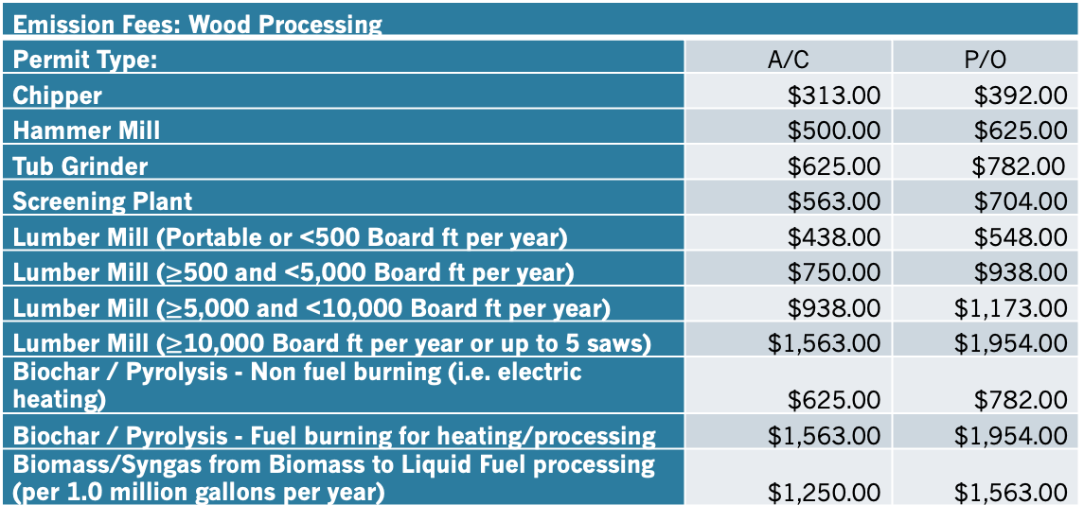
Rule 660.02B (Proposed)
Section 660.02B: Category II(B) - Wood Processing Emission Fees
Emission Fees are based on permitted emissions with applicable controls in place.
Emission Fees: Wood Processing
Permit Type: | A/C | P/O
Chipper | $313.00 | $392.00
Hammer Mill | $500.00 | $625.00
Tub Grinder | $625.00 | $782.00
Screening Plant | $563.00 | $704.00
Lumber Mill (Portable or <500 Board ft per year) | $438.00 | $548.00
Lumber Mill ($≥$500 and <5,000 Board ft per year) | $750.00 | $938.00
Lumber Mill ($≥$5,000 and <10,000 Board ft per year) | $938.00 | $1,173.00
Lumber Mill ($≥$10,000 Board ft per year or up to 5 saws) | $1,563.00 | $1,954.00
Biochar / Pyrolysis - Non fuel burning (i.e. electric heating) | $625.00 | $782.00
Biochar / Pyrolysis - Fuel burning for heating/processing | $1,563.00 | $1,954.00
Biomass/Syngas from Biomass to Liquid Fuel processing (per 1.0 million gallons per year) | $1,250.00 | $1,563.00

Slide 35
Rule 660.03A&B (Proposed)
Section 660.03A: Category III(A) - HELD FOR FUTURE USE
Section 660.03B: Category III(B) - HELD FOR FUTURE USE

Slide 36
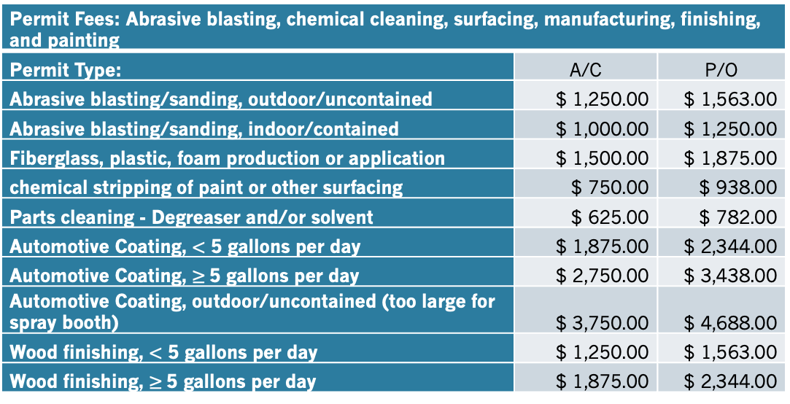
Rule 660.04A (Proposed)
Section 660.04A: Category IV(A) - Abrasive Blasting, Chemical Cleaning, Surfacing, Manufacturing, Finishing, and Painting Permit Fees
Operations including, but not limited to: autobody shops, boat shops, cabinet shops, abrasive blasting, power sanding, surface coatings, fiberglass/plastics/foam materials production or application, parts cleaning, solvent cleaners, paint stripping, painting, staining, or other surface coating processes.
Permit Fees: Abrasive blasting, chemical cleaning, surfacing, manufacturing, finishing, and painting
Permit Type: | A/C | P/O
Abrasive blasting/sanding, outdoor/uncontained | $ 1,250.00 | $ 1,563.00
Abrasive blasting/sanding, indoor/contained | $ 1,000.00 | $ 1,250.00
Fiberglass, plastic, foam production or application | $ 1,500.00 | $ 1,875.00
chemical stripping of paint or other surfacing | $ 750.00 | $ 938.00
Parts cleaning - Degreaser and/or solvent | $ 625.00 | $ 782.00
Automotive Coating, $<$ 5 gallons per day | $ 1,875.00 | $ 2,344.00
Automotive Coating, $≥$5 gallons per day | $ 2,750.00 | $ 3,438.00
Automotive Coating, outdoor/uncontained (too large for spray booth) | $ 3,750.00 | $ 4,688.00
Wood finishing, $<$ 5 gallons per day | $ 1,250.00 | $ 1,563.00
Wood finishing, $≥$5 gallons per day | $ 1,875.00 | $ 2,344.00

Slide 37
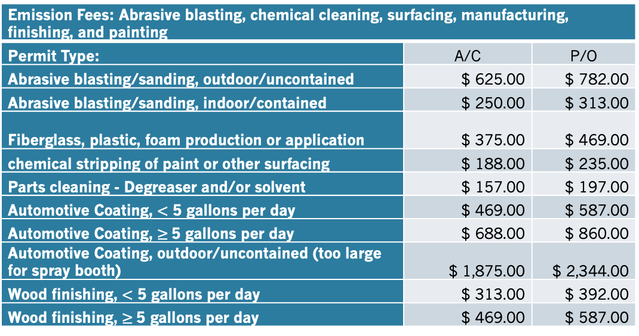
Rule 660.04B (Proposed)
Section 660.04B: Category IV(B) - Abrasive Blasting, Chemical Cleaning, Surfacing, Manufacturing, Finishing, and Painting Permit Fees Emission Fees
Emission Fees are based on permitted emissions limits, controls in place, materials used.
Emission Fees: Abrasive blasting, chemical cleaning, surfacing, manufacturing, finishing, and painting
Permit Type: | A/C | P/O
Abrasive blasting/sanding, outdoor/uncontained | $ 625.00 | $ 782.00
Abrasive blasting/sanding, indoor/contained | $ 250.00 | $ 313.00
Fiberglass, plastic, foam production or application | $ 375.00 | $ 469.00
chemical stripping of paint or other surfacing | $ 188.00 | $ 235.00
Parts cleaning - Degreaser and/or solvent | $ 157.00 | $ 197.00
Automotive Coating, $<$ 5 gallons per day | $ 469.00 | $ 587.00
Automotive Coating, $≥$5 gallons per day | $ 688.00 | $ 860.00
Automotive Coating, outdoor/uncontained (too large for spray booth) | $ 1,875.00 | $ 2,344.00
Wood finishing, $<$ 5 gallons per day | $ 313.00 | $ 392.00
Wood finishing, $≥$5 gallons per day | $ 469.00 | $ 587.00

Slide 38
Rule 660.05A&B (Proposed)
Section 660.05A: Category V(A) -Agricultural Products Permit Fees - HELD FOR FUTURE USE
Section 660.05A: Category V(B) -Agricultural Products Emission Fees - HELD FOR FUTURE USE

Slide 39
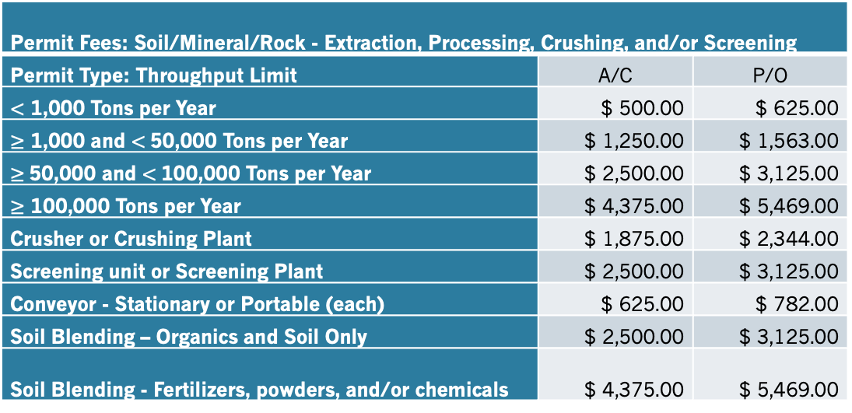
Rule 660.06A (Proposed)
Section 660.06A: Category VI(A) - Soil/Mineral/Rock - Extraction, Processing, Crushing, and/or Screening Permit Fees
Operations that extract, process, crush, or screen rock, soil, specialty mixes, or other similar materials. Equipment units may be permitted separately. Fuel burning engines powering equipment are permitted separately.
Permit Fees: Soil/Mineral/Rock - Extraction, Processing, Crushing, and/or Screening
Permit Type: Throughput Limit | A/C | P/O
$<$ 1,000 Tons per Year | $ 500.00 | $ 625.00
$≥$ 1,000 and $<$50,000 Tons per Year | $ 1,250.00 | $ 1,563.00
$≥$50,000 and $<$100,000 Tons per Year | $ 2,500.00 | $ 3,125.00
$≥$ 100,000 Tons per Year | $ 4,375.00 | $ 5,469.00
Crusher or Crushing Plant | $ 1,875.00 | $ 2,344.00
Screening unit or Screening Plant | $ 2,500.00 | $ 3,125.00
Conveyor - Stationary or Portable (each) | $ 625.00 | $ 782.00
Soil Blending – Organics and Soil Only | $ 2,500.00 | $ 3,125.00
Soil Blending - Fertilizers, powders, and/or chemicals | $ 4,375.00 | $ 5,469.00

Slide 40
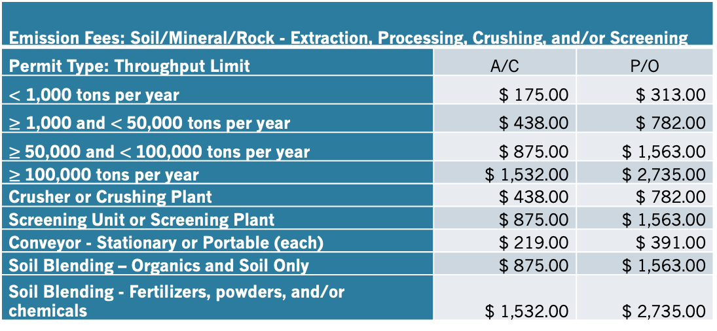
Rule 660.06B (Proposed)
Section 660.06B: Category VI(B) - Soil/Mineral/Rock - Extraction, Processing, Crushing, and/or Screening Emission Fees
Emission Fees are based on permitted emissions limits, controls in place, materials used.
Emission Fees: Soil/Mineral/Rock - Extraction, Processing, Crushing, and/or Screening
Permit Type: Throughput Limit | A/C | P/O
$<$ 1,000 tons per year | $ 175.00 | $ 313.00
$≥$ 1,000 and $<$50,000 tons per year | $ 438.00 | $ 782.00
$≥$50,000 and $<$100,000 tons per year | $ 875.00 | $ 1,563.00
$≥$100,000 tons per year | $ 1,532.00 | $ 2,735.00
Crusher or Crushing Plant | $ 438.00 | $ 782.00
Screening Unit or Screening Plant | $ 875.00 | $ 1,563.00
Conveyor - Stationary or Portable (each) | $ 219.00 | $ 391.00
Soil Blending – Organics and Soil Only | $ 875.00 | $ 1,563.00
Soil Blending - Fertilizers, powders, and/or chemicals | $ 1,532.00 | $ 2,735.00

Slide 41
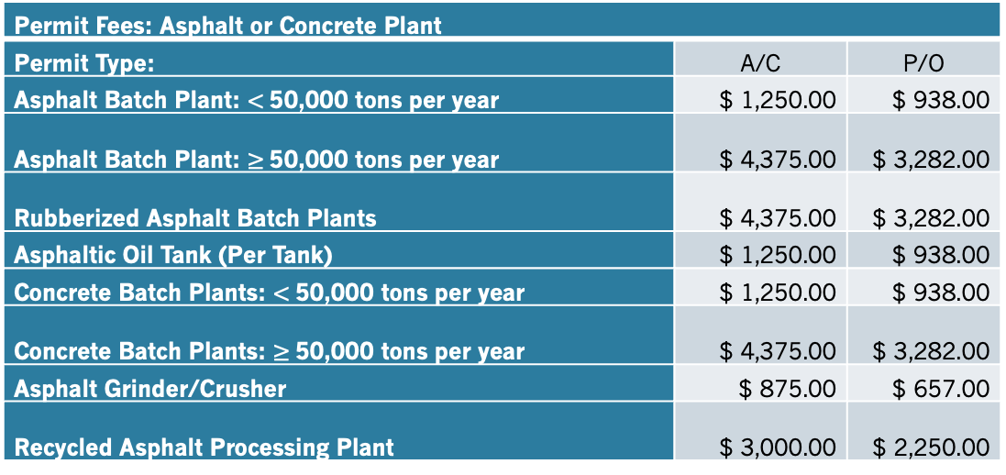
Rule 660.07A (Proposed)
Section 660.07A: Category VII(A) - Asphalt or Concrete Plant Permit Fees
Operation of asphalt batch plants, rubberized asphalt plants, asphaltic oil tanks, and concrete batch plants. Asphalt batch plant permit includes one (1) asphaltic oil tank. Additional tanks and emissions controls are permitted separately. Permit Fees are based on throughput limit of each permit.
Permit Fees: Asphalt or Concrete Plant
Permit Type: | A/C | P/O
Asphalt Batch Plant: $<$50,000 tons per year | $ 1,250.00 | $ 938.00
Asphalt Batch Plant: $≥$50,000 tons per year | $ 4,375.00 | $ 3,282.00
Rubberized Asphalt Batch Plants | $ 4,375.00 | $ 3,282.00
Asphaltic Oil Tank (Per Tank) | $ 1,250.00 | $ 938.00
Concrete Batch Plants: $<$50,000 tons per year | $ 1,250.00 | $ 938.00
Concrete Batch Plants: $≥$50,000 tons per year | $ 4,375.00 | $ 3,282.00
Asphalt Grinder/Crusher | $ 875.00 | $ 657.00
Recycled Asphalt Processing Plant | $ 3,000.00 | $ 2,250.00

Slide 42
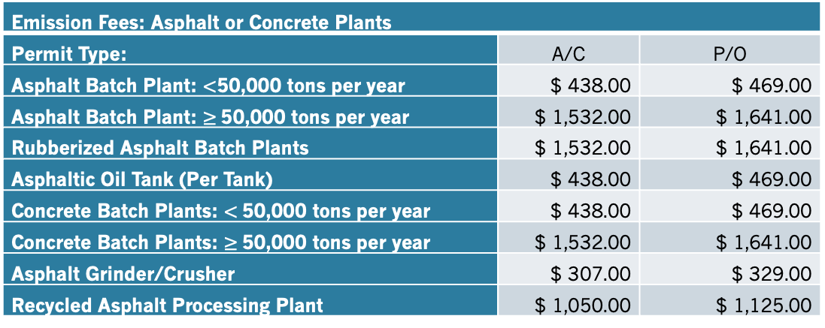
Rule 660.07B (Proposed)
Section 660.07B: Category VII(B) - Asphalt or Concrete Plant Emission Fees
Emission Fees are based on permitted emissions limits, controls in place, processes/materials used. emissions controls are permitted separately. Permit Fees are based on throughput limit of each permit.
Emission Fees: Asphalt or Concrete Plants
Permit Type: | A/C | P/O
Asphalt Batch Plant: $<$50,000 tons per year | $ 438.00 | $ 469.00
Asphalt Batch Plant: $≥$50,000 tons per year | $ 1,532.00 | $ 1,641.00
Rubberized Asphalt Batch Plants | $ 1,532.00 | $ 1,641.00
Asphaltic Oil Tank (Per Tank) | $ 438.00 | $ 469.00
Concrete Batch Plants: $<$50,000 tons per year | $ 438.00 | $ 469.00
Concrete Batch Plants: $≥$50,000 tons per year | $ 1,532.00 | $ 1,641.00
Asphalt Grinder/Crusher | $ 307.00 | $ 329.00
Recycled Asphalt Processing Plant | $ 1,050.00 | $ 1,125.00

Slide 43
Rule 660.08A&B (Proposed)
Section 660.08A: Category VIII(A) - HELD FOR FUTURE USE
Section 660.08B: Category VIII(B) - HELD FOR FUTURE USE

Slide 44
Rule 660.09A (Proposed)
Section 660.09A: Category IX(A) - Treatment Systems Permit Fees
Installation and operation of water treatment systems, sewer treatment systems, and other water/wastewater treatment systems including winery wastewater, pomace disposal, or other systems.
Permit Fees: Treatment Systems
Permit Type: | A/C | P/O
Water Treatment Plant without Ozone Generator | $ 500.00 | $ 625.00
Water Treatment Plant with Ozone Generator | $ 750.00 | $ 938.00
Sewage/Wastewater Pump Station | $ 750.00 | $ 938.00
Sewage/Wastewater Collection System | $ 1,250.00 | $ 1,563.00
Sewage/Wastewater Treatment Plant | $ 3,750.00 | $ 4,688.00
Winery Wastewater, Pomace, and other Waste Systems | $ 2,500.00 | $ 3,125.00
Chemical Abatement Systems | $ 2,750.00 | $ 3,438.00
Odor Control Systems | $ 3,750.00 | $4,688.00

Slide 45
Rule 660.09B (Proposed)
Section 660.09B: Category IX(B) - Treatment Systems Emission Fees
Emission Fees are based on permitted emissions limits, controls in place, processes/materials used.
Emission Fees: Treatment Systems
Permit Type: | A/C | P/O
Water Treatment plant without Ozone Generator | $ 250.00 | $ 313.00
Water Treatment plant with Ozone Generator | $ 375.00 | $ 469.00
Sewage/Wastewater Pump Station | $ 263.00 | $ 469.00
Sewage/Wastewater Collection System | $ 438.00 | $ 782.00
Sewage/Wastewater Treatment Plant | $1,313.00 | $2,344.00
Winery Wastewater, Pomace, and other Waste Systems | $ 875.00 | $1,563.00
Chemical Abatement Systems | $ 963.00 | $1,719.00
Odor Control Systems | $1,313.00 | $2,344.00

Slide 46
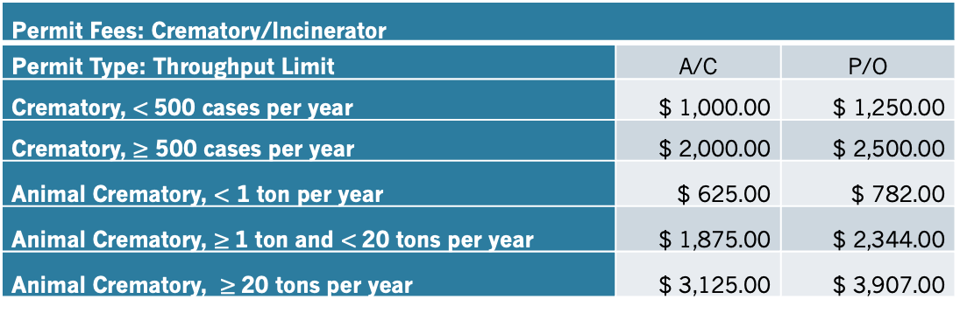
Rule 660.10A (Proposed)
Section 660.10A: Category X(A) - Crematory/Incinerator Permit Fees
Installation and operation of crematory equipment, incinerators, and other similar equipment.
Permit Fees: Crematory/Incinerator
Permit Type: Throughput Limit | A/C | P/O
Crematory, $<$500 cases per year | $ 1,000.00 | $ 1,250.00
Crematory, $≥$ 500 cases per year | $ 2,000.00 | $ 2,500.00
Animal Crematory, $<$ 1 ton per year | $ 625.00 | $ 782.00
Animal Crematory, $≥$1 ton and $<$20 tons per year | $ 1,875.00 | $ 2,344.00
Animal Crematory, $≥$20 tons per year | $ 3,125.00 | $ 3,907.00

Slide 47
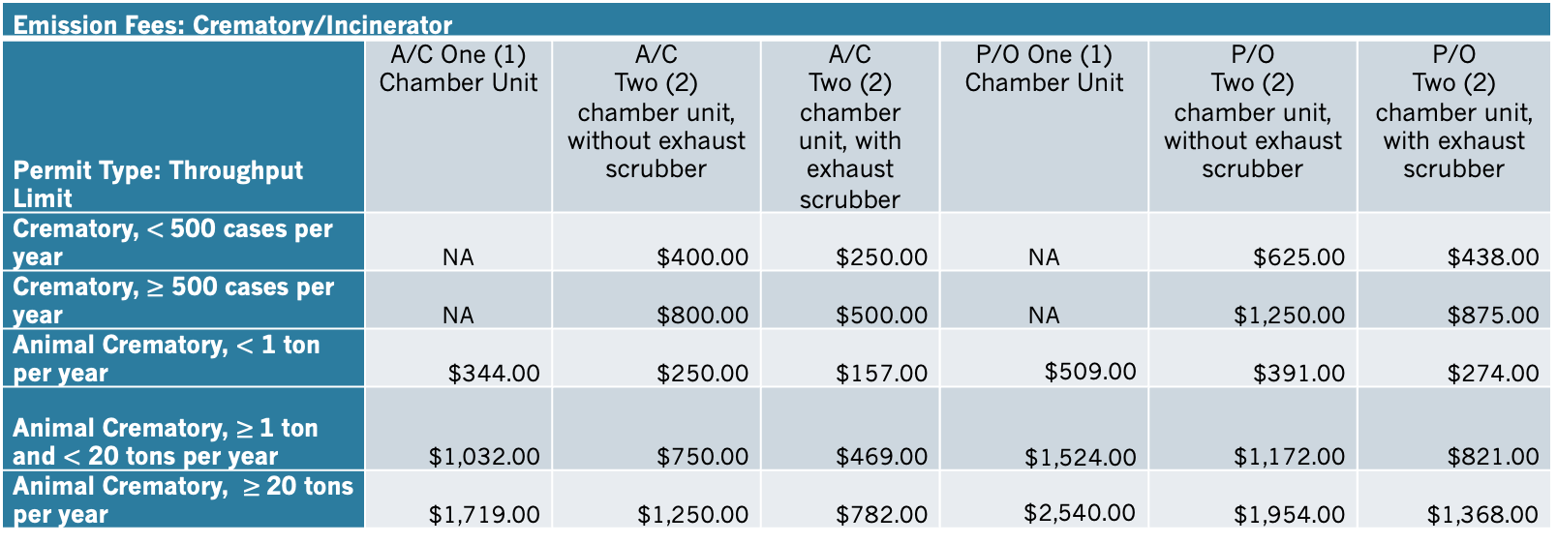
Rule 660.10B (Proposed)
Section 660.10B: Category X(B) - Crematory/Incinerator Emission Fees
Emission Fees are based on processes, controls in place, and potential to emit.
Emission Fees: Crematory/Incinerator
Permit Type: Throughput Limit | A/C One (1) Chamber Unit | A/C Two (2) chamber unit, without exhaust scrubber | A/C Two (2) chamber unit, with exhaust scrubber | P/O One (1) Chamber Unit | P/O Two (2) chamber unit, without exhaust scrubber | P/O Two (2) chamber unit, with exhaust scrubber
Crematory, $<$500 cases per year | NA | $400.00 | $250.00 | NA | $625.00 | $438.00
Crematory, $≥$ 500 cases per year | NA | $800.00 | $500.00 | NA | $1,250.00 | $875.00
Animal Crematory, $<$ 1 ton per year | $344.00 | $250.00 | $157.00 | $509.00 | $391.00 | $274.00
Animal Crematory, $≥$1 ton and $<$ 20 tons per year | $1,032.00 | $750.00 | $469.00 | $1,524.00 | $1,172.00 | $821.00
Animal Crematory, $≥$20 tons per year | $1,719.00 | $1,250.00 | $782.00 | $2,540.00 | $1,954.00 | $1,368.00

Slide 48
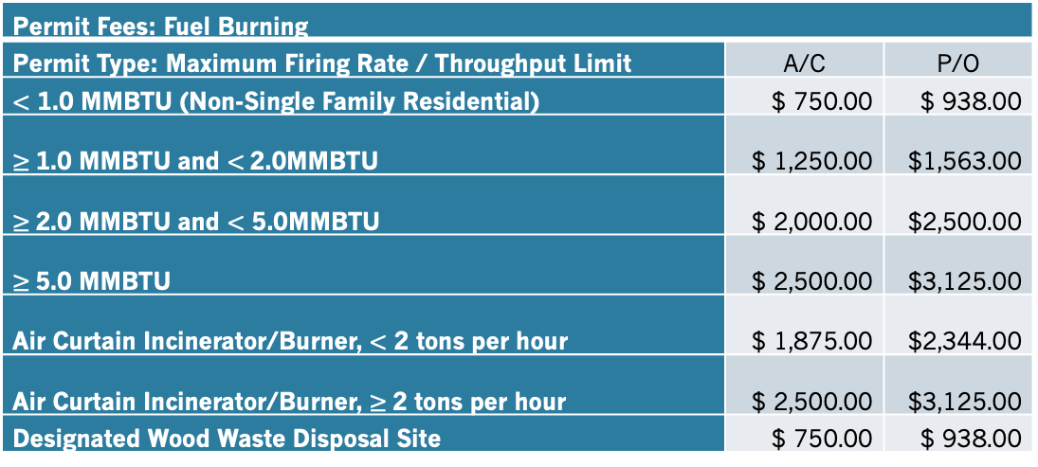
Rule 660.11A (Proposed)
Section 660.11A: Category XI(A) - Fuel Burning Permit Fees
Installation and operation of fuel burning equipment, not subject to another fee category contained herein. Examples include, but are not limited to: boilers, non-single family residential water heaters, air curtain incinerators, wood waste vegetation sites, and other fuel burning equipment. Residential equipment, though not typically permitted, can be required if nuisance conditions exist, risk prioritization score is medium or high, or other requirements exist. Engines powering any fuel burning unit shall be permitted separately.
Permit Fees: Fuel Burning
Permit Type: Maximum Firing Rate / Throughput Limit | A/C | P/O
$<$ 1.0 MMBTU (Non-Single Family Residential) | $ 750.00 | $ 938.00
$≥$1.0 MMBTU and $<$2.0MMBTU | $ 1,250.00 | $1,563.00
$≥$2.0 MMBTU and $<$ 5.0MMBTU | $ 2,000.00 | $2,500.00
$≥$5.0 MMBTU | $ 2,500.00 | $3,125.00
Air Curtain Incinerator/Burner, $<$ 2 tons per hour | $ 1,875.00 | $2,344.00
Air Curtain Incinerator/Burner, $≥$2 tons per hour | $ 2,500.00 | $3,125.00
Designated Wood Waste Disposal Site | $ 750.00 | $ 938.00

Slide 49
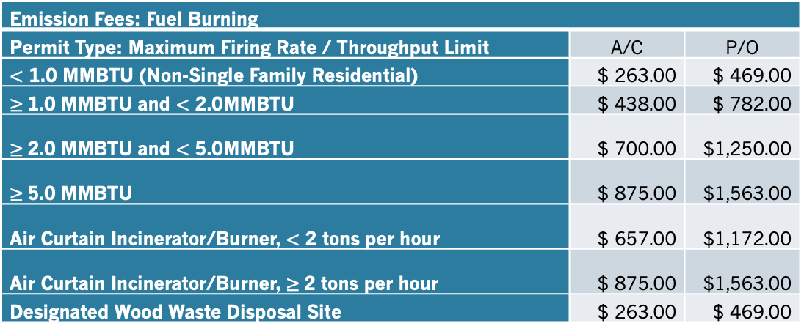
Rule 660.11B (Proposed)
Section 660.11B: Category XI(B) - Fuel Burning Emission Fees
Emission Fees are based on permitted emissions limits, firing rate, throughput limits, or processes.
Emission Fees: Fuel Burning
Permit Type: Maximum Firing Rate / Throughput Limit | A/C | P/O
$<$ 1.0 MMBTU (Non-Single Family Residential) | $ 263.00 | $ 469.00
$≥$1.0 MMBTU and $<$ 2.0MMBTU | $ 438.00 | $ 782.00
$≥$2.0 MMBTU and $<$ 5.0MMBTU | $ 700.00 | $1,250.00
$≥$5.0 MMBTU | $ 875.00 | $1,563.00
Air Curtain Incinerator/Burner, $<$ 2 tons per hour | $ 657.00 | $1,172.00
Air Curtain Incinerator/Burner, $≥$2 tons per hour | $ 875.00 | $1,563.00
Designated Wood Waste Disposal Site | $ 263.00 | $ 469.00

Slide 50
Rule 660.12A&B (Proposed)
Section 660.12A: Category XII(A) - HELD FOR FUTURE USE
Section 660.12B: Category XII(B) - HELD FOR FUTURE USE

Slide 51
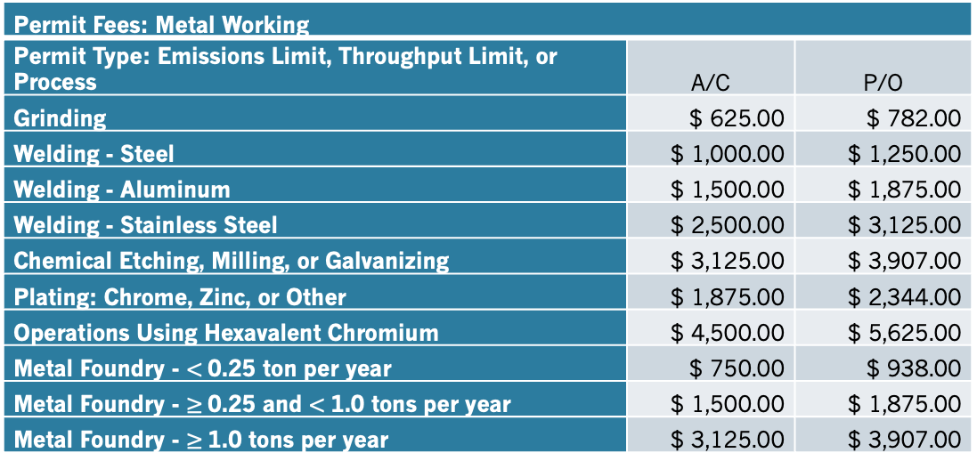
Rule 660.13A (Proposed)
Section 660.13A: Category XIII(A) - Metal Working Permit Fees
Installation and operation of metal working equipment, not subject to another fee category contained herein. Examples include, but are not limited to: welding shops, foundries, metal etching, milling, galvanizing, grinding, precious metal refining/processing, and hexavalent chromium work. Residential equipment, though not typically permitted, can be required if nuisance conditions exist, risk prioritization score is medium or high, or other requirements exist.
Permit Fees: Metal Working
Permit Type: Emissions Limit, Throughput Limit, or Process | A/C | P/O
Grinding | $ 625.00 | $ 782.00
Welding - Steel | $ 1,000.00 | $ 1,250.00
Welding - Aluminum | $ 1,500.00 | $ 1,875.00
Welding - Stainless Steel | $ 2,500.00 | $ 3,125.00
Chemical Etching, Milling, or Galvanizing | $ 3,125.00 | $ 3,907.00
Plating: Chrome, Zinc, or Other | $ 1,875.00 | $ 2,344.00
Operations Using Hexavalent Chromium | $ 4,500.00 | $ 5,625.00
Metal Foundry - $<$0.25 ton per year | $ 750.00 | $ 938.00
Metal Foundry - $≥$0.25 and $<$1.0 tons per year | $ 1,500.00 | $ 1,875.00
Metal Foundry - $≥$1.0 tons per year | $ 3,125.00 | $ 3,907.00

Slide 52
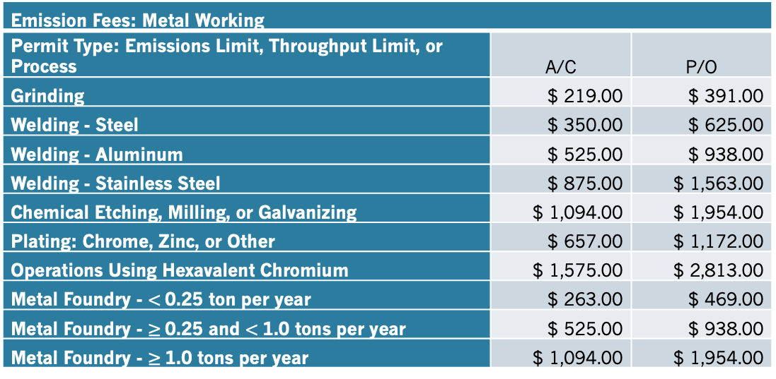
Rule 660.13B (Proposed)
Section 660.13B: Category XIII(B) - Metal Working Emission Fees
Emission Fees are based on permitted emissions limits, throughput limits, or processes.
Emission Fees: Metal Working
Permit Type: Emissions Limit, Throughput Limit, or Process | A/C | P/O
Grinding | $ 219.00 | $ 391.00
Welding - Steel | $ 350.00 | $ 625.00
Welding - Aluminum | $ 525.00 | $ 938.00
Welding - Stainless Steel | $ 875.00 | $ 1,563.00
Chemical Etching, Milling, or Galvanizing | $ 1,094.00 | $ 1,954.00
Plating: Chrome, Zinc, or Other | $ 657.00 | $ 1,172.00
Operations Using Hexavalent Chromium | $ 1,575.00 | $ 2,813.00
Metal Foundry - $<$0.25 ton per year | $ 263.00 | $ 469.00
Metal Foundry - $≥$0.25 and $<$1.0 tons per year | $ 525.00 | $ 938.00
Metal Foundry - $≥$1.0 tons per year | $ 1,094.00 | $ 1,954.00

Slide 53
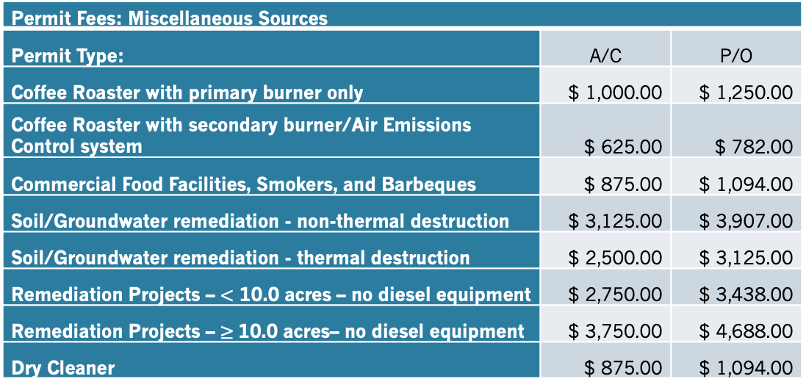
Rule 660.14A (Proposed)
Section 660.14A: Category XIV(A) - Miscellaneous Sources Permit Fees
Installation and operation of miscellaneous sources including, but not limited to: coffee roasters, soil/groundwater remediation, and dry cleaners. Commercial food facilities, commercial smokers and barbeques, and other non-single family residential food preparation facilities may require permitting if they have potential for nuisance conditions, create a moderate or high risk, and/or complaints are received.
Permit Fees: Miscellaneous Sources
Permit Type: | A/C | P/O
Coffee Roaster with primary burner only | $ 1,000.00 | $ 1,250.00
Coffee Roaster with secondary burner/Air Emissions Control system | $ 625.00 | $ 782.00
Commercial Food Facilities, Smokers, and Barbeques | $ 875.00 | $ 1,094.00
Soil/Groundwater remediation - non-thermal destruction | $ 3,125.00 | $ 3,907.00
Soil/Groundwater remediation - thermal destruction | $ 2,500.00 | $ 3,125.00
Remediation Projects – $<$ 10.0 acres – no diesel equipment | $ 2,750.00 | $ 3,438.00
Remediation Projects – $≥$10.0 acres– no diesel equipment | $ 3,750.00 | $ 4,688.00
Dry Cleaner | $ 875.00 | $ 1,094.00

Slide 54
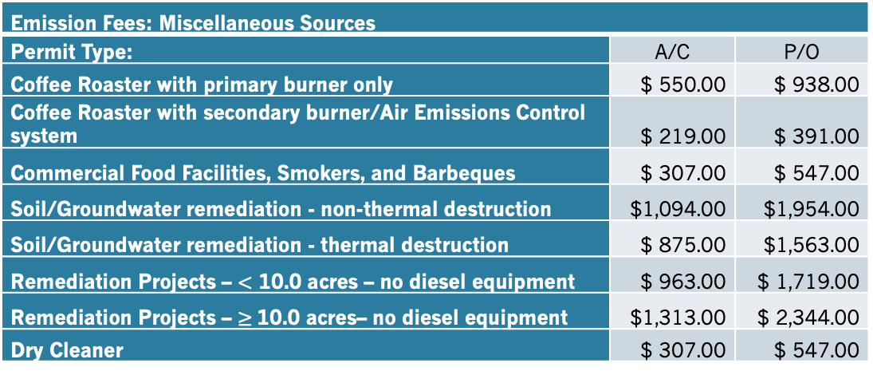
Rule 660.14B (Proposed)
Section 660.14B: Category XIV(B) - Miscellaneous Sources Emission Fees
Emission Fees are based on processes/materials used, controls in place, and potential to emit.
Emission Fees: Miscellaneous Sources
Permit Type: | A/C | P/O
Coffee Roaster with primary burner only | $ 550.00 | $ 938.00
Coffee Roaster with secondary burner/Air Emissions Control system | $ 219.00 | $ 391.00
Commercial Food Facilities, Smokers, and Barbeques | $ 307.00 | $ 547.00
Soil/Groundwater remediation - non-thermal destruction | $1,094.00 | $1,954.00
Soil/Groundwater remediation - thermal destruction | $ 875.00 | $1,563.00
Remediation Projects – $<$ 10.0 acres – no diesel equipment | $ 963.00 | $ 1,719.00
Remediation Projects – $≥$10.0 acres– no diesel equipment | $1,313.00 | $ 2,344.00
Dry Cleaner | $ 307.00 | $ 547.00

Slide 55
Rule 660.15A&B (Proposed)
Section 660.15A: Category XV(A) - HELD FOR FUTURE USE
Section 660.15B: Category XV(B) - HELD FOR FUTURE USE

Slide 56
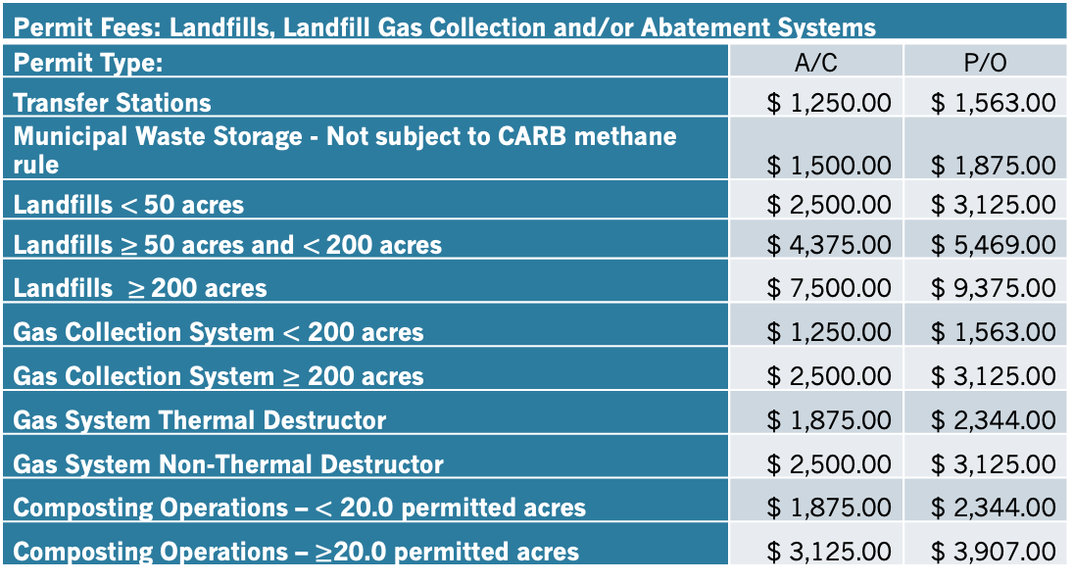
Rule 660.16A (Proposed)
Section 660.16A: Category XVI(A) - Landfills, Landfill Gas Collection and/or Abatement Systems Permit Fees
Installation and operation of landfill facilities, gas collection systems, and/or abatement systems.
Permit Fees: Landfills, Landfill Gas Collection and/or Abatement Systems
Permit Type: | A/C | P/O
Transfer Stations | $ 1,250.00 | $ 1,563.00
Municipal Waste Storage - Not subject to CARB methane rule | $ 1,500.00 | $ 1,875.00
Landfills $<$50 acres | $ 2,500.00 | $ 3,125.00
Landfills $≥$50 acres and $<$200 acres | $ 4,375.00 | $ 5,469.00
Landfills $≥$200 acres | $ 7,500.00 | $ 9,375.00
Gas Collection System $<$ 200 acres | $ 1,250.00 | $ 1,563.00
Gas Collection System $≥$ 200 acres | $ 2,500.00 | $ 3,125.00
Gas System Thermal Destructor | $ 1,875.00 | $ 2,344.00
Gas System Non-Thermal Destructor | $ 2,500.00 | $ 3,125.00
Composting Operations – $<$ 20.0 permitted acres | $ 1,875.00 | $ 2,344.00
Composting Operations – $≥$20.0 permitted acres | $ 3,125.00 | $ 3,907.00

Slide 57
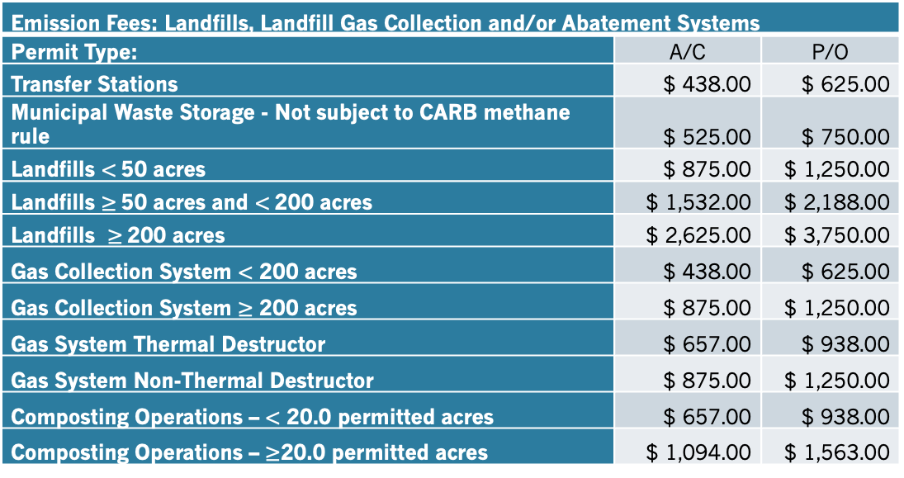
Rule 660.16B (Proposed)
Section 660.16B: Category XVI(B) - Landfills, Landfill Gas Collection and/or Abatement Systems Emission Fees
Emission Fees are based on processes, size of operation, controls in place, and potential to emit.
Emission Fees: Landfills, Landfill Gas Collection and/or Abatement Systems
Permit Type: | A/C | P/O
Transfer Stations | $ 438.00 | $ 625.00
Municipal Waste Storage - Not subject to CARB methane rule | $ 525.00 | $ 750.00
Landfills $<$50 acres | $ 875.00 | $ 1,250.00
Landfills $≥$50 acres and $<$200 acres | $ 1,532.00 | $ 2,188.00
Landfills $≥$200 acres | $ 2,625.00 | $ 3,750.00
Gas Collection System $<$ 200 acres | $ 438.00 | $ 625.00
Gas Collection System $≥$ 200 acres | $ 875.00 | $ 1,250.00
Gas System Thermal Destructor | $ 657.00 | $ 938.00
Gas System Non-Thermal Destructor | $ 875.00 | $ 1,250.00
Composting Operations – $<$ 20.0 permitted acres | $ 657.00 | $ 938.00
Composting Operations – $≥$20.0 permitted acres | $ 1,094.00 | $ 1,563.00

Slide 58
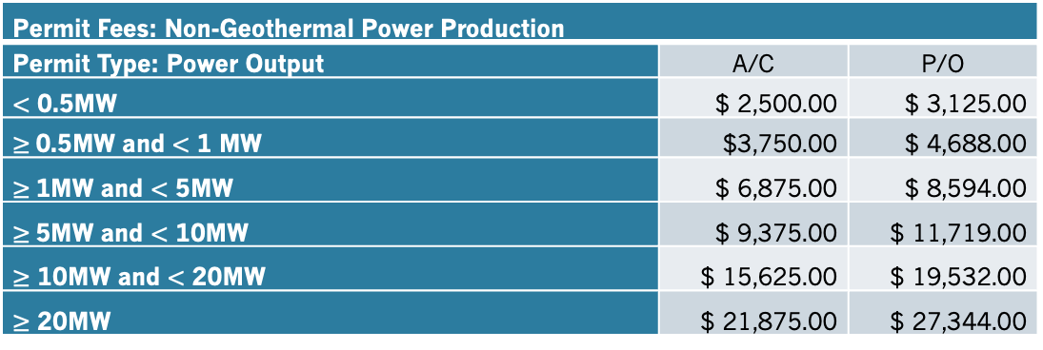
Rule 660.17A (Proposed)
Section 660.17A: Category XVII(A) - Non-Geothermal Power Production Permit Fee
Installation and operation of non-geothermal power production equipment, bioenergy, syngas, non-internal combustion powered generators, and other power production operations that have potential air emissions. Permit fees are based on maximum rated power output.
Permit Fees: Non-Geothermal Power Production
Permit Type: Power Output | A/C | P/O
$<$ 0.5MW | $ 2,500.00 | $ 3,125.00
$≥$0.5MW and $<$ 1 MW | $3,750.00 | $ 4,688.00
$≥$1MW and $<$ 5MW | $ 6,875.00 | $ 8,594.00
$≥$5MW and $<$ 10MW | $ 9,375.00 | $ 11,719.00
$≥$ 10MW and $<$ 20MW | $ 15,625.00 | $ 19,532.00
$≥$ 20MW | $ 21,875.00 | $ 27,344.00

Slide 59
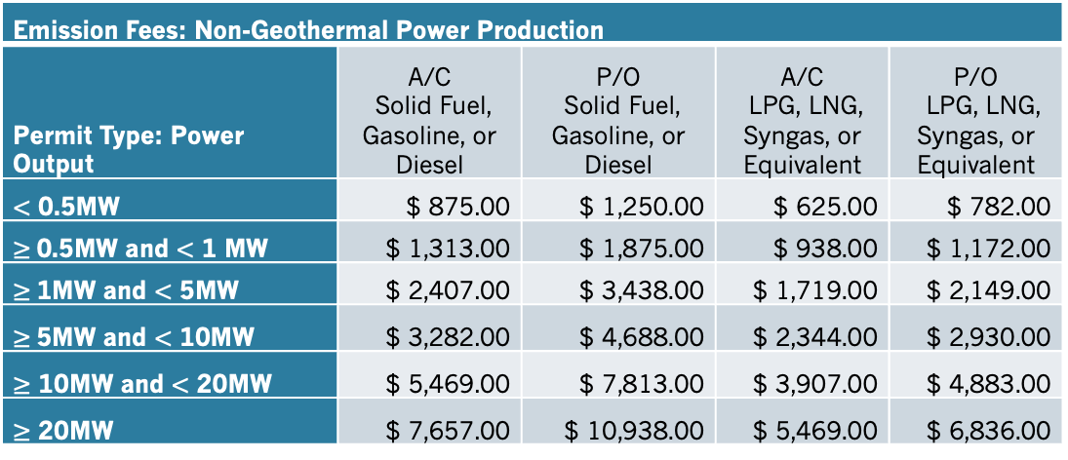
Rule 660.17B (Proposed)
Section 660.17B: Category XVII(B) - Non-Geothermal Power Production Emission Fees
Emission Fees are based on maximum rated power output and fuel types.
Emission Fees: Non-Geothermal Power Production
Permit Type: Power Output | A/C Solid Fuel, Gasoline, or Diesel | P/O Solid Fuel, Gasoline, or Diesel | A/C LPG, LNG, Syngas, or Equivalent | P/O LPG, LNG, Syngas, or Equivalent
$<$ 0.5MW | $ 875.00 | $ 1,250.00 | $ 625.00 | $ 782.00
$≥$0.5MW and $<$ 1 MW | $ 1,313.00 | $ 1,875.00 | $ 938.00 | $ 1,172.00
$≥$1MW and $<$ 5MW | $ 2,407.00 | $ 3,438.00 | $ 1,719.00 | $ 2,149.00
$≥$5MW and $<$ 10MW | $ 3,282.00 | $ 4,688.00 | $ 2,344.00 | $ 2,930.00
$≥$ 10MW and $<$ 20MW | $ 5,469.00 | $ 7,813.00 | $ 3,907.00 | $ 4,883.00
$≥$ 20MW | $ 7,657.00 | $ 10,938.00 | $ 5,469.00 | $ 6,836.00

Slide 60
Rule 660.18A&B (Proposed)
Section 660.18A: Category XVIII(A) - HELD FOR FUTURE USE
Section 660.18B: Category XVIII(B) - HELD FOR FUTURE USE

Slide 61
Rule 660.19A (Proposed)
Section 660.19A: Category XIX(A) - Retail Underground Storage Tank Fuel Dispensing Facility Permit Fee
Permit Fees for the facility and are based on the facility size, underground storage tank (UST) system configuration, and annual fuel sales limits. The fuel dispensing Permit Fee is based on the total permitted limit of gasoline, gasoline blends, aviation fuels, ethanol blends, and E85 throughput. For facilities with multiple dispensing types, such as marina (on the water) and (onroad) vehicle fueling, the fees shall be the higher of the two applicable fees. Enhanced vapor recovery (EVR) and in station diagnostics (ISD) are the most advanced emissions controls available and are required for higher throughput facilities.
Permit Fees: Retail UST Fuel Dispensing Facility
Permit Type: Throughput Limit - Gallons of Fuel Per Year | A/C | P/O
< 100,000 and/or exempt from Phase I and/or Phase II EVR | $ 1,250.00 | $ 625.00
≥ 100,000 and < 600,000 gpy with Phase I and Phase II EVR | $ 3,125.00 | $ 1,563.00
≥ 100,000 and < 600,000 gpy without Phase I and Phase II EVR | $ 3,750.00 | $ 1,875.00
≥ 600,000 and < 2,000,000 gpy with EVR and ISD | $ 5,000.00 | $ 2,500.00
≥ 2,000,000 gpy with EVR and ISD | $ 6,250.00 | $ 3,125.00

Slide 62
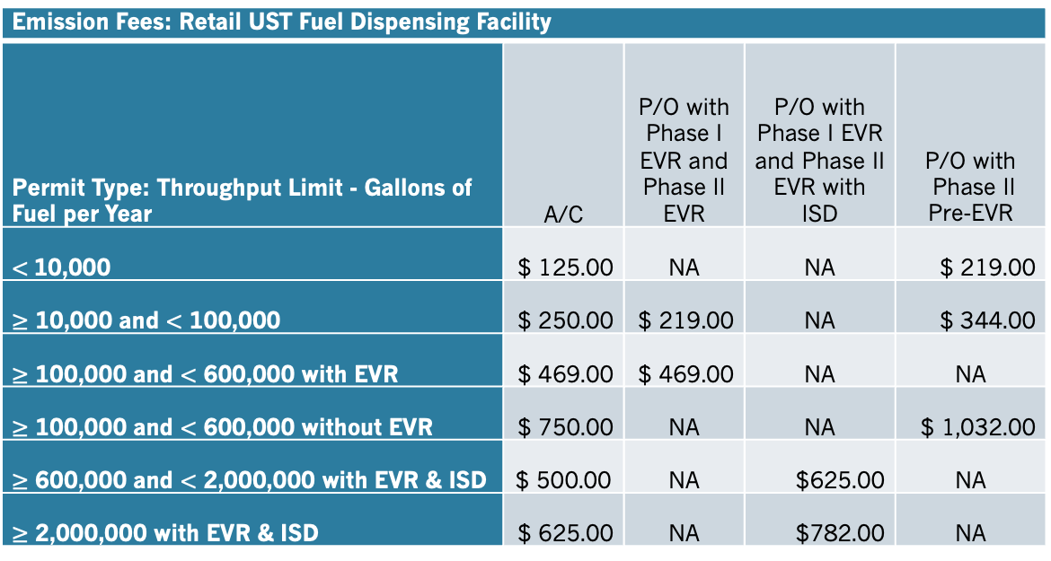
Rule 660.19B (Proposed)
Section 660.19B: Category XIX(B) - Retail Underground Storage Tank Fuel Dispensing Facility Emission Fee
Emission Fees are based on the facility emissions controls. The higher level of emissions controls have lower emission fees. Emissions fees are categorized by facility size, annual fuel sales limits, and control systems in place. The Emission Fee is based on the total permitted limit of gasoline, gasoline blends, aviation fuels, ethanol blends, and E85 throughput as well as the level of emissions controls. Enhanced vapor recovery (EVR) and in station diagnostics (ISD) are the most advanced emissions controls available and are required for higher throughput facilities.
Emission Fees: Retail UST Fuel Dispensing Facility
Permit Type: Throughput Limit - Gallons of Fuel per Year | A/C | P/O with Phase I EVR and Phase II EVR | P/O with Phase I EVR and Phase II EVR with ISD | P/O with Phase II Pre-EVR
$<$10,000 | $ 125.00 | NA | NA | $ 219.00
$≥$ 10,000 and $<$ 100,000 | $ 250.00 | $ 219.00 | NA | $ 344.00
$≥$ 100,000 and $<$ 600,000 with EVR | $ 469.00 | $ 469.00 | NA | NA
$≥$ 100,000 and $<$ 600,000 without EVR | $ 750.00 | NA | NA | $ 1,032.00
$≥$ 600,000 and $<$ 2,000,000 with EVR & ISD | $ 500.00 | NA | $625.00 | NA
$≥$ 2,000,000 with EVR & ISD | $ 625.00 | NA | $782.00 | NA

Slide 63
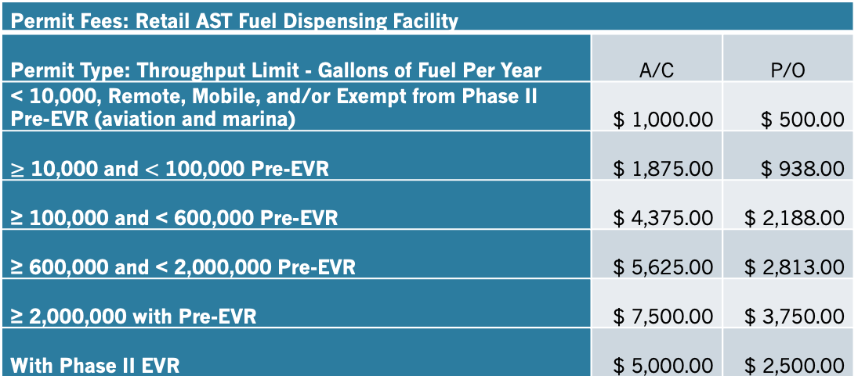
Rule 660.19C (Proposed)
Section 660.19C: Category XIX(C) - Retail Aboveground Storage Tank Fuel Dispensing Facility Permit Fee
Permit Fees are based on the facility size, above ground storage tank (AST) system configuration (including mobile fueling) and annual fuel sales limits. Category is based on Phase II system configuration (Exempt from Vapor Recover, Pre-EVR, or EVR) The fuel dispensing Permit Fee is for gasoline, gasoline blends, aviation fuels, ethanol blends, and E85. For facilities with multiple dispensing types, such as marina and vehicle fueling, the fees shall be the higher of the applicable fees.
Permit Fees: Retail AST Fuel Dispensing Facility
Permit Type: Throughput Limit - Gallons of Fuel Per Year | A/C | P/O
< 10,000, Remote, Mobile, and/or Exempt from Phase II Pre-EVR (aviation and marina) | $ 1,000.00 | $ 500.00
$≥$ 10,000 and $<$ 100,000 Pre-EVR | $ 1,875.00 | $ 938.00
≥ 100,000 and < 600,000 Pre-EVR | $ 4,375.00 | $ 2,188.00
≥ 600,000 and < 2,000,000 Pre-EVR | $ 5,625.00 | $ 2,813.00
≥ 2,000,000 with Pre-EVR | $ 7,500.00 | $ 3,750.00
With Phase II EVR | $ 5,000.00 | $ 2,500.00

Slide 64
Rule 660.19D (Proposed)
Section 660.19D: Category XIX(D) - Retail Above Ground Storage Tank Fuel Dispensing Facility Emission Fee
Emission Fees are based on the facility emissions controls. The higher emissions controls have lower Emission fees. Emission fees are categorized by facility size, annual fuel sales limits, and control systems in place. The Emission Fee is for gasoline, gasoline blends, aviation fuels, ethanol blends, and E85.
Emission Fees: Retail AST Fuel Dispensing Facility
Permit Type: Throughput Limit - Gallons of Fuel per Year | A/C | P/O with Phase I and Phase II Pre-EVR | P/O with EVR | P/O without Phase I and/or Phase II
< 10,000 and Remote and/or exempt from Phase II Pre-EVR (aviation and marina) | $ 150.00 | NA | NA | $ 125.00
≥ 10,000 and <100,000 Pre-EVR | $ 188.00 | $ 329.00 | NA | $ 235.00
≥ 100,000 and < 600,000 Pre-EVR | $ 438.00 | $ 766.00 | NA | NA
≥ 600,000 and < 2,000,000 Pre-EVR | $ 563.00 | $ 985.00 | NA | NA
≥ 2,000,000 Pre-EVR | $ 750.00 | $ 1,313.00 | NA | NA
With Phase II EVR | $ 500.00 | $ 875.00 | $ 625.00 | NA

Slide 65
Rule 660.19E&F (Proposed)
Section 660.19E: Category XIX(E) – Non-Bulk Propane Dispensing Facility Permit Fee
HELD FOR FUTURE USE
Section 660.19F: Category XIX(F) – Non-Bulk Propane Dispensing Facility Emission Fee
HELD FOR FUTURE USE

Slide 66
Rule 660.20A (Proposed)
Section 660.20A: Category XX(A) - Non-Retail Fuel Dispensing Facility Permit Fee
Permit Fees are based on the facility size and system configuration (including mobile fueling) and annual fuel limits. The fuel dispensing Permit Fee is for gasoline, gasoline blends, aviation fuels, ethanol blends, and E85. For facilities with multiple dispensing types, such as marina and vehicle fueling, the fees shall be the higher of the applicable fees.
Permit Fees: Non-Retail Fuel Dispensing Facility
Permit Type: Throughput Limit - Gallons of Fuel Per Year | A/C | P/O
< 10,000, Remote, Mobile, and/or Exempt from Phase II Pre-EVR (aviation and marina) | $ 1,000.00 | $ 500.00
≥ 10,000 and < 100,000 | $ 1,875.00 | $ 938.00
≥ 100,000 and < 600,000 | $ 4,375.00 | $ 2,188.00
≥ 600,000 and < 2,000,000 | $ 5,625.00 | $ 2,813.00
≥ 2,000,000 | $ 7,500.00 | $ 3,750.00
≥ 600,000 with ISD | $ 5,000.00 | $ 2,500.00

Slide 67
Rule 660.20B (Proposed)
Section 660.20B: Category XX(B) - Non-Retail Fuel Dispensing Facility Emission Fee
Emission Fees are based on the facility emissions controls. The higher emissions controls have lower Emission fees. Emission fees are categorized by facility size, annual fuel sales limits, and control systems in place. The Emission Fee is for gasoline, gasoline blends, aviation fuels, ethanol blends, and E85.
Emission Fees: Non-Retail Fuel Dispensing Facility
Permit Type: Throughput Limit - Gallons of Fuel Per Year | A/C | P/O with Phase I and Phase II Pre-EVR | P/O with EVR | P/O without Phase I and/or Phase II
< 10,000 and Remote, Mobile, and/or Exempt from Phase II Pre-EVR (aviation and marina) | $ 150.00 | $ 175.00 | NA | $ 125.00
≥ 10,000 and < 100,000 | $ 188.00 | $ 329.00 | NA | $ 235.00
≥ 100,000 and < 600,000 | $ 438.00 | $ 766.00 | NA | $ 547.00
≥ 600,000 and < 2,000,000 | $ 563.00 | $ 985.00 | NA | $ 704.00
≥ 2,000,000 | $ 750.00 | $ 1,313.00 | NA | $ 938.00
≥ 600,000 with ISD | $ 500.00 | $ 875.00 | $ 625.00 | NA

Slide 68
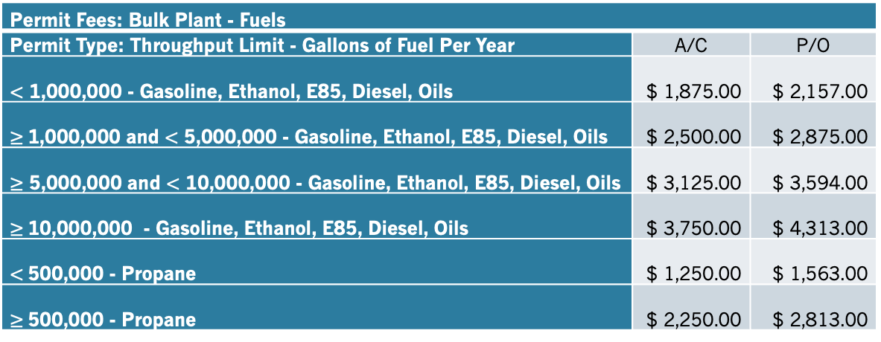
Rule 660.21A (Proposed)
Section 660.21A: Category XXI(A) - Bulk Plant - Fuels Permit Fees
Permit Fees are based on facility size, throughput limit, and fuel type. Fuels include, but are not limited to: gasoline, ethanol, E85, diesel, oils, and propane.
Permit Fees: Bulk Plant - Fuels
Permit Type: Throughput Limit - Gallons of Fuel Per Year | A/C | P/O
$<$ 1,000,000 - Gasoline, Ethanol, E85, Diesel, Oils | $ 1,875.00 | $ 2,157.00
$≥$1,000,000 and $<$ 5,000,000 - Gasoline, Ethanol, E85, Diesel, Oils | $ 2,500.00 | $ 2,875.00
$≥$ 5,000,000 and $<$ 10,000,000 - Gasoline, Ethanol, E85, Diesel, Oils | $ 3,125.00 | $ 3,594.00
$≥$10,000,000 - Gasoline, Ethanol, E85, Diesel, Oils | $ 3,750.00 | $ 4,313.00
$<$500,000 - Propane | $ 1,250.00 | $ 1,563.00
$≥$500,000 - Propane | $ 2,250.00 | $ 2,813.00

Slide 69
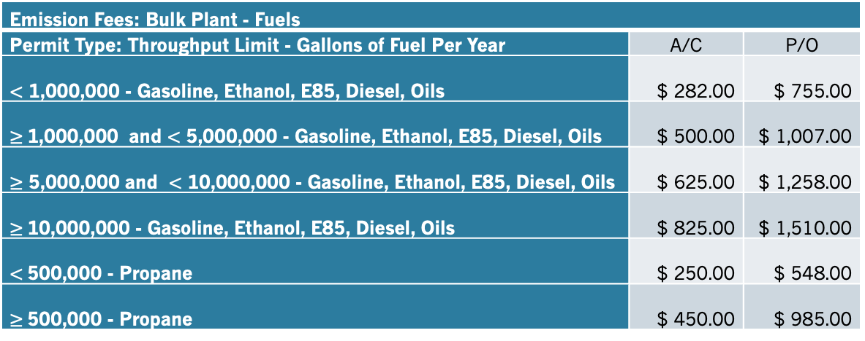
Rule 660.21B (Proposed)
Section 660.21B: Category XXI(B) - Bulk Plants - Fuels Emission Fees
Emission Fees are based on facility throughput limit, fugitive emissions, venting, and operational emissions.
Emission Fees: Bulk Plant - Fuels
Permit Type: Throughput Limit - Gallons of Fuel Per Year | A/C | P/O
$<$ 1,000,000 - Gasoline, Ethanol, E85, Diesel, Oils | $ 282.00 | $ 755.00
$≥$1,000,000 and $<$ 5,000,000 - Gasoline, Ethanol, E85, Diesel, Oils | $ 500.00 | $ 1,007.00
$≥$ 5,000,000 and $<$ 10,000,000 - Gasoline, Ethanol, E85, Diesel, Oils | $ 625.00 | $ 1,258.00
$≥$10,000,000 - Gasoline, Ethanol, E85, Diesel, Oils | $ 825.00 | $ 1,510.00
$<$500,000 - Propane | $ 250.00 | $ 548.00
$≥$500,000 - Propane | $ 450.00 | $ 985.00

Slide 70
Rule 660.22A (Proposed)
Section 660.22A: Category XXII(A) - Geothermal, Gas, or Petroleum Well Permit Fees
Permit Fees are for the installation and operation of a geothermal, gas, or petroleum well.
Permit Fees: Geothermal, Gas, or Petroleum Well
Permit Type: Well | A/C | P/O
Well | $ 3,750.00 | $ 2,813.00

Slide 71
Rule 660.22B (Proposed)
Section 660.22B: Category XXII(B) - Geothermal, Gas, or Petroleum Well Emission Fees
Emission Fees are based on fugitive emissions and venting of geothermal, gas, or petroleum well.
Emission Fees: Geothermal, Gas, or Petroleum Well
Permit Type: Well | A/C | P/O
Well | $ 375.00 | $ 282.00

Slide 72
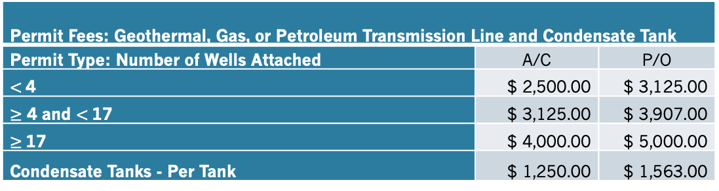
Rule 660.23A (Proposed)
Section 660.23A: Category XXIII(A) - Geothermal, Gas, or Petroleum Transmission Line and Condensate Tank Permit Fees
Permit Fees are based on the number of wells connected to a transmission line on each condensate tank. This includes the pipelines from well pad to power plant or processing facility. Each condensate tank is permitted separately.
Permit Fees: Geothermal, Gas, or Petroleum Transmission Line and Condensate Tank
Permit Type: Number of Wells Attached | A/C | P/O
$<$4 | $ 2,500.00 | $ 3,125.00
$≥$ 4 and $<$17 | $ 3,125.00 | $ 3,907.00
$≥$17 | $ 4,000.00 | $ 5,000.00
Condensate Tanks - Per Tank | $ 1,250.00 | $ 1,563.00

Slide 73
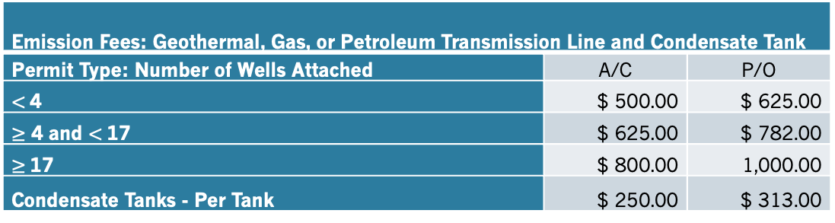
Rule 660.23B (Proposed)
Section 660.23B: Category XXIII(B) - Geothermal, Gas, or Petroleum Transmission Line and Condensate Tank Emission Fees.
Emission Fees are based on emissions from transmission lines including fugitive emissions, venting, maintenance operations and emissions from condensate tanks.
Emission Fees: Geothermal, Gas, or Petroleum Transmission Line and Condensate Tank
Permit Type: Number of Wells Attached | A/C | P/O
$<$4 | $ 500.00 | $ 625.00
$≥$ 4 and $<$17 | $ 625.00 | $ 782.00
$≥$17 | $ 800.00 | 1,000.00
Condensate Tanks - Per Tank | $ 250.00 | $ 313.00

Slide 74
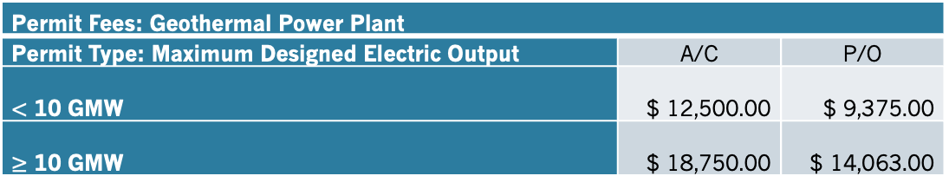
Rule 660.24A (Proposed)
Section 660.24A: Category XXIV(A) - Geothermal Power Plant Permit Fees
Permit Fees are for the installation and operation of a geothermal power plant and is based on the gross megawatt output rating of the power plant.
Permit Fees: Geothermal Power Plant
Permit Type: Maximum Designed Electric Output | A/C | P/O
$<$ 10 GMW | $ 12,500.00 | $ 9,375.00
$≥$ 10 GMW | $ 18,750.00 | $ 14,063.00

Slide 75
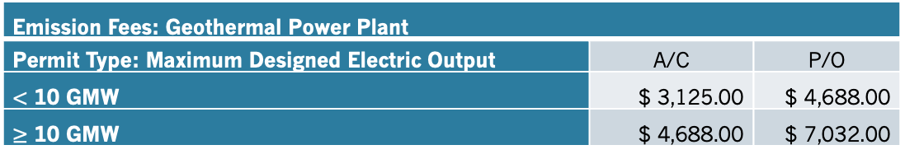
Rule 660.24B (Proposed)
Section 660.24B: Category XXIV(B) - Geothermal Power Plant Emission Fees
Emission Fees are based on the gross megawatt rating of the power plant and emissions potential of the power plant operations.
Emission Fees: Geothermal Power Plant
Permit Type: Maximum Designed Electric Output | A/C | P/O
$<$ 10 GMW | $ 3,125.00 | $ 4,688.00
$≥$ 10 GMW | $ 4,688.00 | $ 7,032.00

Slide 76
Rule 660.25A&B (Proposed)
Section 660.25A: Category XXV(A) - HELD FOR FUTURE USE
Section 660.25B: Category XXV(B) - HELD FOR FUTURE USE

Slide 77
Rule 660.26A (Proposed)
Section 660.26A: Category XXVI(A) - Sources Permitted by Emission Permit Fees
Permit Fees are for sources not covered by another fee section. Permit Fees apply to each pollutant’s potential emissions per ton, per year. The Permit Fee is the total of the per ton fee multiplied by the potential emissions (tons) per year for all pollutants. The fee is rounded up to the whole ton, with a one (1.0) ton minimum for any pollutant.
Permit Fees: Sources Permitted by Emission
Permit Type: Pollutant - Potential to Emit per ton per year | A/C | P/O
Volatile Organic Compounds | $ 65.00 | $ 82.00
Carbon Monoxide | $ 65.00 | $ 82.00
Ozone | $ 500.00 | $ 625.00
Oxides of Nitrogen (expressed as Nitrogen Dioxide) | $ 150.00 | $ 188.00
Gaseous Sulfur Compounds (expressed as Sulfur Dioxide) | $ 150.00 | $ 188.00
Particulate Matter | $ 200.00 | $ 250.00
Toxic Air Contaminants | $ 2,000.00 | $ 2,500.00

Slide 78
Rule 660.26B (Proposed)
Section 660.26B: Category XXVI(B) - Sources Permitted by Emissions, Emission Fees
Emission Fees are based on the Potential to Emit for each pollutant. Emission Fees is the total of the per ton fee multiplied by the potential emissions (tons) per year for all pollutants The Emission fee is calculated by rounding the potential to emit up to the nearest ton, with a one (1.0) ton minimum for any pollutant emitted by the source.
Emission Fees: Sources Permitted by Emissions
Permit Type: Pollutant - Potential to Emit per ton per year | A/C | P/O
Volatile Organic Compounds | $ 23.00 | $ 41.00
Carbon Monoxide | $ 23.00 | $ 41.00
Ozone | $ 175.00 | $ 313.00
Oxides of Nitrogen (expressed as Nitrogen Dioxide) | $ 53.00 | $ 94.00
Gaseous Sulfur Compounds (expressed as Sulfur Dioxide) | $ 53.00 | $ 94.00
Particulate Matter | $ 70.00 | $ 125.00
Toxic Air Contaminants | $ 700.00 | $ 1,250.00

Slide 79
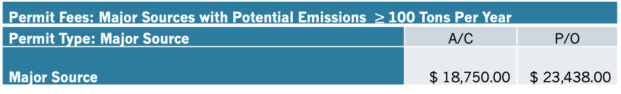
Rule 660.27A (Proposed)
Section 660.27A: Category XXVII(A) - Major Sources: Potential Emissions ≥ 100 tons per year Permit Fees
Permit Fees are based on sources with Potential Emissions ≥ 1equal to or greater than 100 tons per year that are not covered by another fee section.
Permit Fees: Major Sources with Potential Emissions $≥$100 Tons Per Year
Permit Type: Major Source | A/C | P/O
Major Source | $ 18,750.00 | $ 23,438.00

Slide 80
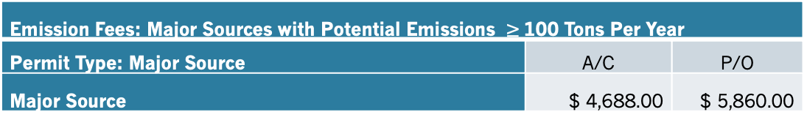
Rule 660.27B (Proposed)
Section 660.27B: Category XXVII(B) - Major Sources: Potential Emissions ≥ 100 tons per year Emission Fees
Emission Fees are based on Potential Emissions equal to or greater than 100ns ≥ 100 tons per year.
Emission Fees: Major Sources with Potential Emissions $≥$100 Tons Per Year
Permit Type: Major Source | A/C | P/O
Major Source | $ 4,688.00 | $ 5,860.00

Slide 81
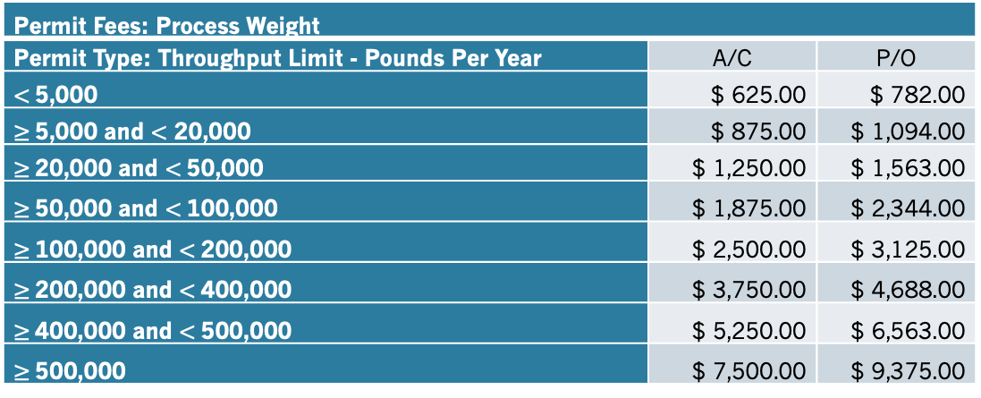
Rule 660.28A (Proposed)
Section 660.28A: Category XXVIII(A) - Process Weight Permit Fees
Permit Fees are for facilities that process materials with material weight as the production tracking mechanism. This category is for facilities that are not covered by another fee section. Permit Fee is based on annual process weight limit in pounds per year.
Permit Fees: Process Weight
Permit Type: Throughput Limit - Pounds Per Year | A/C | P/O
$<$5,000 | $ 625.00 | $ 782.00
$≥$5,000 and $<$ 20,000 | $ 875.00 | $ 1,094.00
$≥$20,000 and $<$50,000 | $ 1,250.00 | $ 1,563.00
$≥$50,000 and $<$100,000 | $ 1,875.00 | $ 2,344.00
$≥$100,000 and $<$200,000 | $ 2,500.00 | $ 3,125.00
$≥$200,000 and $<$400,000 | $ 3,750.00 | $ 4,688.00
$≥$400,000 and $<$500,000 | $ 5,250.00 | $ 6,563.00
$≥$500,000 | $ 7,500.00 | $ 9,375.00

Slide 82

Rule 660.28B (Proposed)
Section 660.28B: Category XXVIII(B) - Process Weight Emission Fees
Emission Fees are based on process throughput limit by material weight.
Emission Fees: Process Weight
Permit Type: Throughput Limit - Pounds Per Year | A/C | P/O
$<$5,000 | $ 219.00 | $ 110.00
$≥$5,000 and $<$ 20,000 | $ 307.00 | $ 154.00
$≥$20,000 and $<$50,000 | $ 438.00 | $ 219.00
$≥$50,000 and $<$100,000 | $ 657.00 | $ 329.00
$≥$100,000 and $<$200,000 | $ 875.00 | $ 438.00
$≥$200,000 and $<$400,000 | $ 1,313.00 | $ 657.00
$≥$400,000 and $<$500,000 | $ 1,838.00 | $ 919.00
$≥$500,000 | $ 2,625.00 | $ 1,313.00

Slide 83
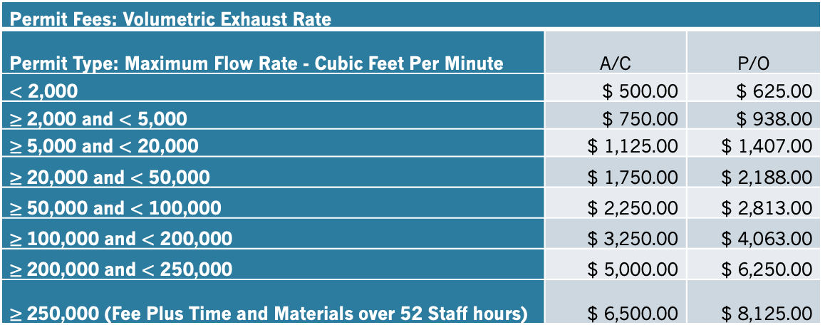
Rule 660.29A (Proposed)
Section 660.29A: Category XXIX(A) - Volumetric Exhaust Rate Permit Fees
Permit Fees are for facilities that can be measured by volumetric exhaust flow rates, including air emissions control systems and particulate control systems, not covered by another fee section. High production facilities exceeding 250,000 cubic feet per minute are subject to a time and materials charge, should staff hours exceed 52 hours per year.
Permit Fees: Volumetric Exhaust Rate
Permit Type: Maximum Flow Rate - Cubic Feet Per Minute | A/C | P/O
$<$ 2,000 | $ 500.00 | $ 625.00
$≥$2,000 and $<$ 5,000 | $ 750.00 | $ 938.00
$≥$5,000 and $<$ 20,000 | $ 1,125.00 | $ 1,407.00
$≥$20,000 and $<$ 50,000 | $ 1,750.00 | $ 2,188.00
$≥$50,000 and $<$ 100,000 | $ 2,250.00 | $ 2,813.00
$≥$100,000 and $<$ 200,000 | $ 3,250.00 | $ 4,063.00
$≥$200,000 and $<$ 250,000 | $ 5,000.00 | $ 6,250.00
$≥$250,000 (Fee Plus Time and Materials over 52 Staff hours) | $ 6,500.00 | $ 8,125.00

Slide 84
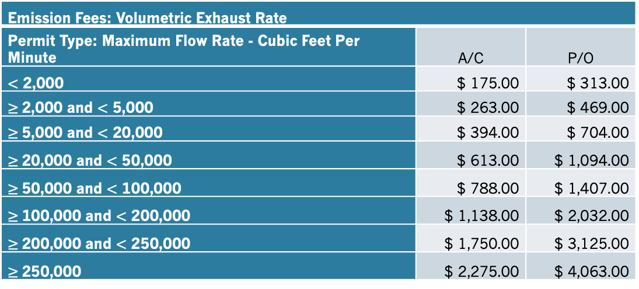
Rule 660.29B (Proposed)
Section 660.29B: Category XXIX(B) - Volumetric Exhaust Rate Emission Fees
Emission Fees are based on volumetric exhaust flow rates.
Emission Fees: Volumetric Exhaust Rate
Permit Type: Maximum Flow Rate - Cubic Feet Per Minute | A/C | P/O
$<$ 2,000 | $ 175.00 | $ 313.00
$≥$2,000 and $<$ 5,000 | $ 263.00 | $ 469.00
$≥$5,000 and $<$ 20,000 | $ 394.00 | $ 704.00
$≥$20,000 and $<$ 50,000 | $ 613.00 | $ 1,094.00
$≥$50,000 and $<$ 100,000 | $ 788.00 | $ 1,407.00
$≥$100,000 and $<$ 200,000 | $ 1,138.00 | $ 2,032.00
$≥$200,000 and $<$ 250,000 | $ 1,750.00 | $ 3,125.00
$≥$250,000 | $ 2,275.00 | $ 4,063.00

Slide 85
Rule 660.30 (Proposed)
Section 660.30: Category XXX - Greenhouse Gas - HELD FOR FUTURE USE

Slide 86
Rule 660.31 (Proposed)
Section 660.31: Category XXXI - Title V Fee
The Title V Fee is added to the associated Permit Fee (applications & annual renewals) to cover the costs of processing and maintaining a Title V permit.
Title V Fee
Permit Type: | Fee
Title V Major Source with Combustion and Opacity CEMS | $ 5,625.00
Title V Major Source with Combustion CEMS | $ 5,000.00
Title V Major Source without CEMS | $ 3,750.00
Non-Major Title V source without CEMS | $ 3,125.00
Designated Non-Major Source | $ 2,500.00

Slide 87
Rule 660.32 (Proposed)
Section 660.32: Category XXXII - Burn Permit Fee
Residential Burn Permits are for small burn piles, less than four (4) feet in diameter, on parcels that have a residence and are between 1.0 acres and 5.0 acres that typically include small diameter vegetation that will be completely consumed during normal burn hours.
Agricultural Burn Permits are for agricultural and fire hazard reduction burns. Burn piles are limited to ten (10) feet in diameter and vegetation diameter must be of a size that will burn dead out during normal burn hours. Extended hours on extended burn days for Agricultural burns may be approved upon request and documentation of need for extended hours.
Lot Clearing / Land Development Burn Permits are one (1) time permits for clearing a lot for development or for fire safety. Lot Clearing Burn Permits may be issued for parcels less than 1.0 acre in size, with documentation that there is no other feasible method of disposal of the vegetation.
A Smoke Management Plan Burn Permit may be obtained for any complex or large burn project, standing vegetation burn project, or other burn projects under single ownership incorporating multiple contiguous parcels. The requirement to obtain a Smoke Management Plan Burn Permit includes, but is not limited to, burn projects which: require a Smoke Management Plan pursuant to Regulation, require an inspection or meteorological review and specific date and time authorization prior to burning, burning of standing brush, are located in close proximity to the public for the amount of material to be burned, have a fire hazard potential, are at a location with a history of violations or complaint, or are conducted by a responsible party having a history of violation or public complaint.
A Smoke Management Plan Burn Permit is required for each parcel of record on which vegetation is to be burned. For projects incorporating multiple burn types (standing brush and piles), the higher fee of the two types is required. Additional fees are required for multiple parcels and burning more than 200 acres and may be assessed for re-inspections or incomplete applications. Examples include, but are not limited to: District staff is required to research properties or obtain other items missing from the application, the time required to assist in preparing a permit application is excessive, staff is required to perform multiple inspections of a burn site, or the burn is found to be non-compliant with the permit.

Slide 88
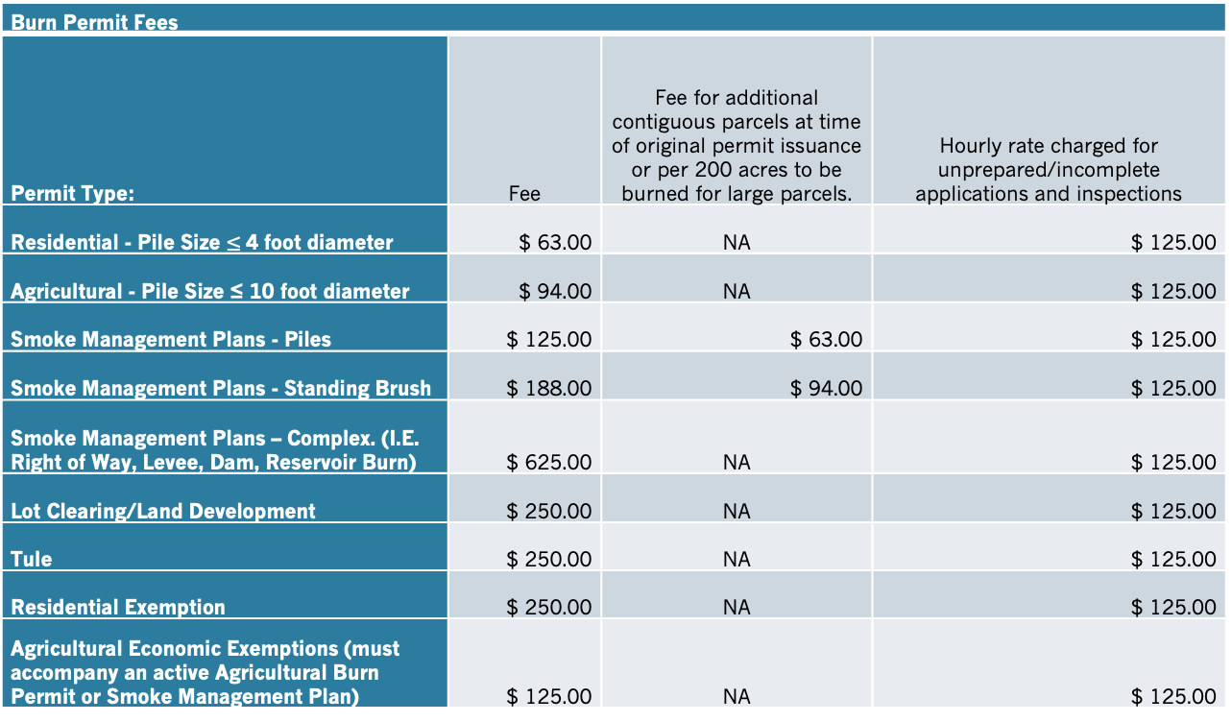

Rule 660.32 (Proposed) cont’d
Section 660.32: Category XXXII - Burn Permit Fee
Tule Burn Permits are for open burning of standing tules for agricultural or habitat improvement purposes. Tule burns require meteorological review and specific date and time authorization prior to burning an shall be incompliance with Rule Section 1150.
Burn Permit Fees
Permit Type: | Fee | Fee for additional contiguous parcels at time of original permit issuance or per 200 acres to be burned for large parcels. | Hourly rate charged for unprepared/incomplete applications and inspections
Residential - Pile Size $≤$4 foot diameter | $ 63.00 | NA | $ 125.00
Agricultural - Pile Size ≤ 10 foot diameter | $ 94.00 | NA | $ 125.00
Smoke Management Plans - Piles | $ 125.00 | $ 63.00 | $ 125.00
Smoke Management Plans - Standing Brush | $ 188.00 | $ 94.00 | $ 125.00
Smoke Management Plans – Complex. (I.E. Right of Way, Levee, Dam, Reservoir Burn) | $ 625.00 | NA | $ 125.00
Lot Clearing/Land Development | $ 250.00 | NA | $ 125.00
Tule | $ 250.00 | NA | $ 125.00
Residential Exemption | $ 250.00 | NA | $ 125.00
Agricultural Economic Exemptions (must accompany an active Agricultural Burn Permit or Smoke Management Plan) | $ 125.00 | NA | $ 125.00

Slide 89
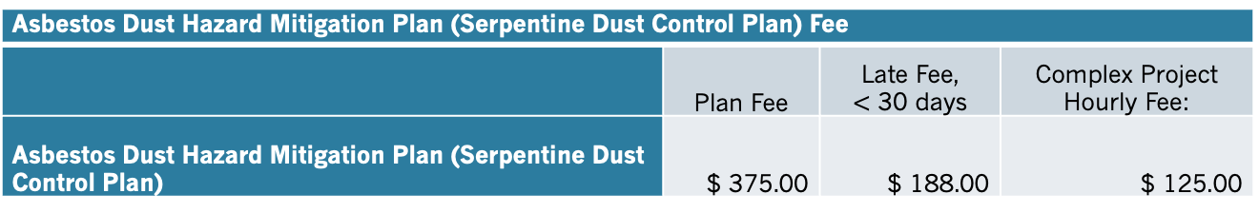

Rule 660.33 (Proposed)
Section 660.33: Category XXXIII - Asbestos Dust Hazard Mitigation Plan (Serpentine Dust Control Plan) Fee
Fee is for each Asbestos Dust Hazard Mitigation Plan (Serpentine Dust Control Plan) submitted. Plans must be renewed annually until the work is complete and all serpentine areas are secured with permanent cover. The Late Fee is incurred, when a Plan is submitted less than 30 days prior to the project start date. The Complex Project Hourly Fee is incurred when Plans require more than one (1) hour of review or when additional research is required.
Asbestos Dust Hazard Mitigation Plan (Serpentine Dust Control Plan) Fee
 | Plan Fee | Late Fee, $<$ 30 days | Complex Project Hourly Fee:
Asbestos Dust Hazard Mitigation Plan (Serpentine Dust Control Plan) | $ 375.00 | $ 188.00 | $ 125.00

Slide 90
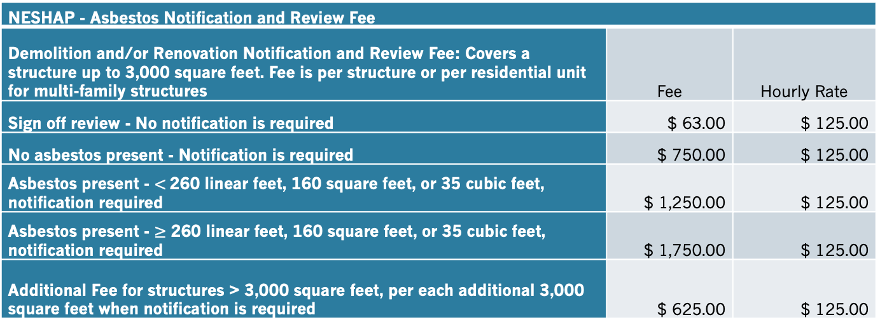
Rule 660.34 (Proposed)
Section 660.34: Category XXXIV - National Emissions Standard for Hazardous Air Pollutants (NESHAP) - Asbestos Notification and Review Fee
Fee paid is for each NESHAP Asbestos Notification and Review submitted, or for a sign-off request. All regulated demolitions and most renovation projects are subject to asbestos inspections and notification to the District. Notifications must be renewed annually if work is not complete. Notification is required for each structure and/or each unit in a multi-family housing unit that will be demolished or renovated. The Fee covers a structure up to 3,000 square feet; larger structures incur additional per square foot fees to cover the additional review and inspection time required. The Hourly Rate Fee is incurred when additional research is required or if the Notification is incomplete.
NESHAP - Asbestos Notification and Review Fee
Demolition and/or Renovation Notification and Review Fee: Covers a structure up to 3,000 square feet. Fee is per structure or per residential unit for multi-family structures | Fee | Hourly Rate
Sign off review - No notification is required | $ 63.00 | $ 125.00
No asbestos present - Notification is required | $ 750.00 | $ 125.00
Asbestos present - $<$260 linear feet, 160 square feet, or 35 cubic feet, notification required | $ 1,250.00 | $ 125.00
Asbestos present - $≥$ 260 linear feet, 160 square feet, or 35 cubic feet, notification required | $ 1,750.00 | $ 125.00
Additional Fee for structures > 3,000 square feet, per each additional 3,000 square feet when notification is required | $ 625.00 | $ 125.00

Slide 91

Rule 660.35 (Proposed)
Section 660.35: Category XXXV - HELD FOR FUTURE USE

Slide 92
Rule 660.36 (Proposed)
Section 660.36: Category XXXVI - Pre-Application / Review Fee
Fee is for review of pre-application materials for project development. Minimum one (1) hour with an hourly rate charged for additional review time.
Pre-Application/Review Fee
Fee Type | Pre-Application/ Review Fee (1 hr) | Hourly Rate for additional review
Pre-Application Review - Request for compliance/equipment options | $ 125.00 | $125.00

Slide 93
Rule 660.37 (Proposed)
Section 660.37: Category XXXVII – CEQA, Planning, Building, and Zoning Review Fee
Fee covers staff time for project review, comments, and sign offs. The Hourly Rate is incurred when additional research or review is required. CALEEMOD support fee is a passthrough fee to support the CALEEMOD emissions model (or its predecessor) required for CEQA.
Review Fee
Review Type | Fee | Hourly Rate for extended review
Permit sign-offs - Project requires no further District action | $ 63.00 | $ 125.00
Permit sign-offs - Project requires a District permit or notification, Zoning Clearances, and other basic reviews/sign-offs | $ 94.00 | $ 125.00
Negative Declarations, Basic Initial Studies, General Plan Amendments, Minor Use Permits etc.. | $ 375.00 | $ 125.00
Use Permits, Subdivision Maps (up to 10 parcels), Small Projects | $ 750.00 | $ 125.00
EIR's, Major Use Permits, Major Projects, and Other Larger Projects | $ 2,500.00 | $ 125.00
CALEEMOD Support Fee, (added to EIRS, Use Permits, and Major Projects Fee) | $ 50.00

Slide 94
Rule 660.38 (Proposed)
Section 660.38: Category XXXVIII - HELD FOR FUTURE USE

Slide 95
Rule 660.39 (Proposed)
Section 660.39: Category XXXIX - Area Source Fee - Commercial and Industrial Parking Lots
Fee is charged at time of application for a building/parking area permit. Fee is calculated per parking space. Paved parking includes asphaltic paving, concrete, or other equivalently durable surfacing. Removal of durable surfacing and regrading is considered new installation. Top coating of existing paved lots or partial grinding to allow adhesion of new pavement is not considered a new installation. Parking lots without marked parking spaces will be calculated using 180 square feet per parking space.
Area Source Fee: Commercial and Industrial Parking Lots
Parking Type - Per Parking Space | Fee | Minimum fee | Maximum Fee
Paved parking space (non-EV only) | $ 10.00 | $ 50.00 | $ 1,000.00
Paved parking space (EV charging only) | $ 1.00 | $ 10.00 | $ 200.00
Unpaved parking space | $ 30.00 | $ 150.00 | $ 5,000.00

Slide 96
Rule 660.40 (Proposed)
Section 660.40: Category XL - Area Source Fee - Commercial and Industrial Buildings
Fee is charged at the time of application for a building/renovation permit for new construction, expansion, or major renovations of commercial and industrial buildings. Fee is based on the square footage undergoing construction, expansion, or renovation and may be used to offset air quality impacts, fund air monitoring activities, inspections and complaints, and other related area source issues.
Area Source Fee: Commercial and Industrial Buildings
Fee Per Square Foot | Minimum Fee per structure | Maximum Fee per structure
$ 0.50 | $ 100.00 | $ 10,000.00

Slide 97
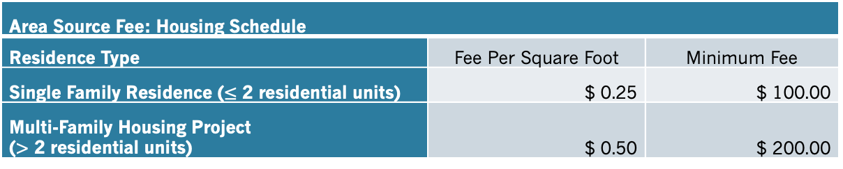
Rule 660.41 (Proposed)
Section 660.41: Category XLI - Area Source Fee - Housing Schedule
Fee is charged at the time of application for a building/renovation permit for new construction, expansion of residential buildings, or renovation (such as removal of drywall and/or siding).
Area Source Fee: Housing Schedule
Residence Type | Fee Per Square Foot | Minimum Fee
Single Family Residence ($≤$ 2 residential units) | $ 0.25 | $ 100.00
Multi-Family Housing Project ($>$ 2 residential units) | $ 0.50 | $ 200.00

Slide 98
Rule 660.42 (Proposed)
Section 660.42: Category XLII - Area Source Fee - Grading, Land Conversion, Crop Conversion
Fee is charged per acre for non-agricultural operations and non-agricultural to agricultural land conversions. Agricultural operations incur a fee when a grading permit or other land conversion permit is required by the applicable land use agency. The Fee is charged at the time of application for the grading or land conversion permit.
Area Source Fee: Grading, Land Conversion, Crop Conversion
Grading Type | Per Acre Fee | Minimum Fee | Maximum Fee
Grading/Land Conversion (Non-Agricultural) | $ 44.00 | $ 125.00 | $ 10,000.00
Grading / Crop Conversion (Agricultural, when land use / grading permit is required) | $ 5.00 | $ 63.00 | $ 10,000.00

Slide 99
Rule 660.43 (Proposed)
Section 660.43: Category XLIII - HELD FOR FUTURE USE

Slide 100
Rule 660.44 (Proposed)
Section 660.44: Category XLIV - AB617/AB197 Implementation Fee
Fee is charged to cover mandatory work related to AB617 and/or AB197. Fee will only be implemented when the State of California does not fully fund the program(s). Any funds collected in excess of program costs will be placed in reserves to cover program costs in future years.
AB617/AB197 Implementation Fee
Fee Type | Percent of A/C or P/O Fee | Minimum Fee
Fee to implement AB617 and AB197 | 5% | $ 125.00

Slide 101
Rule 660.45 (Proposed)
Section 660.45: Category XLV - Legal Notice and Public Notice Fee
Fee charged to process legal notices and public notices shall cover time and materials costs. These include actual cost of publication, distribution, copies, administrative, and any other costs incurred.
Legal Notice and Public Notice
Fee Type | Fee | Staff Time (Hourly Rate)
Legal Notice and/or Public Notice | Actual costs incurred | $ 125.00

Slide 102
Rule 660.46 (Proposed)
Section 660.46: Category XLVI - Miscellaneous Fees
Fees for information requests, public records requests, return check fees, circulars, reports, and other reprints prepared by the District, will be charged by the District in a sum not to exceed the cost associated with reproduction and delivery of such documents. Staff time charged by the ¼ hour at a rate of $125.00 per hour plus copy and distribution charges. The return check fee is charged at a flat rate plus a minimum of one half (0.5) hour of staff time to cover all costs associated with returned checks. Service Fees are not CPI adjusted. Staff hourly rate is adjusted by CPI. Individual brochures provided to the public at the District office are exempt from this fee.
Miscellaneous Fees
Fee Type | Service Fee | Staff Time (per hour, 15 minute minimum)
Copy Charges, per single side page | $0.20 | $ 125.00
Card Stock Copies (brochures, etc), per single side page | $0.25 | $125.00
Return Check Fee (0.5 hours minimum charge for staff time) | $30.00 | $125.00
Digital Records, staff time plus per page ($10.00 minimum charge) | $0.20 | $125.00

Slide 103
Rule 660.47 (Proposed)
Section 660.47: Category XLVII - Change of Ownership
An application for modification to account for a Change of Ownership, including mergers, acquisitions, or any change in the agency or corporate structure of a company, etc., of any District Authority to Construct or Permit to Operate is required and shall include a fee with the application. An application for a Change of Ownership shall be submitted no later than 15 calendar days after the change of ownership occurs. An application and fee is required for each permit associated with an ownership change.
Change of Ownership
 | Minimum Fee | Incomplete or Complex Project Hourly Rate | Legal Review for Complex Changes
Change of Ownership Application | $ 125.00 | $ 125.00 | Actual costs

Slide 104
Rule 660.48 (Proposed)
Section 660.48: Category XLVIII Administrative Changes
An application for an administrative change to account for a change to a permit including but not limited to: a name change of the facility, name change for the facility owner (not a change of ownership), change of contact/mailing address, and/or any other administrative changes of any District Authority to Construct or Permit to Operate is required and shall include a fee with the application. An application for changes to contact information including mailing address shall be submitted no later than 15 day after the change occurs. An application and fee is required for each permit associated with the administrative changes.
Administrative Changes
 | Minimum Fee | Incomplete or Complex Project Hourly Rate | Legal Review for Complex Changes
Administrative Change Application | $ 100.00 | $ 125.00 | Actual costs

Slide 105
Rule 660.49 (Proposed)
Section 660.49: Category XLIX - Transaction Fee / A87 Pass-through Fee
Fee is a pass-through fee from the A87 Cost Plan charges of the County of Lake, or contract rates for services charged by the County of Lake or other governmental entity. The annual costs associated with these charges from the County of Lake or other governmental entities will be added to each fee charged by the District. These will be added as a transaction fee to cover the A87 costs. The fees will be charged at a rate proportional to the fees being paid to the District. This fee will be implemented on an annual basis should the A87 or MOU charges exceed fifty thousand ($50,000) dollars per year as determined at the draft budget hearing. Should fees increase above the threshold during the fiscal year, the pass-through fee will be implemented the following fiscal year.

Slide 106
Rule 660.50 (Proposed)
Section 660.50: Category L - Duplicate Permit
A request for a duplicate Authority to Construct or Permit to Operate shall be made in writing to the District within ten (10) days after the destruction, loss, or defacement of an Authority to Construct permit, Permit to Operate permit, or any other permit, and shall contain the reason a duplicate permit is being requested. A fee of forty dollars ($40.00) shall be paid for each duplicate permit requested prior to processing or issuing of the duplicate permit.

Slide 107
Rule 662 (Proposed)
Section 662: Category LX – Permit Fees and Emission Fees Penalty
The Air Pollution Control Officer shall annually notify permit holders by invoice/letter of fees due for renewal of current permits. If the fees are not paid within sixty (60) days of the invoice mailing date, the renewal fees shall be increased by one-half the amount thereof and the permit is immediately suspended. The Air Pollution Control Officer shall thereupon notify the permit holder of the increased fees and permit suspension. If the increased fees are not paid within ninety (90) days of the original invoice mailing date, the permit shall be voided. The Air Pollution Control Officer shall thereupon notify the permit holder that the permit is void.
A suspended permit may be reinstated only upon payment in full of all accrued fees and penalties. A voided permit shall require a new Authority to Construct permit application and fee, and payment of all accrued penalties for all equipment, operation, or facility previously permitted. The facility equipment/process shall meet all current requirements of a new source.
Annual renewal fees shall continue to be required until such time as the Authority to Construct and/or Permit to Operate permit cancellation has become final and all operations involving the stationary source have ceased and the permitted equipment has either been removed from the site and/or rendered permanently disabled with District approval/concurrence.

Slide 108
Rule 663 (Proposed)
Section 663: Category LXV - Analysis Fee
Whenever the Air Pollution Control Officer finds that an analysis of the emissions from any source is necessary to determine the extent and amount of pollutant being discharged into the atmosphere which cannot be determined by visual observation, he may order the collection of samples and an analysis made by the District or other qualified personnel and/or consultants approved by the Air Pollution Control Officer. The time and materials required for collecting samples, making the analysis and preparing the necessary reports shall be charged against the owner or operator of said premises in a sum to be determined by the Air Pollution Control Officer (see Rule Section 668 Schedule of Fees for Source Evaluation). The minimum charge shall be $400.00.

Slide 109
Rule 664 (Proposed)
Section 664 - Category LXVII – Hearing Board Filing Fee.
Any person or entity petitioning the Hearing Board shall pay a filing and evaluation fee to cover the cost of noticing and evaluating/assessing the petition prior to the hearing. Additional charges may be incurred and will be considered by the Hearing Board. All hearing related costs are considered by the Hearing Board under Section 1620 of the LCAQMD Rules and Regulations. The filing fee is due at time of submittal of filing.
Hearing Board Filing Fee
Fee Type | Fee
Emergency Variance | $750.00
Interim Variance | $1,000.00
Short / 90 – Day Variance | $1,500.00
Regular Variance | $3,000.00
Permit Appeal | $1,000.00

Slide 110
Rule 665 (Proposed)
Section 665: Category LXX - "Air Toxics Hot Spots Information and Assessment Act of 1987" (Act) Fee
The District shall annually collect from the operators of facilities, permit holder, or facility owners subject to Health and Safety Code (H&SC) Section 44320, fees reasonably expected to: (a) Recover the anticipated costs to be incurred by the California Air Resources Board (ARB) and Department of Health Services (DHS) to implement and administer the Act as set forth in Health and Safety Code Section 44380; and (b) Recover the anticipated costs incurred by the District to implement and administer the Act including but not limited to: the cost of reviewing or preparing the emissions inventory plans, review inventory data, review risk assessments, verify plans and data and prepare facilities prioritization.
The District shall notify and assess the operator, permit holder, or facility owner for each facility subject to this rule pursuant to the H&SC in writing of the fee due. The fee shall be calculated from the amount determined by the ARB and DHS as their incurred costs plus the actual District cost for staff time in accordance with the schedule annually adopted by the state board or actual cost of Consultant services, unless such other specific fee schedule is enacted by the District Board. The ARB and DHS fee shall be as indicated below for the 2023/2024 Fiscal Year, and shall be due by January 15, 2026, or as specified on the notice of fees due if required.
A. Sources with estimated actual emissions equal to, or greater than, ten tons per year for air emissions, as determined to be affected criteria air pollutants by the ARB, to include methane, or identified as a toxic air contaminant pursuant to H&SC 44320; $64.17 per ton of annual emissions.
B. Sources subject to H&SC 44320 with estimated actual emissions less than ten tons per year for pollutants which are determined to be criteria air pollutants by the ARB or identified as a toxic air pollutant; $397.00, or as charged by ARB whichever is greater. The fee may be reduced to one half this amount if an industry wide survey is completed, or as part of the air toxics inventory the source is placed under District permit or is already under a District permit. The operator, permit holder, or facility owner shall remit the fee to the District within 60 days after receipt of the notice stating the amount of the fee due or the fee will be considered past due. If the source fails to pay the fee within 60 days of this notice, the District shall assess a penalty of 100 percent of the assessed fee. If the operator, permit holder, or facility owner fails to pay the fee within 120 days after the receipt of the notice, the District may initiate permit revocation proceedings or other legal actions to require the fee be paid and permit application made.

Slide 111
Rule 668 (Proposed)
Section 668: Category LXXV – Schedule of Fees for Source Evaluation
The following fees may be applied to sources when it becomes necessary or desirable for the District to perform evaluations, health risk assessments, assist in preparing reports, source emissions evaluation or testing, prepare required toxics reports or plans, or repeatedly monitor a source in response to complaints or violations.
A. The actual cost of staff time, overhead charges for equipment and facilities, and an administrative fee of 15%.
B. The actual cost of laboratory analysis when utilizing a laboratory service as billed by that service and an administrative fee of 15%.
C. The reasonable costs associated with travel, equipment rental and materials consumed in any test and an administrative fee of 15%.
D. The reasonable costs associated with consultant services and an administrative fee of 15%.

