Slide 1
Strengthening
Lake County:
The Power of Positive Community Norms

Slide 2
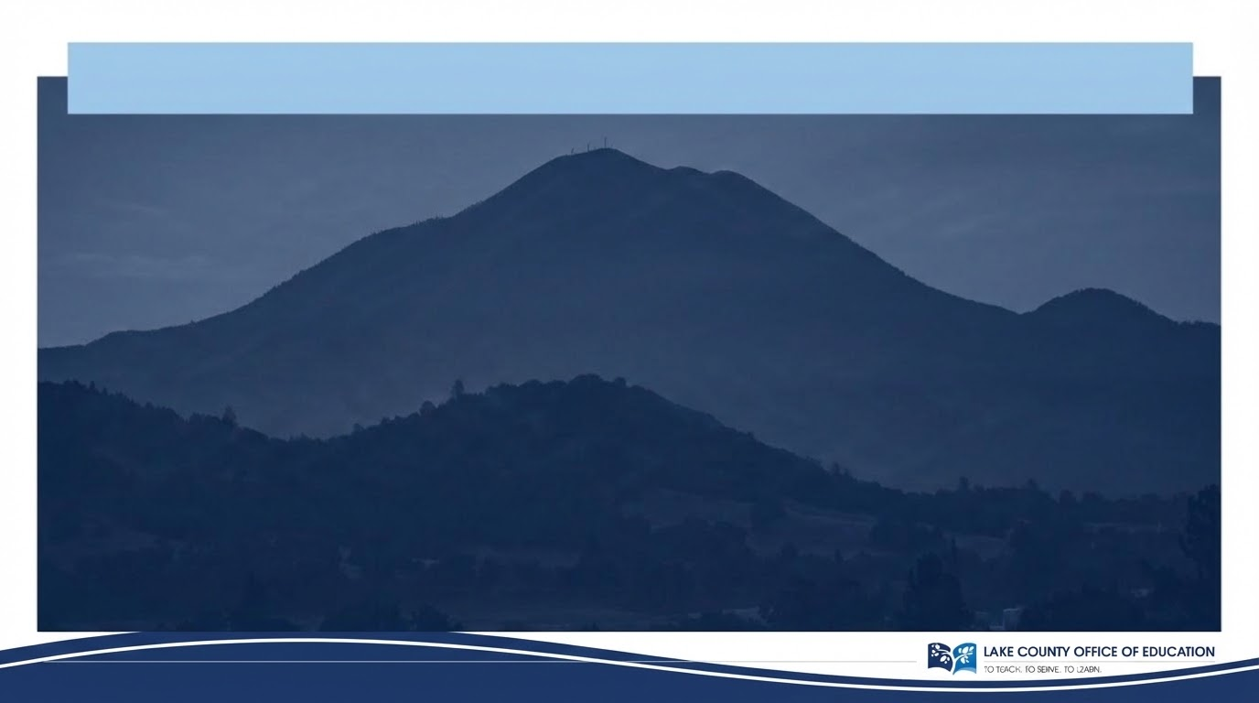
Imagine a Lake County where the best
is the loudest.
Let’s focus the narrative on positivity and growth, fully amplifying the hope, resilience, and strength already present in our community.

Slide 3
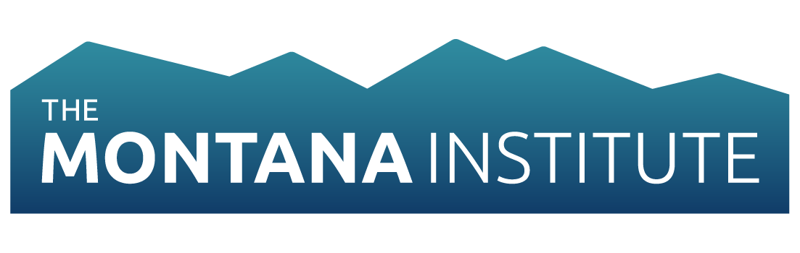
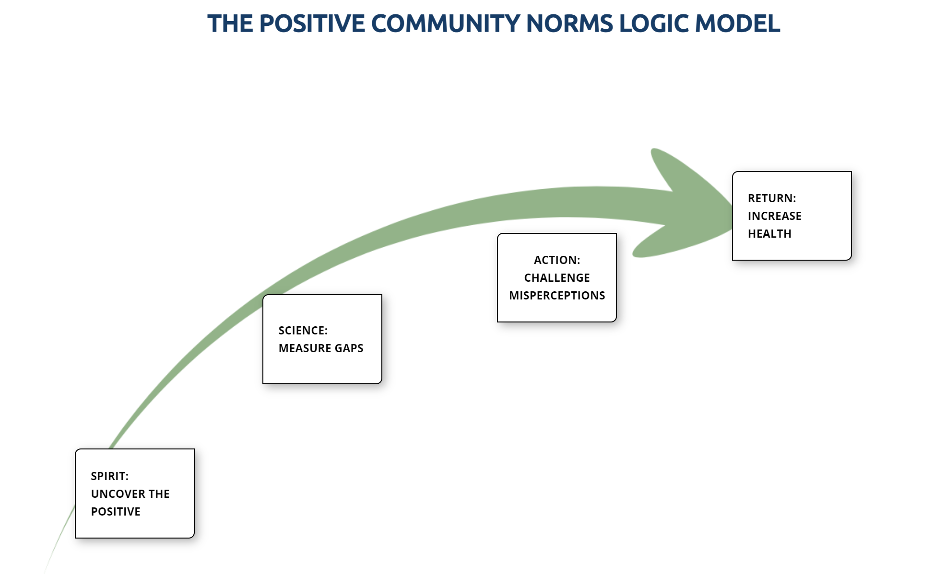
Positive Community Norms (PCN)
Social Norms Theory in Action
Peer Influence: Behavior is shaped by our perception of what others are doing.
Evidence-Based: Developed in collaboration with the renowned The Montana Institute.
Strength-Based: Shifts focus from "what is wrong" to "what is healthy and growing.”
https://www.montanainstitute.com/positive-community-norms

Slide 4





The PCN Solution: Reframing Reality
Identify Gaps
Publicize Truth
Behavior Aligns
Correct the "misperception" that negative behaviors are more common than they actually are.
Strategically identify and broadcast the positive majority norms that already exist in Lake County.
Encourage individuals to align with the positive majority, creating a self-reinforcing cycle of health.

Slide 5
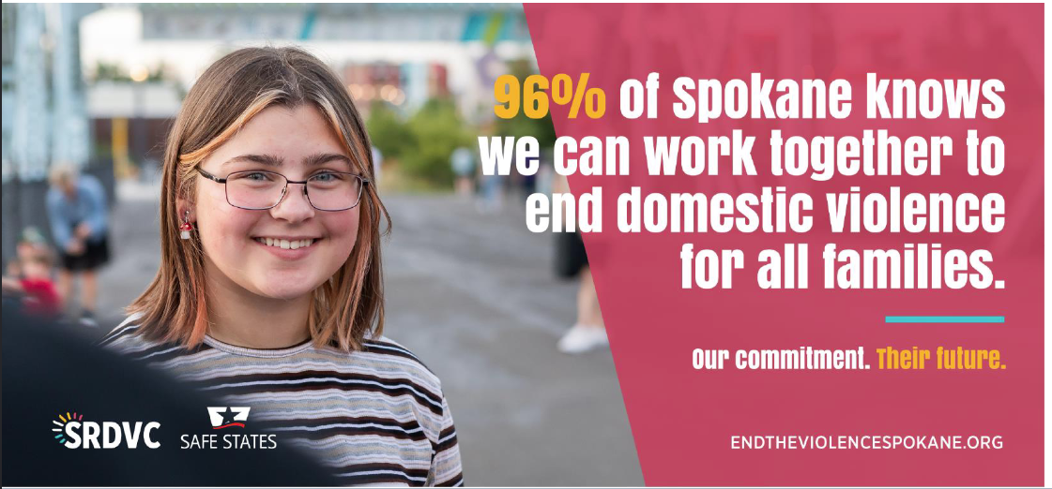
Reframing the Narrative

Slide 6
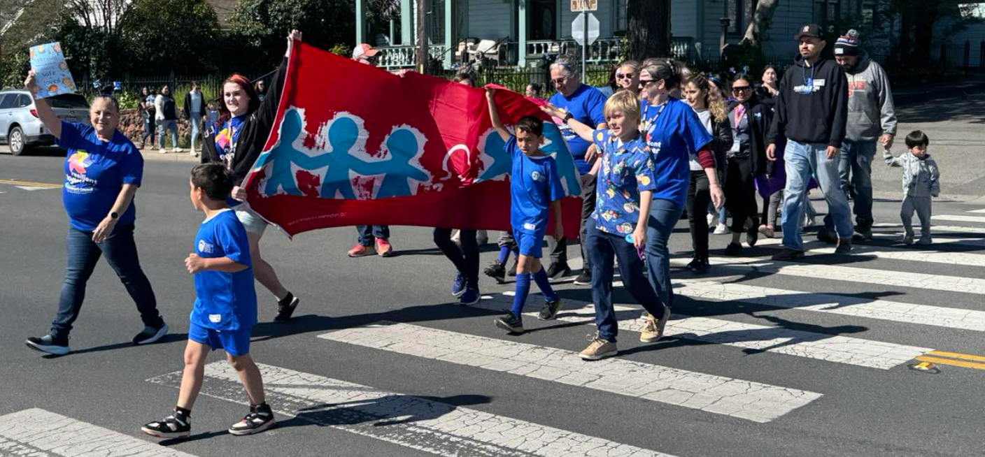
Strategic Focus #1: Supporting Neighbors
How people in Lake County help each other and stay involved in the community

Slide 7
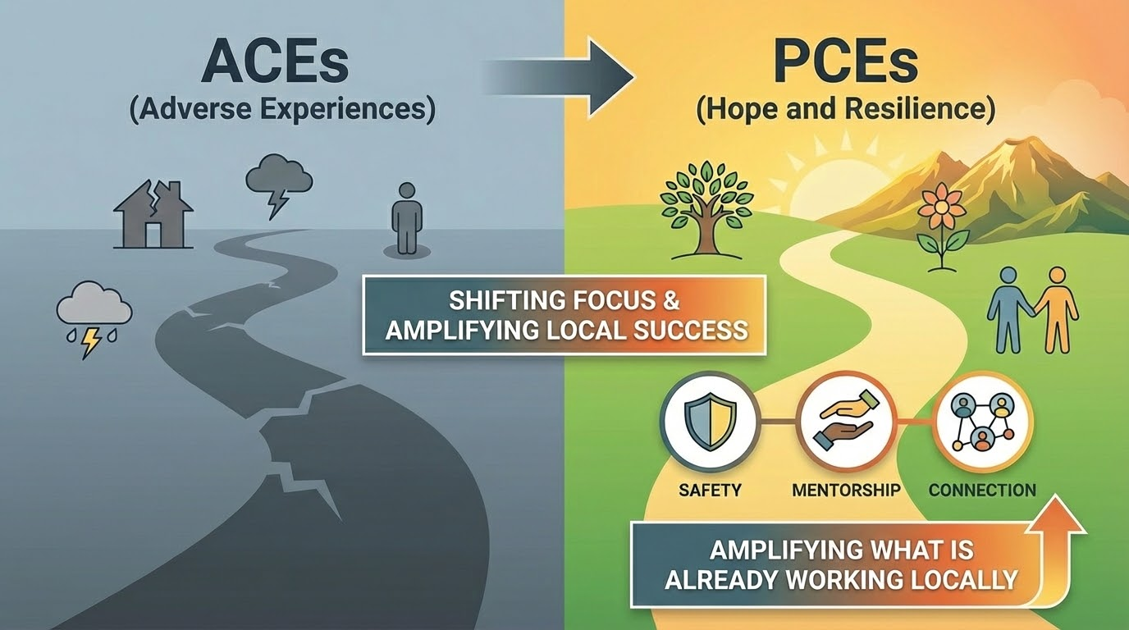
Strategic Focus #2: Hope (PCEs)

Slide 8

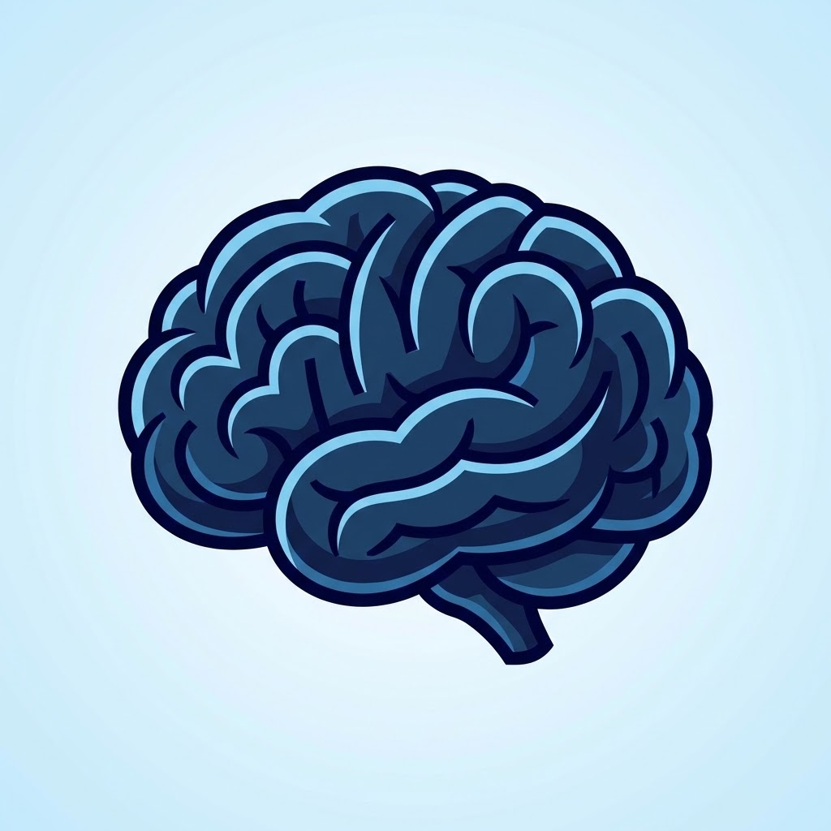

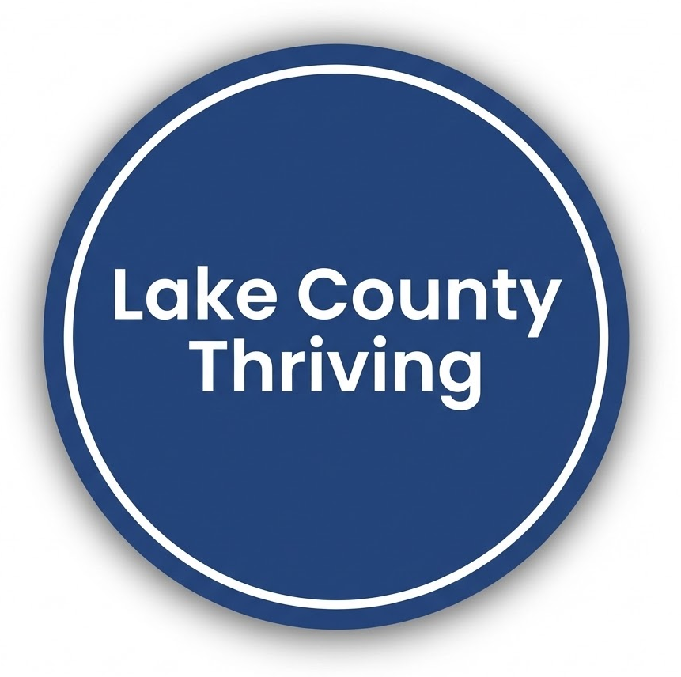
Community Dividends
Community Trust
Shifting from deficit to strength improves morale and fosters trust between residents and agencies.
Mental Health
Workforce Growth
PCEs build resilience and act as protective factors, making prevention cheaper than chronic treatment.
Attendance builds literacy and graduation rates, ensuring a skilled talent pool for local industries.

Slide 9
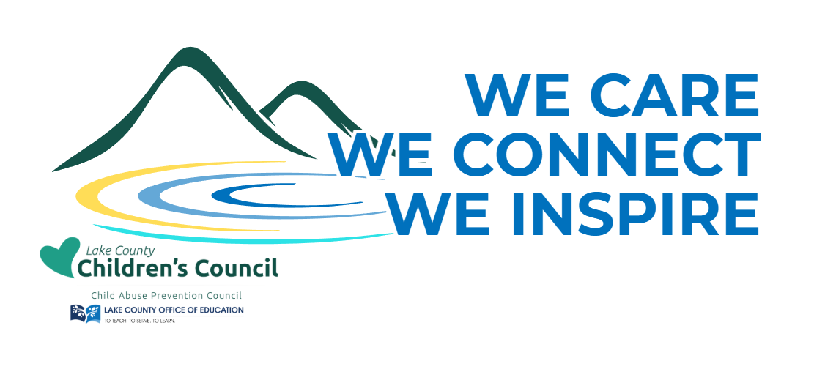

Slide 10
Roadmap
Winter 2026 Survey Development
Summer Survey Analysis
Spring 2025 Planning
Fall 2025 PCN Community Training
April Survey Opens
PCN Messaging

Slide 11
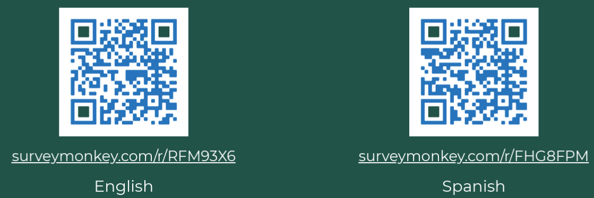
Let’s build a culture of hope together
Contact: Carly at cswatosh@lakecoe.org

