Slide 1
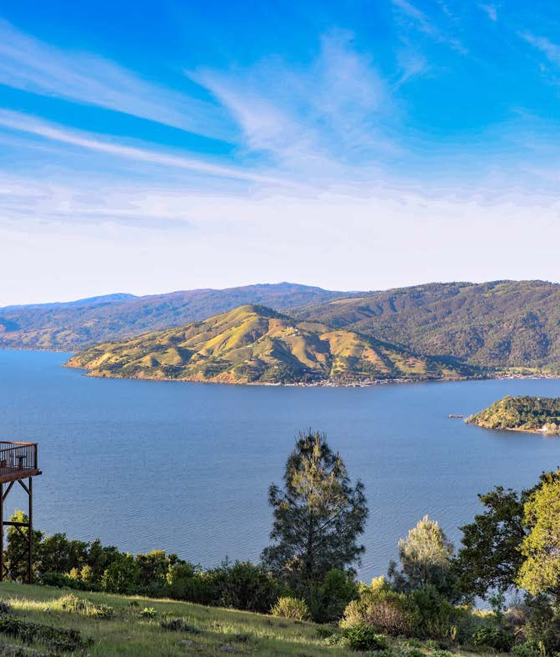
INAUGURAL PLAN
Capital Improvement Plans
FY 2026-27 through FY 2029-30
County of Lake CIP
Lake County Sanitation District (LACOSAN) CIP
Lake County Board of Supervisors
July 14, 2026
Benjamin Rickelman · Deputy County Administrative Officer
Notes:
Today's item is the County's and LACOSAN's first-ever Capital Improvement Plans, covering FY 2026-27 through FY 2029-30. It is one agenda item taken in two parts: part (a) the County CIP with your Board seated as the Board of Supervisors, and part (b) the LACOSAN CIP with your Board seated as the LACOSAN Board of Directors.

Slide 2


OVERVIEW
Two inaugural plans
County of Lake CIP
LACOSAN CIP
$215M identified need
$10.7M identified need
165 distinct projects across Public Works, Special Districts, and Water Resources
17 sanitation projects (11 LACOSAN + 6 shared with the County CIP)
Considered by your Board sitting as the Board of Supervisors
Considered by your Board sitting as the LACOSAN Board of Directors
Both are inaugural, multi-year planning documents — a baseline of capital needs to guide departments and pursue outside funding. They are not pre-approved expenditures; spending is decided annually through the budget process.
2
Notes:
The County CIP identifies roughly $216.1M across 164 distinct projects; the LACOSAN CIP identifies about $11.7M across 21 projects, nine of which also appear in the County's Utilities area. These are planning documents, not appropriations — every dollar is still decided through the annual budget process. The recommended action is to approve both plans.

Slide 3



COUNTY CIP
$216.1M across three functional areas
$116.9M
Transportation
Identified investment by fiscal year
54% of the plan: roads, bridges & airport
$67.8M
Facilities
Buildings, parks & landfill
$30.3M
Utilities
Special Districts water & wastewater
FOUR-YEAR TOTAL
$215M
165 projects · Public Works, Special Districts & Water Resources
3
Notes:
The County CIP is organized into three functional areas. Transportation is the largest at $116.9M (about 54% of the plan), followed by Facilities at $67.8M and Utilities at $31.4M. By year, FY 26-27 and FY 29-30 carry the heaviest planned investment; the dip in the middle years reflects current project timing and will shift as the plan is updated annually.

Slide 4

COUNTY CIP
Where the largest dollars go
Transportation $116.9M
Facilities $67.8M
Roads
Integrated Waste Mgmt
$20.3M
60.2% · $70.4M
Parks
$15.7M
Bridges
Health & Social Services
$7.3M
38.1% · $44.5M
Public Safety
$7.7M
Airport
1.7% · $2.0M
Water Resources
$6.2M
Soda Bay Rd + South Main St corridors total ~$36M combined
Armory → Sheriff's Administration
$10M adaptive reuse — the only project with secured multi-year financing (the County's first bond issuance + Federal funds).
4
Notes:
Within Transportation, roads are 60% and bridges 38%, reflecting the age of the County's rural bridge inventory; the Soda Bay Road and South Main Street corridors alone total about $36M. On the Facilities side, integrated waste management and parks are the largest categories. The Armory adaptive reuse is the plan's signature project and the only one with secured multi-year financing — the County's first bond issuance paired with Federal funds.

Slide 5
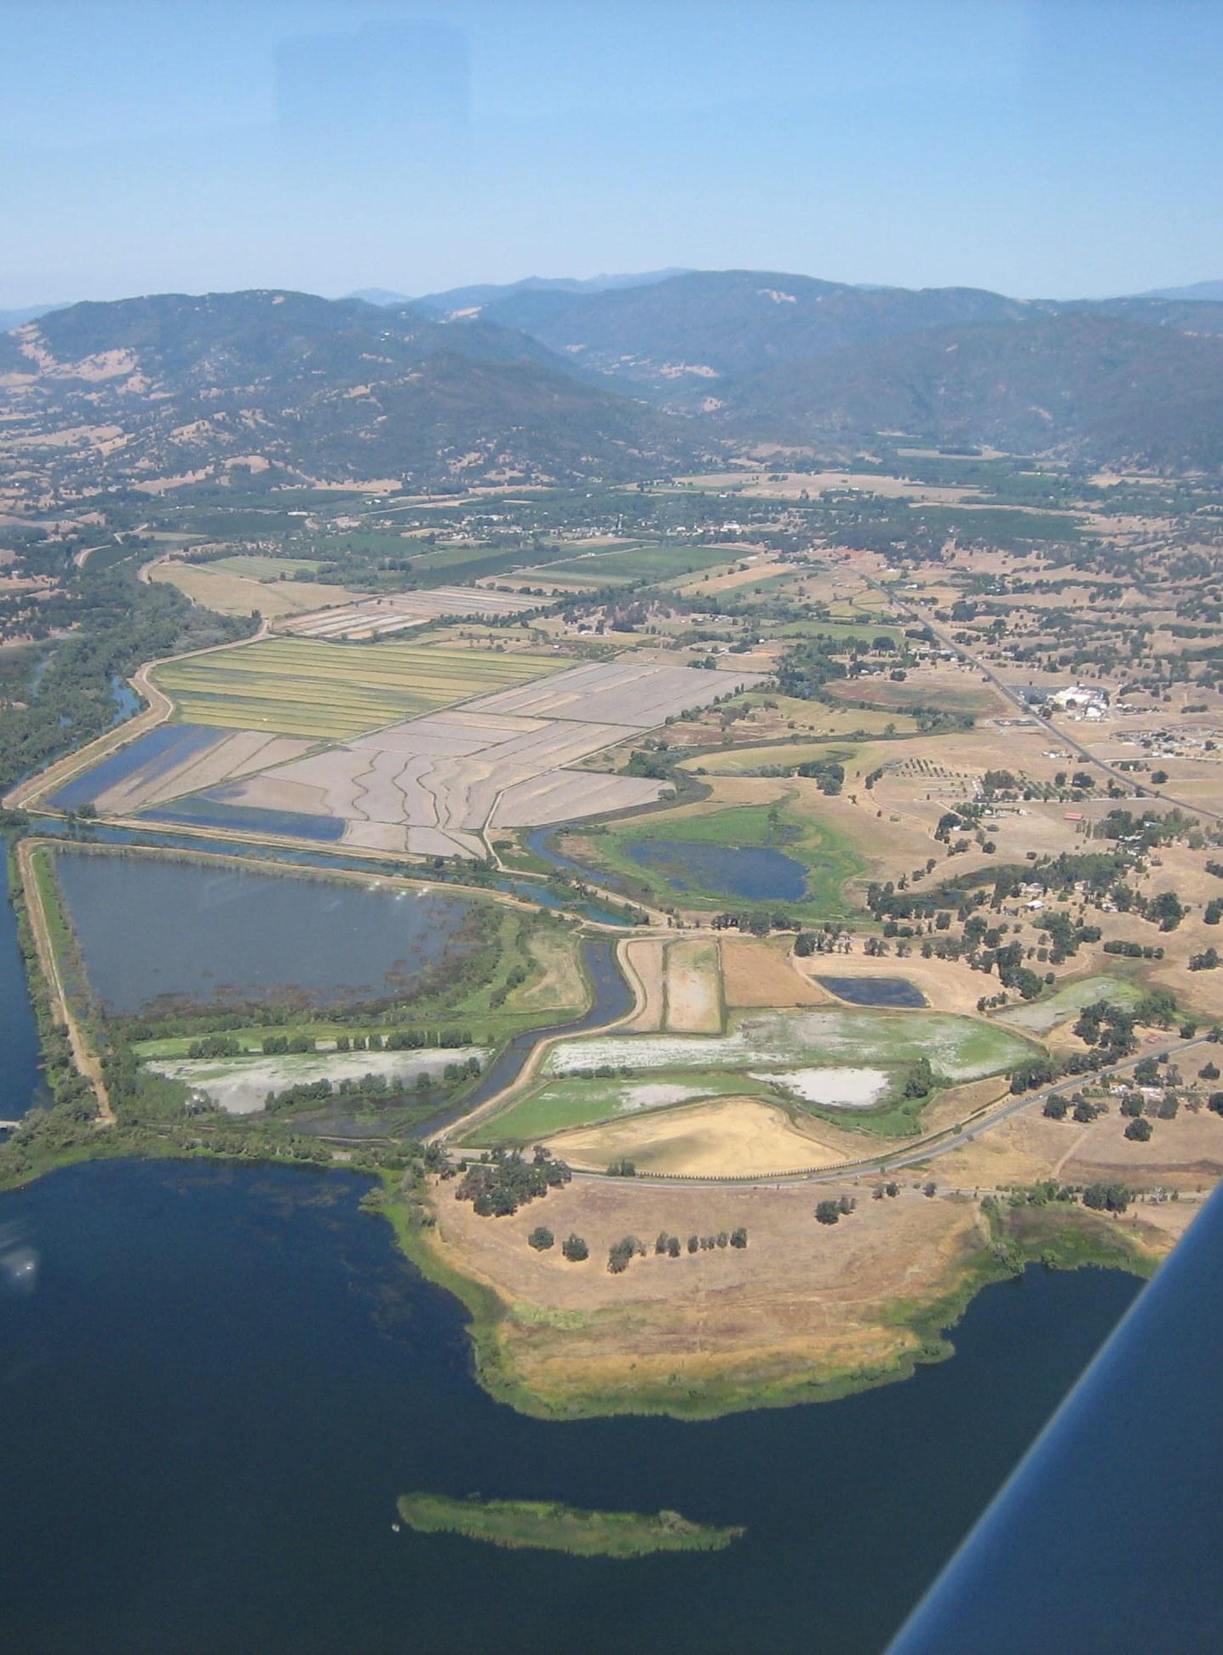

COUNTY CIP
Investment reaches every supervisorial district
Combined four-year planned spending by district
District 4
32.8%
$70.8M
District 3
23.0%
$49.7M
District 5
17.6%
$38.0M
District 1
14.0%
$30.2M
District 2
8.2%
$17.2M
District 4 leads at 32.9%
Multiple
4.4%
$9.1M
Reflects the density of County owned facilities in Lakeport plus the planned South Main / Soda Bay road and utility work.
5
Notes:
Investment reaches all five supervisorial districts. District 4 leads at about 33%, driven by the concentration of County-owned facilities in Lakeport plus the planned South Main and Soda Bay road and utility work. Districts 3 and 5 follow. A small share is countywide or spans multiple districts.

Slide 6
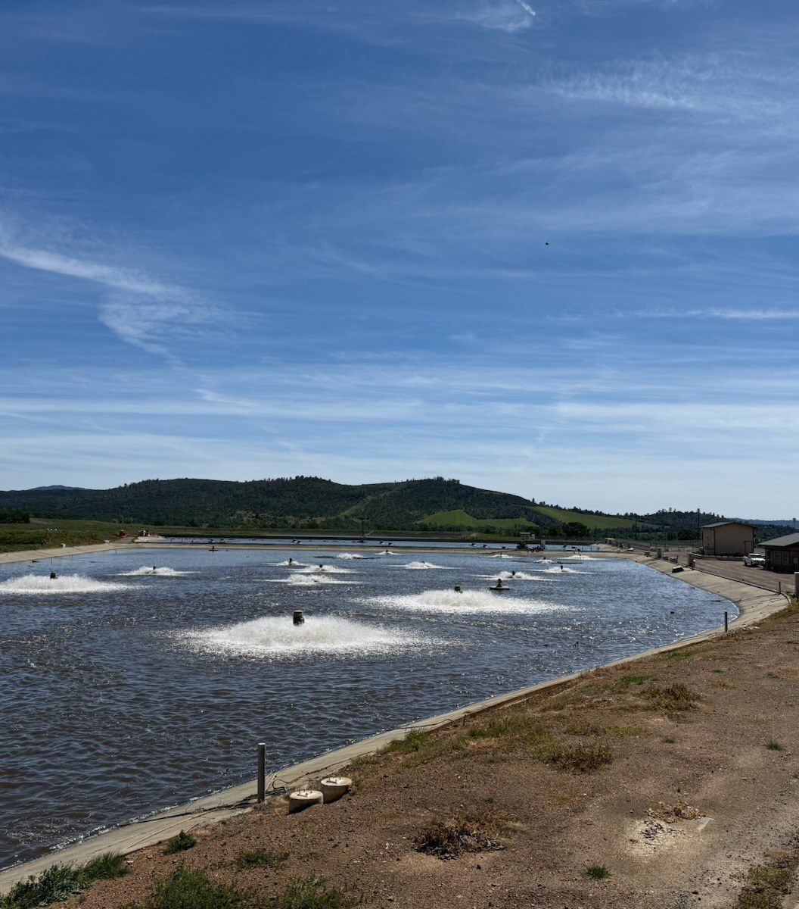
LACOSAN CIP
The County's public wastewater enterprise
A separate legal entity from the County, governed by the Board of Supervisors sitting as its Board of Directors and operated by Lake County Special Districts. LACOSAN maintains no staff of its own.
5
~11,000
wastewater systems
service connections
~90 mi
30+ yrs
gravity collection main
age of much of the system
$10.7M · 17 Projects
Rehabilitating aging lines, lift stations & treatment facilities is the central capital driver.
6
Notes:
Switching to part (b): your Board now sits as the LACOSAN Board of Directors. LACOSAN is the County's wastewater enterprise — a separate legal entity operated by Special Districts with no staff of its own. It runs six systems serving about 11,000 connections over roughly 90 miles of collection main, much of it 30-plus years old, which is why rehabilitation of lines, lift stations and treatment facilities drives the $11.7M, 21-project plan.

Slide 7
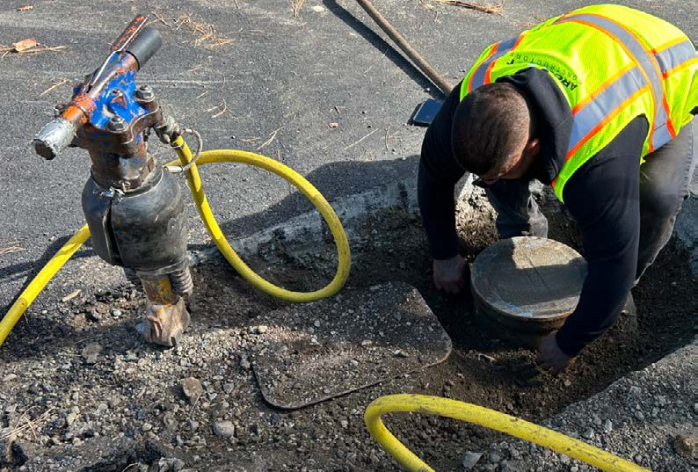
LACOSAN CIP
Largest LACOSAN investments
Top projects by estimated cost (FY 2026-27 – FY 2029-30)
Middletown WWTP — gate structure rehab
$2.00M
SE sewer lift station — Bay Street area
$1.90M
SE collection system pipe replacement
$1.67M
SE Treatment Plant — LS #2 bypass
$1.00M
SE Treatment — Vallejo lift station
$0.90M
Southeast Regional drives the need
Pumper truck — countywide
$0.59M
Wastewater model update
$0.53M
Pipe, lift-station and treatment work in the SE system, plus Middletown's gate rehab, anchor the plan — with fleet, software and a countywide wastewater model rounding it out.
Special Districts software system
$0.46M
7
Notes:
The largest LACOSAN investments cluster in the Southeast Regional system — collection-pipe replacement, the Bay Street lift station, the LS #2 bypass and the Vallejo lift station — plus the Middletown treatment plant gate rehab at $2M. Equipment and countywide items such as the Special Districts software system, a pumper truck and a wastewater model update round out the plan.

Slide 8




FUNDING & NEXT STEPS
How it's funded — and the annual cycle ahead
Transportation
Facilities
Utilities & LACOSAN
State & federal funds (STP, HSIP) plus local road funds.
County General Fund + state/federal grants; landfill via the solid waste enterprise fund.
District service revenues from ratepayers; grants actively pursued for larger projects.
THE ANNUAL CIP PROCESS GOING FORWARD
1
2
3
4
›
›
›
December (prior year)
Early spring
Recommended Budget
Final Budget
Departments submit projects on a rolling five-year horizon.
List is refined — enabling a strong Community Facilities list for Congress.
Refined CIP is incorporated into the County's recommended budget.
CIP is adopted alongside the final budget.
8
Notes:
Funding varies by area: Transportation leans on STP/HSIP and local road funds; Facilities on the General Fund and grants, with the landfill on its enterprise fund; Utilities and LACOSAN on district ratepayer revenues plus grants we are actively pursuing. Going forward this becomes an annual cycle: departments submit a rolling five-year project list each December, the list is refined in early spring — which also gives us a strong Community Facilities List for Congress — and the refined CIP then flows into the recommended budget and is adopted with the final budget. The recommended action is to approve both plans.

Slide 9
INAUGURAL PLAN
Capital Improvement Plans
FY 2026-27 through FY 2029-30
County of Lake CIP
Lake County Sanitation District (LACOSAN) CIP
Lake County Board of Supervisors
July 14, 2026
Benjamin Rickelman · Deputy County Administrative Officer
Notes:
Today's item is the County's and LACOSAN's first-ever Capital Improvement Plans, covering FY 2026-27 through FY 2029-30. It is one agenda item taken in two parts: part (a) the County CIP with your Board seated as the Board of Supervisors, and part (b) the LACOSAN CIP with your Board seated as the LACOSAN Board of Directors.

