Slide 1



Budget Recap and Discussion
FY 2025-2026

Slide 2
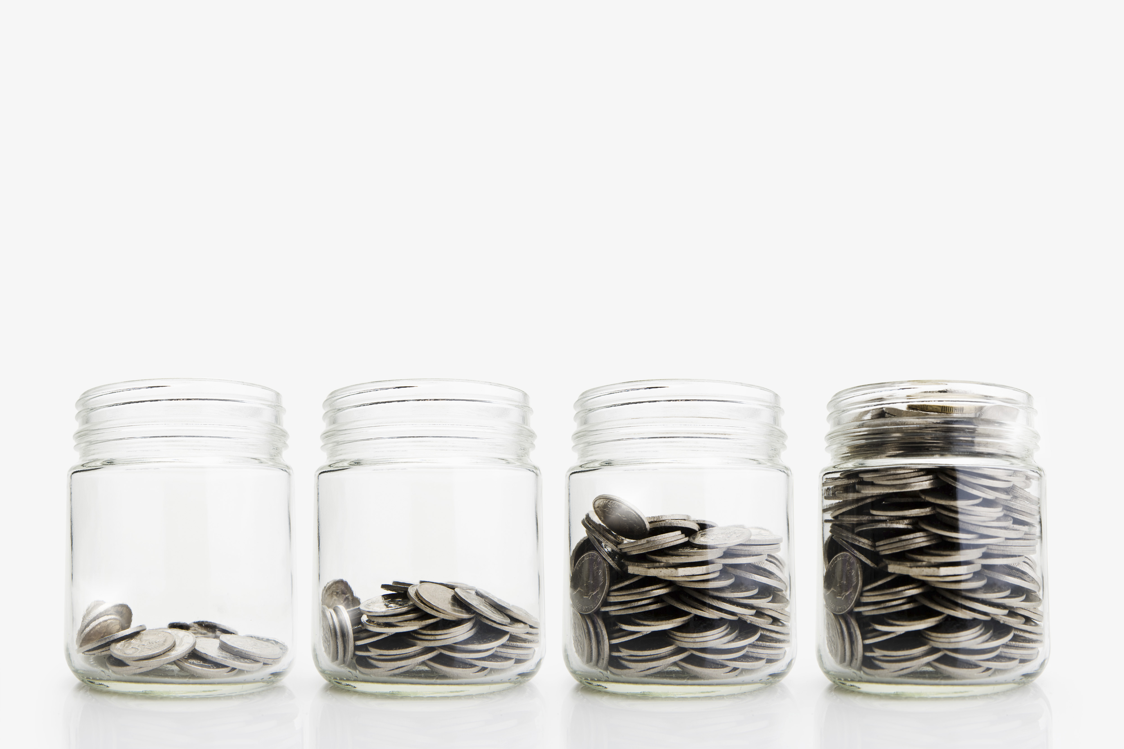
Summary of Changes
BU 1122 Treasurer Tax Collector
  Move $238,450 from Revenue account 10-50 to 31-95
BU 1671 Buildings & Grounds
  Decrease Building and Infrastructure Reserve Fund 153 by $282,000;
  Increase Appropriation account 18-00 by $282,000
BU 2301 Sheriff-Jail Facilities
  Increase revenue account 54-02 by $101,114
  Increase capital asset account 61-60 by $101,114
BU 7011 Parks
  Decrease General Parks Reserve Fund 152 by $400,000
  Create Capital Asset for Middletown Pool Enclosure in the amount of $100,000
  Increase capital asset 63-12 Hammond Park by $300,000

Slide 3

Summary of Changes
BU 1778 Capital Projects
  New Capital Asset Create Capital Asset 63-13 for Middletown Senior Center Solar in the amount of $260,000
Increases
  Increase Capital Asset 63-13 District Attorney Roof in the amount of $120,000
  Increase Capital Asset 63-13 Vista Point Roof in the amount of $90,000
  Increase Capital Asset 63-13 Law Library Roof in the amount of $60,000
  Increase Capital Asset 63-13 Veterans Services Roof in the amount of $60,000
Decreases
  Decrease Capital Asset 63-04 Water Line for South Main Street & Soda Bay Road by $465,796
  Decrease Capital Asset 63-13 Sheriff Admin Roof in the amount of $40,000
  Decrease Capital Asset 63-13 Agricultural Center Roof in the amount of $9,204
  Decrease Capital Asset 63-13 Sheriff Dispatch Roof in the amount of $75,000

Slide 4
Cannabis Tax Usage & Expenditure Policies and Procedures
 | Percentage Allocation after Fixed Amounts
 | Planning Code Enforcement Water Resources Environmental Health | Law Enforcement | Economic Development Housing Risk Reduction | Youth Programs
 | 30.00% | 30.00% | 30.00% | 10.00%
Balance as of July 1, 2025 | $ 1,549,674 | $ 1,352,848 | $ 2,641,237 | $ 335,114
Allocated | $ (1,493,482) | $ (957,997) | $ (170,723) | $ (333,552)
Unallocated | $ 56,192 | $ 394,851 | $ 2,470,514 | $ 1,562

Slide 5
Cannabis Tax Allocations
Planning, Code Enforcement, Water Resources, Environmental Health |  |  | Law Enforcement
Environmental Health-New Software | $ 42,024 |  | Sheriff-2 Deputies | $ 249,389
Water Resources-Quagga Muscles | $ 170,723 |  | Sheriff-1 Sargent | $ 203,006
Code Enforcement-COPTR Salaries | $ 181,465 |  | Sheriff-ALPR | $ 68,500
Code Enforcement-COPTR Expenses | $ 22,141 |  | Sheriff-COPTR Salaries | $ 437,102
Code Enforcement-1 Officer | $ 89,629
Water Resources-Hitch | $ 200,000 |  | Economic Development, Housing, Risk Reduction
Water Resources-Hitch Project (flow monitor installation) | $ 25,000 |  | Water Resources-Quagga Muscles | $ 170,723
Water Resources-Lakebed Abatements and Salvage | $ 100,000
Water Resources-Match for BRC Grants | $ 100,000 |  | Youth Programs
Water Resources-Match for USACE-Middle Creek Restoration | $ 562,500 |  | Library Staff Time | $ 333,552

Slide 6
Proposed Cannabis Tax Allocations for Final Recommended Budget
Economic Development, Housing, Risk Reduction
Economic Development
Capitalization of a revolving fund for a fee deferral program for qualifying commercial and industrial developments | $ 900,000
Design and production for retail and hospitality attraction | $ 40,000
Retail analytics and site selection software contract | $ 50,000
Supplemental funding for CDBG facade improvements initiative | $ 100,000
Travel for ICSC, IEDC, and hospitality events | $ 20,000
Housing
ProHousing Designation | $ 150,000
Consultant for ProHousing Designation | $ 150,000
Consultant for Housing Rehab Program | $ 150,000
Consultant and Funds for Development Incentive Program | $ 200,000
Housing Department Staff | $ 700,000
Housing Related Training | $ 20,000
Total | $ 2,480,000

Slide 7
Community Oriented Policing & Targeted Restoration
(COPTR)
Budget Status
 | Spent in FY 24/25 | Budgeted in FY 25/26
Code Enforcement
Salary | $108,972 | $181,465
Supplies | $6,632 | $22,141
Nuisance Abatement | $118,625 | $131,375
Sheriff
Salary | 393,104 | $437,102
Total | $627,333 | $772,083

Slide 8
Pension Stabilization Reserve
Established to make up for revenue shortfalls in paying for the County’s share of PERS
Since December of 2021, the funds were invested in the market able to accrue interest
Recommendation: Leave funds in the market until they are needed

Slide 9
Water Line for South Main Street & Soda Bay Road
Established in FY 14/15 using General Fund dollars
Balance has fluctuated throughout the years as additional funding has become available
It has also decreased as funds were needed for existing projects
Recommendation: move funds to other General Fund projects
Notes:
Original amount of $1,704,745

Slide 10
BU 1892
Marketing & Economic Development
Discussion on 1 Team 1 Dream
  $50,000 currently budgeted
Discussion on the Lake County Chamber of Commerce
  Currently not budgeted
  Request from the chamber to contribute
Recommendation: Any changes decided on today can be made during the Final Recommended Budget hearing

Slide 11
Unfunded Allocations for Discussion
$50,000 for BU 2113 Victim Witness
Previously anticipated decrease in federal funds for VOCA funding
The State Budget included one-time General Fund support
$50,000 for the purpose of a solution to veterans experiencing homelessness
Staff recommends discussing next steps with Social Services

Slide 12
Extraordinary Budget Requests from Departments
Budget Name | Amount Requested
Registrar of Voters (BU 1451) | $66,806
Probation (BU 2302) | $210,599
Animal Control (BU 2703) | $30,000
Lampson Field Cap. Imp. (BU 3121) | $274,115
Sheriff-Jail Facilities (BU 2302) | $3,820,800
Parks and Recreation (BU 7011) | $399,312
Museums (BU 7201) | $4,841,080
Total Requested | $9,642,712

Slide 13
Budget Unit | Request | Amount
BU 1451 | Salary from half time permanent position | $66,806
BU 2302 | Solar Back-up Battery | $210,599
BU 2703 | Surveillance Cameras | $30,000
BU 3123 | Wildlife Hazard Assessment (Grant Pending) | $135,000
BU 3123 | East Apron Pavement Rehabilitate Apron - Design | $73,039
BU 3123 | East Apron Pavement Rehabilitate Apron - Design (Phase #2) | $66,076
BU 2301 | Smoke Detector and Fire Alarm System | $300,000
BU 2301 | HVAC Control System | $50,000
BU 2301 | Jail Phase 1 Roof | $2,800,000
BU 2301 | Portable Radios | $145,800
BU 2301 | Security Camera System | $525,000

Slide 14
Budget Unit | Request | Amount
BU 7011 | Lucerne Community Garden Park | $50,000
BU 7011 | Nice Clubhouse | $200,000
BU 7011 | Mount Konocti Park | $149,312
BU 7201 | Lower Lake Schoolhouse Museum Historic Restoration and Seismic Retrofit | $2,300,000
BU 7201 | Courthouse Museum Historic Restoration | $2,500,000
BU 7201 | Inventory as needed for Exhibits and Museum Operations | $10,000
BU 7201 | Exhibit Preservation and Collection | $15,000
BU 7201 | Extra Help Office Manager | $16,080

Slide 15

Veterinarian Position
A salary bench was attempted by Human Resources
Unsuccessful due to most counties contracting services out
Shortage of licensed Veterinarians both locally and regionally
Discussion on increased rate of pay
Recommendation: wait until the new director is hired

Slide 16

Other Topics Mentioned During Budget Hearings
Department Transfers
  Attachment to this board item
Lake Family Resource Center Annual Report
  Will be presented at a future date
Cooling & Warming Centers
  Will be discussed at a future date

Slide 17

Thank You
z

