Slide 1

2025-2026
Budget Hearing
June 24 & 25, 2025

Slide 2
Budget Units
Street Light Districts (9 Districts – Anderson Springs; Clearlake Oaks; Clearlake Keys; Glenhaven; Lucerne, Kelseyville; Lower Lake; Middletown; Upper Lake)
Wastewater Districts (4 Plants – Northwest; Kelseyville; Middletown; Southeast)
Water Districts (6 Districts – Kono Tayee; North Lakeport; Spring Valley; Kelseyville; Finley; Soda Bay)
Does not include project roll over budgets which will be part of the Final Budget.
Total Special District Budget is $24,665,000 and CIP $1,103,000 new $25,768,000
Base budget
2 new FTEs – Analyst for Financial tracking; Rate Studies, Project Accounting etc.

Slide 3
Budget Units Reserves
Operation and Maintenance Reserves: Like to have 50% in reserve.
Capacity Reserves: These funds are specific to system improvements that are related to capacity such as lift station upgrades. Expansion type projects.
Capital Improvement Project (CIP) Reserves: For capital projects which can be line replacements, headworks repair, wear items that are projects that extend the useful life of the system. Outside routine, recurring and usual expenses.

Slide 4
Current Project Status
I&I Reduction Countywide Grant
Total Funding: $1,800,000 Total Project: $2,006,000 ($206,000)
Remaining: $1,100,000 Grant
Current: SL-RATs Purchase and Repair ($115k); Dog Bowl Purchase ($250k); Season Crew ($216k) Working on Smoke Testing, Capping, Manhole inspections, SL-RAT and Cleaning. Pipelining in Kelseyville; Lift Station Lining in Paradise Cove.
Remaining: Requesting extension 12/31/26, reallocation of funds – July

Slide 5
Current Project Status
SCADA Updates Countywide
Total Funding: $655,000 design
This will be a new project and will return with the CIP presentation. This project will review all existing systems and determine the best option for a fully integrated countywide SCADA system. This will need to be off the County network and will be a stand-alone network accessible remotely by all Utility Areas.

Slide 6
Current Project Status
Water Model and Capacity Improvement Needs
Total Funding: $100,000 ARPA
ETA – Fall/Winter 2025

Slide 7
Current Project Status
Wastewater Model and Capacity Improvement Needs
Total Funding: $100,000 ARPA
Expect the SE plant to be at capacity with potential connection moratorium
Sealed LS#4; LS#1 and 2 sealing/wet well repairs in design; Rerouted LS#19 (Meadowbrook); Cleaned lines in the State Park; Solved I&I on 36th Ave. and Trailer Park off Dam Road that had burned but was not cut and capped.

Slide 8
Current Project Status
Kelseyville Tertiary Treatment Plant Study
Total Funding: $300,000 ARPA
Remaining: Contract was awarded, engineers are working on the study. Expect to have draft for review this summer.

Slide 9
Current Project Status
Full Circle Effluent Pipeline Design
Total Funding: $320,000
Design contract was awarded and they have been working on pipeline locations and should have the design completed this summer or fall.

Slide 10
Current Project Status
Redwood Tank Replacement (Phase 2 – Tank 3 and 4)
Total Grant Funding: $600,000 Total Project: $800,000
Expended: Phase I was completed.; Design for Tank 3 and 4
Remaining: Bid and construction
Current: Funding expires: 3/17/26
Engineers are completing the bid package to be awarded over the summer of 2025.

Slide 11
Current Project Status
Live Oak Drive Water Line Replacement
Total Funding: $329,000
Remaining: Design funding awarded and complete. Should go to bid this summer.

Slide 12
Current Project Status
Sewage Dump Station at Southeast
Total Funding: $160,000
Remaining: Design is being completed with the NW Station. All materials have been purchased.
Completed: December 2025

Slide 13
Current Project Status
Southeast Headworks Realignment
Total Funding: $200,000
Remaining: This will begin with the new budget. The headworks has multiple pipes coming in at the same location. The smaller pipes can’t overcome the large pipes when they kick on which causes the smaller lines to backup until the large pipe shuts off or reduces enough for the small pipes to overcome. This project will separate the lines and allow each to dump into the headworks without being impacted by other pipe flows.

Slide 14
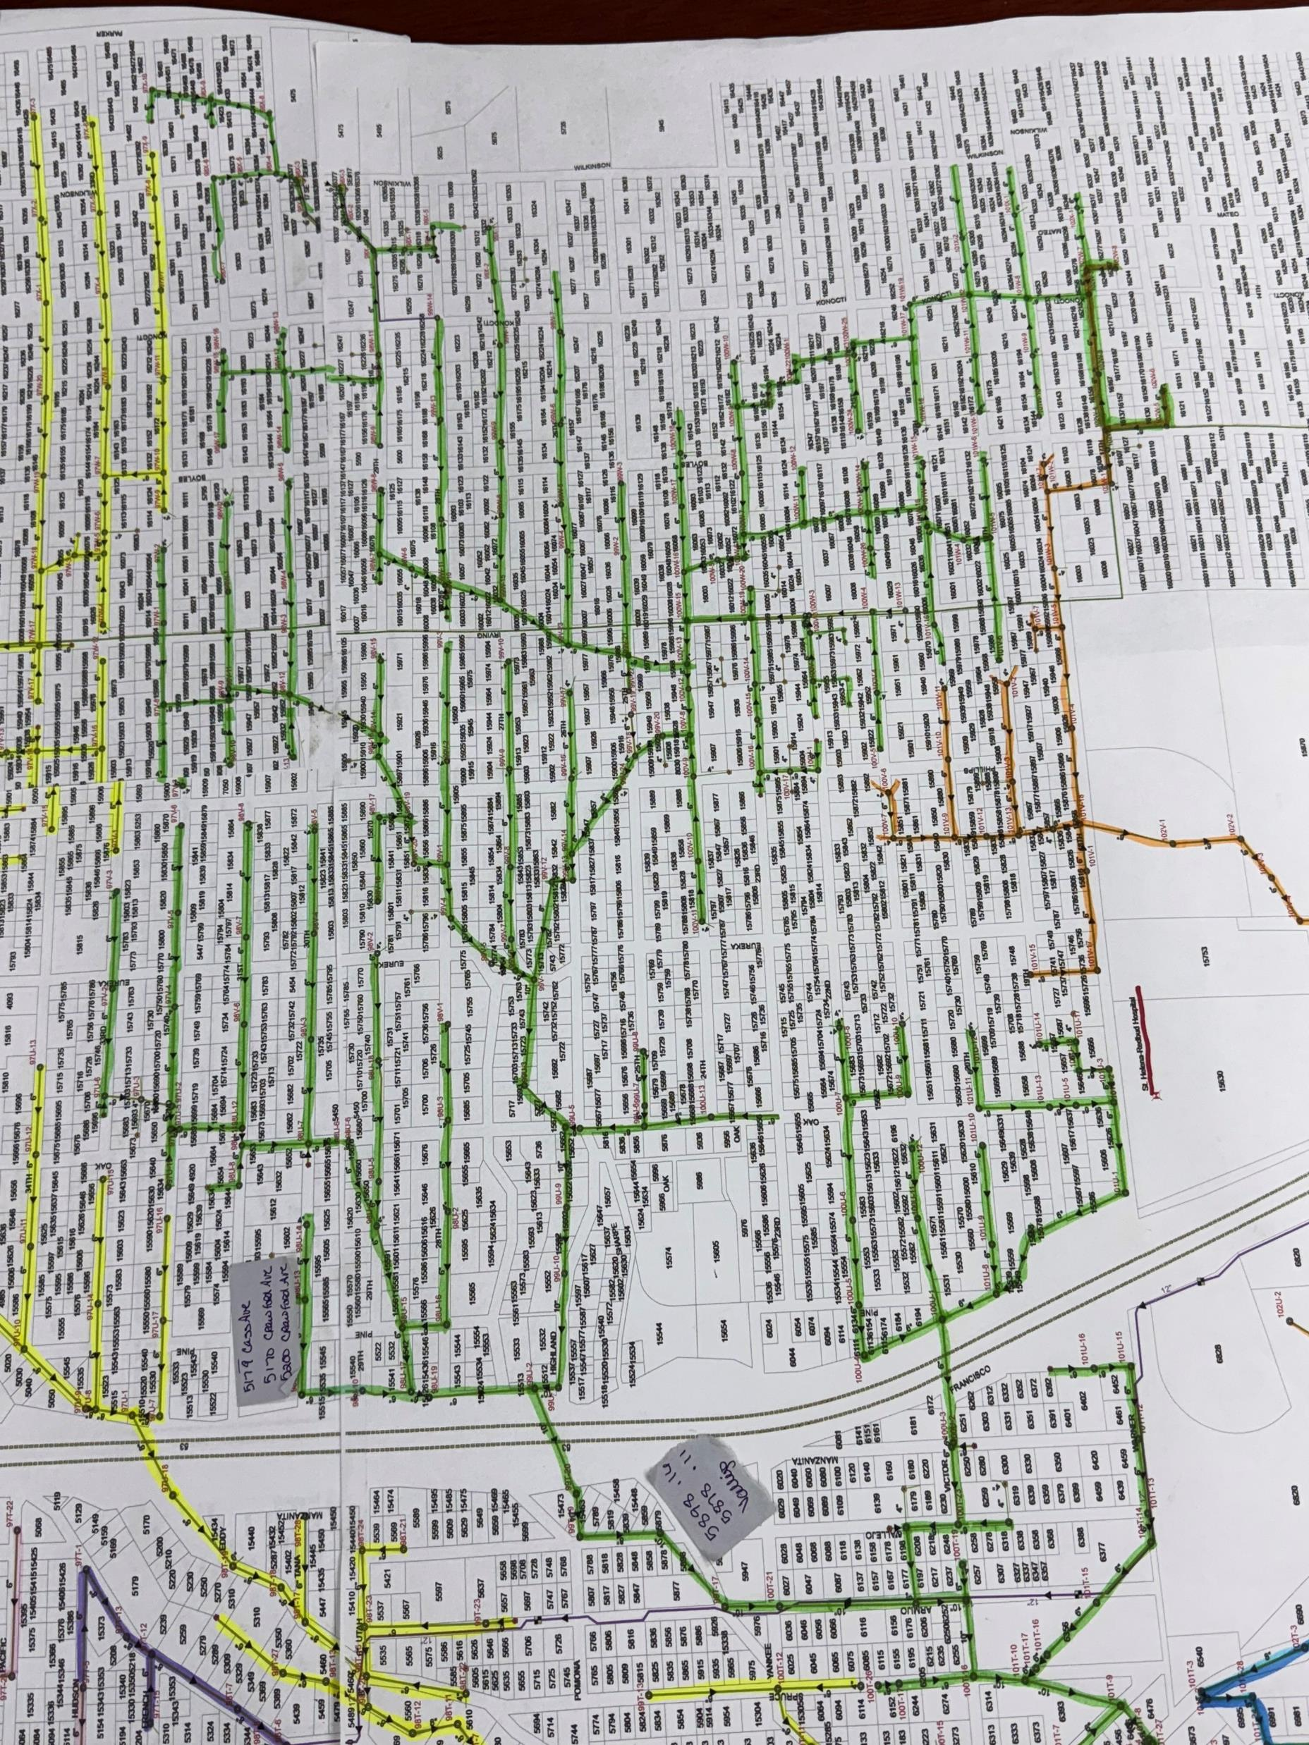
Vallejo Lift Station
Property Closing by December 2025
Capture the green flow lines at Vallejo
The Sewer Lines bisect the Lots
Connect to the Force Main
Odor controls will be installed

Slide 15
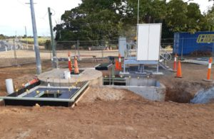
Highlands Metering Station
  Allows flows to be metered or the station pumped
  Off-street location with enough space to loop around with trucks if needed
  Currently lots experience dumping and encampments
  The site will be fenced and secured with odor controls installed
  Property purchase expected to be completed by December 2025

Slide 16
Current Project Status
Water Line for Soda Bay Road to South Main Street and Fire Hydrant
Total Funding: $2,000,000
Expended: $0
Remaining: Engineers are reviewing that we have so far on the project. Feasibility study or design/environmental documents and determining next steps. Looks like we will need to tie in at Finley. Finley well use as a Fire filling station.

Slide 17
Current Project Status
Sewage Dump Station at Northwest
Total Funding: $400,000 ARPA
Design is 90-95% design; Construction this Summer/Fall

Slide 18
Current Project Status
North Lakeport Water Tanks at Grandview
Total Funding: Looking for funding to add 2 – 500,000 gallon tanks next to our existing tanks plus add a chlorine station to help with our residuals.
Remaining: Property expected to close by December 31, 2025.

Slide 19
Current Project Status
Wells – North Lakeport (2) and Spring Valley
Total Funding: $2,380,500
Remaining: $450,000 Spring Valley; $1,154,000 for 2 North Lakeport (Test well drilling has been accounted). Remaining funding is to retrofit the wells and put them online into the respective systems.
Spring Valley – 300 gpm; test water samples and preparing bids for production well installation (pump, chlorine, etc.)
North Lakeport – Test well drilling will start 6/24/25 at the water plant and move to Crystal Lake Way next. Sale of Crystal Lake Way has been completed for a cost of $87,747.05

Slide 20
Current Project Status
Distribution Study for Spring Valley (Pressure)
Total Funding: $387,000
Remaining: Engineering contract was awarded, and they have provided options. We are reviewing the best location for a pressure tank and possible zones to improve the overall pressure of the system and eliminating the areas with very high pressure.
Construction funding is in the process with the State Water Resource Control Board.

Slide 21
Current Project Status
Spring Valley Community Center Parking Lot Pavement
Total Funding: $199,000
Just received the grant agreement. Will be working on design and bid documents in this coming FY and construction in 2026.

Slide 22
Current Project Status
Other Capital Projects that will come back with the CIP include:
Meter Reading Pilot
Generator for Spring Valley Water Plant/Community Center
Security Cameras in North Lakeport
Kono Tayee Tank upgrades and Well #2 upgrades; asphalt resealing at Tank #1
GAC replacement North Lakeport
SE Treatment Plant Headworks Screen Rebuild

Slide 23
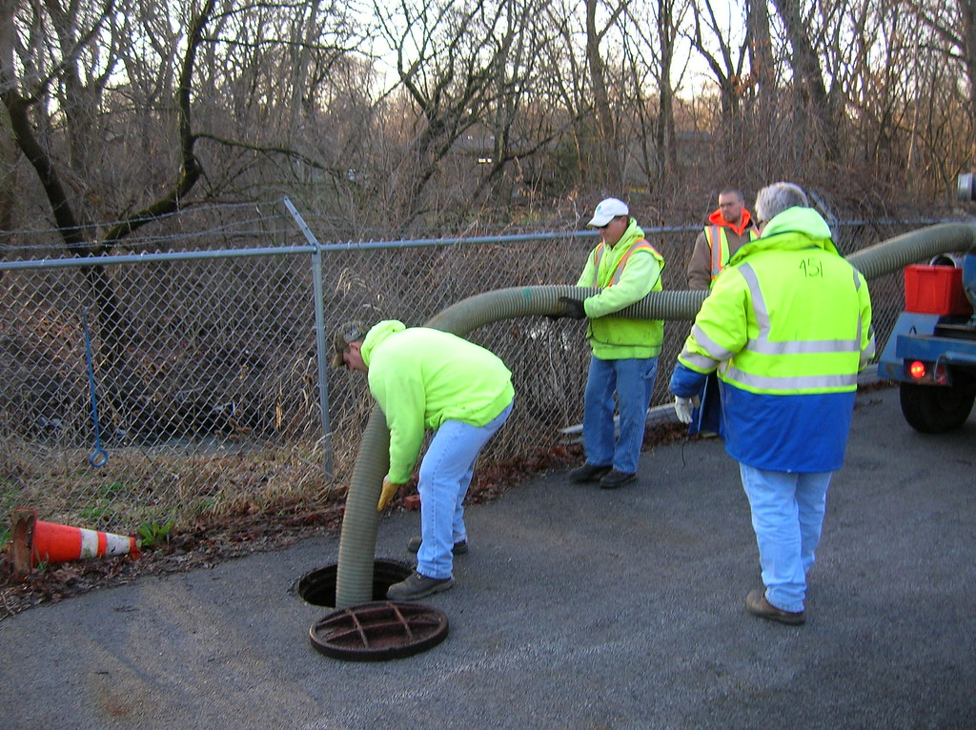
Rate Studies and Consolidations
Received RFP back and will award in July/August 2025
User Fees
Lands End
Corithian Bay
LACOSAN SE
Kono Tayee
Consolidations – Finley/Kelseyville Water; Corithian Bay, Lands End and Kelseyville Sewer; Clearlake Oaks and Clearlake Keys Lighting. Applied for funding for Soda Bay, Kelseyville, Finley and possible other private water systems in Soda Bay due to PFAs for water and wastewater feasibility.

Slide 24
Thank you
Robin Borre
Lake County Special Districts Administrator

