Slide 1
Lake County Wildfire Preparedness and Evacuation Plan
Project Recap
Lake County Board of Supervisors
October 21, 2025

Slide 2
Project Purpose and Objectives
Identify and Mitigate Risk
Develop Communication Procedures
Finalize Evacuation Routes
Establish Coordination Protocols
This project will prepare a Wildfire Evacuation and Preparedness Plan for Lake County. Given the frequency of several catastrophic wildfire events in recent years, the Plan is intended to coordinate evacuations and other activities to standardize future response protocols for probable wildfires. It will also inform community members of practices and procedures to better prepare for future events, helping facilitate orderly evacuations.

Slide 3
Technical Advisory Group
STAKEHOLDERS
Lake APC County of Lake Supervisor Board member County Department of Public Works County Community Development City of Clearlake Council member Dept of Public Works Community Development City of Lakeport Council member Dept of Public Works Community Development Sheriff Auditor's Office
Cal OES CalFire Caltrans Redwood Coast Regional Center California Highway Patrol
STAKEHOLDERS
Big Valley Band of Pomo Indians (Lakeport ) Elem Indian Colony of Pomo Indians (Clearlake Oaks) Habematolel Pomo of Upper Lake Koi Nation of Northern California Middletown Rancheria of Pomo Indians Robinson Rancheria of Pomo Indians (Nice) Scotts Valley Band of Pomo Indians (Lakeport)
Sheriff’s Office/OES
Local Fire Councils/Agencies Lake County Fire Protection District
EOC Ops - County Department of Social Services American Red Cross
Lake Transit Authority Private Sector Transportation Representatives
STAKEHOLDERS
Easter Seals Northern California Bayberry. Inc. Lake County Mental Health Services Area Agency on Aging School Representatives Hospital Representatives Senior Centers Highlands Senior Service Center Lakeport Senior Center, Inc. Live Oak Seniors Middletown Senior Center Redwood Coast Regional Center COAD
Public Works

Slide 4
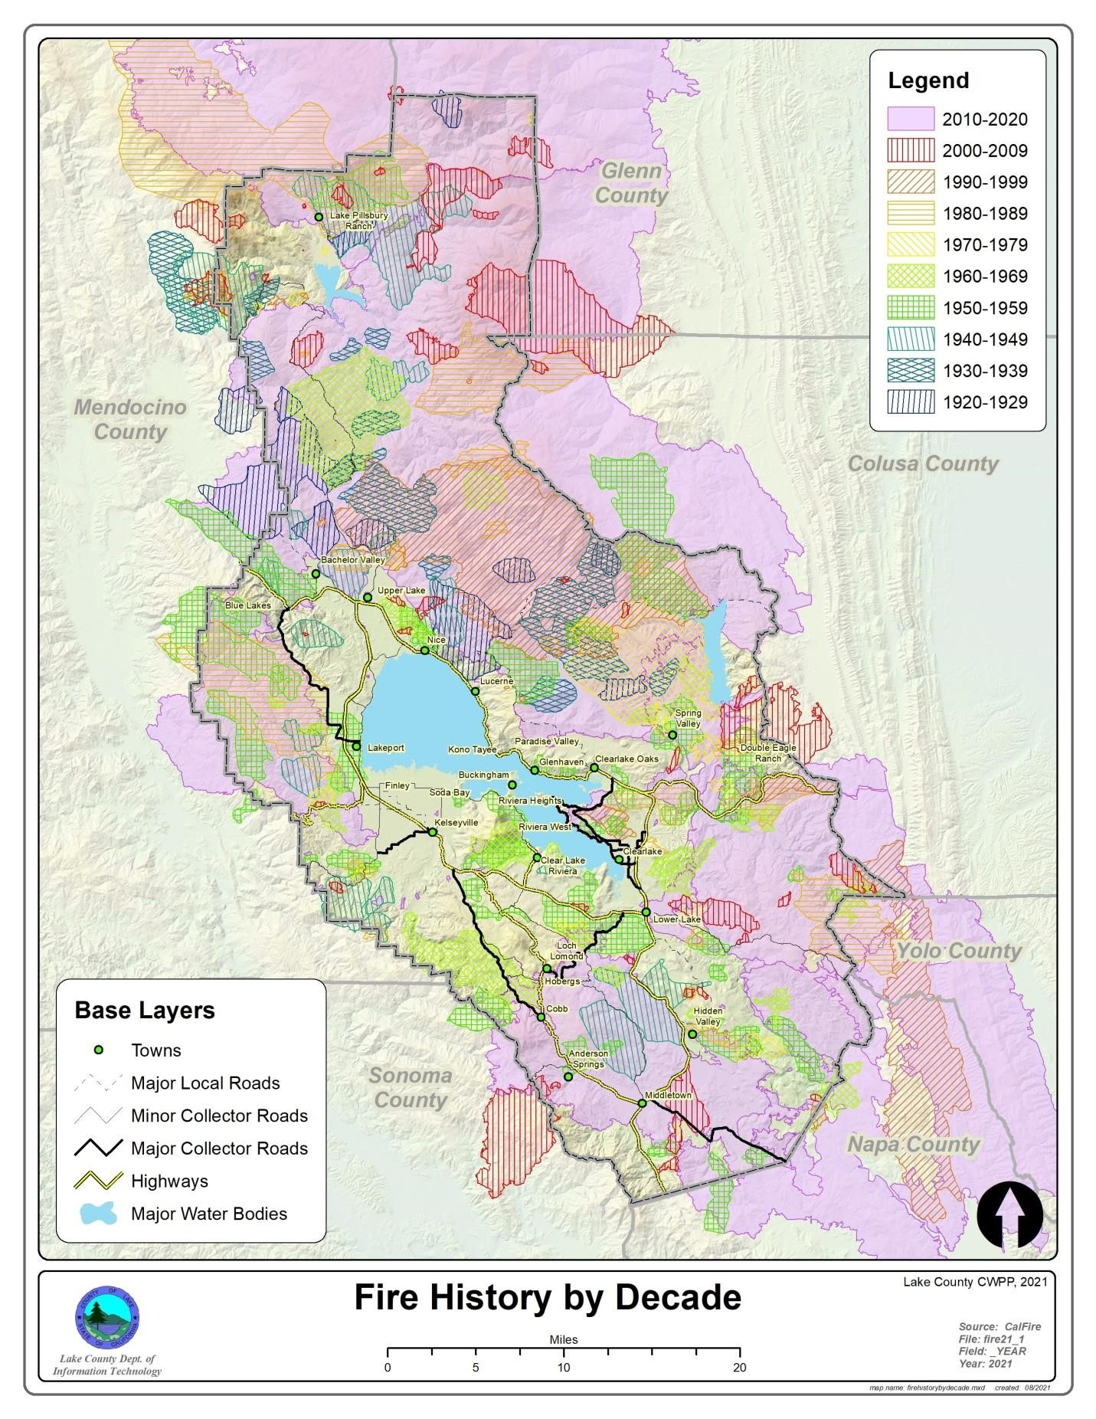
Hazard Profile
Likelihood of Future Occurrences:
  Highly Likely: 90-100% chance of occurrence in the next year or happens every year.
Magnitude/Severity:
  Critical: 25-50 percent of property severely damaged; shutdown of facilities for at least two weeks; and/or injuries and/or illnesses result in permanent disability.
Significance:
  High: widespread potential impact
Climate Change Influence:
  High: Climate change is very likely to increase the probability of this hazard.
Vulnerability: Extremely
  High: Very widespread with catastrophic impact.
Notes:
Update based on conversation with Leah and Committee

Slide 5
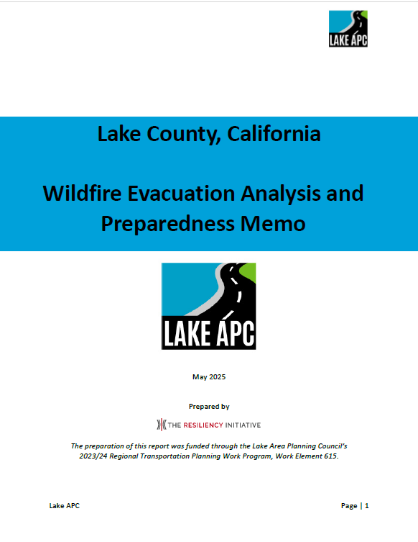
Wildfire Evacuation Analysis and Preparedness Memo

Slide 6
Lake County Demographics
Education
Bachelor's Degree or Higher
Housing
Total Housing Units
34,220
Population & People
Total Population
68,878
16.8%
Households
Total Households
26,092
Employment
Employment Rate
Health
People with 1 or more disabilities
Income & Poverty
Median Household Income
$59,444
48.8%
Business & Economy
Total Employer Establishments
22.2%
1,092

Slide 7
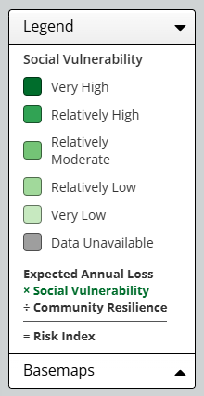
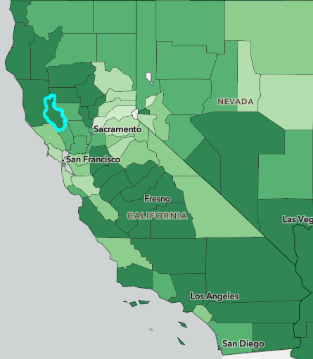
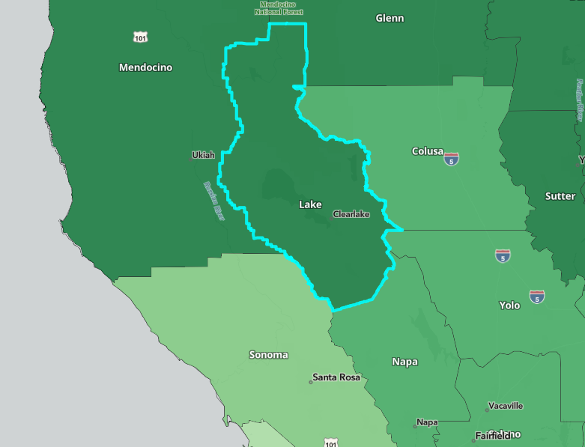
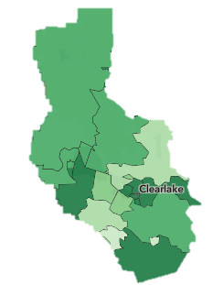
Vulnerable Populations
1
2
3
Notes:
Lake County, when compared to California in general, has:
A higher median age than in California
A higher percentage of people who fall below the poverty line
A lower employment rate
A lower percentage of educational attainment
A higher percentage of people with disabilities
As part of FEMA’s National Risk Index, a community's Social Vulnerability score indicates its relative social vulnerability compared to other communities. A higher Social Vulnerability score leads to a higher Risk Index score.
According to FEMA’s National Risk Index, Lake County’s social vulnerability is Very High.

Slide 8
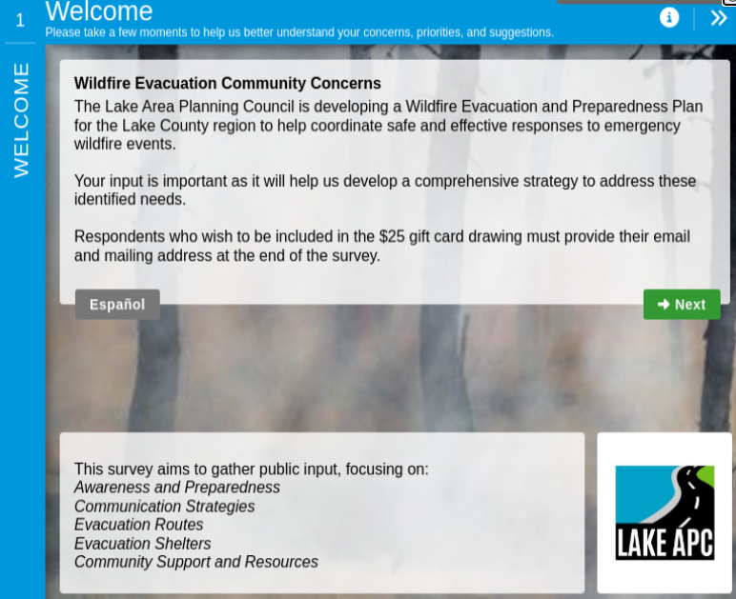
Public Input Survey
August 29, 2024 – November 8, 2024
243 Respondents
Available in English and Spanish

Slide 9
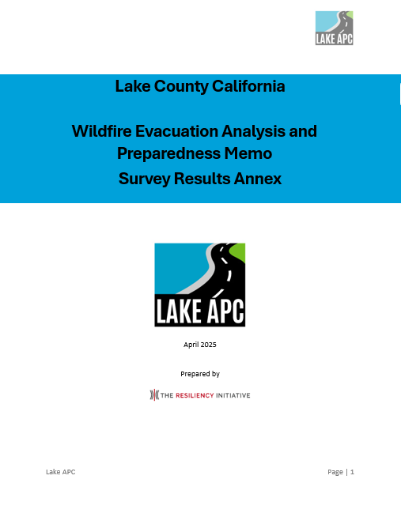
Survey Results
Annex 1

Slide 10
Recommendations

Slide 11
Recommendations
Emergency Communications
Network Improvements
Resilient Emergency Communications Network
Additional Changeable Message Signage
Inclusive Communication
Training, Exercise, & Drills
Community-Based Evacuation Assistance & Transit Support Workshop
Zone Familiarization Workshops
Community Partner Evacuation Drills
Rural Road Hardening & Alternative Evacuation Routes
Strategic Fuel Breaks Along Evacuation Corridors
Intelligent Evacuation Traffic Management Systems

Slide 12
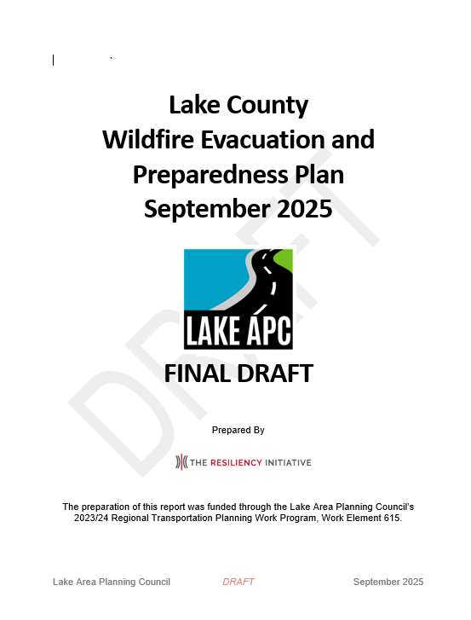
Lake County Evacuation Plan

Slide 13
Plan Structure
Introduction
Information Collection & Dissemination
Communications
Authorities and References
Situation and Assumptions
Organization and Alignment of Responsibilities
Concept of Operations
Direction, Control, & Coordination
Administration, Finance, & Logistics
Plan Development & Maintenance
The Lake County Wildfire Evacuation and Preparedness Plan outlines a comprehensive framework for facilitating safe, efficient, and coordinated evacuations during wildfire emergencies, whether the incident occurs with or without advance warning. This plan provides evacuation strategies, recommended agency roles and responsibilities, and key considerations for relocating individuals from hazardous areas to designated safe zones.
The Lake County Wildfire Evacuation and Preparedness Plan is intended to support and complement existing emergency protocols established in the Lake County Emergency Operations Plan (EOP), as well as those of the incorporated cities of Lakeport and Clearlake.

Slide 14
Key Definitions
Evacuation Order
Evacuation Warning
Evacuation Order(s) Lifted
Immediate threat to life. This is a lawful order to leave now. The area is lawfully closed to public access.
There is a potential threat to life and/or property. Those who require additional time to evacuate and those with pets and livestock should leave now. Evacuation Warnings are essential when dealing with various issues, such as access and functional needs of populations and large animals.
The formal announcement of lifting evacuations in an area currently under evacuation.

Slide 15
Key Definitions
Soft Closure
Resident Only Closure
Hard Closure
Closed to all traffic except Fire and Law Enforcement.
Closed to all traffic except Fire, Law Enforcement, and Critical Incident resources (i.e., Utility, Caltrans, Public Works, etc., or those needed to repair or restore infrastructure).
Soft closure with the additional allowance of residents and local government agencies assisting with response and recovery.

Slide 16
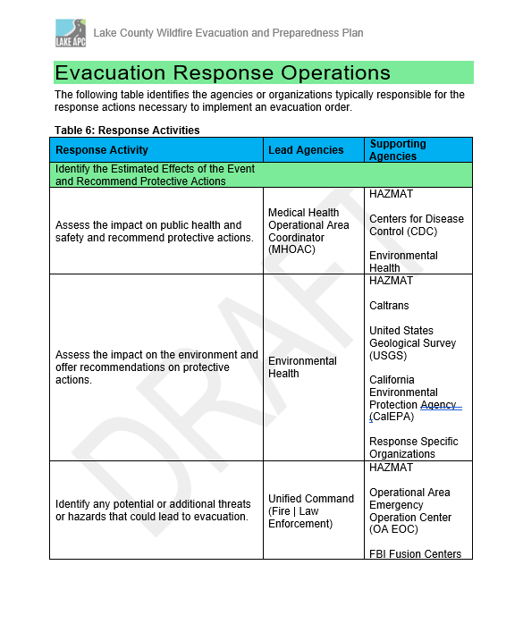
Response Operations: Unified Command
Unified Command is utilized between Clearlake, Lakeport, and Lake County regarding evacuation decision-making.
Law enforcement agencies coordinate evacuation and movement during emergencies and disasters.
Sheriff’s Office
OES EOC (Operational Area)
Lakeport Police
Lakeport Fire
Lakeport Director of Emergency Services
Clearlake Police
Lake County Fire Protection District
Clearlake Director of Emergency Services
Unified Command – Operational Area
Local – Emergency Operations Plan
Lake County
Clearlake
Lakeport
Mutual Aid - State | Federal
Notes:
The Wildfire Evacuation and Preparedness Plan is activated when the Operational Area - requiring evacuation efforts that require coordination across the OA (Unincorporated Lake County, Clearlake, and Lakeport).
The Sheriff’s Department, in coordination with Unified Command, has the authority to issue an evacuation order, whether in the form of an ordinance, resolution, or verbal order.
Each disaster is local and will escalate to the operational area as outlined in the respective EOPs.
All jurisdictions will operate according to NIMS and SEMS and respond utilizing ICS.
Basic command and control of a multi-jurisdictional evacuation effort will follow the provisions outlined in the EOP and the California Master Mutual Aid Agreement, as with any emergency or disaster.
The Sheriff's Department is responsible for county-wide evacuation activities. Unified Command is responsible for multi-jurisdictional evacuation efforts.
An evacuation coordination checklist was created to assist in assessing key response actions that need to occur during a regional disaster or the threat of a disaster.
Immediate Actions For Any Incident
Situational Awareness
Response Status
Initial Protective Actions
Additional Protective Actions
Emergency Public Information
Next Steps

Slide 17
Evacuation Strategies
Intersection & Traffic Signal Coordination
Phased Evacuation
Use of Road Barriers
Designated Markers
Hi-Lo Sirens

Slide 18
Evacuation Considerations
Schools
Individuals with Disabilities and Other AFNs
Animals

Slide 19
Evacuation Coordination
Temporary Evacuation Point
Emergency Shelter
Serves as temporary safe zones for evacuees but generally do not provide services like food, water, restrooms, etc. This is typically a transfer point from the immediate danger to then the shelter.
Emergency shelters are opened when at least one overnight stay is necessary.

Slide 20
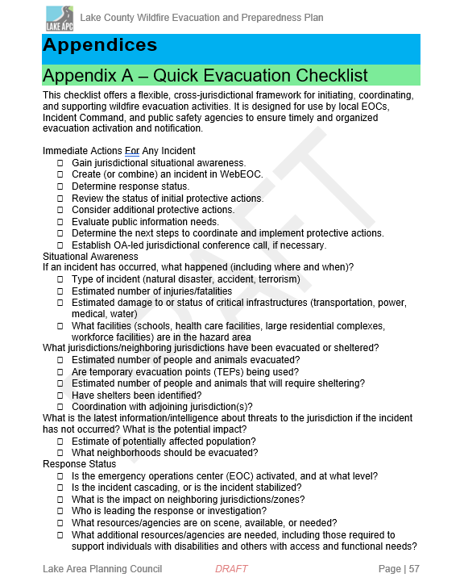
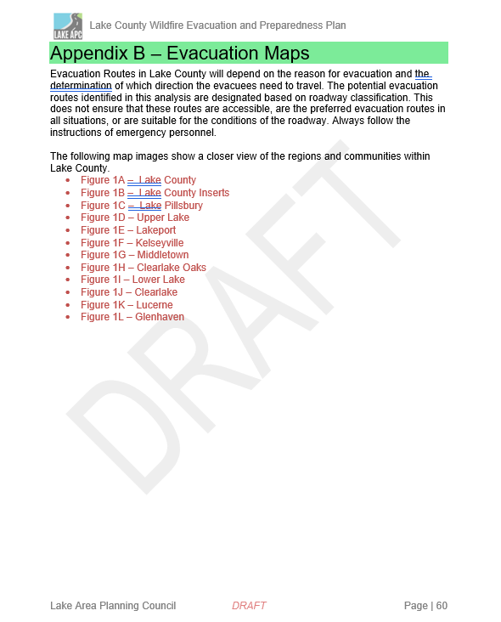
Appendices

Slide 21
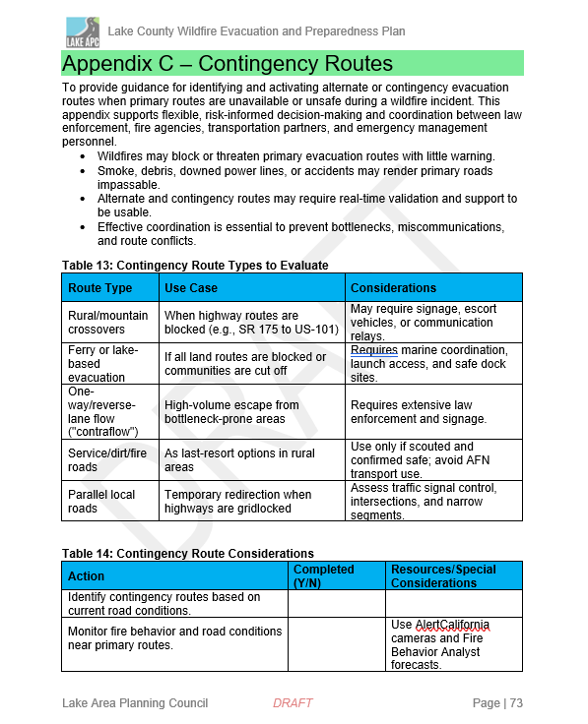
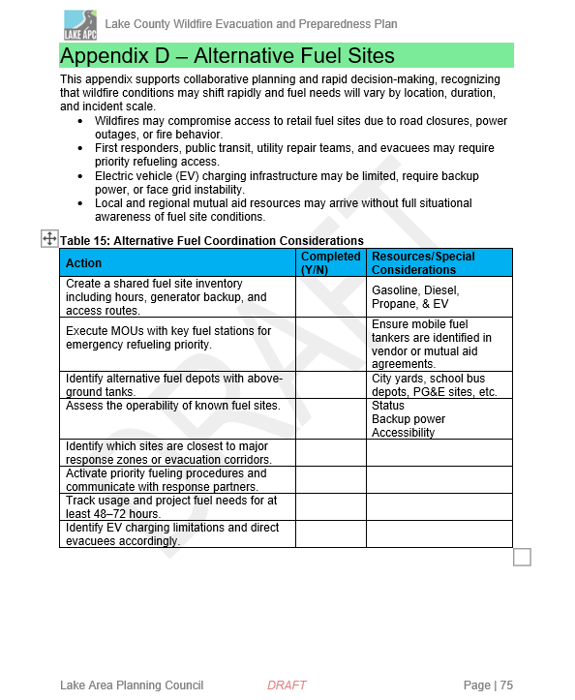
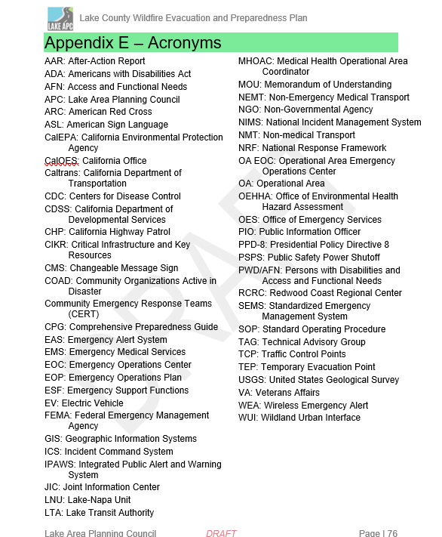
Appendices

Slide 22
Evacuation Preparedness
Know Your Zone
Make A Plan
Be Informed

Slide 23
Know Your Zone
Genasys Protect

Slide 24
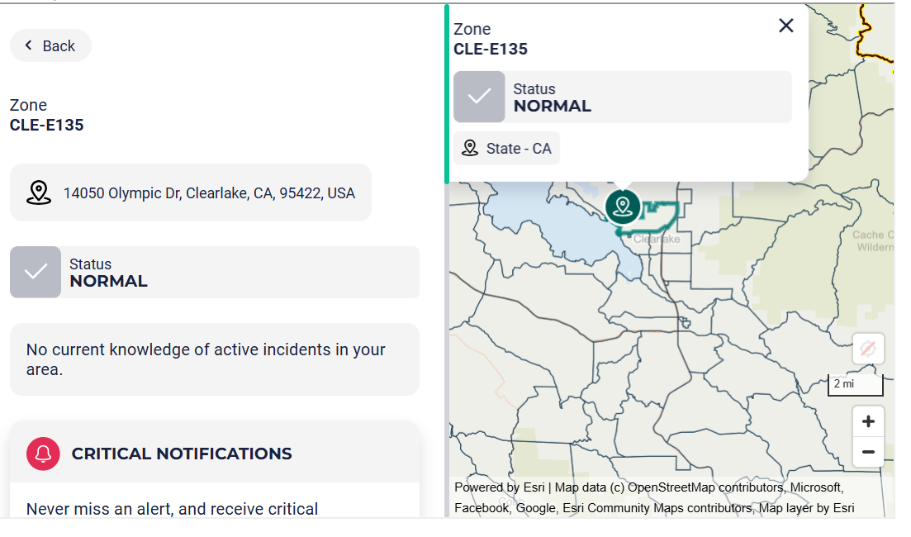
Evacuation Zones
Zone Identification: Each zone is assigned a specific code, such as "MNF-E024," representing a particular geographic area within the county.
  MNF – Mendocino National Forrest
  UPP – Upper Lake
  LAK – Lakeport
  NIC – Nice
  LUC – Lucerne
  CLE – Clearlake
  CLO – Clear Lake Oaks
  KEL – Kelseyville
  LOW- Lower Lake
  COB- Cobb
  MID - Middletown
  HID – Hidden Lake
Notes:
Clearlake

Slide 25
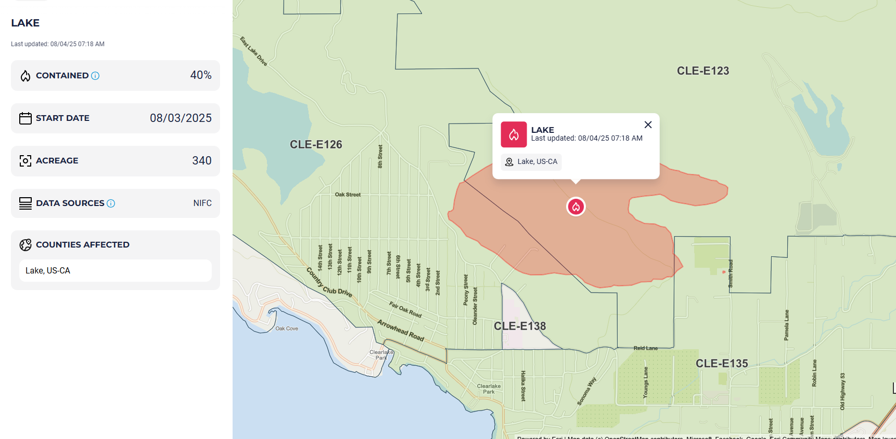
Active Fire Information

Slide 26
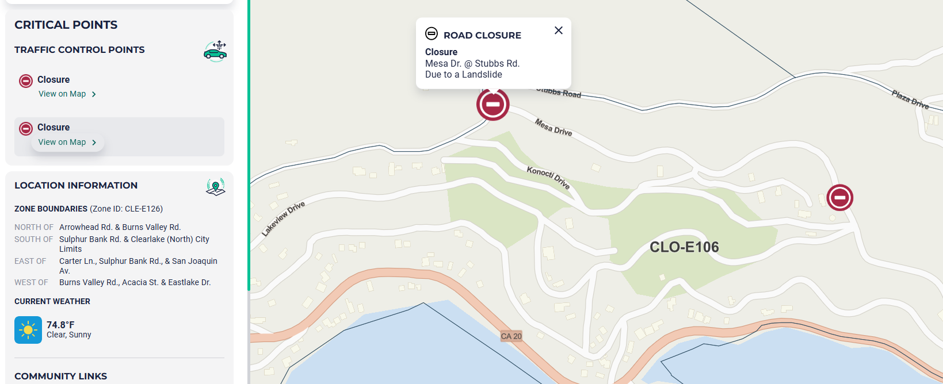
Transportation and Closures

Slide 27
Make a Plan
Potential Routes and Transportation Resources

Slide 28
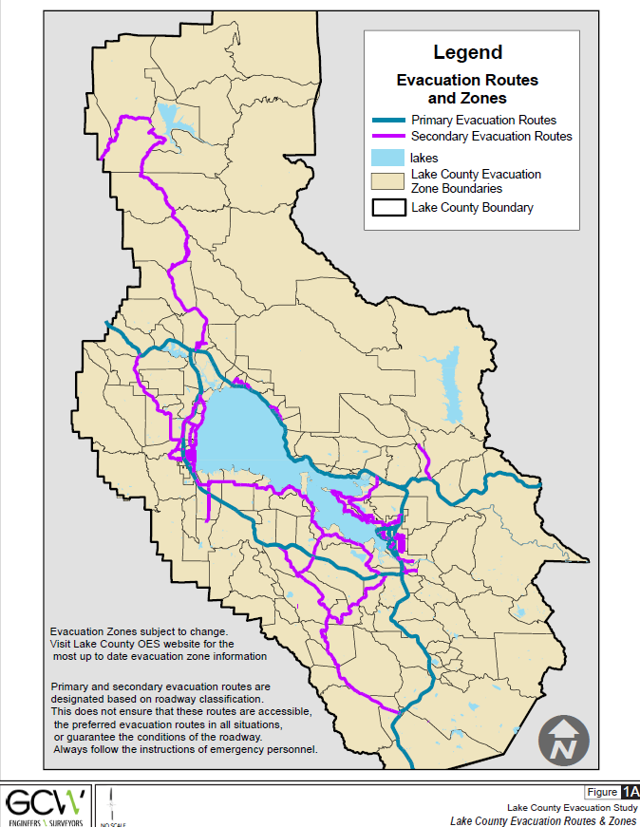
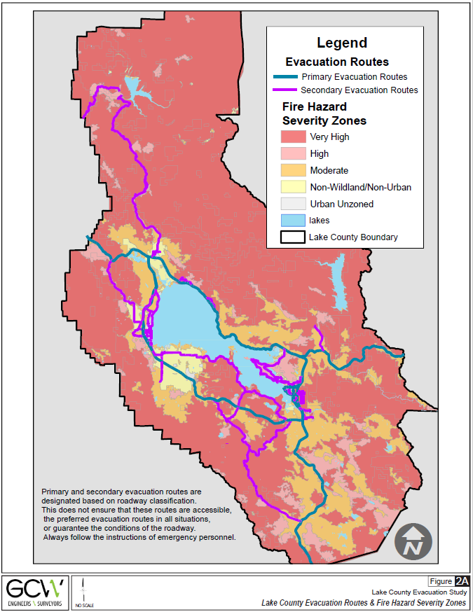
Evacuation Routes
Potential Primary Routes
CALISTOGA ST
E STATE HWY 20
S STATE HWY 29
STATE HWY 29
STATE HWY 53
W STATE HWY 20
LAKESHORE DR
OLD HWY 53
OLYMPIC DR

Slide 29
Evacuation Routes
  18TH AVE
  40TH AVE
  ALVITA AVE
  ARROWHEAD RD
  BEVINS ST
  BIG BEAR RD
  BIG VALLEY RD
  BOYLES AVE
  BURNS VALLEY RD
  BURPEE DR
  BUSH ST
  BUTTS CANYON RD
  CENTRAL PARK AVE
  CLEAR LAKE AVE
  CLOVER DR
  COMPTON ST
  COPSEY CREEK WY
  COUNTRY CLUB DR
  CRAWFORD AVE
  CRESTVIEW DR
  CRYSTAL LAKE WY
  DAM RD
  DAVIS ST
  ELEVENTH ST
  ELK MOUNTAIN RD
  EMERFORD RD
  FOOTHILL DR
  HARRINGTON FLAT RD
  HARTLEY RD
  HARTLEY ST
  HIGHLAND SPRINGS RD
  HILL RD
  HILL ROAD EAST
  HOBERG DR
  HOWARD AVE
  KEELING AVE
  LADDELL AVE
  LAKE ST
  LAKEPORT BLVD
  LAKESHORE BLVD
  LAKESHORE DR
  LAKEVIEW DR
  LOCH LOMOND RD
  MAIN ST
  MARTIN ST
  MENDENHALL AVE
  MIDDLE CREEK RD
  MILL ST
  MOSS AVE
  MULLEN AVE
  N BRUSH ST
  N FORBES ST
  N HIGH ST
  N MAIN ST
  N RUSSELL ST
  NEW LONG VALLEY RD
  NORTH DR
  OLD HWY 53
  OSPREY CT
  PALMER AVE
  PARK ST
  PARK WY
  PHILLIPS AVE
  POINT LAKEVIEW RD
  QUARTERHORSE LN
  RED HILLS RD
  RIGGS RD
  RUMSEY RD
  S FORBES ST
  S MAIN ST
  S RUSSELL ST
  SAN JOAQUIN AVE
  SCOTTS VALLEY RD
  SECOND ST
  SEIGLER CANYON RD
  SIXTH ST
  SODA BAY RD
  SPURR ST
  STATE HWY 175
  STATE HWY 281
  SULPHUR BANK DR
  SUMMIT BLVD
  UHL AVE
  W 40TH ST
  WINCHESTER ST
Potential
Secondary Routes

Slide 30
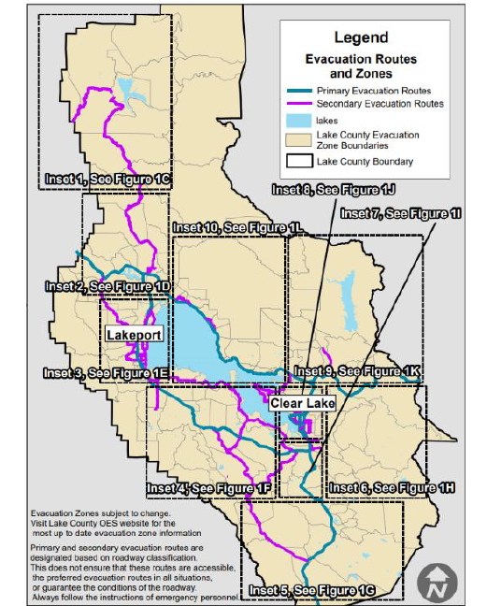
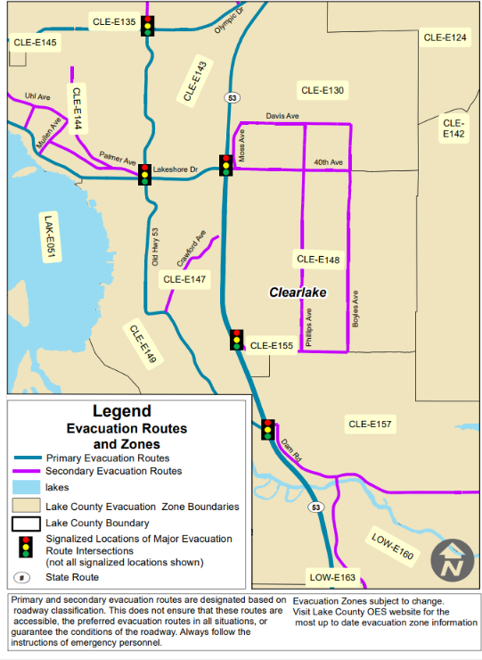
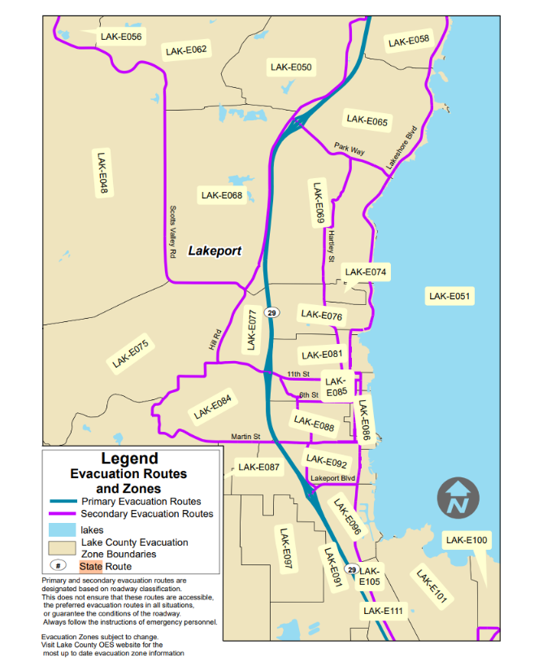
Community Maps
Potential routes mapped for planning purposes.

Slide 31
Be Informed
Emergency Notifications and Communications

Slide 32
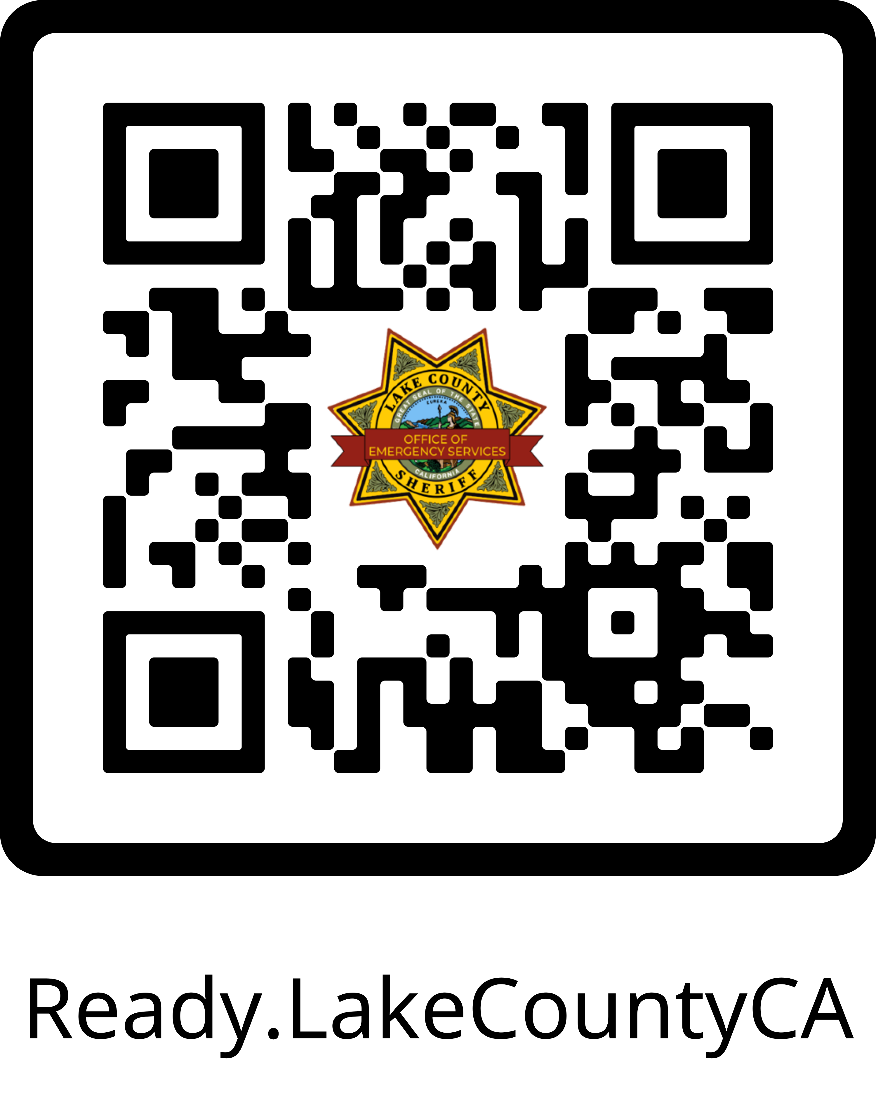
Emergency Communications
LakeCo Alerts: Lake County’s official emergency notification system, providing critical alerts via phone calls, text messages, emails, and public broadcast systems
  Enables officials to issue geographically targeted warnings and countywide alerts during major emergencies
  Integrated Public Alert and Warning System (IPAWS)
  Emergency Alert System (EAS)
  Wireless Emergency Alerts
Law Enforcement
  Door-to-door notification
  Hi-Lo Siren
Changeable message signs
  Caltrans
  Local Business
  Lake Transit Bus

Slide 33

Thank you
Faith Newton, CEM, MBCP
Chief Client Engagement Officer
The Resiliency Initiative (TRI)
Faith@theresiliencyinitiative.com

