Slide 1


UCCE Lake
Water and Climate Change Program
Laura Garza, Ph.D.
Area Water Resources Management Advisor
UC Cooperative Extension
Mendocino and Lake

Slide 2
UCCE Lake
Water and Climate Change Program
Mission
Provide research-based guidance, education, and support to communities, water users, and stakeholders in Lake County.
The program promotes sustainable water management, supports adaptation to climate variability, and encourages collaboration to protect water resources for current and future generations.
Notes:
The University of California Cooperative Extension (UCCE) Water and Climate Change Program in Lake and Mendocino Counties is dedicated to addressing the challenges posed by climate change on water resources in these regions.
Objective: To develop and implement strategies that enhance water resilience and sustainability in Lake and Mendocino Counties, ensuring the availability and quality of water resources amidst changing climatic conditions.
Mission: To provide research-based guidance, education, and support to local communities, water users, and stakeholders in Lake and Mendocino Counties. The program aims to promote sustainable water management practices, facilitate adaptation to climate variability, and foster collaborative efforts to safeguard water resources for current and future generations.
Vision: A future where Lake and Mendocino Counties have resilient water systems that effectively adapt to climate change, supporting thriving ecosystems, robust agricultural practices, and healthy communities. Through informed decision-making and community engagement, the program envisions sustainable water management that balances environmental, economic, and social needs.

Slide 3




UCCE Lake
Water and Climate Change Program
WATER
QUANTITY
WATER
QUALITY
CLIMATE
CHANGE

Slide 4
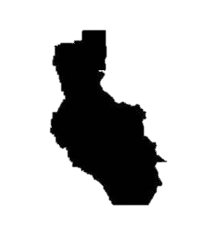


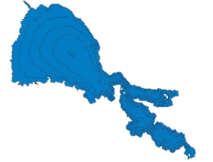
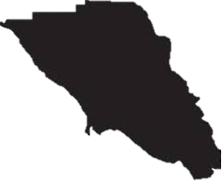
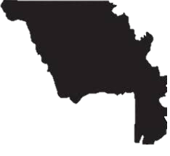
Geographic Scales Effort
Local
County
Regional
State
Transboundary Water Projects
Farmers
Mendocino
Lake
Transboundary
watersheds
Lake
California
Sonoma
Yolo
Big Valley GSA
Tribes

Slide 5
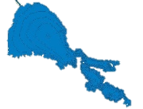
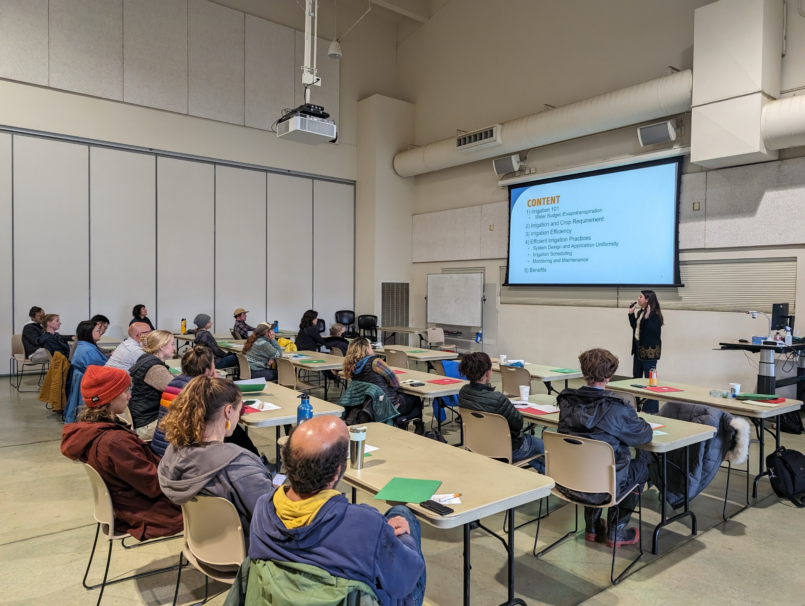
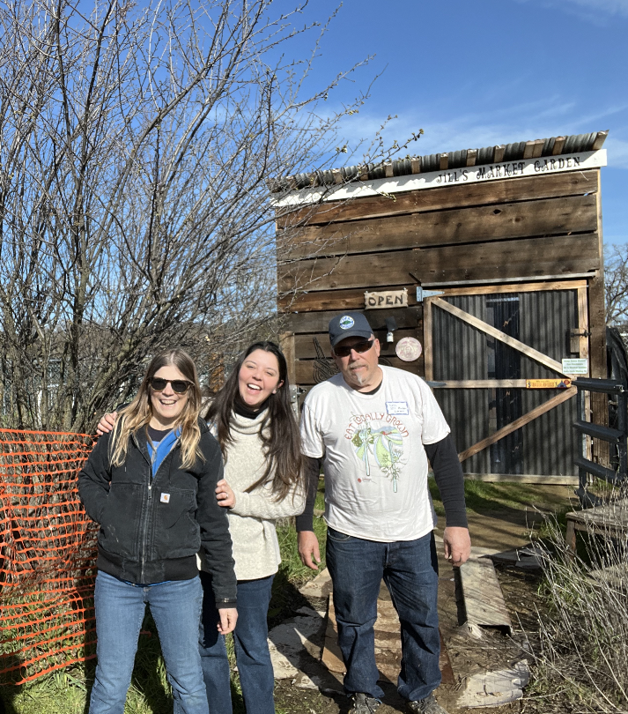
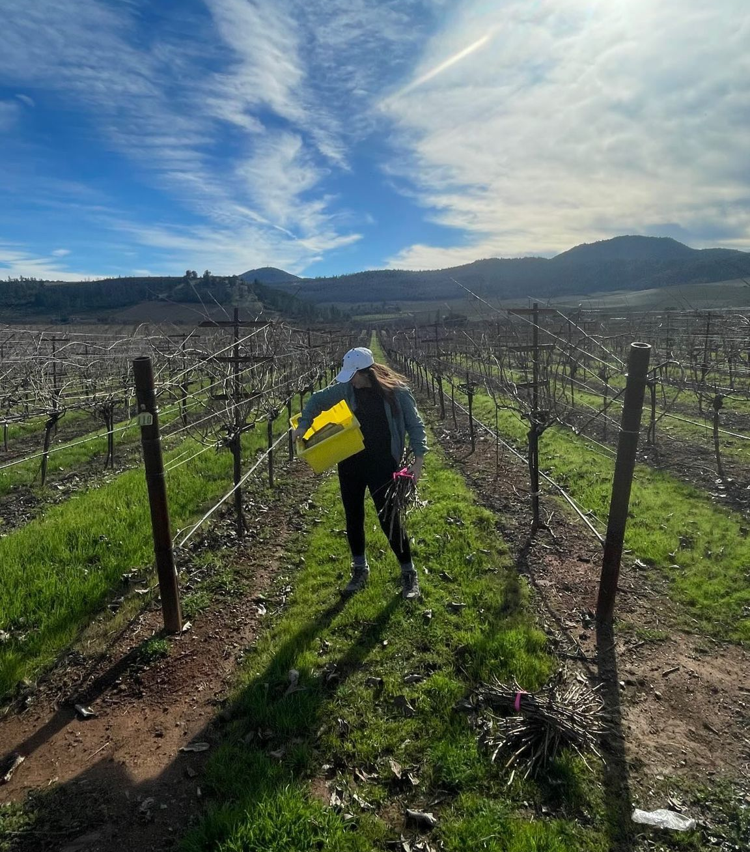
Local
Portfolio of Activities
Local Engagement: Educational Events and Farm Visits
Small Farmers Conference
Organic Day
Grape and Olive/Pear Day
Strategies for Drought Resilience in Agriculture
Irrigation Scheduling Workshop

Slide 6
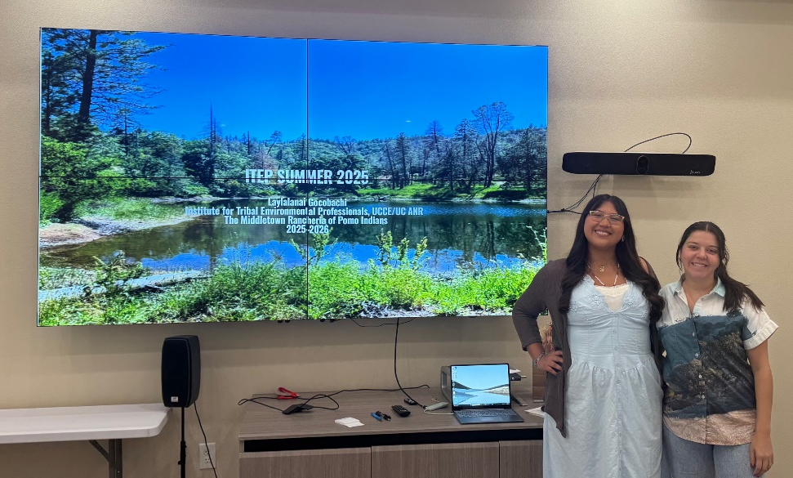
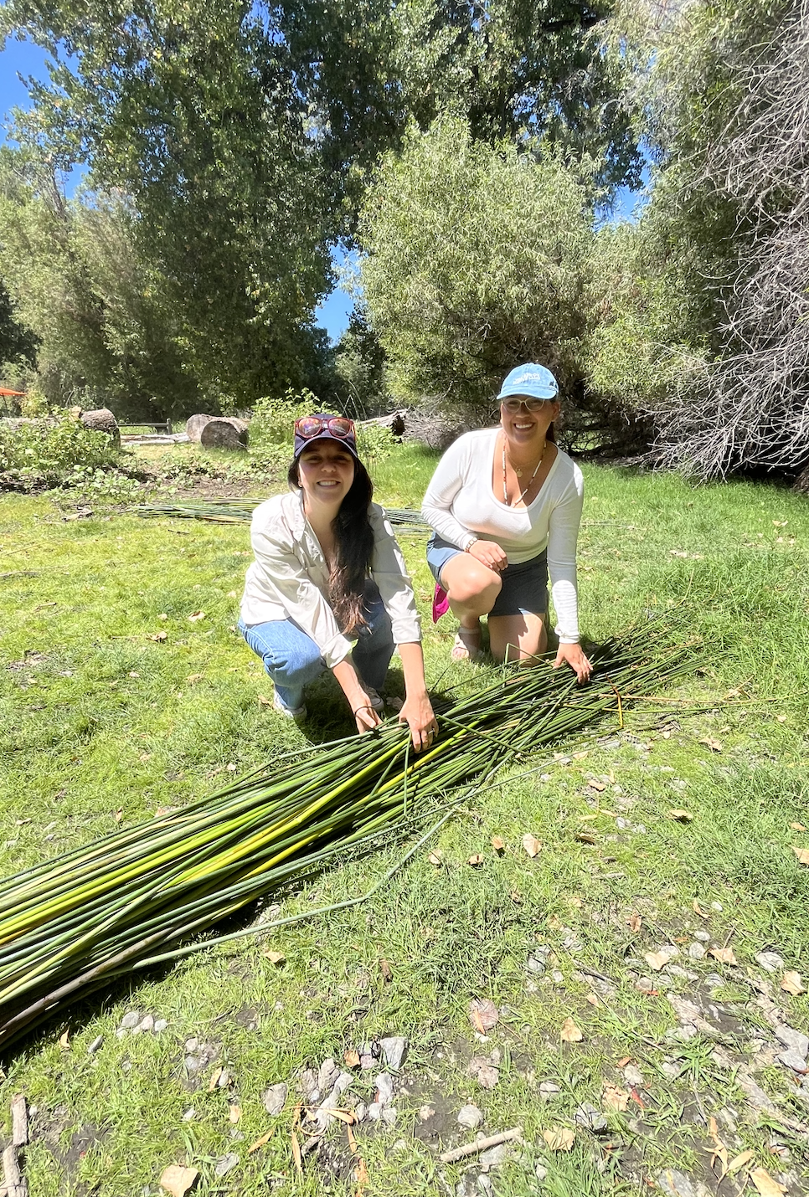
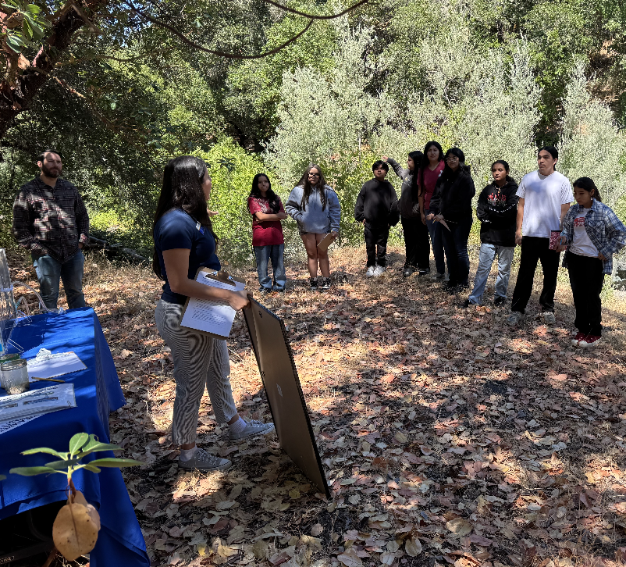
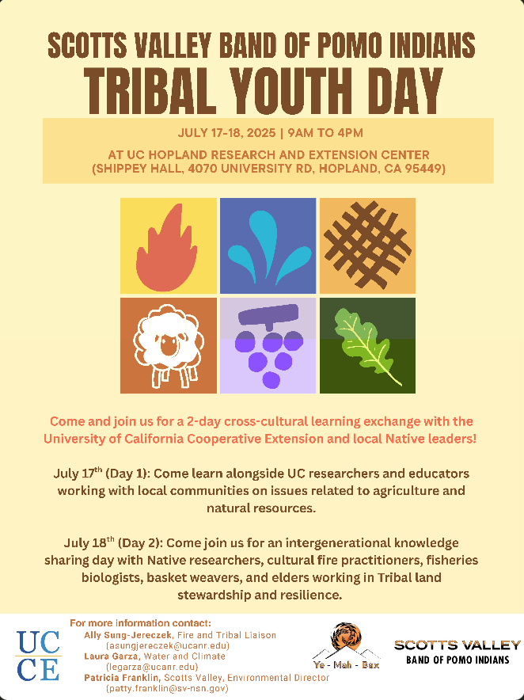
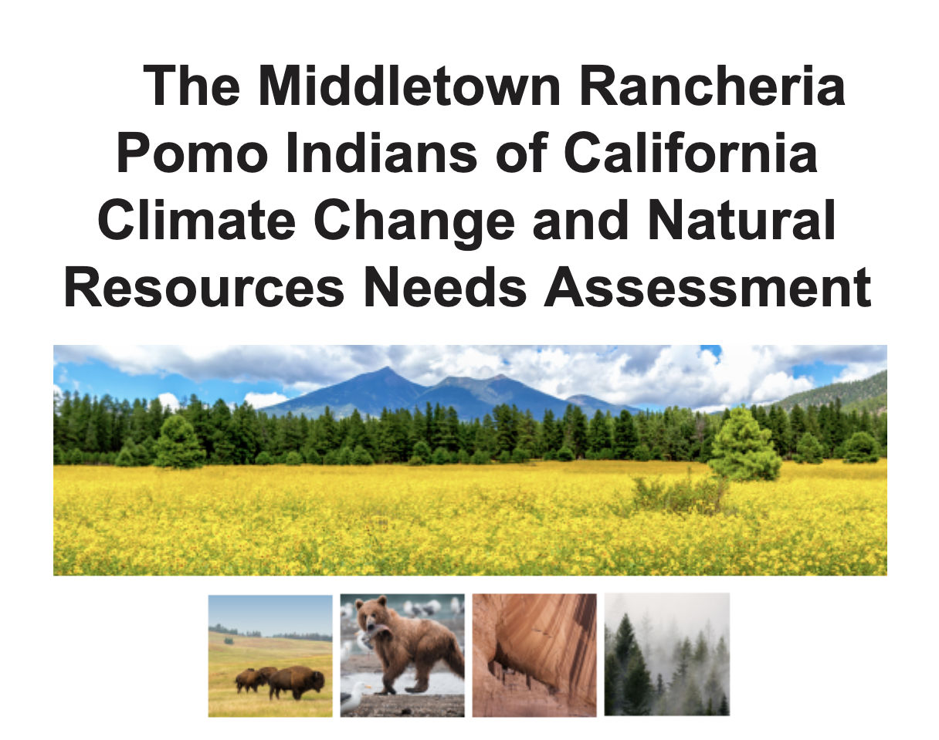
Local
Portfolio of Activities
Tribal Engagement
Middletown Rancheria: Water and Climate Needs Assessment
Support Water and Climate Programs within Tribes
Scotts Valley Tribe: STEM Tribal Youth Day

Slide 7
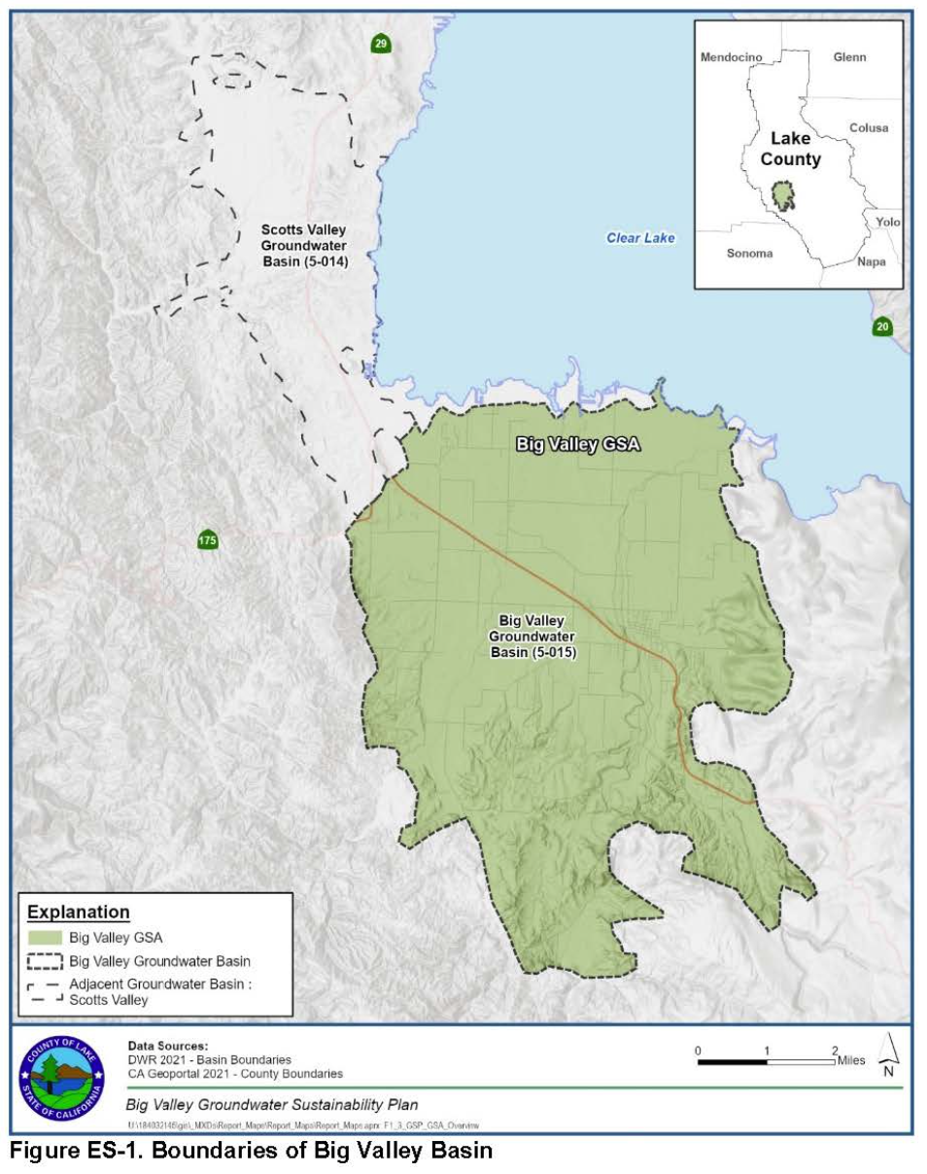
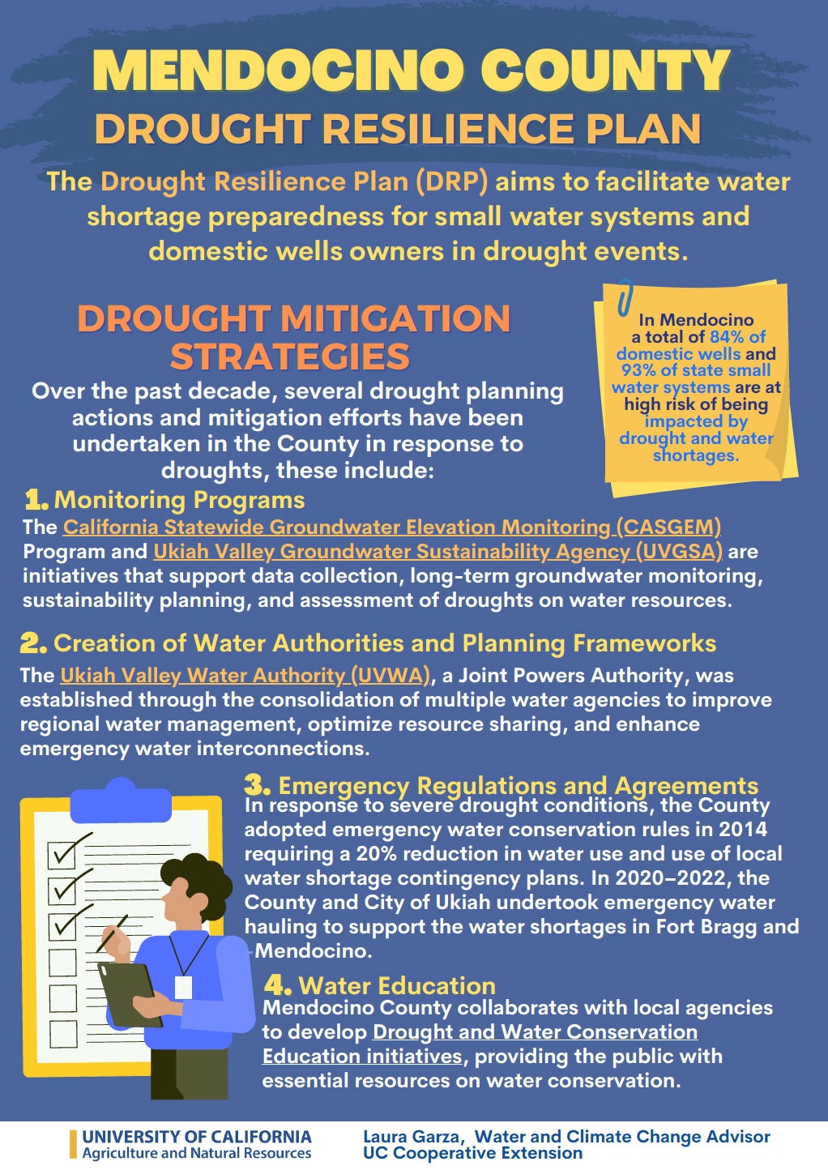
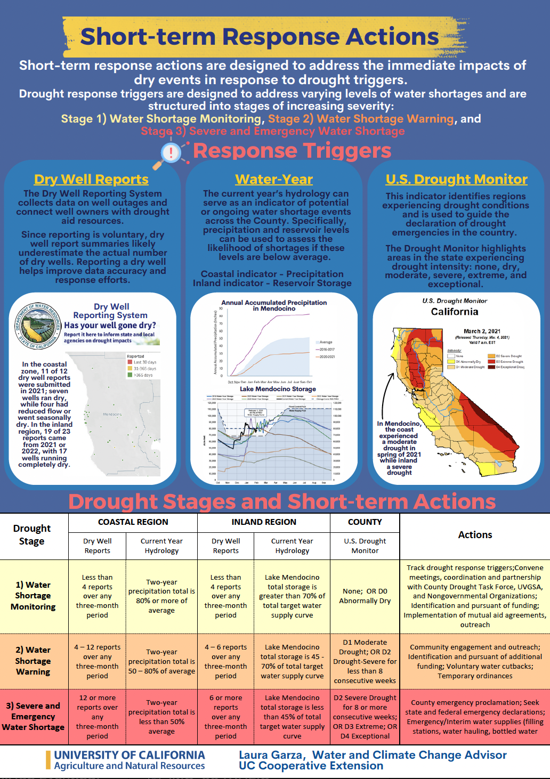
County
Lake
Portfolio of Activities
Support to Lake Water Agencies and GSAs
Support Lake Water Resources Department and STANTEC in efforts related to Lake County DRP
Support Big Valley GSA and Lake Water Resources
on SGMA projects

Slide 8
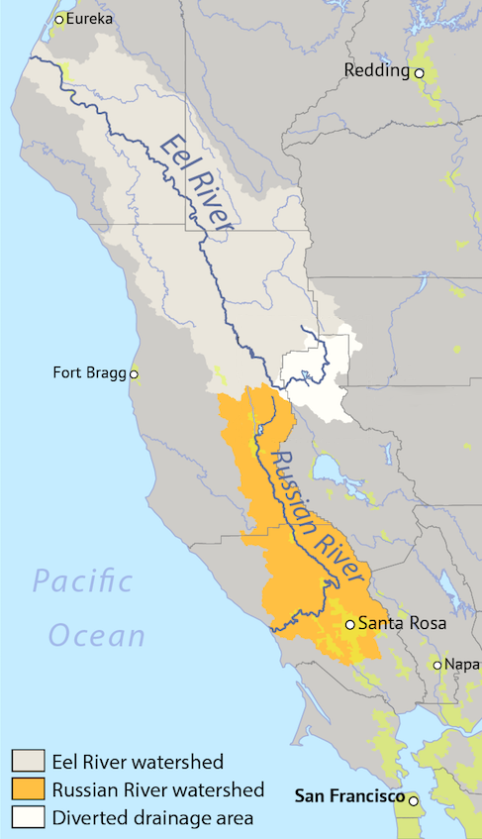
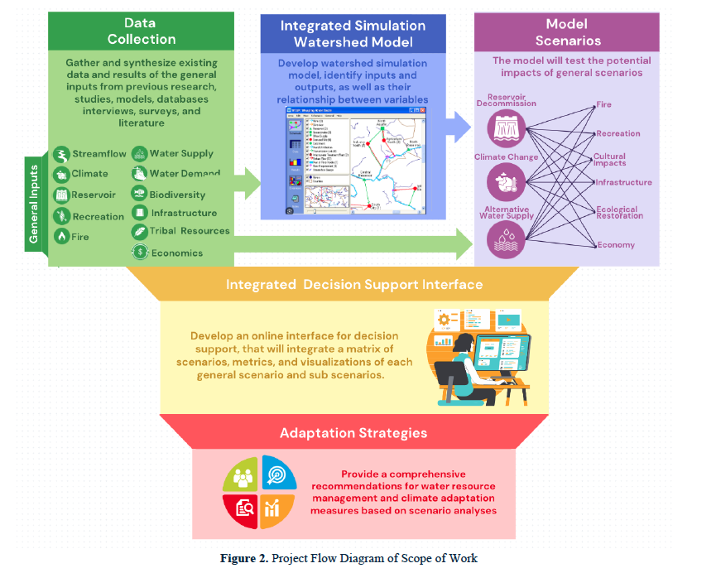
Regional
Mendocino
Lake
Sonoma
Yolo
Portfolio of Activities
Research Project: An integrated Decision Support Framework to analyze the hydrologic, environmental and social resilience of Scott Dam Removal
Project funded by CIWR (California Institute of Water Resources) and USGS
Notes:
Adapting to Change: Hydrological, Environmental, and Social Resilience Following a Dam Removal in Northern California
As the removal of Scott Dam approaches, the transition poses both opportunities and challenges. While removing the dam will restore fish migration, reconnect habitats, and reestablish sediment transport, it also requires local water users to adapt to the loss of stored water and diversions. Addressing these changes requires a social-ecological resilience approach, which evaluates how ecosystems and human societies absorb, adapt, and respond to disturbances while maintaining critical functions.
This study aims to assess the resilience of the Eel River watershed in response to Scott Dam removal, focusing on hydrologic variability, ecological recovery, and governance adaptation. As one of the most significant dam removals in Northern California, this case study will provide a model for understanding how river systems and water management strategies evolve in response to major environmental changes.
The scope of this study focuses on the Eel River watershed, analyzing the hydrologic, ecological, and socio-political effects of Scott Dam removal. The study will evaluate short-term and long-term responses by assessing pre-removal conditions, modeling post-removal scenarios, and tracking stakeholder adaptation efforts.
The main objective is to conduct a Social-Ecological Resilience Assessment of Scott Dam removal, analyzing its impacts through three key components:
Hydrologic Variability – Assessing natural flow changes, sediment transport, and water availability through hydrological modeling and climate scenario analysis.
Ecosystem Heterogeneity and Connectivity – Examining fish passage, habitat restoration, and water quality improvements to determine ecological recovery patterns.
Basin-Scale Management and Adaptability – Investigating how stakeholders, governance structures, and policy frameworks adjust to dam removal and changing water dynamics.

Slide 9



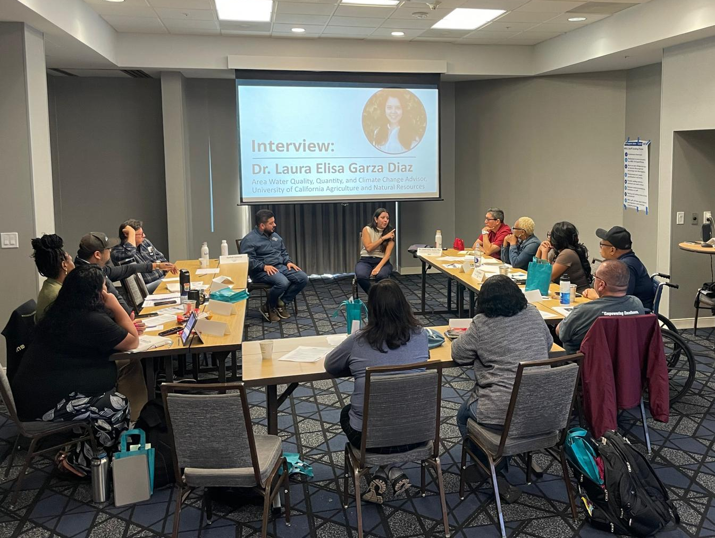
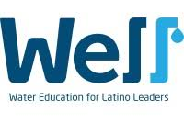
State
Portfolio of Activities
California Water Course
A bilingual (En/Sp) program for entry level water professionals
WELL Program
Water Education for Elected Latino Leaders
Notes:
We are excited to announce the launch of the California Water Course a bilingual (English/Español) program designed for entry level water professionals (or refresher), community and advocates, or any person interested in addressing California’s water challenges and solutions.
This 40-hour hybrid course combines:
- Self-guided content (16 hours): Educational materials and personalized assignments are available online so you can work at your own pace
- Three in-person events (8 hours each): these sessions offer hands-on activities, opportunities to share experiences, and community-building
The course focuses on real-world water systems, policies, and management strategies in California. A certificate of completion will be awarded at the end of the program. The course offers a flexible, applied approach to strengthening your knowledge and skills in California water management.
WELL Program: six-month program for local elected leaders aimed at helping participants make an impact on California water policy while addressing individual community water challenges.

Slide 10
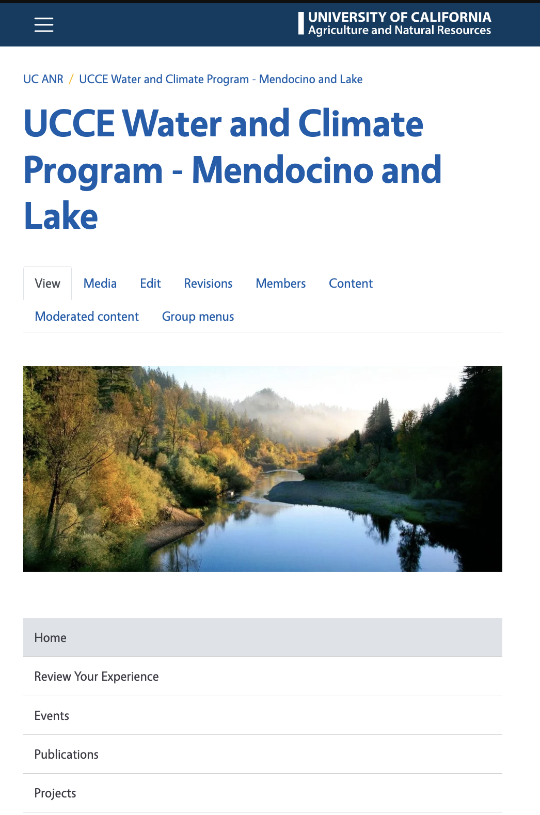
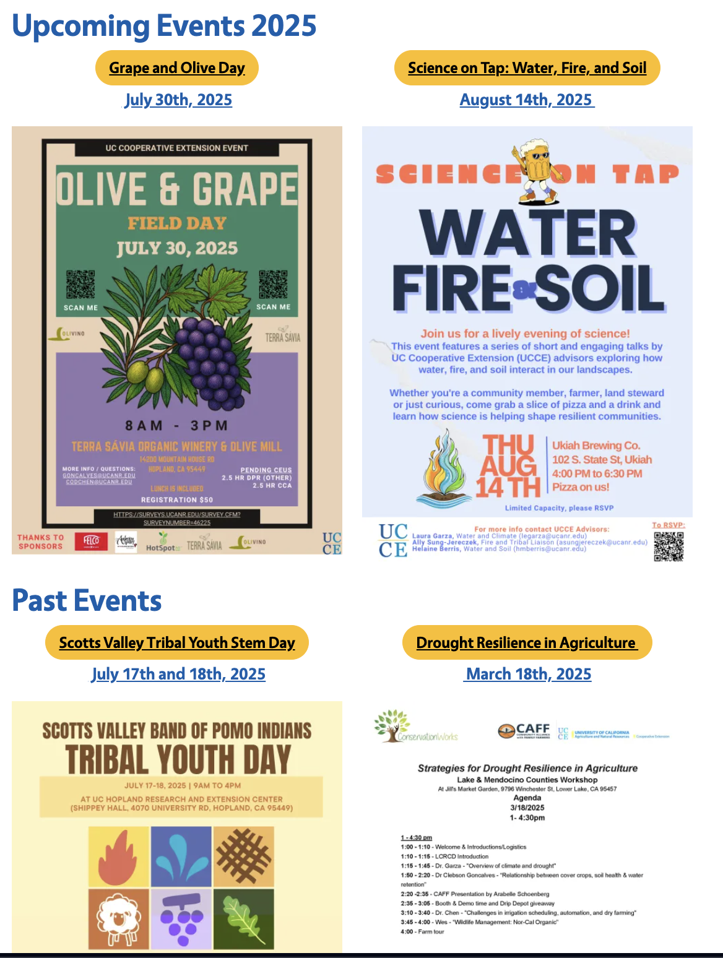
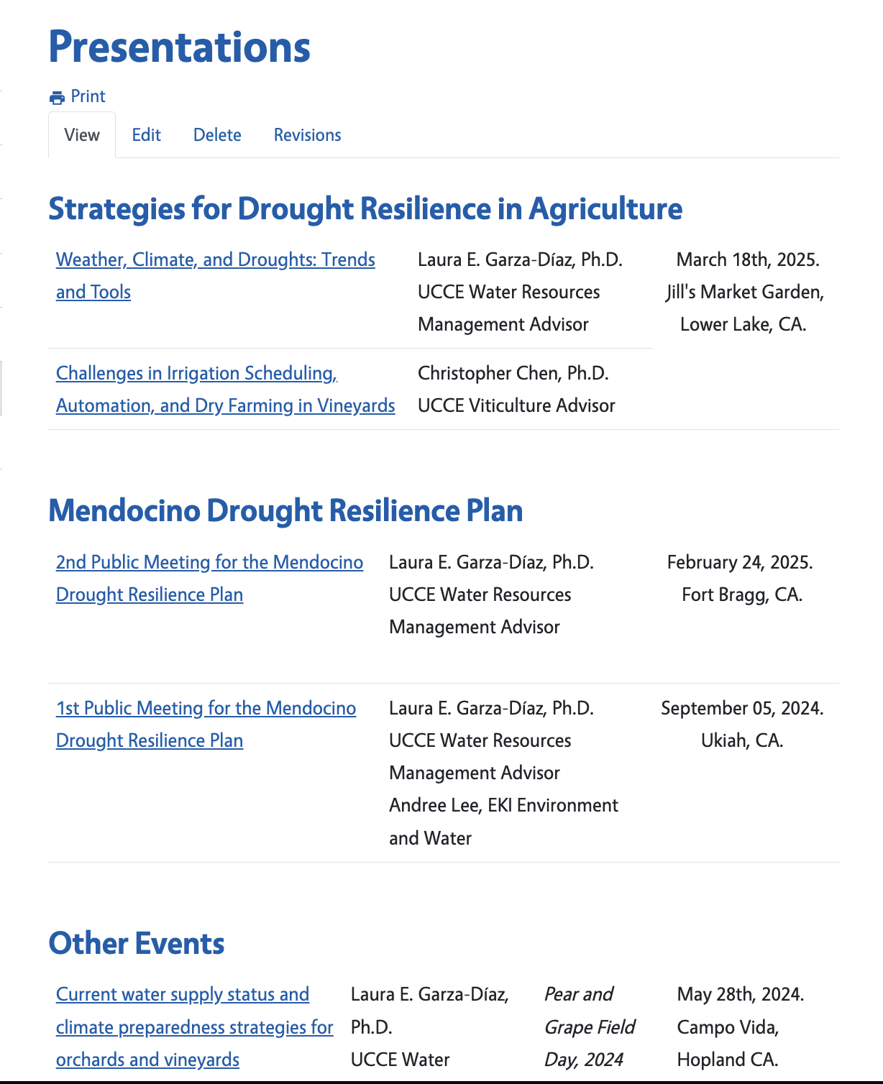
Want to know more…
Visit the UCCE Water and Climate Program Website
https://ucanr.edu/site/water-resources-management

Slide 11
Thank you!
UCCE Lake
Water and Climate Change Program
Laura Garza, Ph.D.
Area Water Resources Management Advisor
UC Cooperative Extension
Mendocino and Lake
legarza@ucanr.edu

