Slide 1
Big Valley Groundwater Sustainability Plan Advisory Committee (GSPAC) Updates
Board Of Supervisors Meeting
November 18, 2025

Slide 2
SGMA Overview
SGMA: Sustainable Groundwater Management Act
SGMA is a 2014 California law requiring local management of groundwater to prevent overdraft and ensure long-term sustainability.
It mandates the formation of Groundwater Sustainability Agencies (GSAs) to develop and implement Groundwater Sustainability Plans (GSPs) for high- and medium-priority basins, with the goal of reaching sustainability by 2042.
Oversight: CA DWR and State Water Resources Control Board oversee compliance.

Slide 3
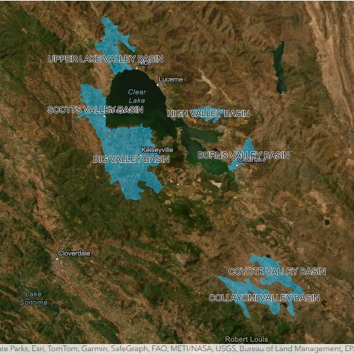
Groundwater Basins in Lake County

Slide 4
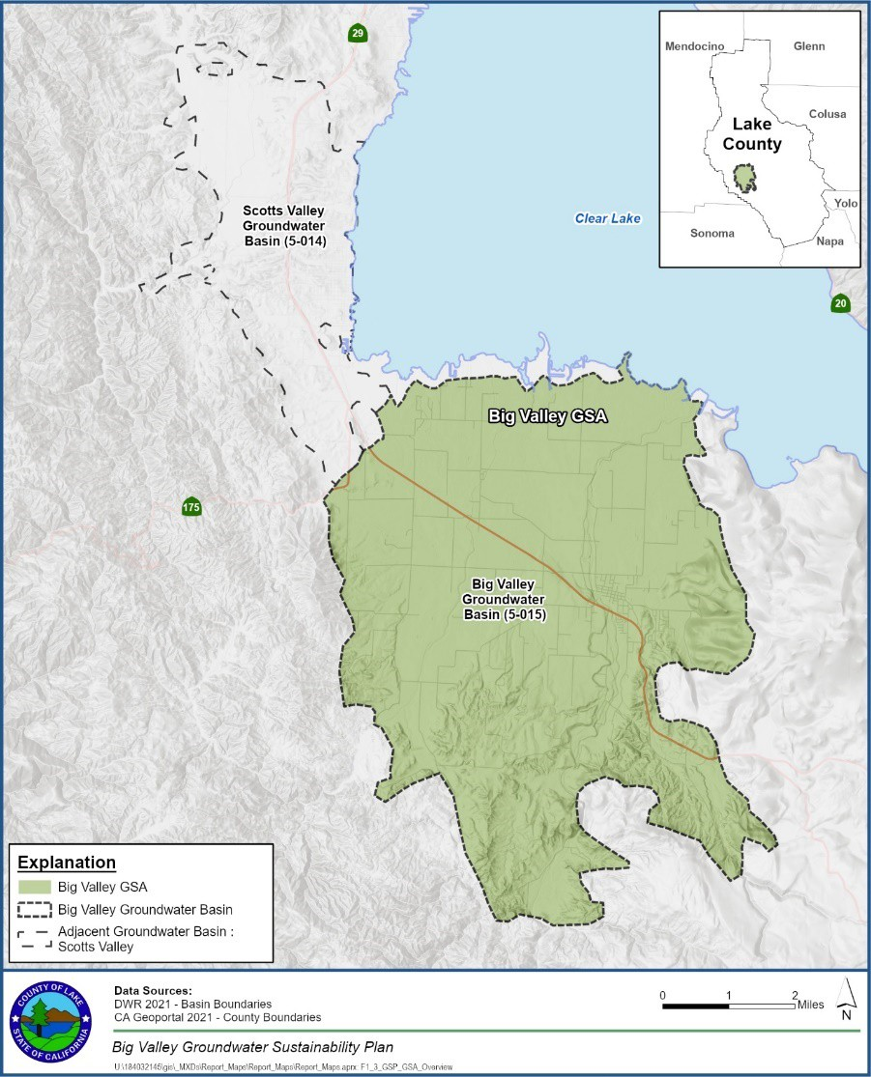
Big Valley Groundwater Basin

Slide 5
SGMA Progress In Lake County
Lake County Watershed Protection District is the Local GSA for the Big Valley Groundwater Basin
Notes:
Questions or comments from committee?
Any from the Public?
Do I have a move to approve?
Second?

Slide 6
Lake County SGMA Progress Cont.
2014: CA Passed SGMA
2015: DWR releases Basin prioritization
2021: Received $1.3M SGMA Implementation Grant (DWR).
- Formation of the GSA & GSP
- Consulting services, meetings, etc.
2022: Submit GSP to DWR, approved in 2023 (4/27)
2021 – 2024: Annual Report submitted (2025 report submitted 4/26’)
2027: Next 5-Year Evaluation due
2042: Achieve long-term sustainability

Slide 7
Requirement to be Compliant with SGMA
Submit an annual update Report
Submit a periodic evaluation every 5 years (a comprehensive update)
  Next periodic evaluation is due in 2027

Slide 8
Cost to Implement SGMA
Source: DWR’s Funding SGMA Implementation Resource Guide

Slide 9
Cost to Implement SGMA Cont.
Grants: Applied (successful and unsuccessful)
Water Resources internal funds (limited)
Need to establish a long-term funding stream

Slide 10
Immediate Funding Needs
Notes:
Questions or comments from committee?
Any from the Public?
Do I have a move to approve?
Second?

Slide 11
Immediate Funding Needs
Cost of the Annual GSP update report:
  Approximately $80k annually (as of 2025)
  Will reduce to about $40k annually with internal staff support
Cost of the Periodic Evaluation: $200k
  Once every 5 years; $200k total with internal staff support
  OR $40k annually
Funding Evaluation & Feasibility Study to determine long term funding options.
  Approximately $100k (incl. $10k to 15k contractor retainer fee)

Slide 12
Immediate Funding Needs
Annual Report (GSP update): ~$40K/year (with staff support).
5-Year Periodic Evaluation: $200K total ($40K/year avg).
Funding Feasibility Study: ~$100K
Total of Approximately: $340k

Slide 13
Options to Address
Immediate Funding Needs
Notes:
Questions or comments from committee?
Any from the Public?
Do I have a move to approve?
Second?

Slide 14
Immediate Funding Options
Funding Strategy & Ask
Previously allocated matching funds: $500K (May 3, 2022) for stormwater projects.(File # 22-402)
  Only $50K used so far.
Request: Expand use of remaining ~$450K to include groundwater management costs.
Purpose: Cover annual reports, 5-year evaluations, and long-term funding feasibility study.

Slide 15
Long Term Funding Needs
Annual report: Approximately $40k/year (as of 2025)
(with internal staff support)
Periodic Evaluation: $200k every 5 years (or ~$40k/year)
Total of Approximately: $80k to $100k/year (adjusted for inflation)

Slide 16
Long Term Funding Options
Need to be in effect by 2027, so the next periodic evaluations and annual reports cost is covered
Option 1: County provides 100% of annual need (~$100K/year).
Option 2: County provides 50% (~$50K/year), balance via local fee mechanisms (e.g., Prop 218).
Option 3: 100% of the need is met with a local fee mechanisms (e.g., Prop 218).
We will continue to pursue external grant opportunities for this work, with County funds serving as a contingency to ensure continuity if such funding is not secured

