Slide 1
MA 17 Transfer of Maintenance and Operation
Presentation describing and requesting Board of Supervisors support of the MA-17 transfer process, with relation to the Middle Creek Restoration Project

Slide 2
What is MA 17
& Why Transfer It to County Operation and Maintenance?
Brief History of the Area’s State and County O&M
Current Issues
Proposed Solutions

Slide 3
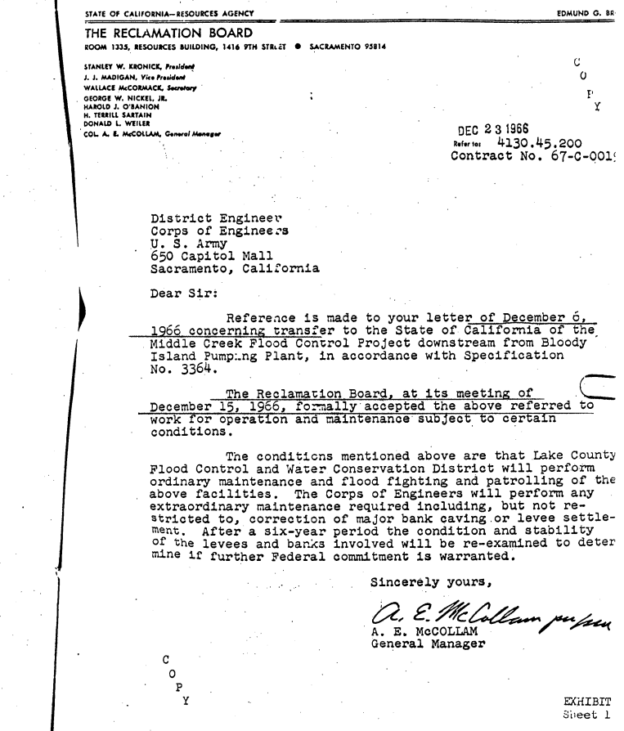
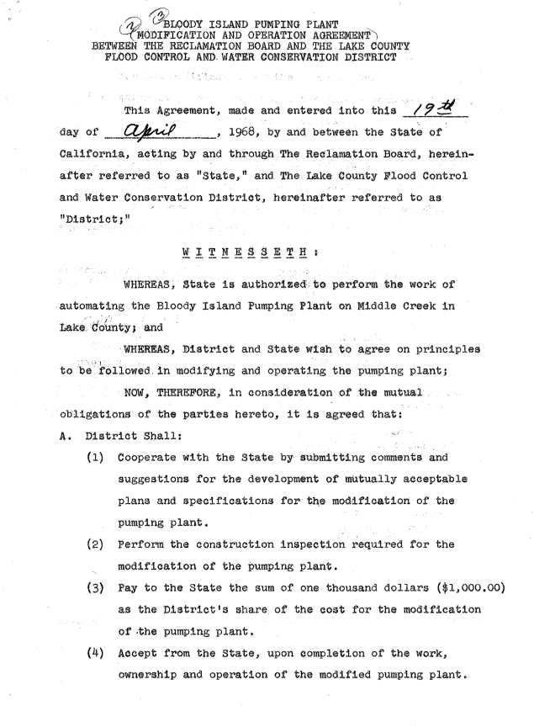
In the 1960’s, the State assumed O&M of the area “downstream from Blood Island Pumping Plant.”
After that in the 21st century Lake County took over O&M again.
At some point in 2017 or before, the State assumed O&M again.
Now would be a good time to take O&M back.

Slide 4
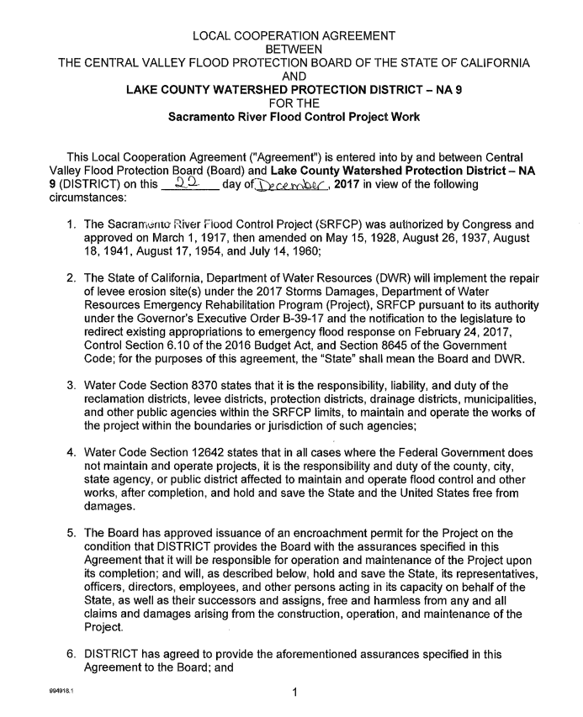

Slide 5
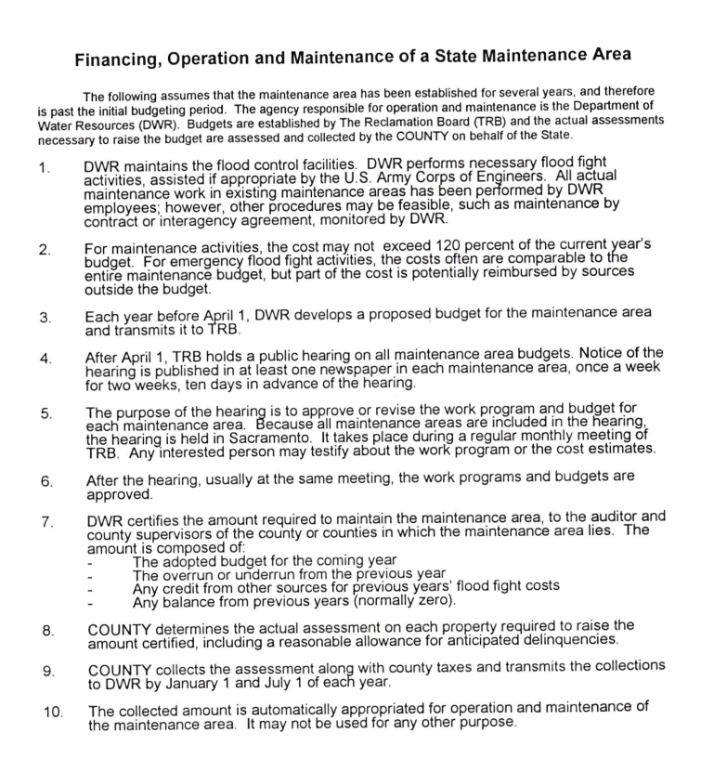
The primary role of the State in MA17 has been maintaining flood control facilities.

Slide 6
Funds paid for MA 17 per year from FY21-22 to FY 25-26
FY25/26 was offset by $200k from existing funds in the FUND 631 trust, so in reality the percentage of the bill paid from LCWPD owned properties was closer to 67% ($439K).

Slide 7
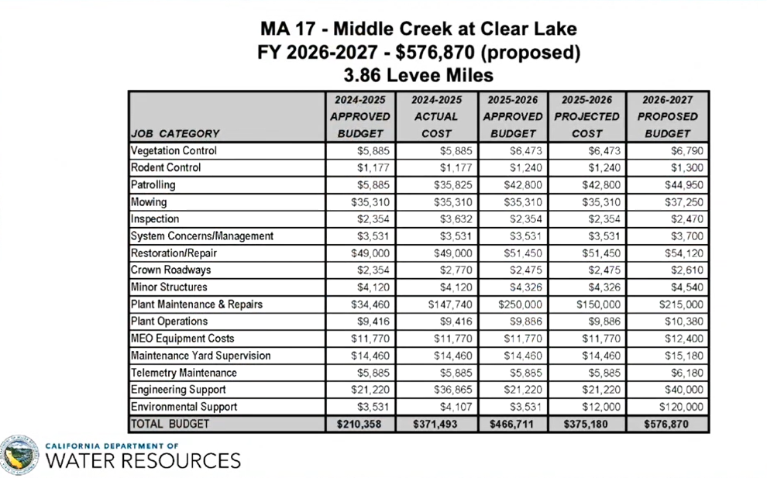

Slide 8
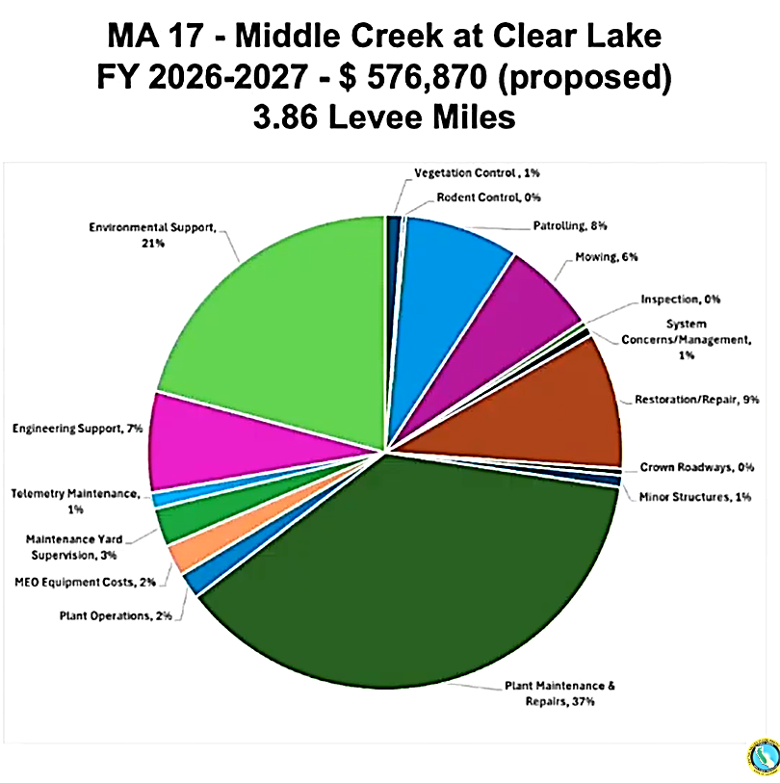

Slide 9
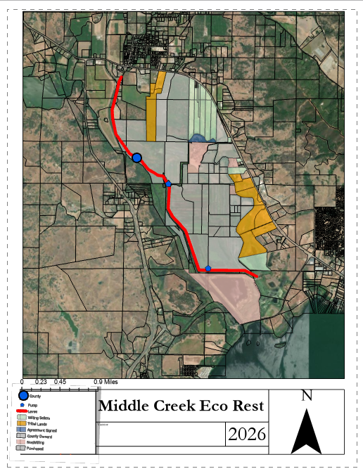
Pump
Levee
Willing Sellers
Tribal Lands
Agreement Signed
County-Owned
Non-willing
Purchased
The area behind the USACE levees include both Lake County Zone 8 and CA MA17.
The State MA17 area is behind < 2 miles of levees.
Lake County already maintains areas behind ~2 miles of the same levees.
The cost per size of the area maintained behind MA17 levees is disproportionate relative to other state MA’s.
The largest (39-56%) and fast-growing cost that Lake County pays the State is maintenance and repair of the DWR Pumping Station.
Does Lake County need the DWR Pumping Station to be operated and maintained currently and in the future?

Slide 10
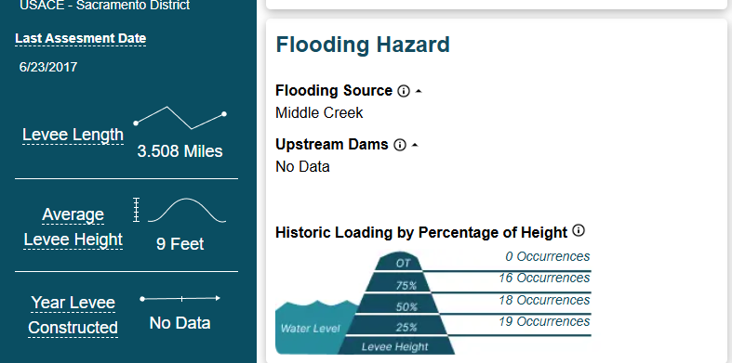

Slide 11
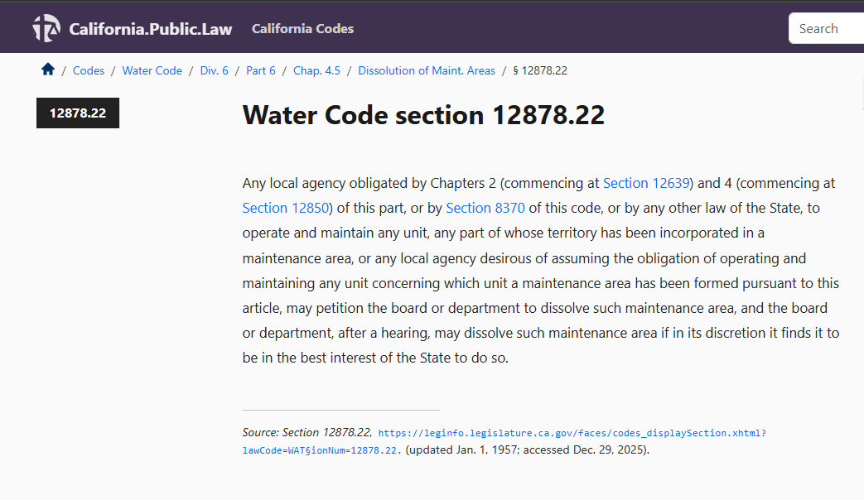

Slide 12

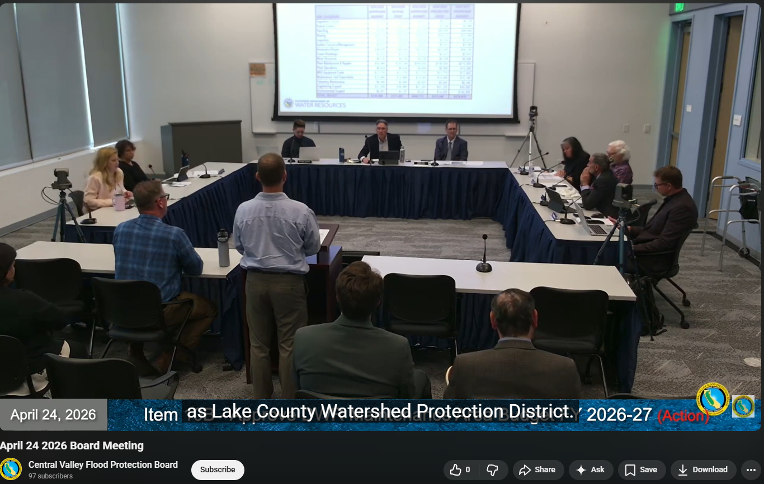
DWR and CVFPB determine the budget to be spent on State maintenance areas, which are billed to the County.
Lake County Water Resources Director Upadhyay to CVFPB: “In the last five years, the budget has gone from roughly $100,000 to roughly $500,000 annually. This fivefold increase is something very difficult for us to pass to our constituents. Additional to that, this facility services mainly agricultural areas that are no longer in production and have been identified as part of the Middle Creek ecosystem.”
DWR Division of Flood Management to CVFPB:
“Lake County is welcome to move to dissolve MA 17, but at this time, we need a budget.”

Slide 13
Considerations for Taking Back O&M, Maintaining the Area Like Zone 8, and Dissolving MA17:
Plant has not been working at a high efficiency for the last 19 years, with at least one pump not working at all.
Planning with PG&E is ongoing to disconnect the facility’s power, in relation to the MCRP.
County now owns the currently non-producing agricultural lands that could be effected, yet it is now that DWR seeks rapidly rising rate of payment.

Slide 14
All,
During our previous meeting and at the CVFPB meeting last week Lake County staff mentioned it may be time to take back the O&M responsibility for MA17. This would require a legal process to be initiated by Lake County. We are available to discuss this further and hope we can find a likely path to this.
Although the MA17 budget was passed and included increased assessments for ongoing maintenance, including a large increase for the required rehabilitation of the Middle Creek pumping plant, if Lake County takes over and MA17 is dissolved prior to those expenditures being completed, any unused MA17 funding that has been paid to DWR would be returned to Lake County once all of the MA17 debits and credits are processed and the books are closed.
Therefore, the sooner Lake County takes over, the more likely budgeted funds may go unused, reducing actual expenditures before MA17 is dissolved, and flood work for this area reverts back to local control and responsibility.
Please let us know if you would like to meet and get input on the process to take over MA17.
Thank you,
Mark R. List, P.G., CEG, CHG
Supervising Engineering Geologist
FMO/Technical Support Section Manager
State of California
Department of Water Resources
Division of Flood Management
3310 El Camino Ave., Room 110
Sacramento, CA 95821

Slide 15
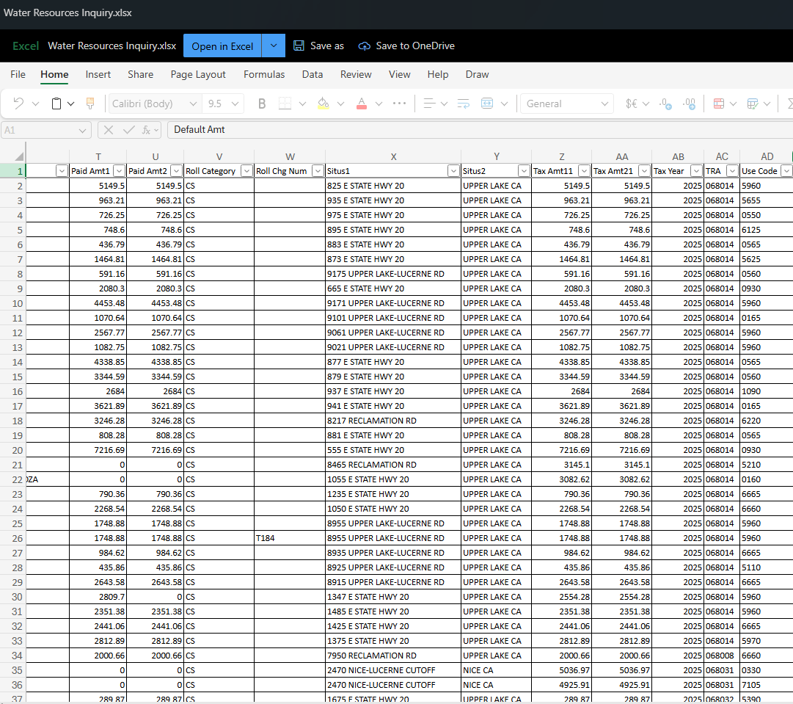

Slide 16
Which puts the ball in our court re: MA 17 operation and maintenance.

