Slide 1
Lake County Multi-Jurisdiction
Hazard Mitigation Plan
Lake County Board of Supervisors

Slide 2
Plan Structure
Base Plan
Clearlake Annex
Lakeport Annex

Slide 3
Chapters 1: Introduction
Organization
Public Information Sessions
Organize Resources
Assess Risks
Plan Development
Implement & Monitor
Meeting Type | Meeting topic | Meeting Date | Meeting Locations
Public Session #1 | 1) Introduction to the Multi-Jurisdictional Hazard Mitigation Plan 2) Update Process 3) Hazard Identification 4) Public Engagement | September 23, 2024 | Clearlake City Hall and via Zoom
Public Session #2 | 1) Introduction to the Multi-Jurisdictional Hazard Mitigation Plan 2) Update Process 3) Hazard Identification 4) Public Engagement | September 24, 2024 | Lakeport City Hall and via Zoom
Public Session #3 | 1) Introduction to the Multi-Jurisdictional Hazard Mitigation Plan 2) Update Process 3) Hazard Identification 4) Public Engagement | September 30, 2024 | Via Zoom
Public Session #4 | 1) Introduction to Presenters, Hazard Mitigation Plan and Update Process 2) Mitigation Actions 3) Assess Risks & Capabilities | December 12, 2024 | Via Zoom
Hazard Mitigation Planning Committee
Meeting Type | Meeting Topic | Meeting Date(s) | Meeting Location(s)
HMPC Meeting #1 | 1) Committee Expectations & Roles 2) MJHMP Update Overview 3) Phase 1 – Organize Resources 4) Phase 2 – Assess Risks and Profiling Hazards | October 23, 2024 | Emergency Operations Center, Lakeport & Via Zoom
HMPC Meeting #2 | 1) MJHMP Progress Status Update 2) MJHMP Update Draft – Hazard Profiles 3) MJHMP Mitigation Actions | November 20, 2024 | Via Zoom
HMPC Meeting #3 | 1) MJHMP Progress Status Update 2) MJHMP Update Draft 3) Plan Implementation | December 12, 2024 | Via Zoom

Slide 4
Public Outreach
Working Group
HMP Committee
Public Input
Stakeholders from County Departments, both Cities, Special Districts, Utilities, state and federal agencies connected to Lake County, community organizations including homeowner associations, councils, fire-wise community representatives and others, non-profit and faith-based providers, including agencies that work with seniors, AFN and minority communities were invited and encouraged to participate in the entire planning process through regular invitations and updates.

Slide 5
Hazard Mitigation Planning Committee
Name | Title | Representing
Dakhota Hockett | Emergency Event Fiscal Manager | Auditor-Controller
Rob Howe | Sheriff | Sheriff/OES
Ron Ladd | Public Works Superintendent | City of Lakeport
Adeline Leyba | Public Works Director | City of Clearlake
David Fromer | Individual | District 1
Russ Cremer | Individual | District 2
Rob Young | Individual | District 3
David Brown | Individual | District 4
Jessica Fitzgerald | Individual | District 5

Slide 6
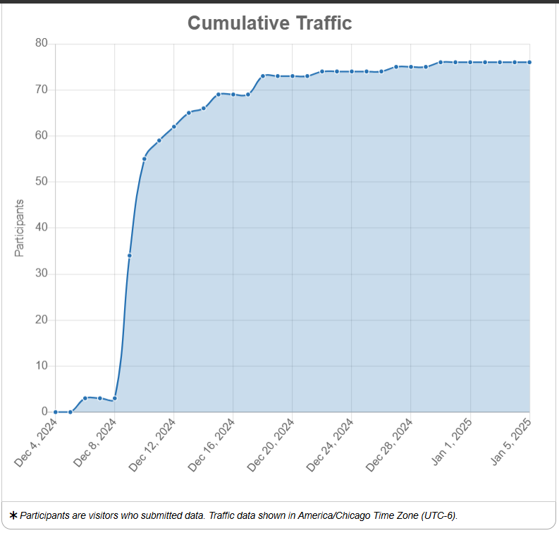
MJHMP Survey
The Lake County 2025 Multi-Jurisdictional Hazard Mitigation Survey was available for public input from December 05, 2024, through January 05, 2025. The survey was available to Lake County via
  Social Media
  Email Distribution
  Public Information Session
  Project Websites
75 Participants

Slide 7
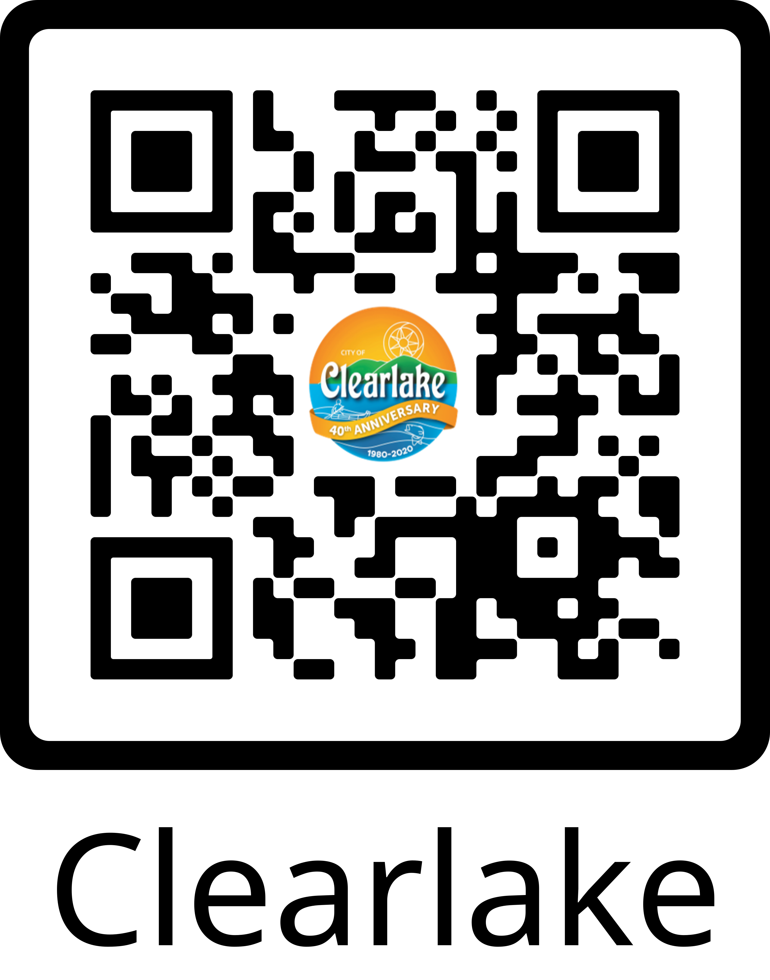
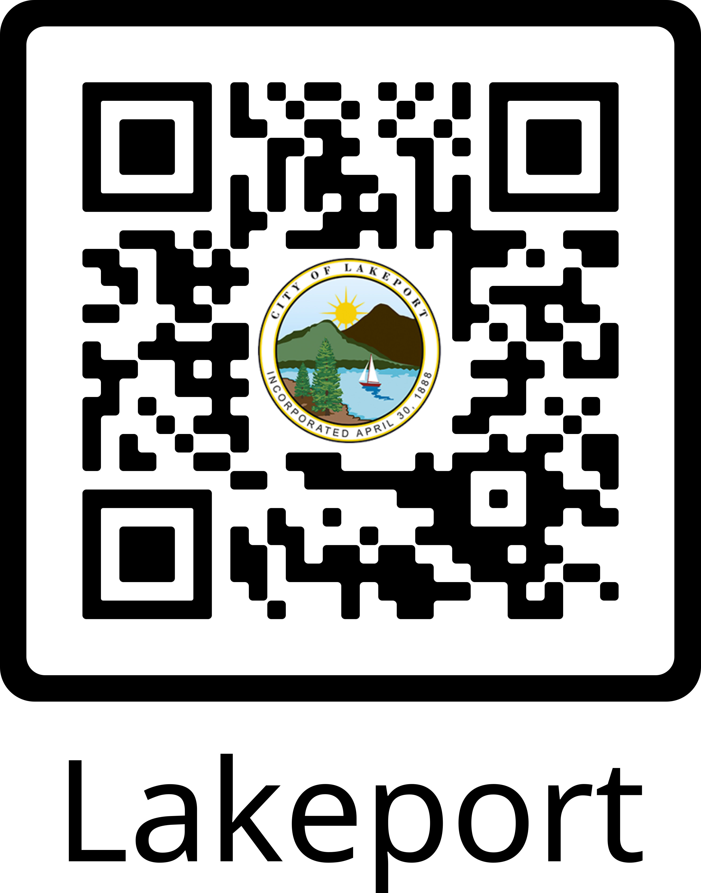

Project Websites

Slide 8
Chapter 2: Hazards of Concern
*Hazards are included as secondary hazards.
±Profiles combined, see below.
Hazard | Included in 2023 Update? | Include in 2024 Plan? | Lakeport | Clearlake
Drought & Water Shortage | Yes | Yes | Yes | Yes
Wildfire | Yes | Yes | Yes | Yes
Earthquake | Yes | Yes | Yes | Yes
Severe Weather: Storms (Heavy Rain, Wind, Snow, Freeze) | Yes | Yes | Yes | Yes
Epidemic/Pandemic/Vector Borne Disease Hazards | No | No | No | No
Severe Weather: Extreme Heat | Yes | Yes | Yes | Yes
Aquatic Biologic Hazards: Invasive Species | Yes | Yes | Yes± | Yes±
Flood | Yes | Yes | Yes± | Yes±
Tree Mortality | No | Yes | Yes | Yes
Climate Change | Yes | Yes | Yes± | Yes±
Landslide & Debris Flows | No | No | Yes* | Yes*
Levee Failure | Yes | Yes | Yes | Yes
Geothermal Concerns (Seismic, Environmental) | No | No | Yes± | Yes±
Hazardous Materials Transportation | No | No | No | No
Oil Spills | No | No | No | No
SEICHE | No | No | Yes* | Yes*
Terrorism | No | No | No | No
Ag Hazards (i.e. insect pests/smoke taint) | Yes | Yes | Yes* | Yes*
Air Pollution | No | No | No | No
Dam Failure | Yes | Yes | Yes | Yes
Volcano and Geothermal Gasses | No | Yes | Yes | Yes
Avalanche | No | No | No | No
Coastal Flooding/Erosion, Sea Level Rise | No | No | No | No
Radiological Accidents | No | No | No | No
Subsidence | Yes | Yes | Yes* | Yes*
Tsunami | No | No | No | No

Slide 9
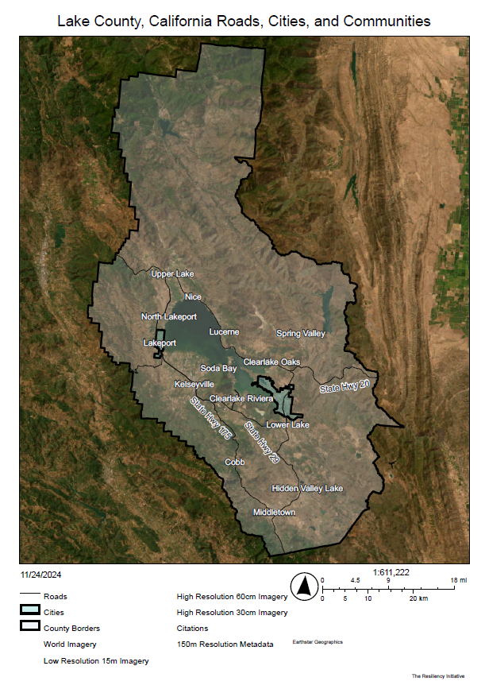
Chapter 3: Profiling
Education
Bachelor's Degree or Higher
Housing
Total Housing Units
34,220
Population & People
Total Population
68,878
16.8%
Households
Total Households
26,092
Employment
Employment Rate
Health
People with 1 or more disabilities
Income & Poverty
Median Household Income
$59,444
48.8%
Business & Economy
Total Employer Establishments
22.2%
1,092

Slide 10
Chapters 4- 15: Hazard Profiles
Earthquake
Wildfire
Tree Mortality
Aquatic Hazards
Drought
Flood
Levee Failure
Dam Failure
Severe Weather – Extreme Heat
Severe Weather
Volcano | Geothermic Gas Release

Slide 11
Chapter 16: Mitigation Actions
Clearlake
32 Mitigation Actions
Lakeport
52 Mitigation Actions
Lake County
55 Mitigation Actions

Slide 12
Chapter 17: Compliance with NFIP
National Flood Insurance Program
Community Rating System
Lake County has participated in the Regular Phase of the NFIP since October 17, 1978. Since then, the County has administered floodplain management regulations that meet the minimum requirements of the NFIP.
The County of Lake participates in the Community Rating System (CRS) through the NFIP. Currently, Lake County has a Class 7 Rating, which affords Lake County residents a 15% discount on their flood insurance policies.

Slide 13
Chapter 18 – 19
Plan Adoption and Maintenance
Data Sources
Adoption
Implementation
Maintenance
  Ongoing: Annually review and following any significant hazard event or disaster declaration
  5 Year Update Cycle
List of Figures
List of Tables
Data Sources

Slide 14
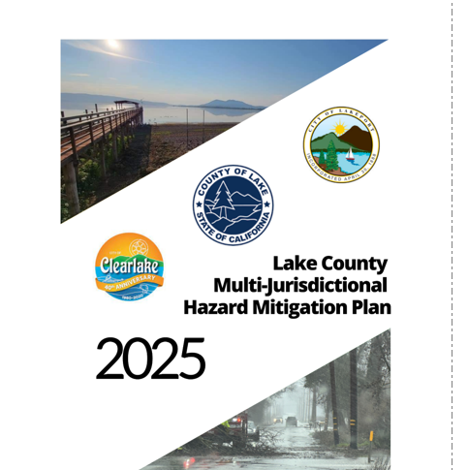
MJHMP Plan Adoption
HMP Committee Approval
CalOES Review, Revisions, and Approval
FEMA Review and Approval
The City of Clearlake Approval
The City of Lakeport Approval
Lake County Board of Supervisors Approval
Final 2025 MJHMP Adopted Plan

