Slide 1


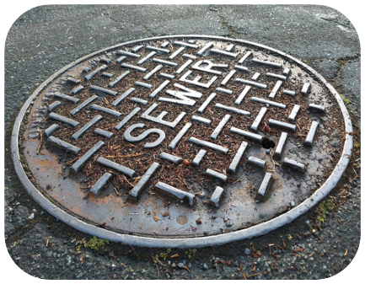

Sewer Rate Study
Land’s End County Sanitation District Regional Collection Area
March 24, 2026

Slide 2

Background
The Land’s End service area is a collection system that contracts with the City of Lakeport for treatment and serves about 170 homes and about 60 businesses
The District has implemented annual CPI increases in recent years
Last rate study was done in 2011.
Despite inflationary increases, utility rates have fallen behind the cost of service
Each rate structure is also proposed to be adjusted to better reflect current sewer flow patterns
Rate study will cover a 5-year period
  Rates adjusted each July 1 beginning 2026 to 2030

Slide 3
Legal Requirements: Proposition 218
Governs how property-related charges are adopted
  Covers rates over a maximum 5-year period
  Rates must be based on the reasonable cost of service and proportionally recover costs based on how customers take service
Procedural requirements:
  Conduct a rate study
  Mail a notice to property owners in English and Spanish
  Hold a public hearing a minimum of 45 days after notice is mailed
  Rates cannot be adopted if more than 50% of parcels submit written protests

Slide 4
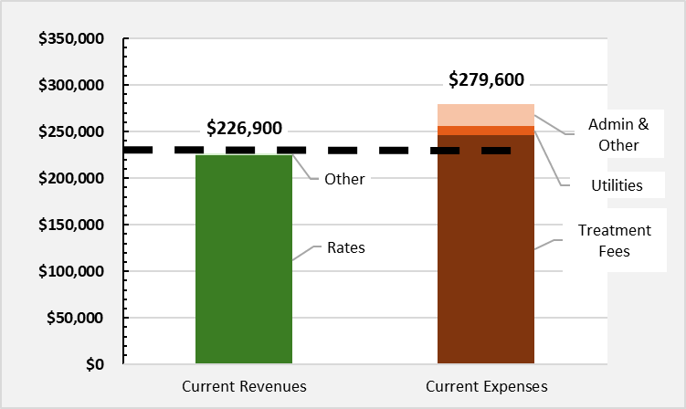
Cost of Service Analysis
Financial Status
  Revenues of about $226,900 will not cover operating costs of $279,600
  City of Lakeport charges about $245,000 for treatment; Lake County has no control over this cost
  Operating Fund is projected to end this year with a negative fund balance of ($52,700)
  Capital Fund is projected to end this year with a negative fund balance of ($2,900)
Rate increases are needed to fund operating expenses, deferred maintenance and accumulate operating reserves
Capital improvement fee increase is needed to fund upcoming projects such as software upgrades, SCADA, air release valves, Land’s End’s share of a pumper truck, and to accumulate reserves

Slide 5
Review of Current Monthly Sewer Rates
BASE RATE | Billing unit | February 15, 2025
Residential | dwelling unit | $72.93
Low Strength Commercial | each | $72.93
Medium Strength Commercial | each | $219.56
High Strength Commercial | each | $394.34
IN ADDITION TO THE BASE RATES ABOVE
Convalescent/Group Home/Hospital/Detention | per bed | $36.33
Hotel/Motel w/o kitchen | per room | $7.97
Hotel/Motel with kitchen | per room | $12.09
Hotel/Motel (permanently occupied) | per room | $36.33
Laundromat | per machine | $26.09
Theater or Drive-in | per seat/car space | $0.59
Bars and Lounge or Restaurants | per seat over 33 | $1.51
RV & Campgrounds w/o sewer hookup | per space | $4.94
RV & Campgrounds with sewer hookup | per space | $12.09
Schools w/o cafeteria or showers | per student | $1.99
Schools w cafeteria & showers | per student | $4.09
ADDITIONAL CHARGES – ALL CUSTOMERS
Capital Improvement Fee | each customer | $4.50

Slide 6
Sewer Rate Design
Proposed fixed rates are based on estimated sewer flows and pollutant loadings of each customer class
Data from the wastewater treatment plant and water use data from the past 3 years are used to estimate sewer flows
Multi-family Residential customers are proposed to be moved to a separate rate category from single family residential customers
  Multi-family customers are proposed to have a lower rate
  Average single family residential flow is 210 gallons per day and multi-family flow is 160 gallons per day per dwelling unit
Schools and daycares are proposed to be combined into one customer category

Slide 7
Single Family Residential Sewer Rates
 | FY2025/26 | FY2026/27 | FY2027/28 | FY2028/29 | FY2029/30 | FY2030/31
 | Current | July 1, 2026 | July 1, 2027 | July 1, 2028 | July 1, 2029 | July 1, 2030
MONTHLY RATES
Base Sewer Rate | $72.93 | $126.03 | $136.11 | $147.00 | $158.76 | $171.46
CIP Fee | $4.50 | $8.00 | $8.00 | $8.00 | $8.00 | $8.00
Total | $77.43 | $134.03 | $144.11 | $155.00 | $166.76 | $179.46
$ Increase |  | $56.60 | $10.08 | $10.89 | $11.76 | $12.70
% Increase |  | 73% | 8% | 8% | 8% | 8%
163 single family homes and 7 duplexes
First base rate increase reverses the deficit (i.e. minimum increase needed to cover operating costs)
Further rate increases are needed to keep up with inflation, fund $50,000 per year of deferred maintenance and rebuild reserves up to the target of 6 months of operating costs

Slide 8
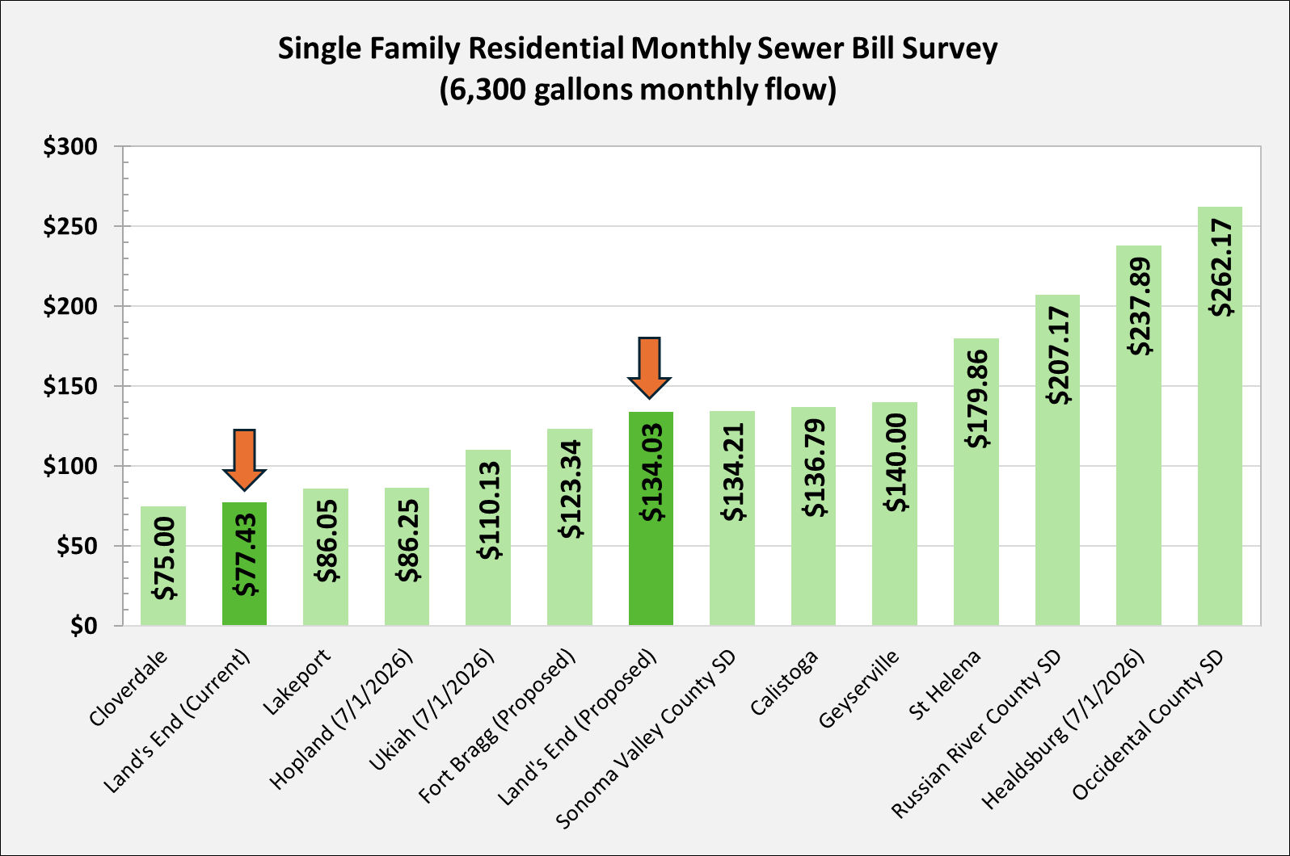
Sewer Rate Survey

Slide 9
Proposed Monthly Sewer Rates
Customer Class | Units | Current Rate | Proposed Rate July 1 | Rate Change | # of Customers
BASE RATE
Single Family Residential | Dwelling Unit | $72.93 | $126.03 | 73% | 163
Multifamily Residential | Dwelling Unit | $72.93 | $96.02 | 32% | 10
Low-Strength Commercial | Each | $72.93 | $141.30 | 94% | 54
Medium-Strength Commercial | Each | $219.56 | $360.08 | 64% | 5
High-Strength Commercial | Each | $394.34 | $705.36 | 79% | 2
Customer Class | Units | Current Rate | Proposed Rate July 1 | Rate Change | # of Customers
BASE RATE
Single Family Residential | Dwelling Unit | $72.93 | $126.03 | 73% | 163
Multifamily Residential | Dwelling Unit | $72.93 | $96.02 | 32% | 10
Low-Strength Commercial | Each | $72.93 | $141.30 | 94% | 54
Medium-Strength Commercial | Each | $219.56 | $360.08 | 64% | 5
High-Strength Commercial | Each | $394.34 | $705.36 | 79% | 2
IN ADDITION TO THE BASE RATE
Convalescent/Group Home/Hospital/Detention | per bed | $36.33 | $45.01 | 24% | 0
Hotel/Motel w/o kitchen | per room | $7.97 | $23.55 | 195% | 0
Hotel/Motel with kitchen | per room | $12.09 | $45.01 | 272% | 0
Hotel/Motel (permanently occupied) | per room | $36.33 | $96.02 | 164% | 0
Laundromat | per machine | $26.09 | $70.65 | 171% | 0
Theater or Drive-in | per seat or car space | $0.59 | $0.94 | 59% | 465
Bars and Lounge or Restaurants | per seat over 33 | $1.51 | $1.88 | 25% | 0
RV & Campgrounds w/o sewer hookup | per space | $4.94 | $7.07 | 43% | 0
RV & Campgrounds with sewer hookup | per space | $12.09 | $45.01 | 272% | 0
Schools w/o cafeteria or showers | per student | $1.99 | $3.77 | 89% | 0
Schools w cafeteria & showers | per student | $4.09 | $3.77 | -8% | 0

Slide 10
Full Rate Schedule
 |  | Current | Proposed
 |  | FY2025/26 | FY2026/27 | FY2027/28 | FY2028/29 | FY2029/30 | FY2030/31
 |  |  | July 1, 2026 | July 1, 2027 | July 1, 2028 | July 1, 2029 | July 1, 2030
Description | Billing Unit |  | Varies | +8% | +8% | +8% | +8%
BASE RATE
Single Family Residential | per dwelling | $72.93 | $126.03 | $136.11 | $147.00 | $158.76 | $171.46
Multifamily Residential | per dwelling | $72.93 | $96.02 | $103.70 | $112.00 | $120.96 | $130.63
Low-Strength Commercial | each | $72.93 | $141.30 | $152.60 | $164.81 | $178.00 | $192.24
Medium-Strength Commercial | each | $219.56 | $360.08 | $388.88 | $419.99 | $453.59 | $489.88
High-Strength Commercial | each | $394.34 | $705.36 | $761.78 | $822.73 | $888.54 | $959.63
IN ADDITION TO THE BASE RATES ABOVE
Convalescent/Group Home/Hospital/Detention | per bed | $36.33 | $45.01 | $48.61 | $52.50 | $56.70 | $61.24
Hotel/Motel w/o kitchen | per room | $7.97 | $23.55 | $25.43 | $27.47 | $29.67 | $32.04
Hotel/Motel with kitchen | per room | $12.09 | $45.01 | $48.61 | $52.50 | $56.70 | $61.24
Hotel/Motel (permanently occupied) | per room | $36.33 | $96.02 | $103.70 | $112.00 | $120.96 | $130.63
Laundromat | per machine | $26.09 | $70.65 | $76.30 | $82.41 | $89.00 | $96.12
Theater or Drive-in | per seat/car space | $0.59 | $0.94 | $1.02 | $1.10 | $1.18 | $1.28
Bars and Lounge or Restaurants | per seat over 33 | $1.51 | $1.88 | $2.03 | $2.19 | $2.37 | $2.56
RV & Campgrounds w/o sewer hookup | per space | $4.94 | $7.07 | $7.63 | $8.24 | $8.90 | $9.61
RV & Campgrounds with sewer hookup | per space | $12.09 | $45.01 | $48.61 | $52.50 | $56.70 | $61.24
Schools w/o cafeteria or showers | per student | $1.99 | $3.77 | $4.07 | $4.40 | $4.75 | $5.13
Schools w cafeteria & showers | per student | $4.09 | $3.77 | $4.07 | $4.40 | $4.75 | $5.13
Capital Improvement Program (CIP) Fee | each | $4.50 | $8.00 | $8.00 | $8.00 | $8.00 | $8.00

Slide 11
Wrap Up

