Slide 1
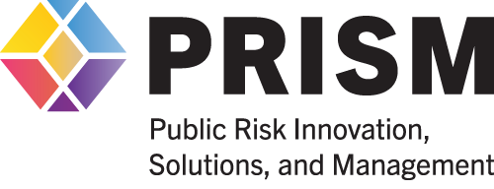

Casualty Market Coverage, Cost Drivers & Primary Coverage Change
for Lake County Board of Supervisors
Presenters
Gina Dean, PRISM CEO

Slide 2

About PRISM
We are a Member-Directed Risk Sharing Pool
  Established in 1979 – Name Change in July 2020 from CSAC EIA
  Joint Powers Authority with primary goal: serve CA public agencies
  Create cost effective/member directed insurance risk pools
  Contain costs & provide in-depth services
  54 of 58 Counties; 311 California Public Entities (approx. 2k organizations); 11 Non-California Participants (approx. 260 organizations)
2.3B
67B
1.56M
94B
140K
Premium
Payroll
Daily Attendance
Total Insured Val.
Employee Lives
Notes:
GINA
Largest JPA in the nation
Property – Largest EQ buyer in the world
Large size and economies of scale = more stability, better valued priced insurance market deals, and deals from our service vendors

Slide 3



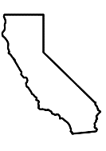

Risk Sharing
PRISM is not traditional insurance, it is a member-directed risk sharing pool.
Member contributions are pooled for:
Payment of claims
Purchase of reinsurance
Member services
Administration
Investment
Contributions are based on annual budget.
Notes:
GINA
PRISM is not traditional insurance. It was formed by its members as a Risk Sharing Pool. It is funded by member contributions which are pooled to pay claims, purchase reinsurance, provide member services, pay for administration and to invest monies for payment of future expenses.
Members benefit from PRISM’s size. The large membership allows for economy of scale when negotiating with reinsurers. Further, the diversification of risk among members – different types and sizes of agencies, and different geographic locations – make the group more appealing to underwriters. Monies coming into PRISM allow for development of members services and risk control programs that would probably not be available to members operating independently.
How much members pay is based on PRISM’s annual budget.

Slide 4
Lake County Participation
Founding Member in 1979
Program | Participant Since
Workers’ Compensation | 11/1/1979
Liability | 7/1/1980
Property | 1/1/1993
Health | 1/1/2011
*County participated in prior years (1991-2009)
Notes:
Gina

Slide 5




Cost Drivers
Specifics vary by program, but generally:
Exposure base (property values, payroll, etc.)
Actuarial estimates of losses for pool layers
Insurance market
Investment returns
Notes:
GINA
There are a few major cost drivers for PRISM’s budget – in other words, there are a few main things that make our budgeted expenses go up or down:
First is exposure base – which is what, and how much of something we are covering. For example, if we cover more employees for workers’ compensation, the exposure base - and associated risk of loss - necessarily goes up.
Next is loss estimates – which is what are our actuaries estimate losses will cost the pool. For example, if the prevailing cost of medical care for workers’ compensation claims is increasing, that will increase costs to the pool and more must be collected from the membership to cover losses.
Next, insurance markets – those determine what kind of reinsurance coverage is available on the open market and how much it will cost PRISM to transfer risk outside the pool.
Finally, we have investment returns – which is how much PRISM’s investments yields can offset costs. The more money we earn on investments, the less money must be collected from members.

Slide 6
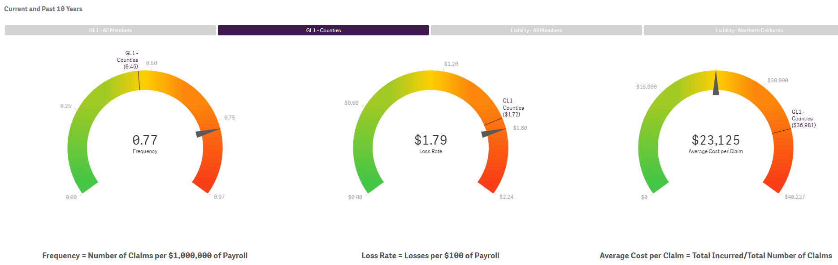
Lake County’s Experience
 | Lake County | Other PRISM Counties
Frequency | .77 | .46
Loss Rate | $1.79 | $1.72
Avg. Cost Per Claim | $23,125 | $36,981
Notes:
GINA
There are a few major cost drivers for PRISM’s budget – in other words, there are a few main things that make our budgeted expenses go up or down:
First is exposure base – which is what, and how much of something we are covering. For example, if we cover more employees for workers’ compensation, the exposure base - and associated risk of loss - necessarily goes up.
Next is loss estimates – which is what are our actuaries estimate losses will cost the pool. For example, if the prevailing cost of medical care for workers’ compensation claims is increasing, that will increase costs to the pool and more must be collected from the membership to cover losses.
Next, insurance markets – those determine what kind of reinsurance coverage is available on the open market and how much it will cost PRISM to transfer risk outside the pool.
Finally, we have investment returns – which is how much PRISM’s investments yields can offset costs. The more money we earn on investments, the less money must be collected from members.

Slide 7

Why Are Costs Continuing to Increase?
Nuclear Verdicts
Social Inflation
and
Nuclear Verdicts
The Court Backlog
Court cases with verdicts above $20M
Source: Verdict Search, Inside P&C
Notes:
Kevin

Slide 8
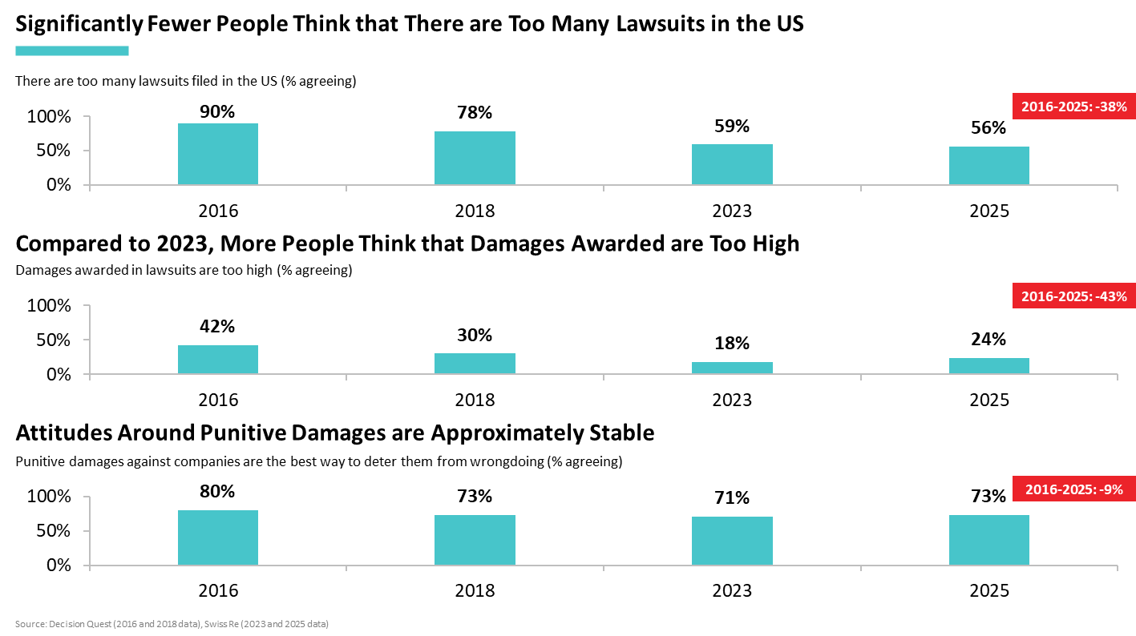

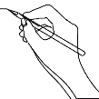
Why Are Costs Continuing to Increase?
Notes:
Kevin

Slide 9
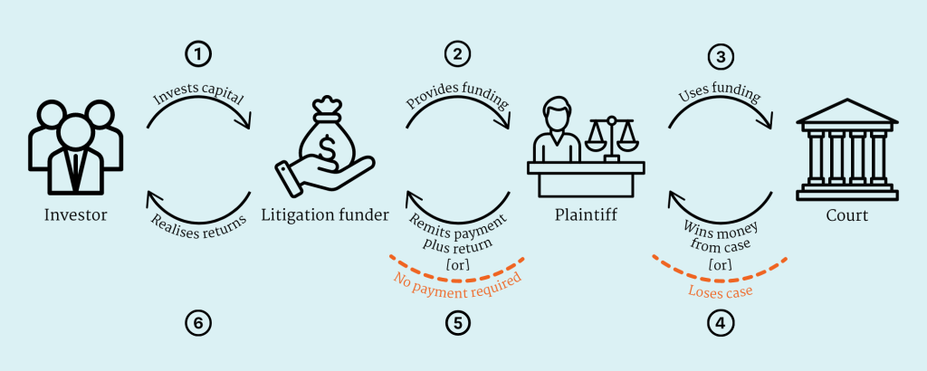
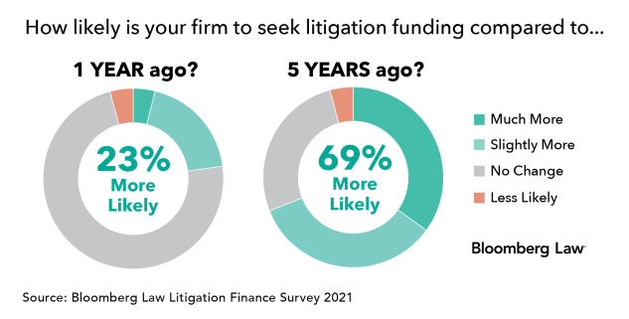
Why Are Costs Continuing to Increase?
Litigation Funding
Notes:
Seth

Slide 10
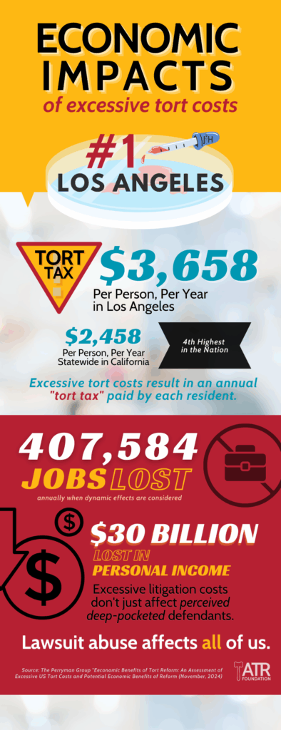
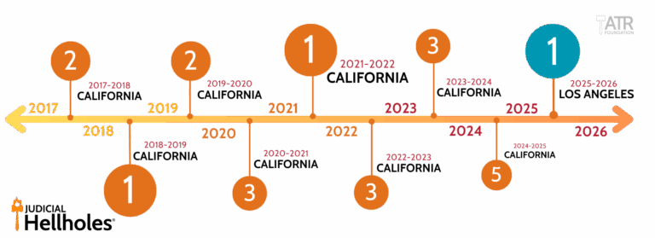
Why Are Costs Continuing to Increase?
Jurisdiction
$2,458 Per Person, Per Year Statewide in CA!
Notes:
Seth

Slide 11



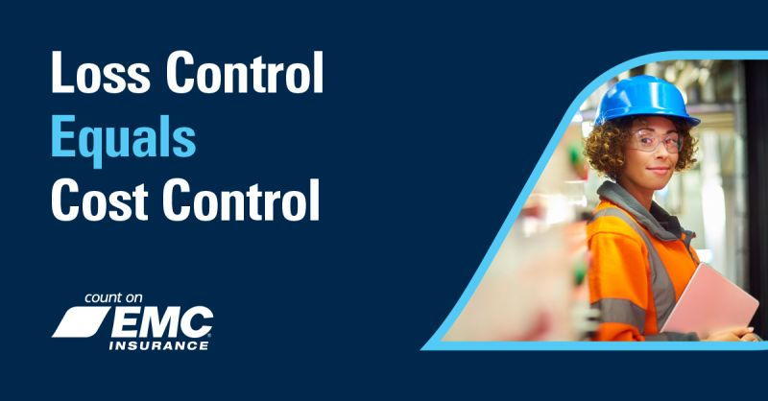
What is PRISM Doing About it?
  Underwriting
  Development of efficient program structures
  Equitable allocations
  Assists with member retention analysis
  Claims
  Assists in setting accurate reserves
  Recommends experts and other experts
  Assist in strategy and advise on settlement negotiations
  Data & Analytics
  On staff actuarial and data analytics expertise, and a Data Scientist
  Predict future costs and establish appropriate funding
  Identify trends, emerging risks and opportunities for loss control
  Loss Control/Member Services
  Tailored trainings and other services to address identified loss trends
  Identify and manage contracts with 3rd party resources for the members
  Manage the Enterprise Risk Consultant program available to the members
Notes:
Gina

Slide 12
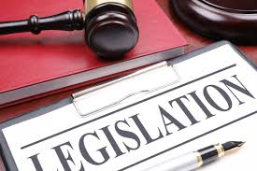


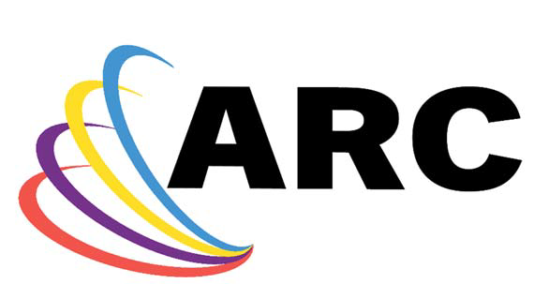
What is PRISM Doing About it?
  Legislative Efforts
  Legislative Committee works with PRISM’s lobbyist to support/oppose bills
  PRISM works with other JPAs to gather/analyze data to support legislation
  Support specific claims through Amicus briefs
  Long Term Carrier Relationships
  PRISM and Alliant work throughout the year to maintain good carrier relationships
  Many have lasted over 25 years
  Incredibly valuable during difficult market conditions or complex claims situations
  Captive Insurance Company
  PRISM developed a Captive Insurance Company
  PRISM Affiliated Risk Captive
  Allows for better investment returns thereby reducing the cost to the members
PRISM | Portfolio | ARC
4.73% | Liquidity | 4.74%
6.39% | Core | 6.99%
N/A | Equity | 12.39%
5.73% | Consolidated | 7.70%
Consolidated Earnings: 7.03%
* Earnings as of 6/30/25
Notes:
Gina

Slide 13
What Can the County Continue Doing?
Take advantage of risk prevention and cost control programs offered through PRISM
Stay current on maintenance, inspections and training
Consider assuming more risk
Vigorously defend claims that are defensible
Ensure you can provide high-quality data
Support legislative change that is beneficial to defendants
Consider purchasing additional coverage limits
Help educate the public that the costs of nuclear verdicts are not borne by the insurance industry, but rather by public entities and ultimately the taxpayers
Notes:
Gina 1-4
Seth 5-8

Slide 14
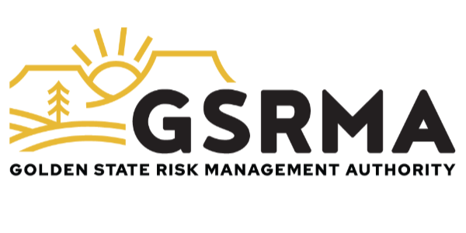
Lake County Options to Transition Primary Liability Coverage
Gina Dean, PRISM Chief Executive Officer
Scott Schimke, Golden State Risk Management Authority Executive Director
Notes:
PRISM Staff
Thank you for your time
Purpose is to check in and see how things are going, any new needs, go over services
Slides help to provide some structure, but the meeting is meant to be conversational
Also attending the meeting are your Alliant brokers
Alliant is our brokerage partner and has been for many years. They provide a number of different services for the EIA and its mbrs, one of which is being the primary contact for our PE mbrs
I will make this PPT available to download after the meeting

Slide 15
Why Transition is Needed
PRISM formed a primary liability coverage option in 1998
The Primary General Liability Program grew slowly, and eventually larger members returned to a self-insured retention
To reduce administrative burden to continuing members, the Primary General Liability Program was merged into the General Liability 1 Program in 2018
Since then, additional members have returned to an SIR and the reduced volume and administrative load is no longer viable
Board determined to eliminate the primary liability option effective 6/30/26
Staff has been tasked with assisting the members with a transition
Notes:
Largest JPA in the nation
Property – Largest EQ buyer in the world
Large size and economies of scale = more stability, better valued priced insurance market deals, and deals from our service vendors

Slide 16
Alternatives
Join GSRMA
Same coverage
Assume Self Insured Retention
Hire/contract claims administrator
Insurance Marketplace
Least viable option = cost and coverage
Not many options available
Claims handled by GSRMA staff
Fund for self-insured claim costs
Requires more staff time & resources
Potential for additional limits
Eliminate $10k deductible
PRISM & Staff Recommend joining GSRMA
Notes:
Largest JPA in the nation
Property – Largest EQ buyer in the world
Large size and economies of scale = more stability, better valued priced insurance market deals, and deals from our service vendors

Slide 17
About GSRMA
We are a Member-Directed Risk Sharing Pool
Est. in 1979 - Name Change in July 2000 from Glenn County JPA
Primary goal: Help CA public agencies Thrive
Sound, stable, well-funded
  351 members consisting of small to medium size public entities, including Glenn County and possibly Siskiyou County
  GL Program funded above 90% confidence level
  Continuously Accredited with Excellence by Calif. Association of Joint Powers Authority (CAJPA) since 1992
  Stable rates with history of dividends and no assessments.
Notes:
Largest JPA in the nation
Property – Largest EQ buyer in the world
Large size and economies of scale = more stability, better valued priced insurance market deals, and deals from our service vendors

Slide 18
About GSRMA
We are a Member-Directed Risk Sharing Pool
Members receive personalized attention
  Claims are managed by in-house professional claims staff
  Proactive risk management services
  RMAP, LPSF, beneficial funding options
All the PRISM services will continue to be available, plus many more directly from GSRMA
Notes:
Largest JPA in the nation
Property – Largest EQ buyer in the world
Large size and economies of scale = more stability, better valued priced insurance market deals, and deals from our service vendors

Slide 19
2026/27 Costs
GSRMA
$5,511,228
Includes claims administration & risk control services
Self-Insure
Rough Estimate $5,575,000 to $5,625,000*
*Plus other Admin costs (staff, TPA services, actuarial services, etc.)

Slide 20
Process to Join GSRMA
Lake County Board of Supervisors to approve joining GSRMA
Direct Staff to execute required documents including Joint Powers Agreement
Before end of June
Notes:
Largest JPA in the nation
Property – Largest EQ buyer in the world
Large size and economies of scale = more stability, better valued priced insurance market deals, and deals from our service vendors

