Slide 1



May 2025
Helping Lake County Cut Costs & Save Energy

Slide 2

Practical Energy Solutions, Real Savings
Seven Flexible Local Programs
  Residential Education & Outreach
  Residential Rebates
  Finance/Loan Programs
  Public Agencies
  Commercial & Small Business Direct Install/Rebates
  Workforce, Education & Training
  Codes and Standards Education
01

Slide 3

Residential Education and Outreach:
Outreach and energy awareness information to all residential utility customers in Lake County
  Local events
  Website Northernren.org
  Advertising, email marketing etc.
    Free Energy Efficiency Kits – available now!
    Free Home Energy Assessments – launching 6.2.25
Residential Education and Outreach
GOAL: Determine local energy needs & priorities, increase awareness, provide entry point to benefit from rebates and finance programs.
01

Slide 4
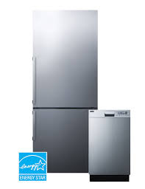
Residential Rebate Program
Energy Rebate Program for Lake County
  Rebate Finder on the website by zip code. Currently offering:
    Heat pump heating/cooling
    Heat pump water heaters
    Appliances
    Ventilation and room air conditioners
    Hope to launch insulation (attic/crawl/walls), duct sealing & insulation (including mobile homes) in the future.
Residential Rebates
GOAL: Create drivers to overcome barriers to Energy Efficiency in rural, hard to serve areas and achieve reductions in energy consumption.
01

Slide 5
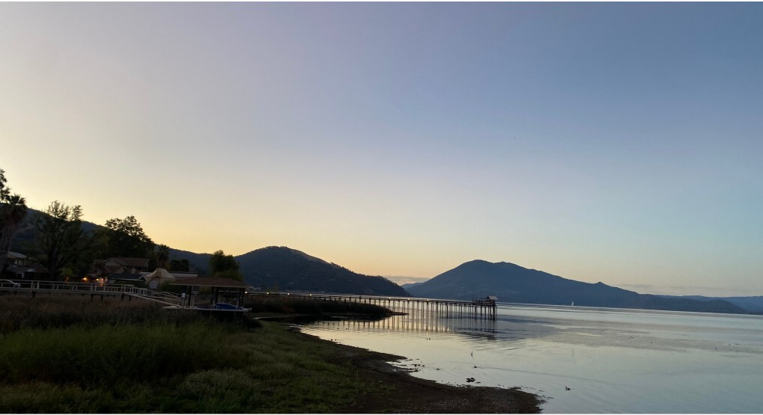
Finance Program
  0% interest loans for varying terms
  Micro loans
  Bridge loans
  Electrification loans
  Needs Assessment will be launched soon with surveys targeted at these sectors:
      Residential
      Small & Medium Sized Businesses
      Public Buildings
  Just interviewed a firm to craft the program design
  Expect programs to launch in November of 2025
Finance Programs

Slide 6

Thank You!
Jennifer Brennan
Energy Program Manager
Jbrennan@dbcteam.net
707-234-3314
Ryan O’Neill
Energy Program Specialist
Roneill@dbcteam.net
707-234-3314
Northern Rural Energy Network
Helping Lake County Cut Costs & Save Energy

