Slide 1

Poe Mountain FLASHES Project Update
22 July 2025
Michael Day
Advanced Energy Project Development Leader

Slide 2

Biggest Issues facing County
What is an ESCO?
Energy Services Contractor
Develop energy projects to solve customer problems
Bring in grants, incentives, savings to pay for some or all of the project (Self funded)
Often includes Finance
What issues topped the list for Lake County?
Fire Threat
PSPS Impacts
Lack of funds
Solution Trane and the County came up with was FLASHES

Slide 3
Trane/County of Lake Energy Project History
RFP released January 2020
Trane Selected July 2021
Letter of Commitment September 2021
Update July 2022
Grant Application July 2024
CPUC Action June 2025

Slide 4
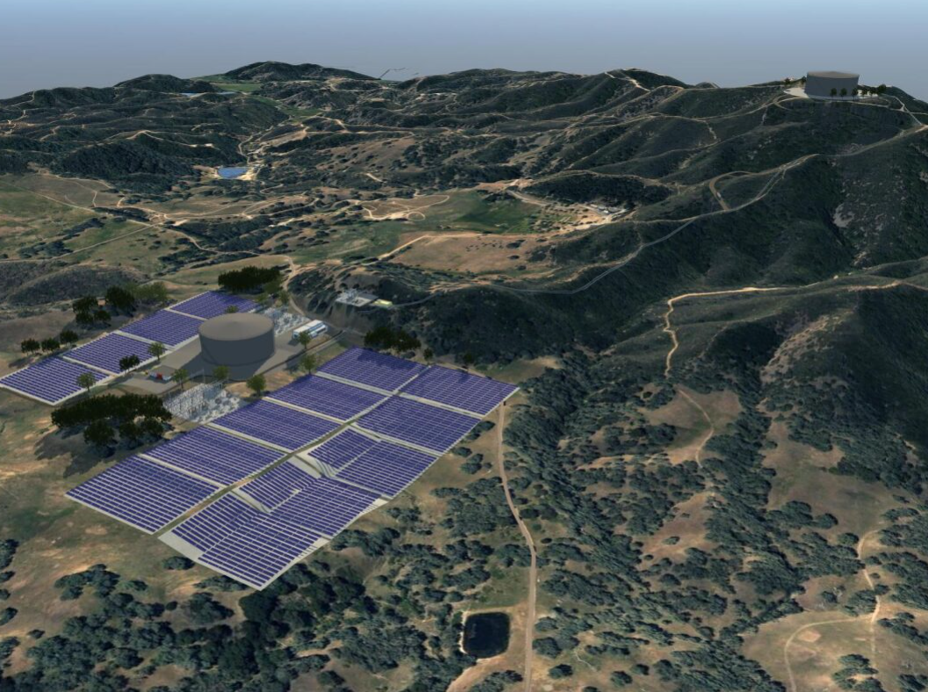
Firemain Linked Auxiliary Supply Hydraulic Energy Storage FLASHES
System Description
Super Closed Loop Pumped Storage Hydro
  Roofed Tanks, not reservoirs
  Top/Bottom of hill
30 MW PV
30 MW Pelton Wheel Turbines
Connected to two substations (Lucerne & Hartley)
Purposes
Daily Renewable power generation
Community Microgrid during outages
Firefighting support as needed

Slide 5
Feasibility Project
Project needs an in-depth Feasibility Study to proceed, but there is some risk
Study Tasks
Site Control
Surveying
Civil/Mechanical Engineering
Geotechnical
Environmental
Hydrologic Study
Cost Estimation
Environmental Review
Financial Analysis

Slide 6
Feasibility Project Status
Feasibility Project cost ~$5M
Applied for a PG&E Microgrid Incentive Program (MIP) grant to cover study costs
Grant awarded November 2024, but legal issues with PG&E contract
On June 26 2025 CPUC directed PG&E to revise contract language within 30 days
Note: Interconnection engineering and costs are in a separate PG&E MIP application currently under development

Slide 7
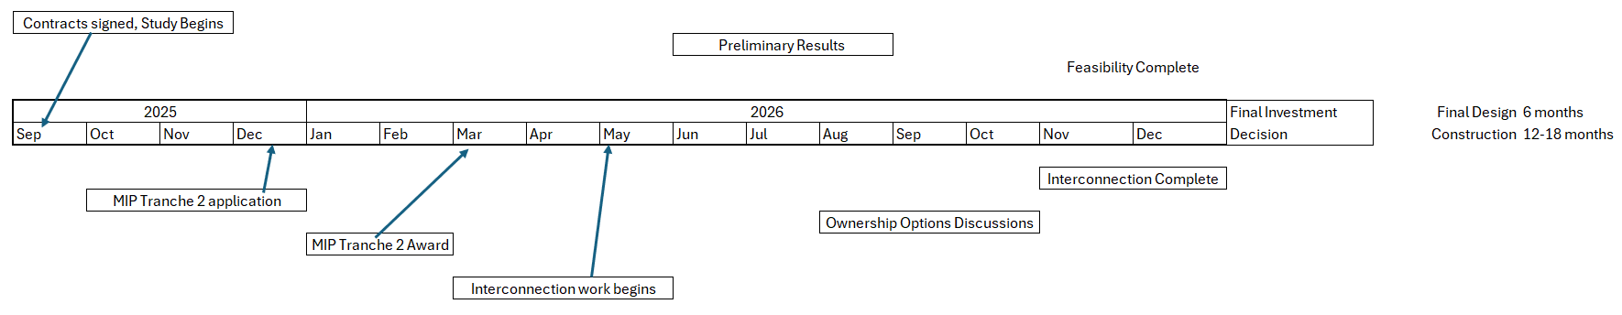
Rough Estimate of Path Forward

Slide 8
Thank You!
Michael Day,
Account Executive, Trane
Michael.day@trane.com
(916) 660-3464

