Slide 1


Lake County Behavioral Health: Path to Fiscal Recovery
Progress Update on Financial Stabilization and General Fund Loan Repayment
Elise Jones
Director, Lake County Behavioral Health Services

Slide 2
Key Objectives for Today’s Discussion
Summarize decisive actions taken to stabilize department finances and ensure sustainable loan repayment, including a no-cost, long-term partnership with the California Mental Health Services Authority’s (CalMHSA) Department of Behavioral Health Financing.
Highlight major cost savings, revenue enhancements, and improved billing practices.
Explain strategies to maintain service continuity while strengthening fiscal discipline and compliance.
Clarify legal, cash flow, and governance considerations in response to Board inquiries.
Present next steps and anticipated timeline for full loan repayment.

Slide 3
Partnership with CalMHSA
CalMHSA (California Mental Health Services Authority) is a Joint Powers Authority (JPA) formed by California counties and cities to collaboratively manage and fund statewide mental health programs.
CalMHSA’s Department of BH Financing Areas of Expertise
Enhance Operational Efficiency and Sustainability
  Advises on allowable expenses, administrative claiming, and program planning.
  The department helps counties allocate resources effectively, ensuring continuity of care without compromising fiscal health.
Deliver Advanced Fiscal Analysis and Strategic Planning
  Sophisticated fiscal modeling, cost containment strategies, and revenue optimization plans tailored to counties’ unique challenges.
Implement Medi-Cal Payment Reform Strategies
  Guidance on Medi-Cal payment reform impacts ensures counties maximize reimbursement for SMH and SUD services.
T

Slide 4
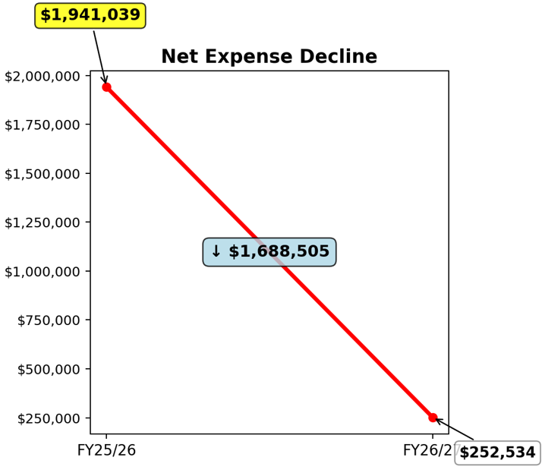
Major Cost Savings Achieved
Successfully renegotiated contract with Community Behavioral Health (CBH), effective 9/1/25:
  Realized $2.6 million in savings for the current fiscal year.
  Projected net expense for CBH to decrease from $1.94 million to $252K in FY2026/27, a reduction of $1.69 million.

Slide 5
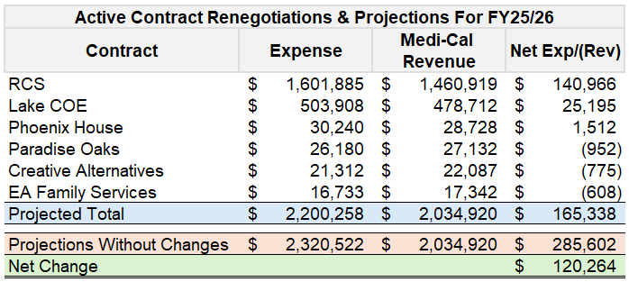
Additional Savings from Smaller Provider Contracts
Actively renegotiating contracts with multiple smaller providers.
  Expected savings for the current fiscal year: $120,264.
  Net expense projected to decline from $165,000 to $46,000 in FY2026/27.

Slide 6
Improved Billing and Revenue Capture
Partnership with CalMHSA to leverage advanced analytics and tools.
Focused on increasing billable services and optimizing billing processes.
An anticipated minimum 1% increase in billable service generation is expected to yield $211,000 in new Medi-Cal revenue starting in FY2026/27.
Ongoing collaboration to identify further billing improvements.

Slide 7
New Revenue Streams and Claiming Strategies
Working with CalMHSA to implement enhanced administrative, utilization review, and quality assurance claiming strategies.
These efforts are conservatively projected to generate at least $200,000 in new annual net revenue.
LCBHS will submit claims for FY2024/25 (+$200,000), FY2025/26 (+$200,000), and each fiscal year thereafter.
This new revenue stream will offset administrative, utilization review, and quality assurance costs, freeing up Realignment funds to support repayment of the county general fund loan.

Slide 8
Financial Position Improvement: Current Year & Next Fiscal Year
Current Fiscal Year:
Achieved $2.6 million in savings from renegotiating CBH contract
Additional $120,264 projected in savings from renegotiation of smaller provider contracts.
$200,000 in new revenue from administrative, utilization review, and quality assurance claiming.
Next Fiscal Year (FY26/27) Projections:
Net expense for CBH will drop to $252,000, a total YoY reduction of $1,688,505.
Net expense for smaller provider contracts projected to decline to $46,425.
Sustained gains from billing enhancements and new claiming initiatives, with at least $411,000 in additional annual revenue anticipated ($211,000 from billing and $200,000 from new claiming).

Slide 9
Legal Use of Funds & Restrictions
What funding sources can the department use to repay the loan?
The department plans to use Patient Care Revenue (Medi-Cal), 1991 Realignment, 2011 Realignment, and MHSA funds to repay the remaining loan balance.
The loan served as a temporary bridge to cover expenses that are eligible for these funding sources.
As eligible revenues are received, they are used to repay the loan, consistent with standard accrual accounting practices.
The department does not foresee any compliance risks/restrictions with using these funds.
Funding sources that are more challenging to use for loan repayment include:
Opioid Settlement Funding – May be used to repay loans if the loan was used exclusively for eligible opioid remediation activities; however, OSF@DHCS should be consulted prior to using OSF for this
Grant Funding – Block grants and other grant funds should not be used for loan repayment.

Slide 10
Available Cash & Liquidity Position
What is the cash on hand position?
The current unencumbered cash on hand, as of 12/1/2025, is $745,863.
The department is anticipating a Patient Care Revenue payment from Medi-Cal on 12/7 totaling several million dollars.
What is the department doing to improve its cash position?
The department has adopted a new payment approach: contracted providers are now paid after Medi-Cal revenues for their services are received.
Combined with renegotiated contract rates, this strategy is expected to significantly reduce ongoing cash shortfalls and strengthen the department’s financial stability.
The department is working collaboratively with providers to ensure payment continuity and does not anticipate any disruption to services.

Slide 11
Time to Execute Loan Repayment
Dependencies Before Loan Repayment Can Begin
Major structural changes to provider contracts and internal billing processes are underway.
These improvements are being implemented rapidly, with initial results expected within the current fiscal year.
The department will reassess its financial position in March 2026 and, at that time, present a concrete repayment timeline and amounts for the General Fund loan.
Governance
The department has secured long-term support from CalMHSA’s fiscal optimization team at no cost.
CalMHSA will provide ongoing technical assistance, training, and analytical support to strengthen internal controls and ensure sustainable financial practices, helping prevent future fiscal challenges.

Slide 12
Thank You!
Elise Jones
Director, Lake County Behavioral Health Services

