Slide 1
Behavioral Health FY 2025–26 Budget Presentation
Loan Repayment Plan & Revenue Overview

Slide 2
Revenue Outlook
• Total anticipated revenue: $39.9 million
• State Medi-Cal payments have been paused since May 1st; however, billing has remained continuous
• A significant influx of delayed reimbursements is expected between late August and early September

Slide 3
Service Growth & Community Impact
FY25–26 budget reflects intentional growth in direct service activities
Investment in front-line response aligns with statewide emphasis on crisis stabilization
Resource allocation supports rising demand for behavioral health interventions
Department is scaling to meet increased need—without reducing service access

Slide 4
Expanded Crisis Response Services
Mobile Crisis program continues to expand with increased staffing, training, and resource support
Budget reflects investments in transportation, communications, and safety tools to enhance field operations
Enhances real-time responsiveness and builds a more agile, trauma-informed field presence
Bolsters public confidence and system capacity through consistent, professional outreach

Slide 5
Fiscal Indicators of Expansion
Department budget has grown in alignment with rising service delivery
Upfront IGT contributions increased due to higher Medi-Cal service volume
Continued billing activity ensures future revenue growth
Strategic use of resources reflects a proactive approach to long-term community needs

Slide 6
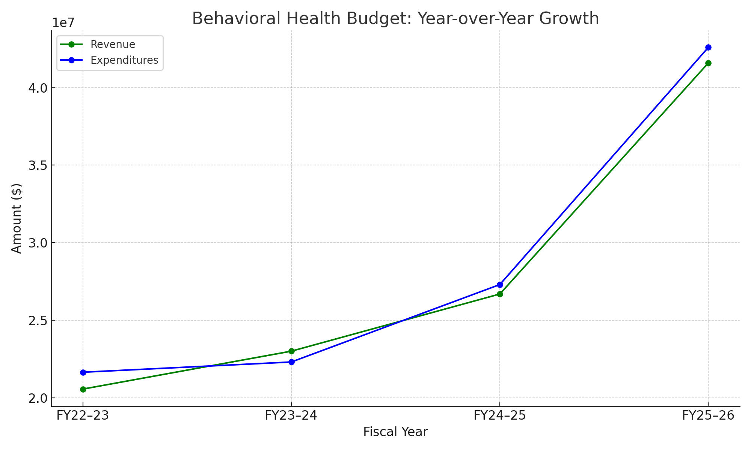
Budget Growth & Expansion FY22–23 to FY25–26
Behavioral Health revenue has doubled over four years, rising from $20.6M to $41.6M
Expenditures also increased, reflecting expansion in services, staffing, and clients reached
Annual carryover remains strong, showing responsible fiscal management during rapid growth

Slide 7

Current Cash Flow Challenge
State payment delays have created short-term cash flow constraints
Increased service utilization has significantly raised IGT (Intergovernmental Transfer) demands alongside upfront IGT contributions placing pressure on departmental liquidity
Despite the pause, billing has remained active, securing reimbursement once payments resume
Notes:
It should be noted that the yearly pause is normal, this year was different in floating payments due to IGT

Slide 8
Use of $2M Loan
Offset cash flow disruptions caused by the pause in State payments
Preserve fiscal stability to ensure timely provider payments
Maintain uninterrupted delivery of client services despite delayed reimbursements

Slide 9

Loan Payback Plan
Repayment to reserve funds will commence promptly upon restoration of cash flow
Addressing this obligation remains a top fiscal priority for the department
State reimbursements anticipated between late August and early September 2025

Slide 10
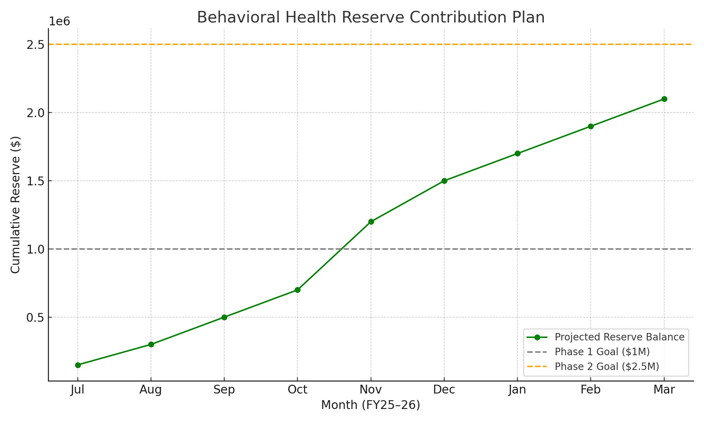
Reserve Contribution Strategy FY25–26
Beginning in July 2025, Behavioral Health will initiate structured monthly reserve contributions
Target: $150K–$500K per month, based on net operating surplus
Reserve will serve as a buffer against IGT delays, and payment reform lags
Contributions may adjust quarterly based on revenue trends and cash flow projections

