Slide 1

AB481
California Government Code 7070-7075
Military Equipment.
Lake County Sheriff's Office Lt. Joe Dutra

Slide 2
AB481
On September 30, 2021, Governor Newsom signed Assembly Bill 481 (“AB 481”), which became effective on January 1, 2022. AB 481 stated goals are to provide legally enforceable safeguards to protect the public’s welfare, safety, civil rights, and civil liberties before military equipment is funded, acquired, or used.
Section 7071 requires each law enforcement agency to obtain approval of the applicable governing body, by adoption of a military equipment use policy, by ordinance at a regular meeting held pursuant to specified open meeting laws, prior to taking certain actions relating to the funding, acquisition, use, or collaboration with another agency in the use, of military equipment. The section requires similar approval for the continued use of military equipment acquired before January 1, 2022.

Slide 3
Equipment Currently Utilized
by the
Lake County Sheriff's Office

Slide 4
Vehicles

Slide 5
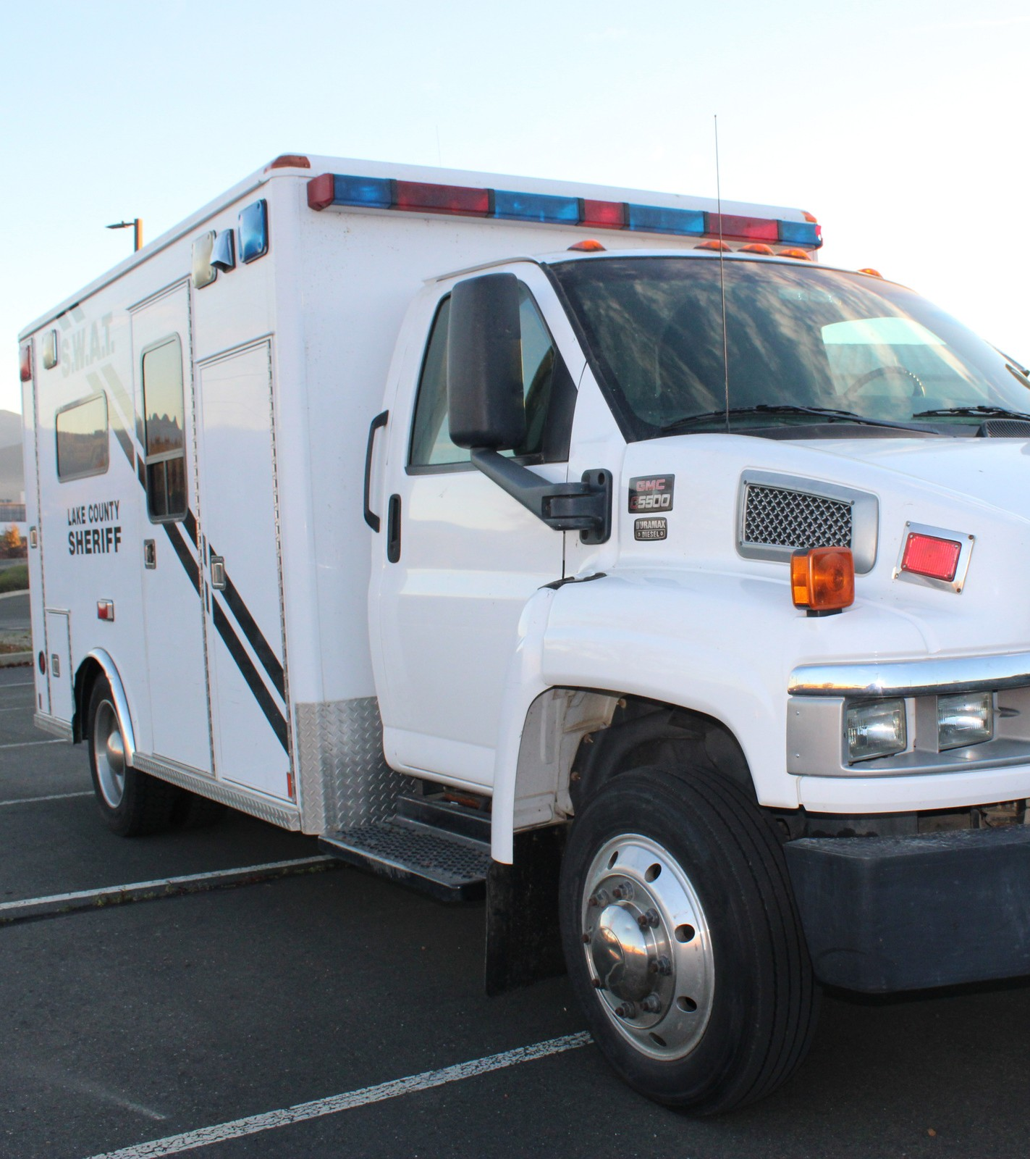
SWAT/Crisis Response Unit Van
Quantity: 1
Deployed 2024-2025
9
Year Acquired:
2007
COST
$65,329
Maintenance Cost
2024-2025 $2,084.85

Slide 6
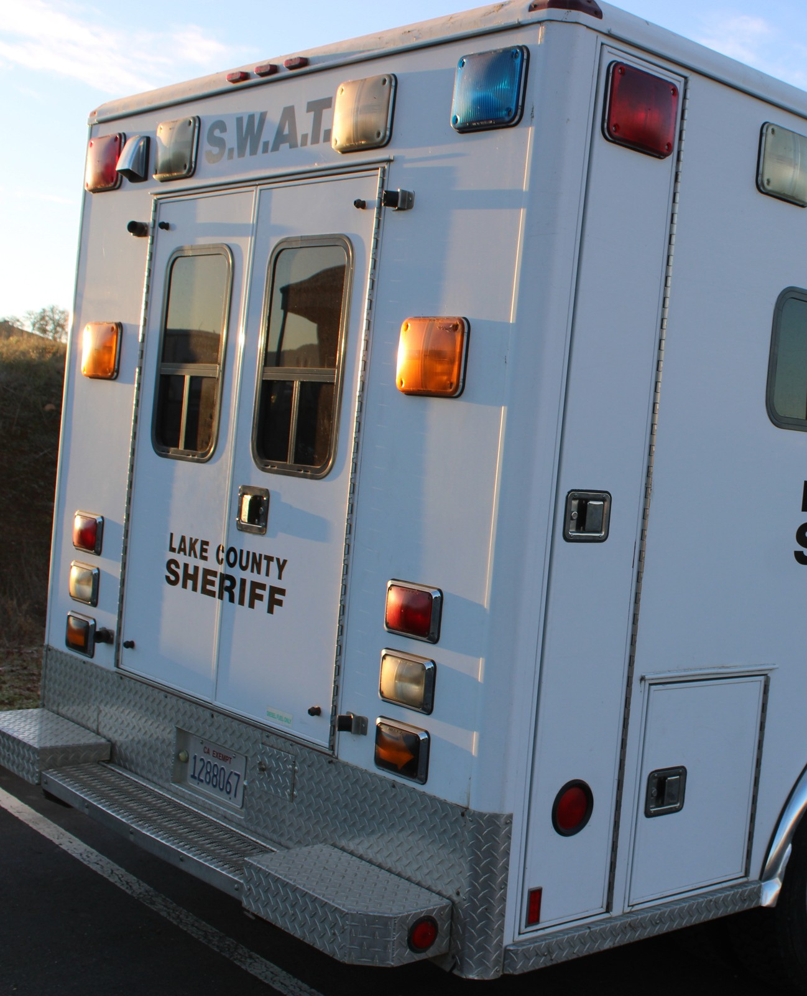
Description:
Repurposed ambulance, obtained from South Lake Fire District.
How used:
Used to transport equipment, personnel, and
operate as a command post for all crisis response unit call-outs.

Slide 7
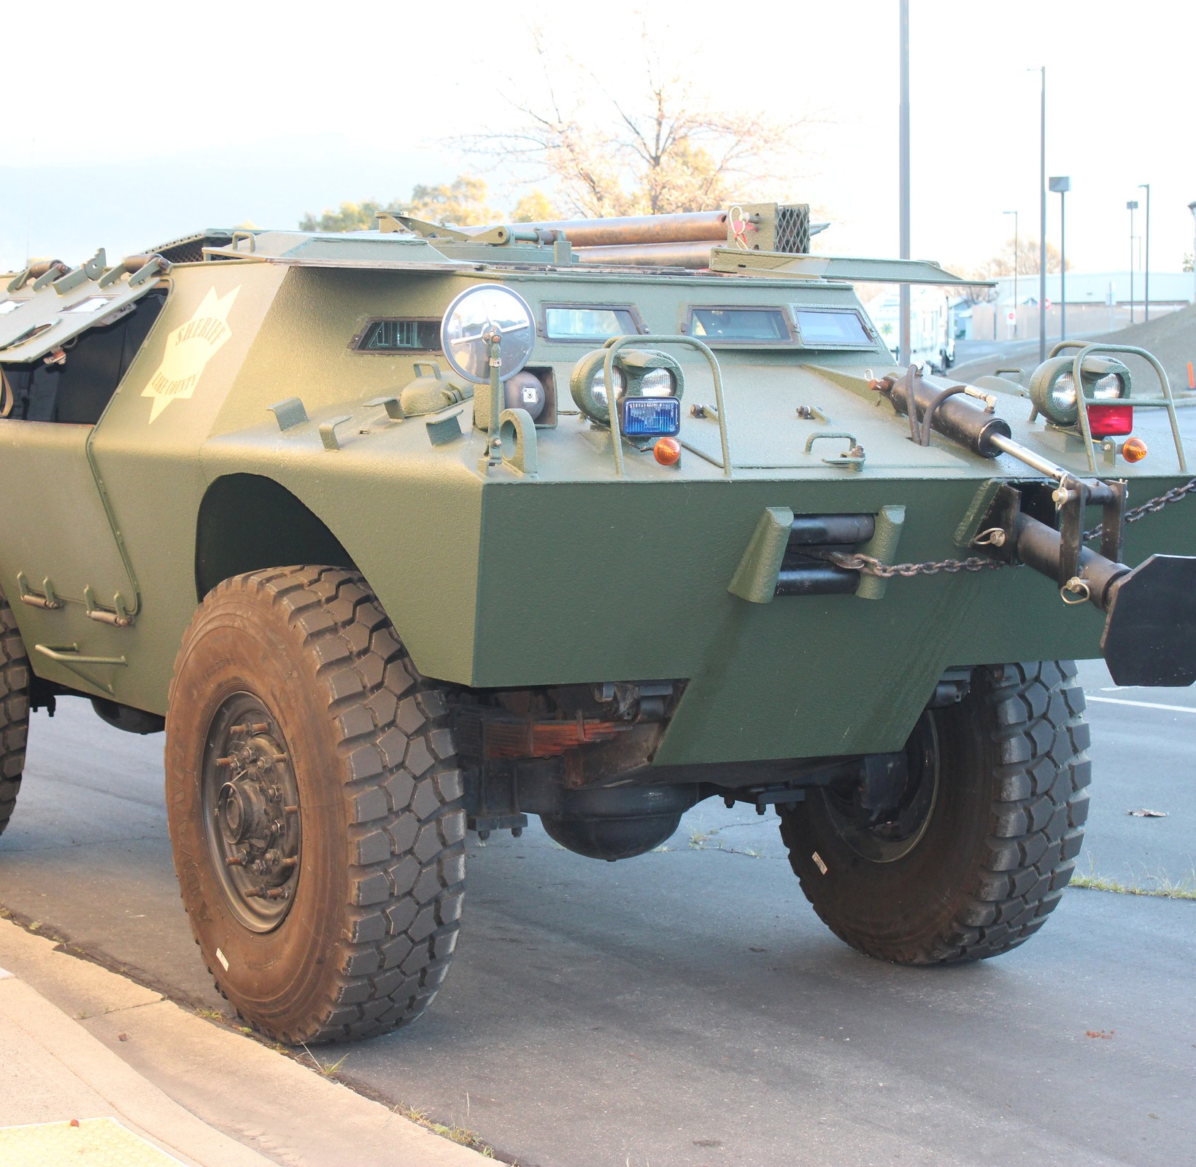
LAV-150: Lighted Armored Vehicle
Quantity 1
Year Acquired 2014
Deployed 2024-2025
9
Aquired From Sonoma County Sheriff's Office
Cost
$0
Maintenance Cost
2024-2025 $2,291.13

Slide 8
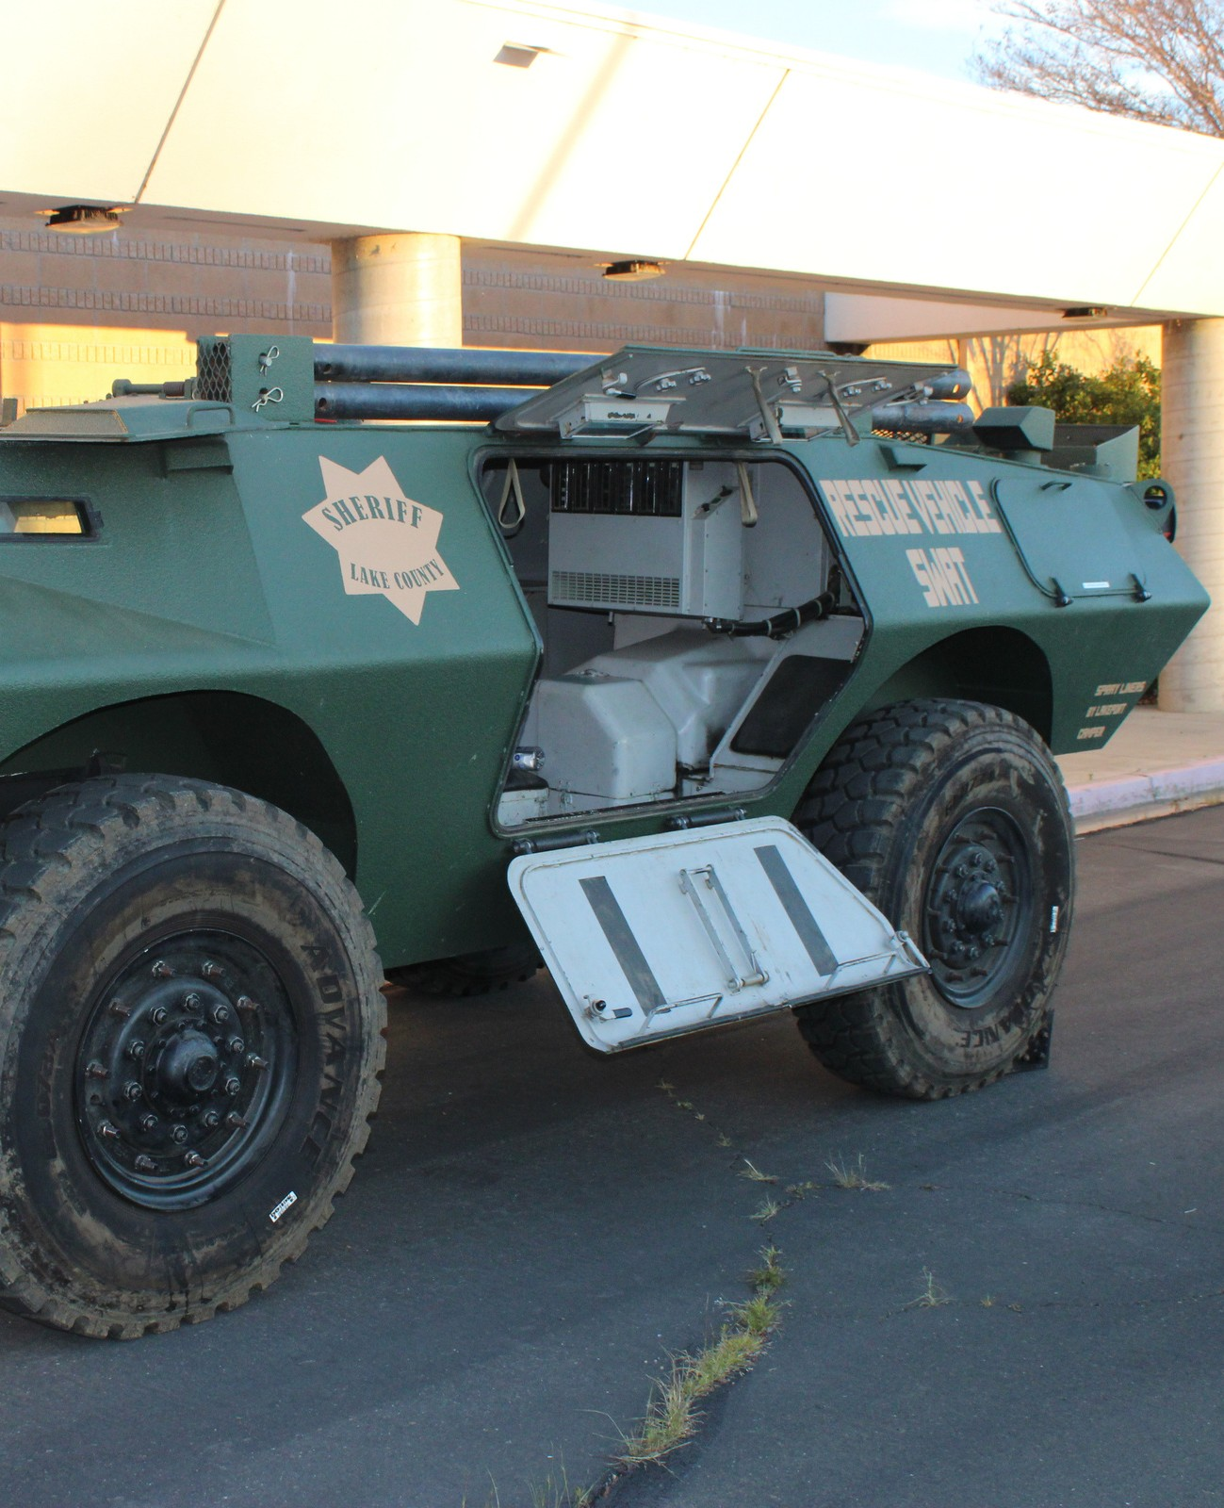
Description:
Wheeled Armored vehicle, provides protection from all types of firearms up to 50 caliber. Accepted by the Lake County Board of Supervisors in 2015.
How used:
Citizen, Officer rescue. Provides transportation and protection to Crisis Response Unit members during critical incidents. Used to breaching reinforced structures and deploy chemical munitions.

Slide 9
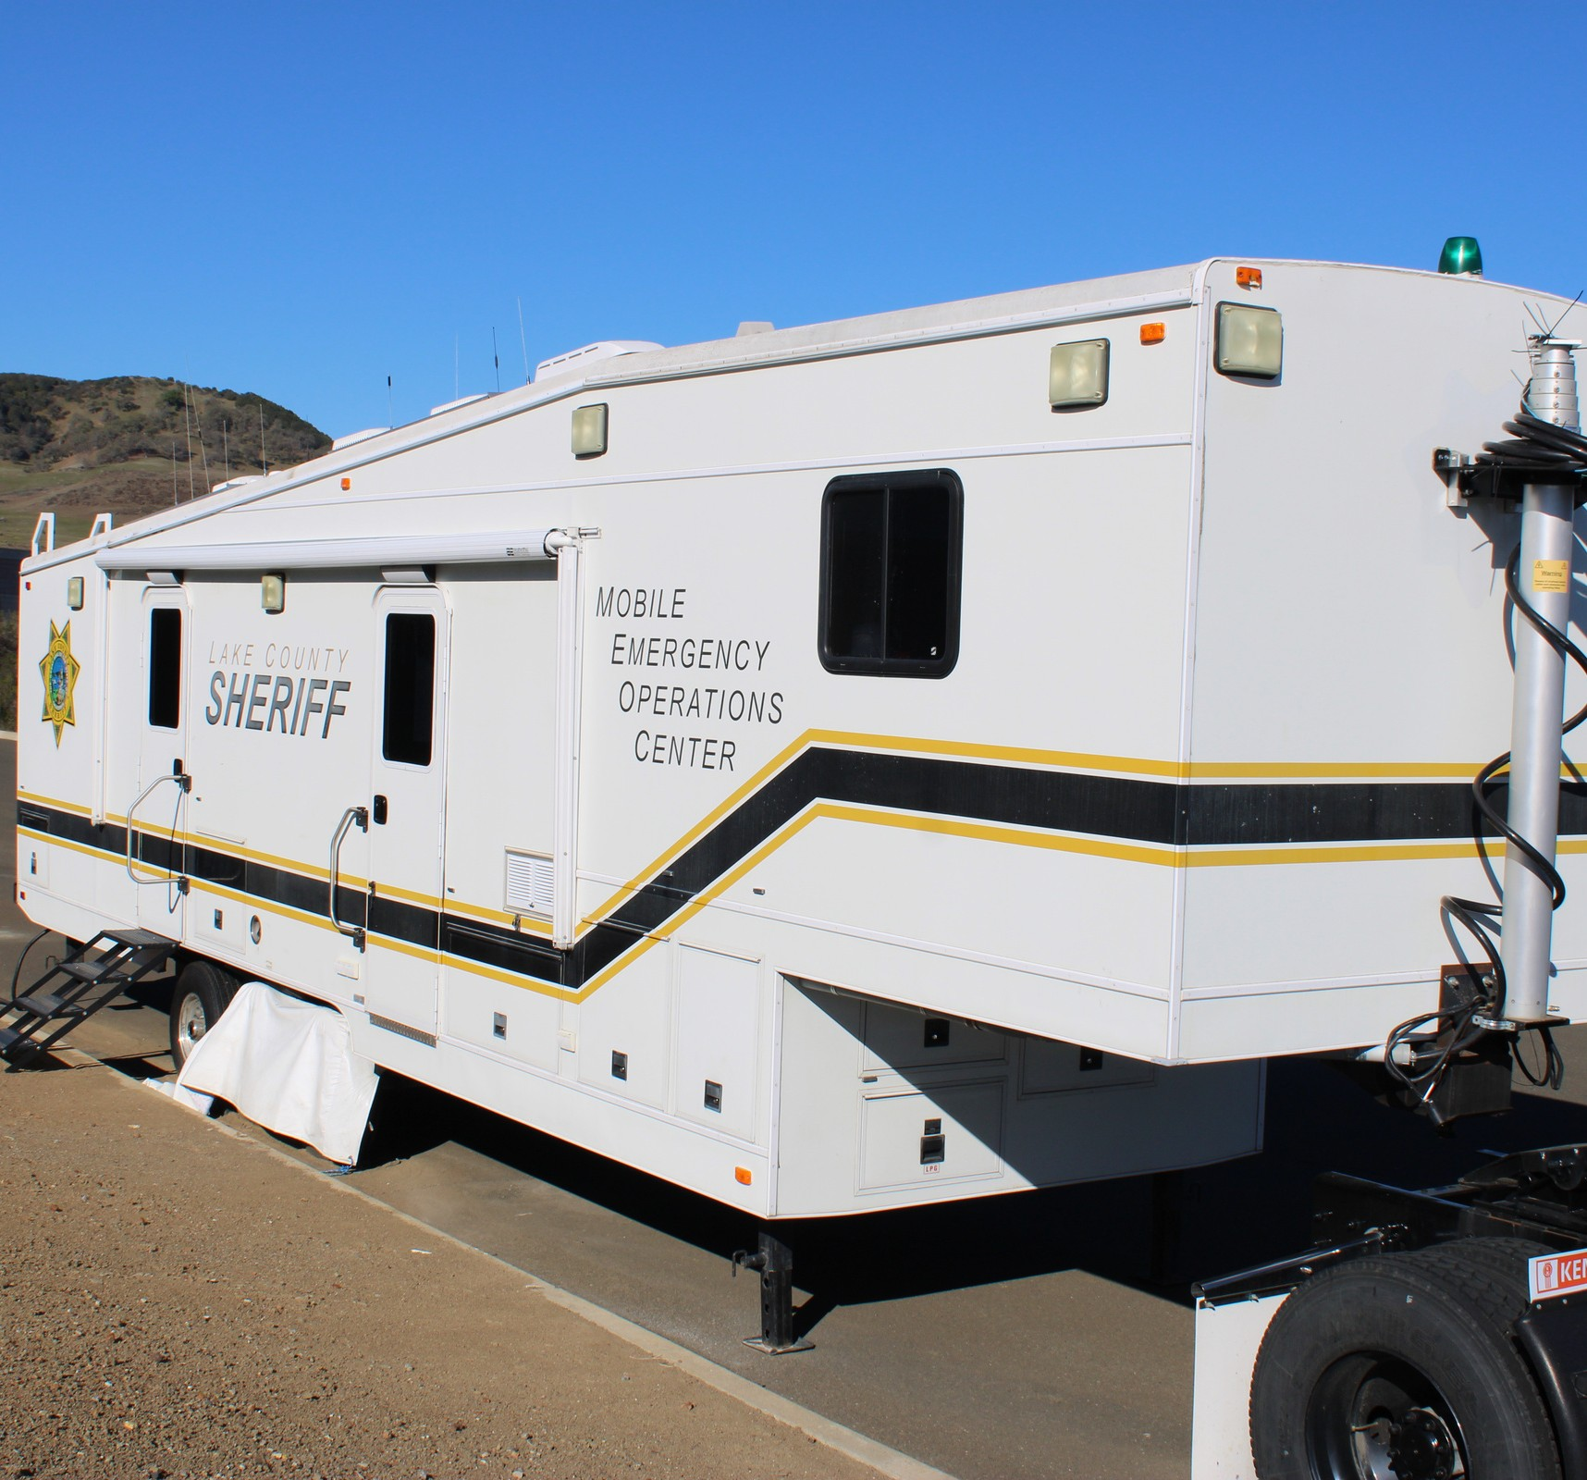
Mobile Emergency Operations Center
Purchased in 2006, OES Grant funding
Initial Cost: $229,059
Maintenance Cost, 2024-2025 $0
Deployed as IC during: Pre–planned events and emergencies

Slide 10
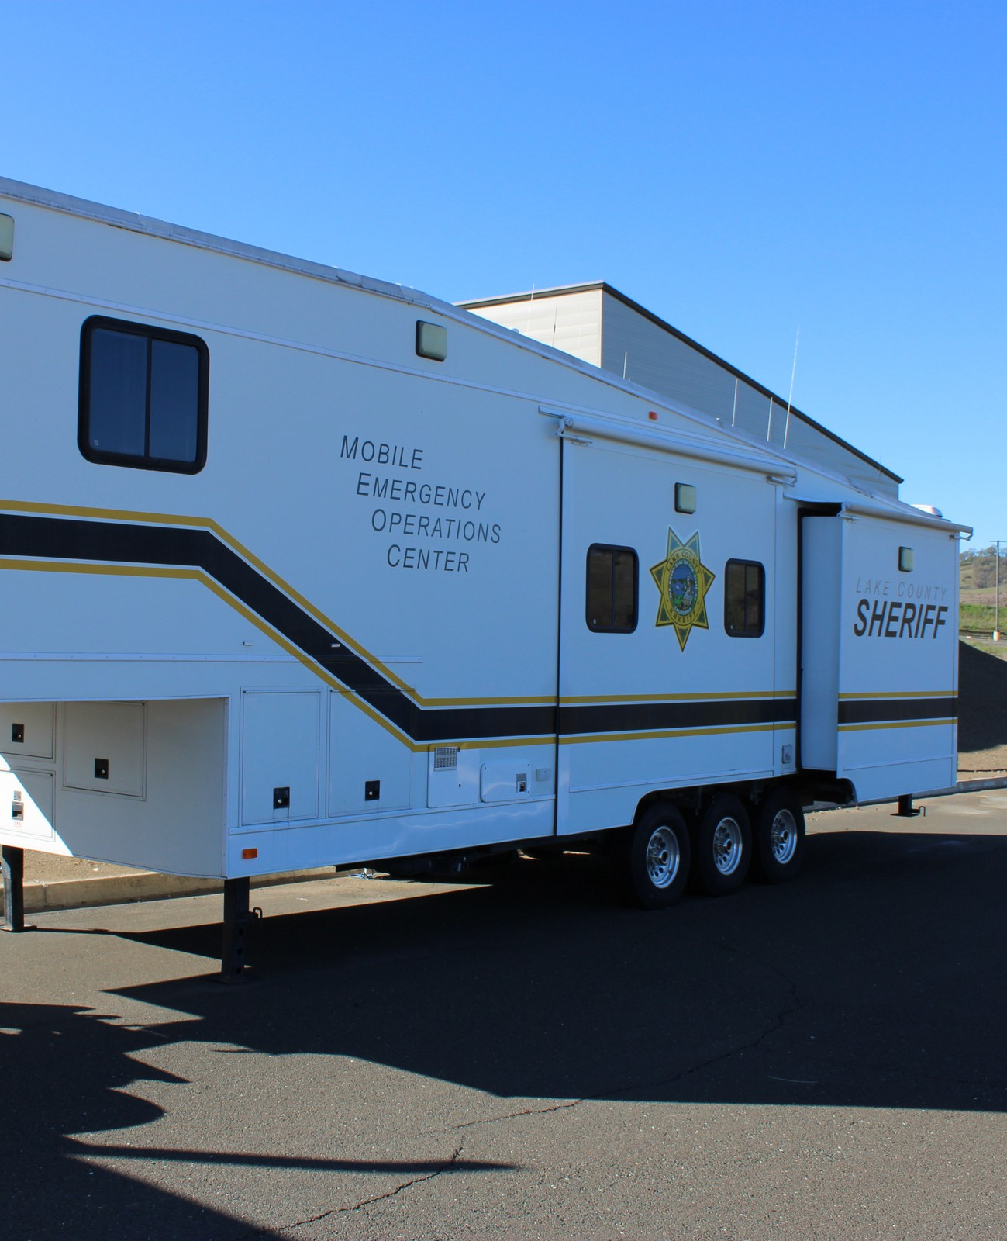
Description:
Self contained Incident Command Post, 5th wheel trailer.
How used:
Operates as the incident command post during emergencies and pre planned events.

Slide 11
Robots &
Unmanned Aircraft System

Slide 12
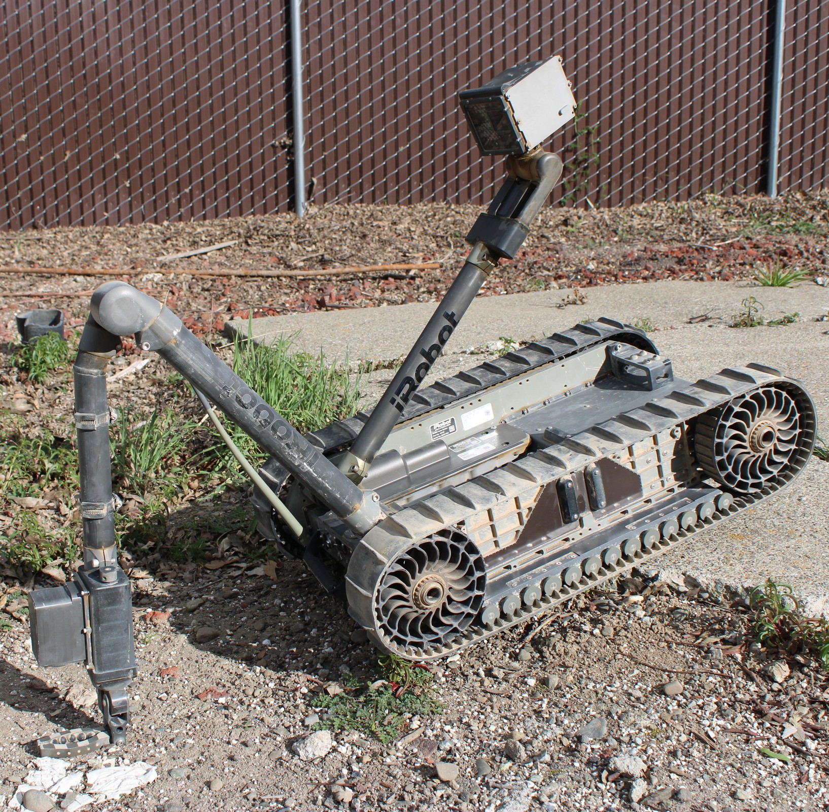
IRobot Model 510 - Tactical Surveillance Tracked Robot
Quantity: 1
Obtained from 1033 Program / 2017
Maintenance cost to date: $445.80
Deployed:
Use restricted to LCSO Crisis Response Unit. The robot is stored in secure facility and access is restricted to CRU members.

Slide 13
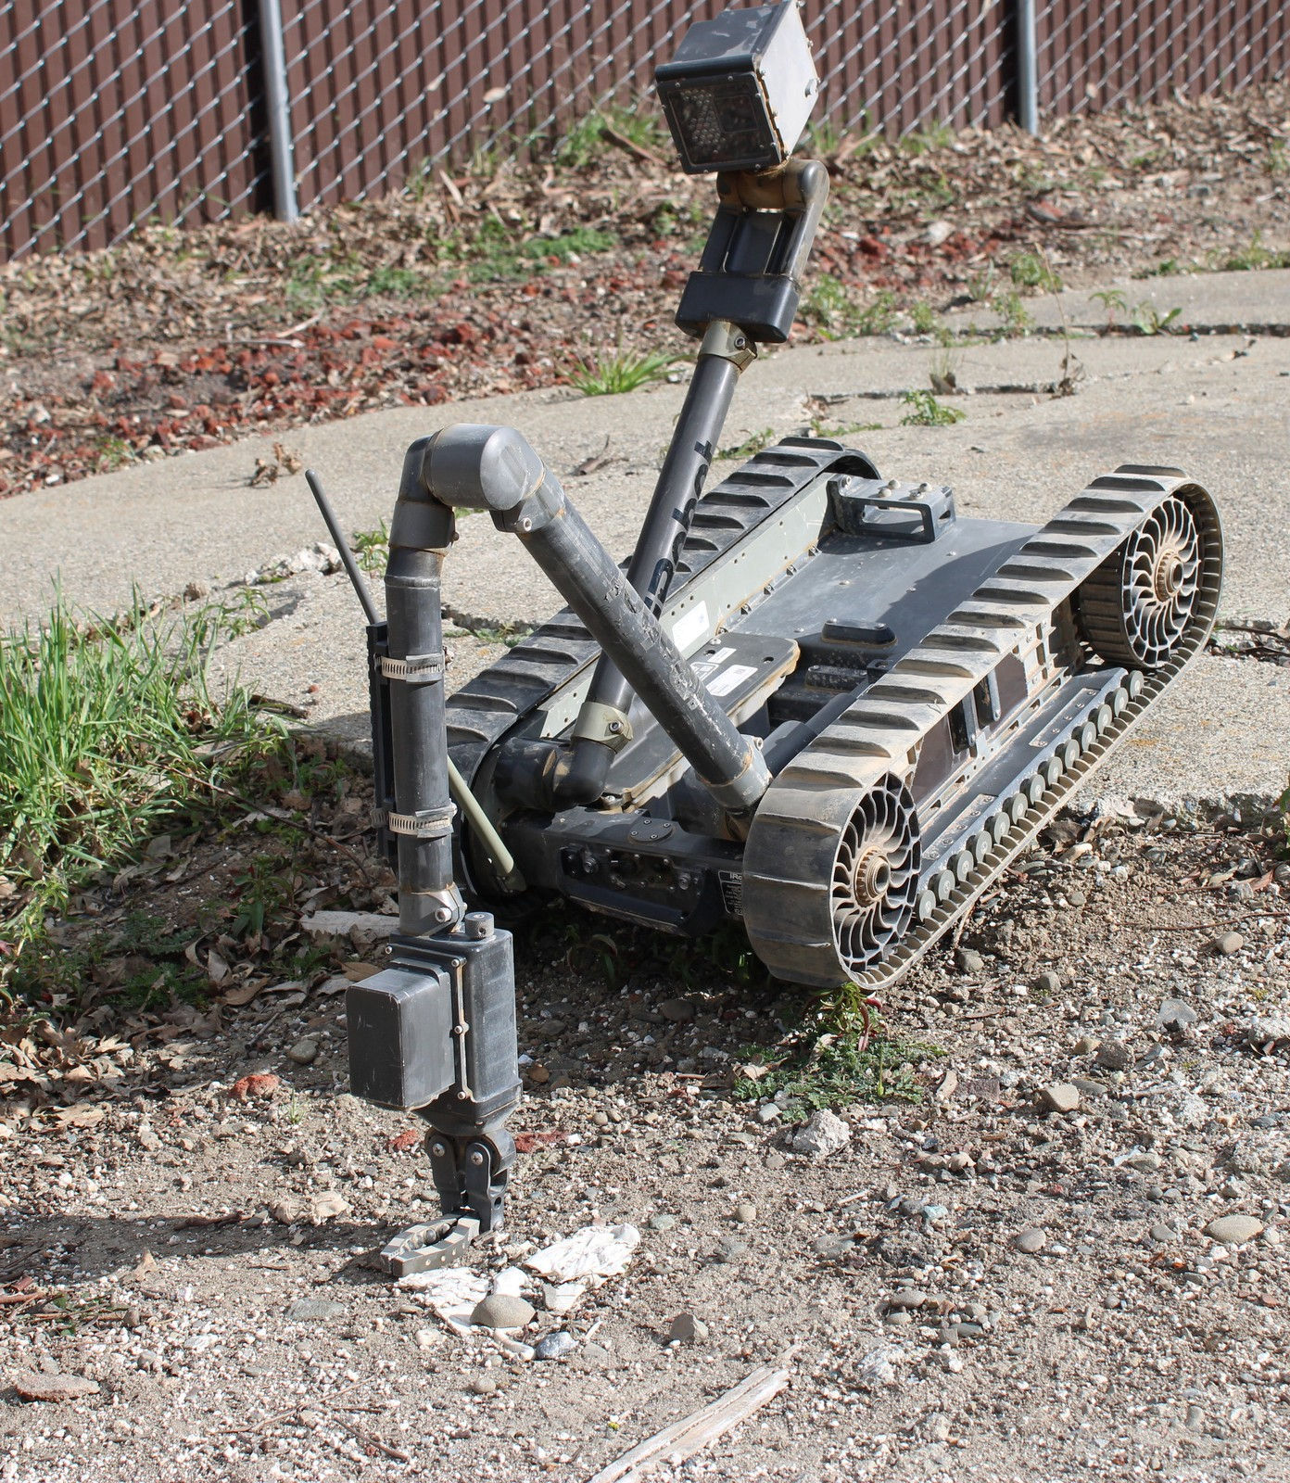
IRobot Model 510 - Tactical Surveillance Tracked Robot
How used:
The IRobot 510 is a transportable robot that is capable of bomb disposal, surveillance, reconnaissance, and HazMat operations. The robot is a tracked, remote- controlled apparatus with two onboard cameras, lights, microphone, and an articulating grabber arm.
Why used:
The robot is utilized by the LCSO Crisis Response
Unit for a wide range of missions including surveillance, hostage situations, barricaded subjects, and suspicious circumstances. The robot easily navigates stairs and narrow passages, relaying real time information while the operator remains at a safe distance, reducing the need to expose Crisis Response Unit members to hazardous situations.

Slide 14
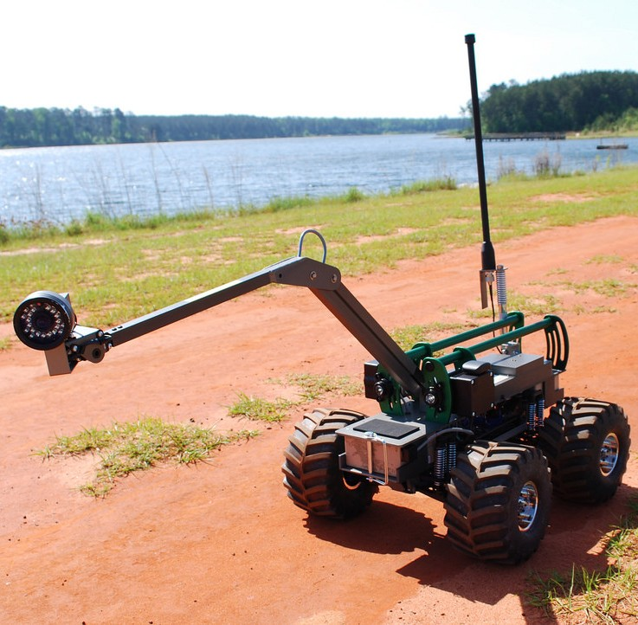
Exponent Inc.
Multi-function, Agile, Remote-Controlled Robot
(MARCbot VI/V)
Quantity: 1
Obtained from 1033 Program / 2015
Maintenance Cost: $148.60
Deployed: 0
Use restricted to LCSO Crisis Response Unit. The robot is stored in secure facility and access is restricted to CRU members.

Slide 15
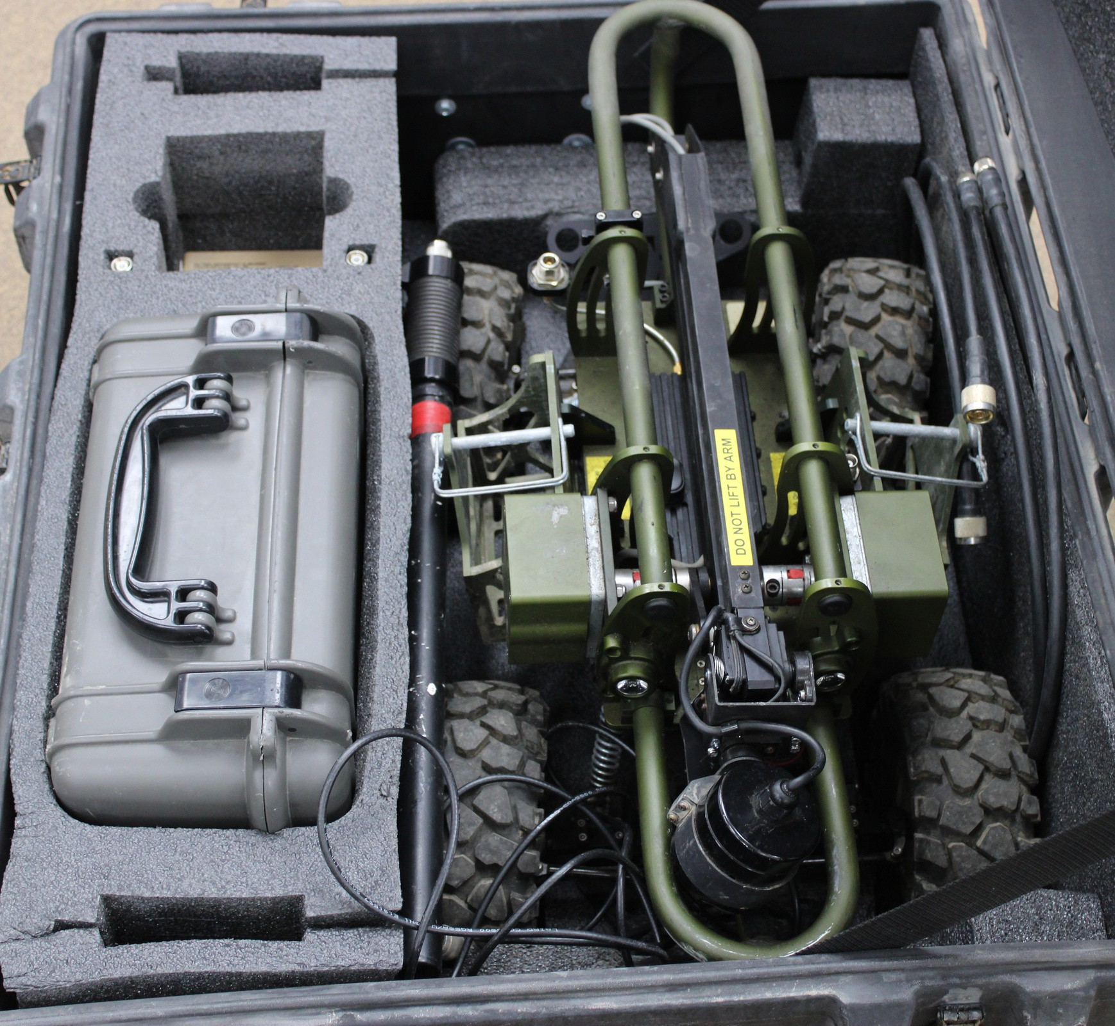
How used:
MARCbot VI/V – Multi-Function wheeled Robot
Originally developed as an inexpensive robot for the military, MARCbots were intended for use in detecting improvised explosive devices. Because of the low cost and maintenance, they became one of the most commonly used robots abroad. Because of the 1033 Program, many of these military surplus robots were transferred to civilian agencies. Their main purpose in law enforcement has been the detection and disposal of bombs. They have also been utilized in other missions such as threat assessments and reconnaissance, such as entering a building to investigate barricaded subjects and hostage situations.
How used:
This robot is utilized by the LCSO Crisis Response Unit and
is used in critical incidents. These missions include barricaded subjects, investigating suspicious items, and hostage situations. The purpose of this robot is to assist in dangerous incidents while maintaining officer and citizen safety.

Slide 16
Distraction Devices
Distractions Devices are used by special tactical units during hostage rescue and high-risk warrant service. In a dangerous situation, these device provide momentary distraction allowing for a safer extraction of hostages or apprehension of dangerous individuals.
Distraction Devices are ATF-controlled Class-C explosive device that emit a bright light and thunderous noise to distract potentially dangerous individuals.

Slide 17
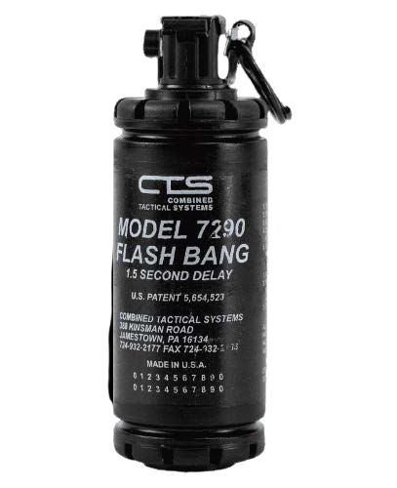
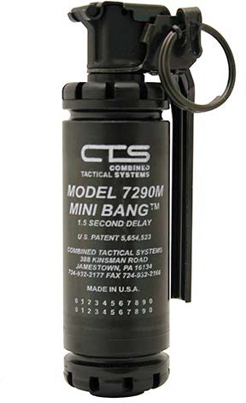
CTS 7290M (mini)
Distraction Device
CTS 7290
Distraction Device
The CTS 7290 is the standard for diversionary flash-bang devices. The 7290 produces a 175db and 6-8 million candelas of light output
The CTS 7290M is the compact version of the 7290. The 7290M Flash-Bang exhibits all of the same attributes as its larger counterpart but in a smaller and lighter package.
Restricted to certified Crisis Response Unit members
Quantity:
1
CPU:
$34.81
Quantity:
36
CPU:
$37.51

Slide 18
Chemical Agents
These munitions are used to disorient and distract potentially dangerous individuals allowing for a safe apprehension.

Slide 19
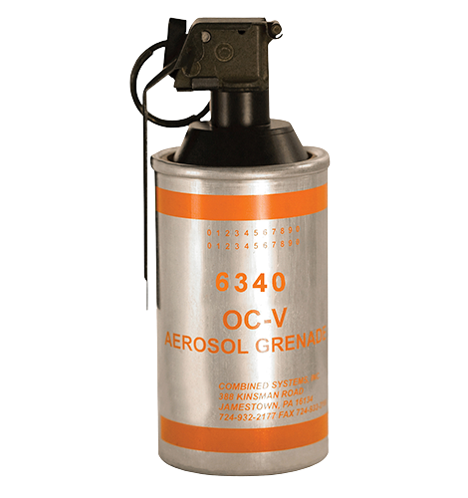
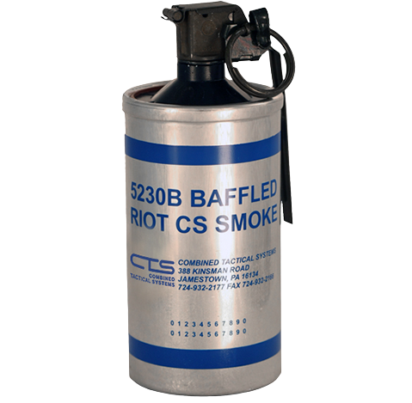
CTS 6340 OC
(oleoresin capsicum) Vapor Canister
CTS 5230B
Baffled Riot CS
(2-chlorobenzalmalononitrile) Smoke Canister
Pyrotechnic cannister designed for indoor use delivering a maximum amount of CS irritant smoke throughout multiple rooms with minimal risk of fire. Can be hand thrown or launched. CS gas is one of the most commonly used tear gases in the world. Law enforcement agencies have found this agent invaluable when faced with combative suspects, for riot control, and for alleviating hostage and siege situations
This canister delivers an invisible OC vapor and renders an intense respiratory effect to a non-compliant subject. Usually used indoors in enclosed area to cause pain and discomfort to those who come into contact with the released contents in order to gain compliance or de-escalate violent subjects.
SERT / CRU
SERT / CRU
Quantity: 18
MFD: 2021
Expiration:
CPU:
$36.61
Quantity:
MFD: 2021 (Qty 12)
2018 (Qty 24)
Expiration:
CPU:
$36.61
52
5 Years from MFD
5 years from MFD
2016 (Qty 14)- Expired (For Training Use Only)

Slide 20
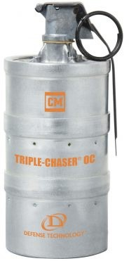
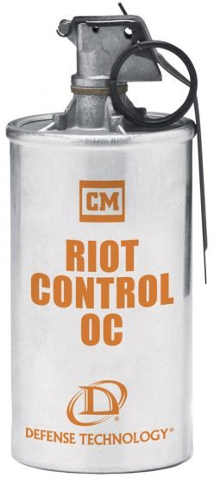
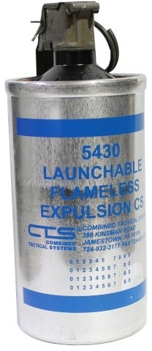
DEF TECH 1020
OC Triple-Chaser Separating Canister
The Triple-Chaser® OC consists of three separate canisters pressed together with separating charges between each. When deployed, the canisters separate and land approximately 20 feet apart allowing increased area coverage in a short period of time. This canister can be hand thrown or launched from a fired delivery system.
DEF TECH 1080
Riot Control Continuous Discharge Canister, OC
The Riot Control OC Canister is designed specifically for use in crowd control situations with a high volume continuous burn that expels its payload in approximately 20-40 seconds through four gas ports located on the top of the canister. This canister can be used to conceal tactical movement or to route a crowd.
CTS 5430
CS Flameless Expulsion Canister
Large diameter flame-less canister posing no risk of fire and discharging a large CS powder payload through multiple emission ports. Provides best results when used indoors. This canister can be hand thrown or launched from a fired delivery system.
SERT
SERT
SERT
Quantity: 3
MFD: 2017
CPU:
$36.61
Quantity: MFD:
CPU:
$28.21
CPU:
$42.81
Quantity: MFD:
6
2017
6
2021

Slide 21
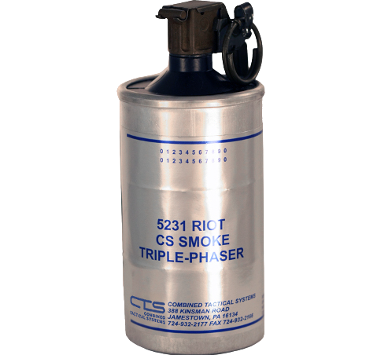
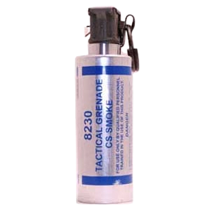
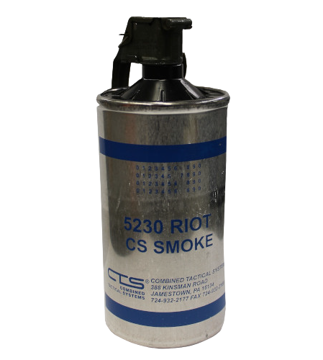
CTS 5231
Riot CS Smoke Triple-Phaser Canister
CTS 8230
Tactical CS (2-chlorobenzalmalononitrile) Smoke Canister
The smallest diameter burning canister that discharges a high volume of smoke and chemical agent through multiple emission ports. Specifically for outdoor use and it should not be deployed on rooftops, in crawl spaces or indoors due to fire-producing capability. Can be hand thrown or launched.
CTS 5230
CS (2-chlorobenzalmalononitrile) Riot Smoke Canister
Large diameter burning canister that discharges a high volume of smoke and chemical agent through multiple emission ports. Specifically for outdoor use and should not be deployed on rooftops, in crawl spaces or indoors due to potential fire hazard. Can be hand thrown or launched. The discharge duration can reach up to 40 seconds.
CS Triple Phaser canister is a large diameter canister consisting of 3 separate aluminum canisters pressed together with separate charges between each canister. When deployed, the canister will separate over a broad space to give a wider area of coverage. Can be launched or thrown.
SERT
CRU
CRU
Quantity: 3
MFD: 2021
CPU:
$40.93
Quantity:
MFD: 2018 (Qty 4)
CPU:
$28.21
Quantity: 11
MFD: 2021 (Qty 5)
2016 (Qty 6) - Expired (For Training Use Only)
CPU:
$28.21
10
2016 (Qty 6) - Expired (For Training Use Only)

Slide 22
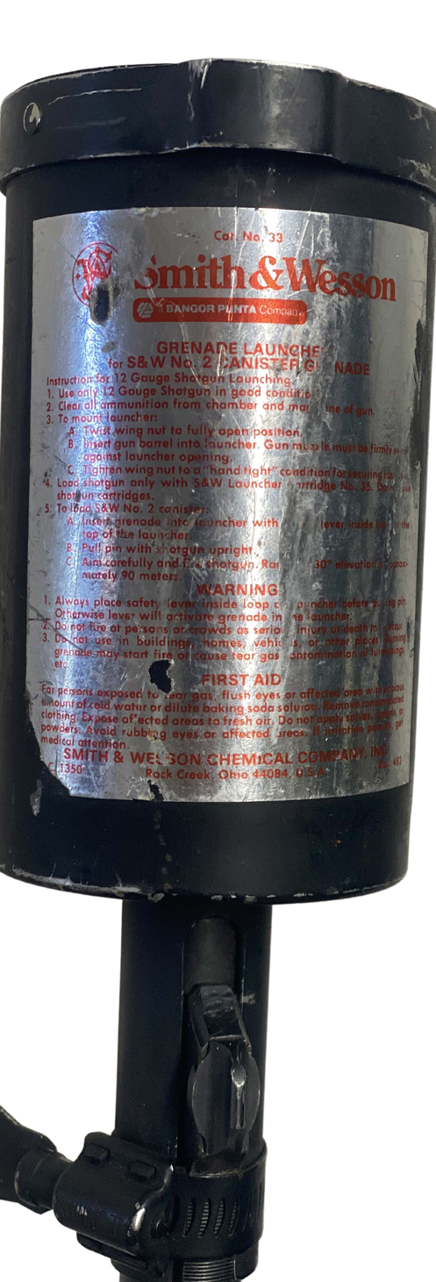
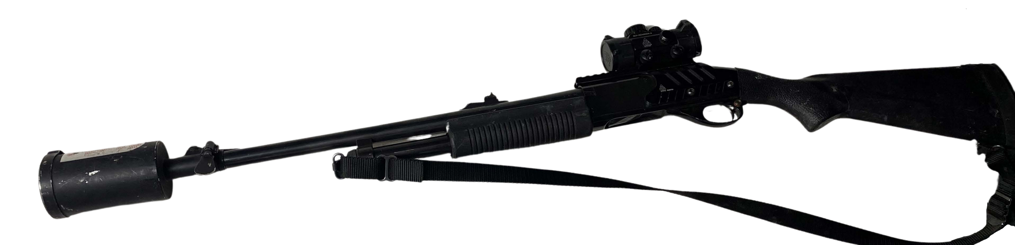
Smith and Wesson #33 12 Gauge Canister Launcher
Quantity: 1
COST -Unk
Heavy duty Launcher is designed to be mounted and used on a 12 gauge law enforcement shotgun. Used for launching a single smoke/chemical munition canister with a #35 12 gauge launching cartridge.
Use is restricted to certified Crisis Response Unit members.

Slide 23
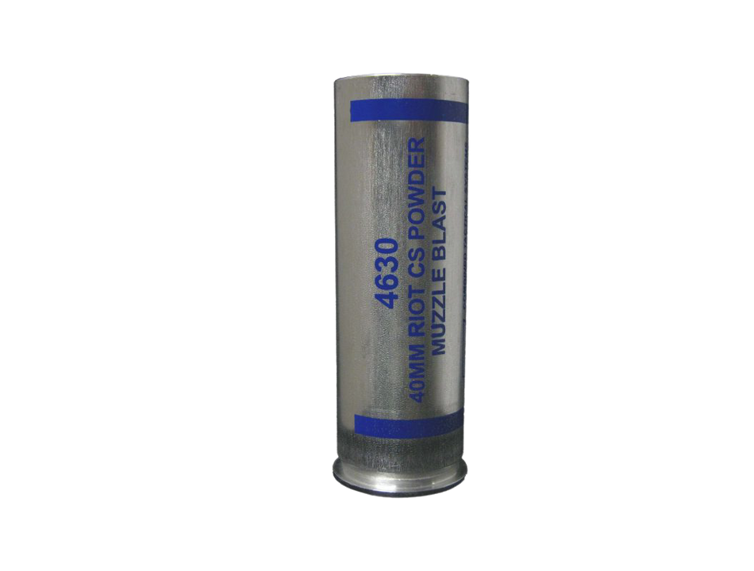
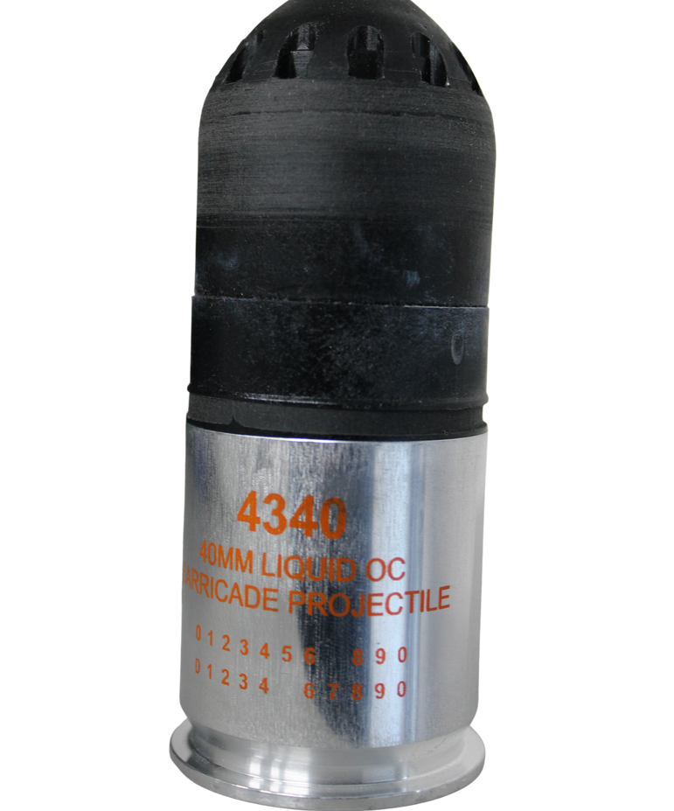
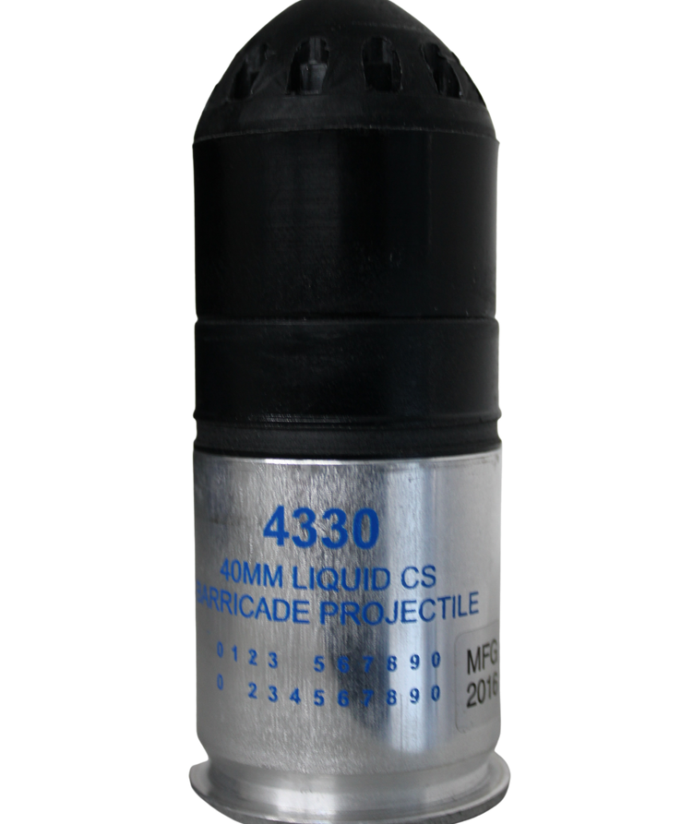
Use restricted to Crisis Response Unit
CTS 4340
40MM OC LIQUID BARRICADE SPIN STABILIZED
CTS 4330
40MM CS LIQUID BARRICADE SPIN STABILIZED
CTS 4630
40MM CS Muzzle Blast
40MM Liquid CS filled projectile penetrates intermediate barriers and delivers irritant agents into an adjacent room
40MM Liquid OC filled projectile penetrates intermediate barriers and delivers irritant agents into an adjacent room
A 40MM aluminum cartridge that launches a single projectile round emitting smoke or irritant agents via rapid burning. Used effectively during riots at safe stand-off distances to disperse groups or deny areas.
Quantity: 6
CPU:
$22.68
Quantity: 17
CPU:
$22.80
Quantity: 4
CPU:
$18.84

Slide 24
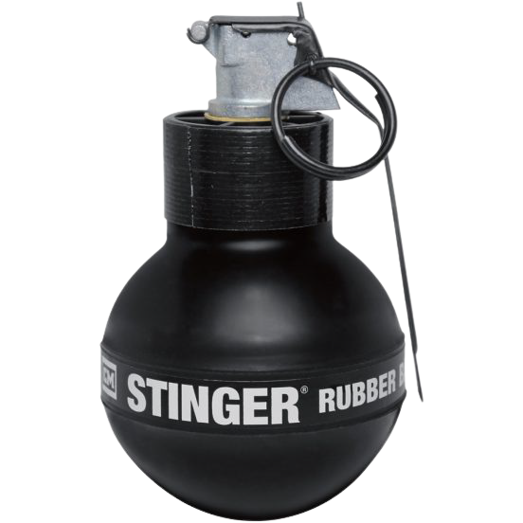
DEF TECH 1090
"STINGER" 32 CAL.
Rubber Ball Impact Device
SERT
The Stinger® Rubber Ball GDevice is a maximum effect device that delivers three stimuli for psychological and physiological effects: rubber pellets, light, and sound. The Stinger® Rubber Ball Device is most widely used as a crowd management tool by Law Enforcement and Corrections.
Quantity:
10 5 Years from MFD
MFD:
2017
Expiration:
Cost:
$52.50
Use and deployment is restricted to LCSO Correctional SERT members. Deployment MUST be authorized by a supervisor.

Slide 25
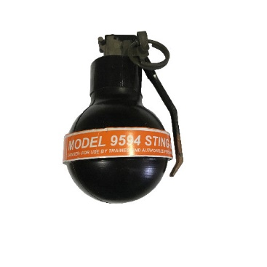
CTS 9594 – OC STING- BALL
SERT
9594 – Multi-effect device with a loud blast, bright flash and dispersion of stinging .31 caliber pellets. Can also be configured to dispense an instantaneous cloud of irritant powder. Device is most widely used as a crowd management tool by Law Enforcement and Corrections.
Quantity Expiration Cost
12 5 years from MFD $43.68ea
MFD 2021
Use and deployment is restricted to LCSO Correctional SERT members. Deployment MUST be authorized by a supervisor.

Slide 26
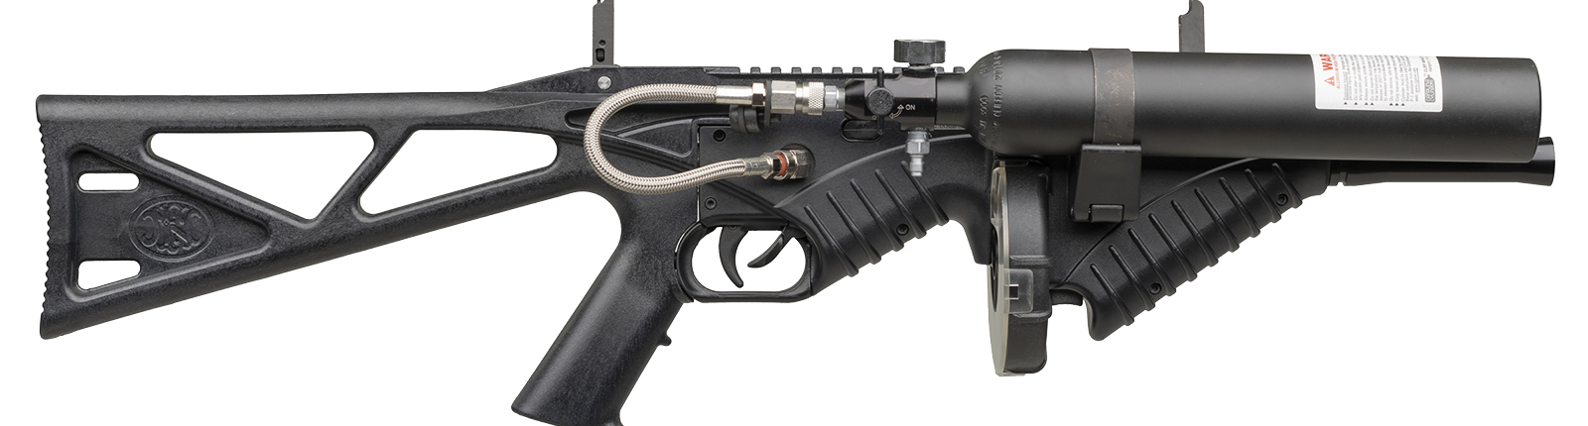
The FN 303 is a less-than-lethal system used by numerous law enforcement agencies across the country to manage crowds and defuse tense situations without having to elevate to more lethal options.
Chambered for 18mm (.68") projectiles, the 303 Launcher is an air-operated system that uses a tank of compressed air to launch rounds which come in a variety of loads.
FABRIQUE NATIONALE DE HERSTAL(FN) MODEL 303
Quantity: 2
Cost: $1299/unit
Use of this launcher is restricted to Corrections SERT members. Deployment approval is strictly determined by the SERT Supervisor.
Only SERT Members have access to this system, and the launcher is stored in the secure armory at the LCSO Correctional Facility.

Slide 27
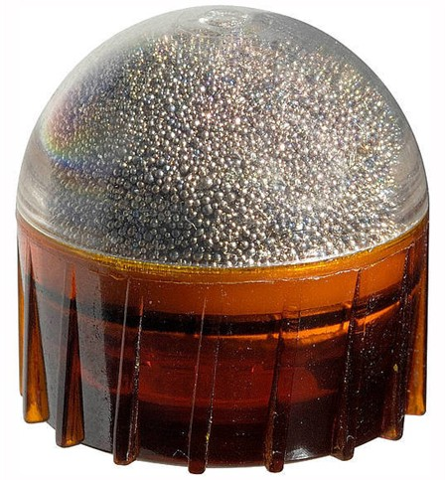
FNH LE FN303
Pava Powder Projectile
68 Cal. Less-than-lethal projectile delivers a sufficiently dissuasive level of pain within the projectile’s impact zone to disable targets temporarily from safe standoff distances. This projectile dispenses an irritant for individual suspects, point-specific targets or small-area denial. The active ingredient is 0.5% PAVA/OC in a powder form for ease of storage, deployment and clean-up.
Quantity: 225
Expiration:
CPU:
$3.34
3 Years from MFD
*330 Expired (Training Only)

Slide 28
Use and Storage:
Robots, Distraction Devices and Chemical munitions are strictly controlled, used and trained with by the Lake County Sheriff’s Office Crisis Response Unit (CRU) and Corrections Special Emergency Response Team (SERT) members. They are stored and secured in climate-controlled, and alarmed rooms.
The CRU facility is fenced, has perimeter alarms and 24-hour video and audio surveillance. Only members of CRU have access to the secured room where the Robots, Distraction Devices and Chemical Munitions are stored. Only CRU members are authorized to use and deploy the robots, distraction devices and chemical munitions and only under the direct approval of the CRU commander or Sheriff
Access to chemical munitions and SERT equipment at the Correctional facility is restricted to SERT members. Only SERT members are authorized to deploy chemical munitions, Rubber Ball Impact Devices, FN 303 and equipment, and only under the direct approval of the SERT commander, Correctional facility commander or Sheriff when necessary and appropriate.

Slide 29
EXTENDED RANGE KINETIC ENERGY PROJECTILES
Flexible or non-flexible projectiles, which are intended to gain compliance or distract a subject through pain compliance, with a reduced potential for causing death or serious injury when properly used, as compared to conventional weapons or projectiles.

Slide 30
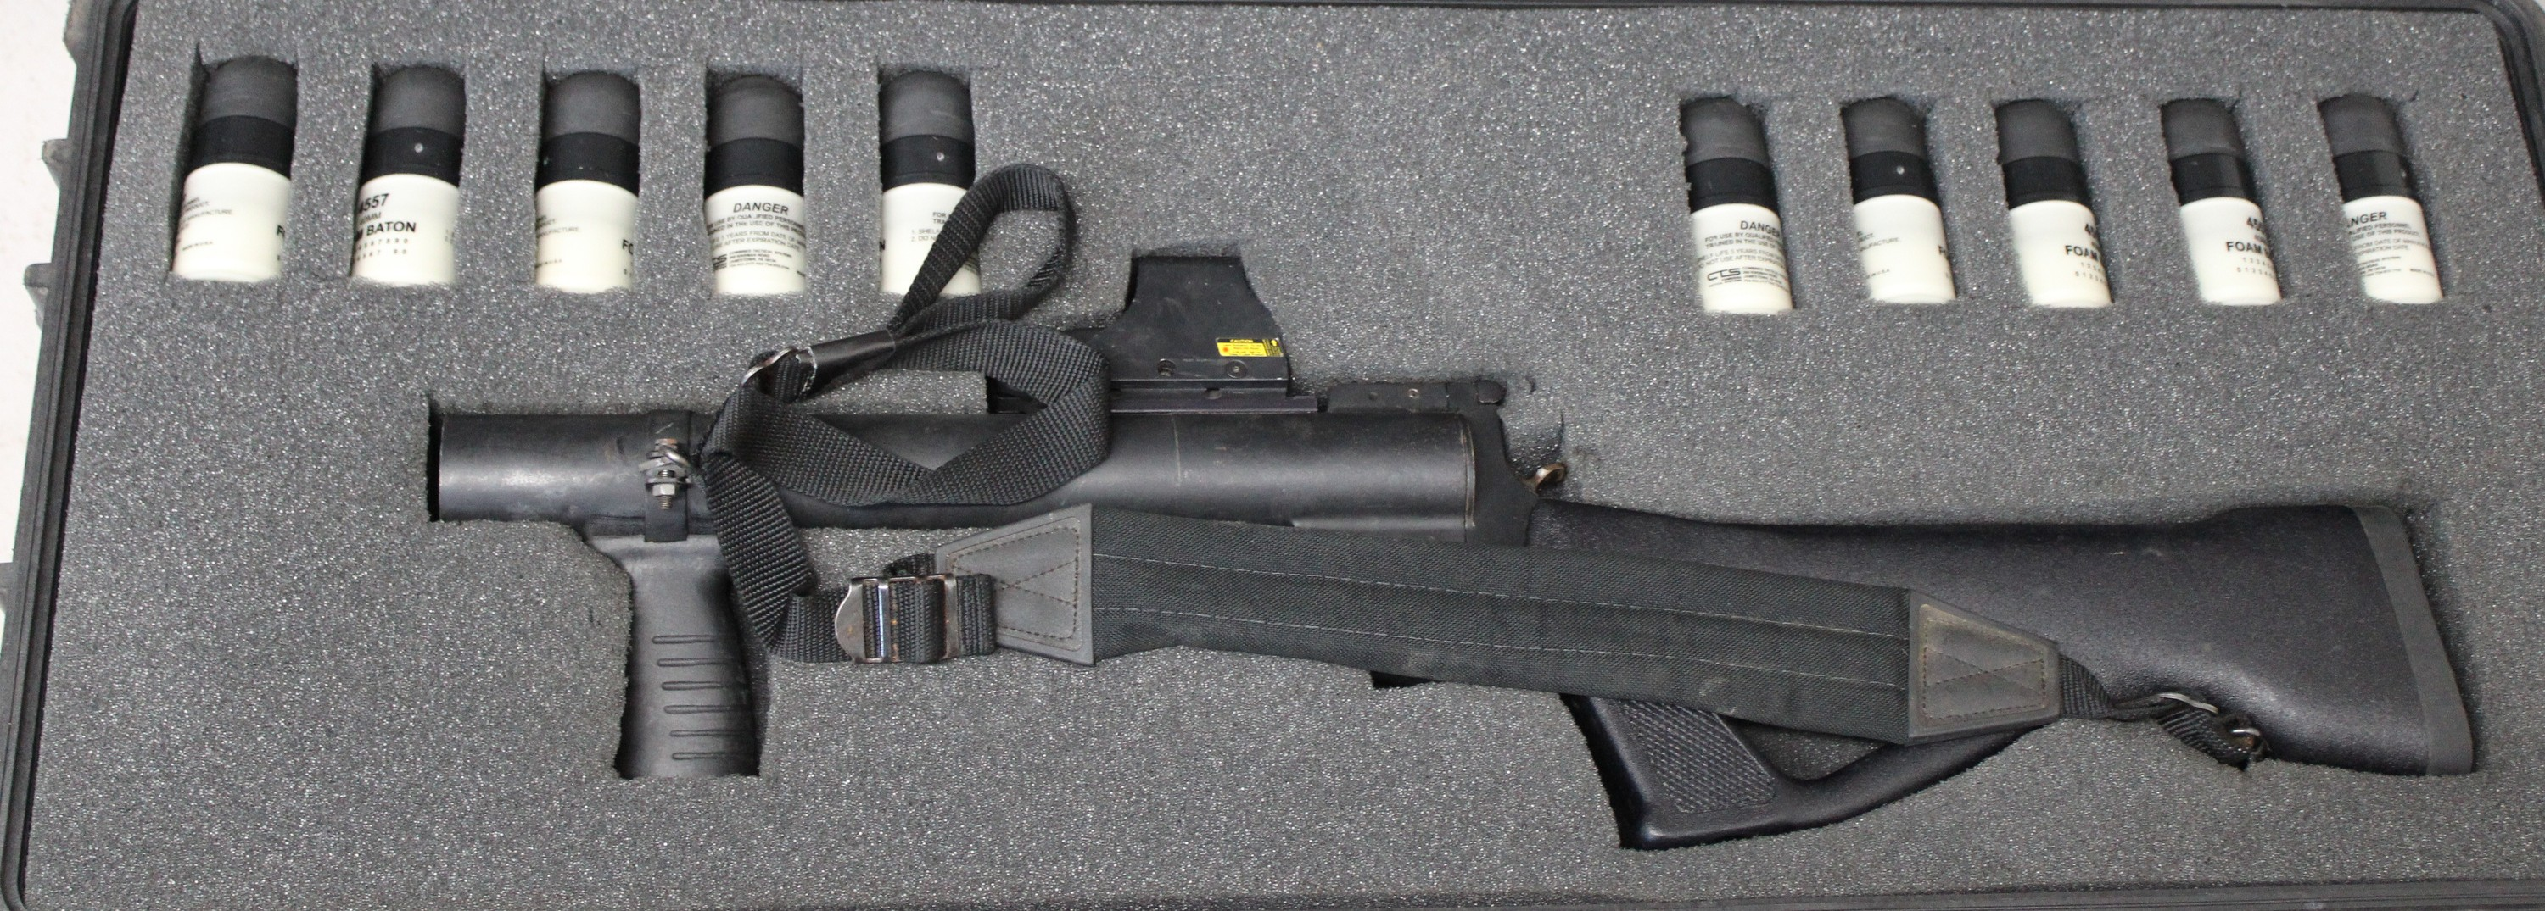
Quantity 4
Cost $998 CPU
Obtained: 2005
This delivery system is a 40mm single-shot launcher that features a solid stock and an adjustable front grip with a light rail. It will launch standard 40mm Less Lethal ammunition or chemical munitions. It has an EOTech mounted sight to improve accuracy when deploying munitions.
ARMOR HOLDINGS 40MM
LESS-THAN-LETHAL
LAUNCHER

Slide 31
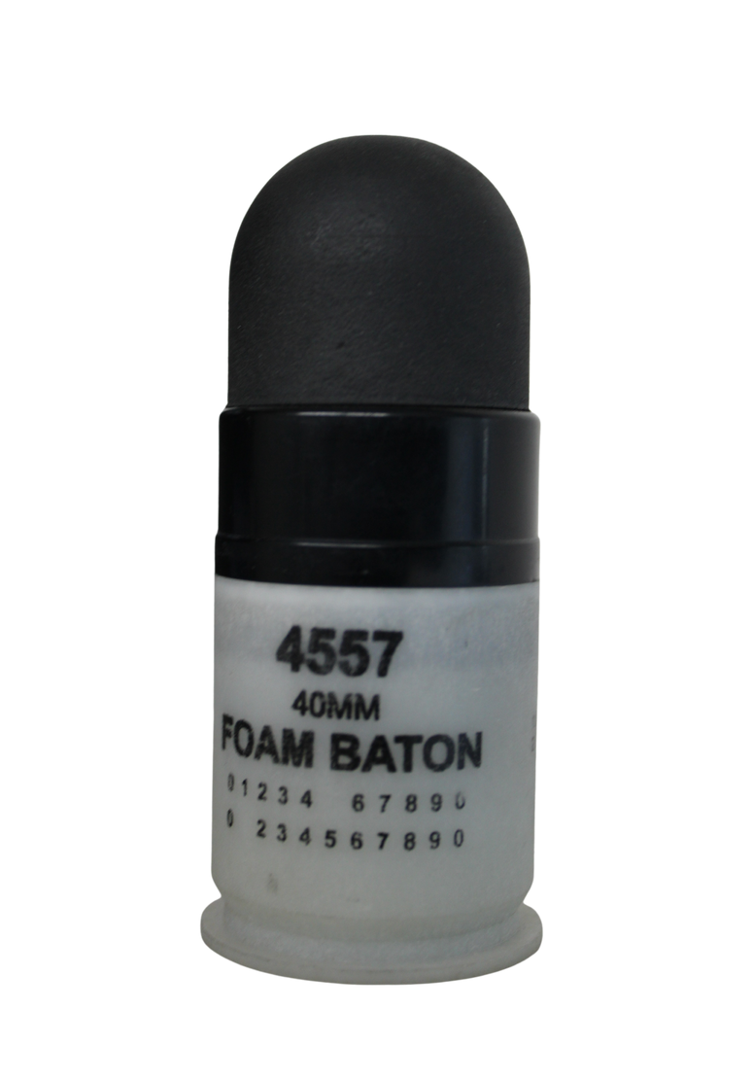
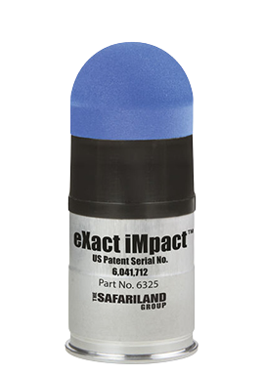
Safariland 6325
40 mm Sponge, Impact Projectile
CTS 4557
40MM Sponge, Impact Projectile
The Model 4557 Sponge Baton is a spin-stabilized projectile. Used in crowd control and pain compliance.
The eXact iMpact™ 40 mm Sponge Round is a point-of-aim, point-of-impact direct-fire round. Used in crowd control and pain compliance.
Use is currently restricted to SERT / CRU
and trained / certified supervisors.
Training: 40mm Less Than Lethal kinetic energy platform. 8 hour Less Than Lethal course, annual department recertification training / qualification.
Quantity: 4
CPU:
$17.95
Quantity: 221
10 Expired
(Training Use Only)
CPU:
$17.95

Slide 32
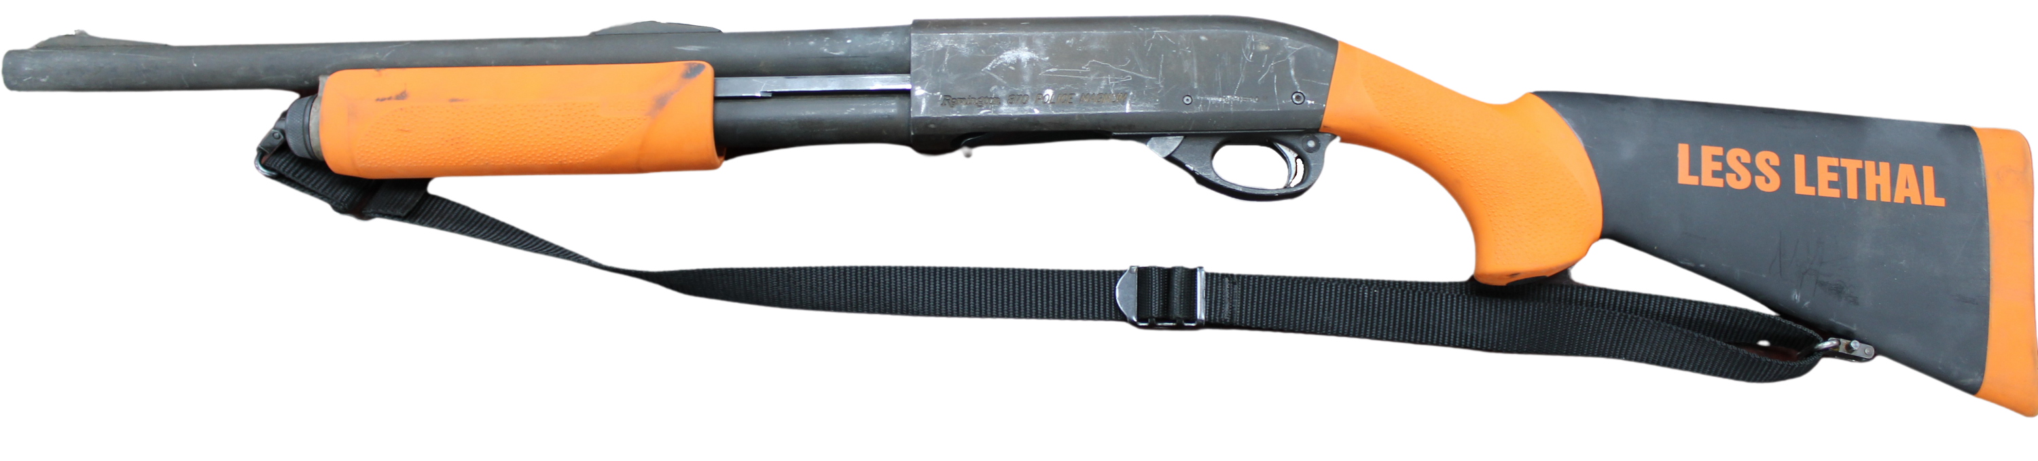
This patrol standard issued shotgun has been converted to distinguish it as a less-than-lethal shotgun used to deploy the 12ga "Super Sock" kinetic energy round. Used to gain compliance while maintaining a safe distance from non-compliant or dangerous subjects.
Quantity:
40
Cost:
$410 CPU
Obtained 2005
REMINGTON 870 LESS-THAN-LETHAL 12 GAUGE SHOTGUN
Issued to trained and qualified patrol deputies
Secured in Corrections armory and available for deployment in the corrections setting by trained / qualified Corrections deputies.
Training: 12ga Less Than Lethal kinetic energy platform. 8 hour Less Than Lethal course, annual department recertification training / qualification.

Slide 33
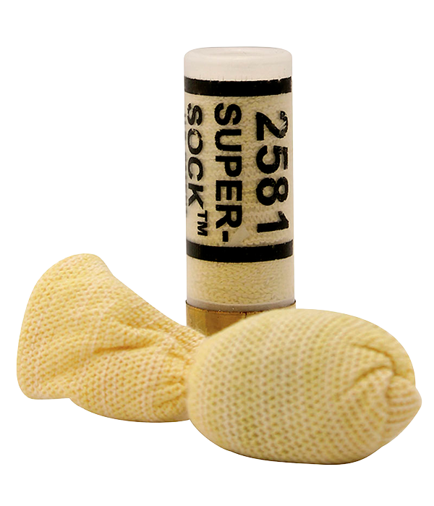
CTS 2581 12GA SUPER-SOCK
Kinetic Energy Munition
The Model 2581 Super-Sock is in its deployed state immediately upon exiting the barrel. It does not require a minimum range to “unfold” or “stabilize.” The Super-Sock is an aerodynamic projectile and it’s accuracy is relative to the shotgun, barrel length, environmental conditions, and the operator. The Super- Sock® is first in its class providing the point control accuracy and consistent energy to momentarily incapacitate violent, non- compliant subjects. The effective range is 75ft.
Quantity Expiration Cost
997 5 years from MFD $4.55ea
MFD 2020
(patrol / corrections standard issue)

Slide 34
Applicable Sheriff's Office Policy and California Penal Codes.
All listed equipment is governed by Sheriff’s Office policy and California Penal code.
Lake County Sheriff’s Office policy manual
300 Use of Force
308 Control Device Techniques
707.1 Special Purpose Vehicles
Lake County Sheriff’s Office Custody policy manual
571 Custody Use of Force
California Penal Codes
835(a) Use of Reasonable Force to Effect Arrest
836 Arrest by Peace Office
Complaints pertaining to the deployment of the aforementioned equipment are received and investigated per, Lake County Sheriff’s policy 1019 – Complaints.

Slide 35
The Following Equipment is not currently utilized by the Sheriff’s Office and is retained for training purposes only.

Slide 36
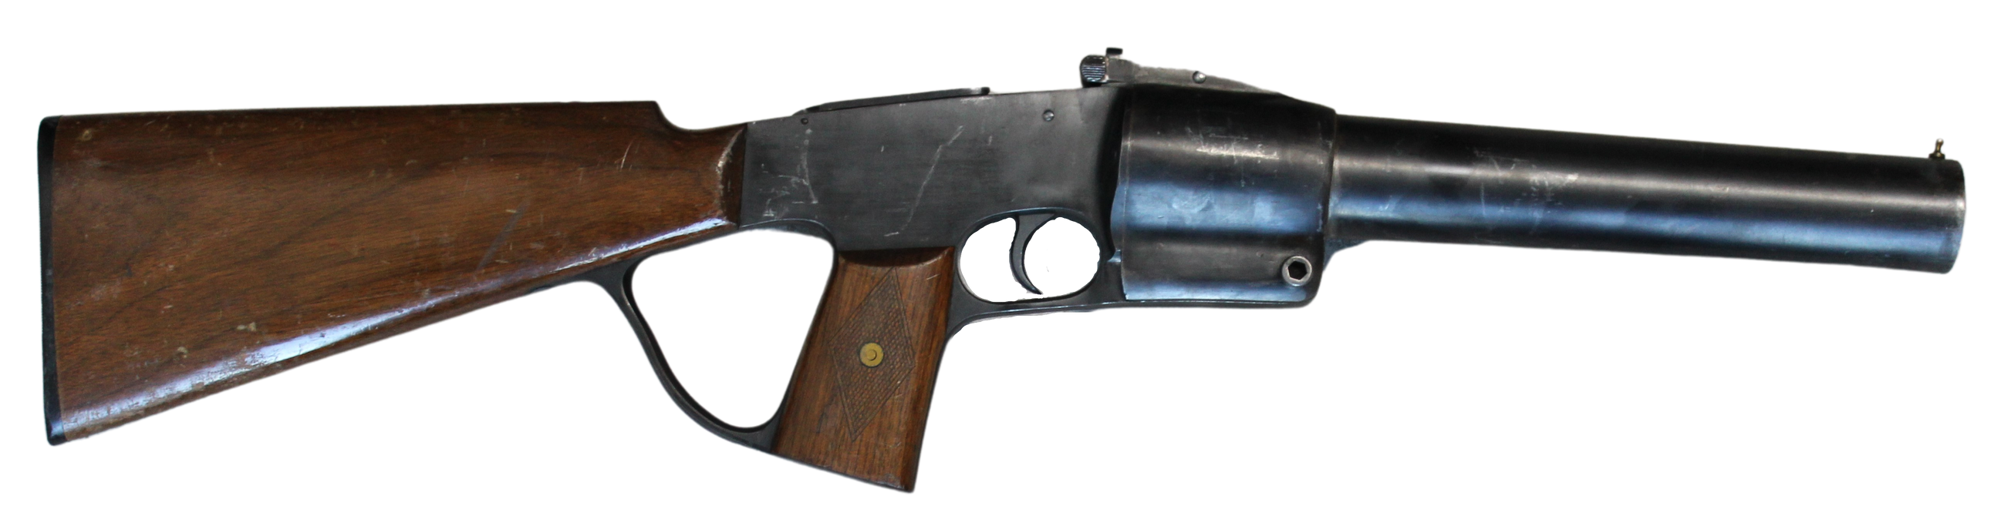
Developed in the 1930s as a 37mm, single shot launcher designed to deploy chemical munitions at both short and long range.
Designed to be used for riots, barricaded subjects, prison riots, and hostage situations.
37mm Federal Laboratories "Riot Gun"
Quantity: 1
Cost: $90.00
Obtained: 1995
TRAINING PURPOSES ONLY.
Stored in CRU locker, access restricted to CRU members

Slide 37
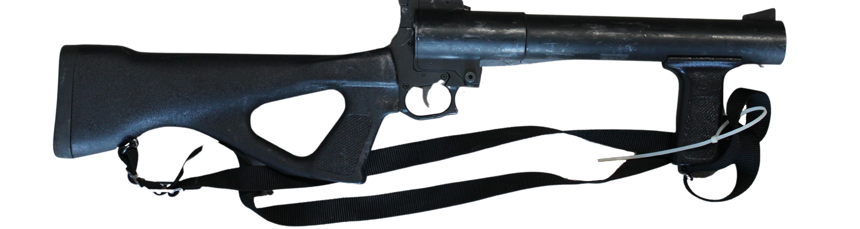
Quantity: 1
37mm, single shot, less than lethal launcher designed to deploy chemical munitions at both short and long-range. Break action with a flip-up rear sight. Designed to be used for riots, barricaded subjects, prison riots, and hostage situations.
37MM Defense Technology Model 1315 "Gas Gun"
Cost: $90.00
Obtained: 2000
TRAINING PURPOSES ONLY.
Stored in CRU locker, access restricted to CRU members.

Slide 38
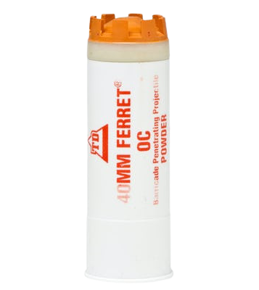
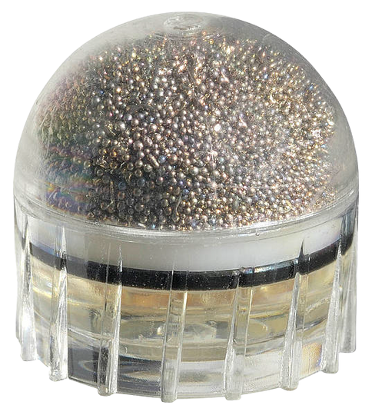
FNH LE FN303
Impact Projectile
DEF TEC 1290
40MM OC Powder Barricade Penetrating Projectile
40mm Barricade Penetrating Projectile uses a OC powder chemical agent to primarily dislodge barricaded subject and to deny areas of refuge. The nose ruptures upon impact and instantaneously delivers its payload.It is designed to penetrate barriers, such as windows, particleboard, doors and interior walls.
FN Impact Projectile is a fin-stabilized projectile which provides greater accuracy than a standard paintball round. The forward half of the sphere is a non-toxic granulated bismuth shell designed to fragment on impact to prevent penetration damage. The tip is a non-toxic glycol base with no additives, used for training and when the impact sting is the preferred deterrent. It delivers a sufficiently dissuasive level of pain within the projectile’s impact zone to disable targets temporarily.
Quantity: 240
Expired (Training Use Only)
Quantity: 14
MFD:
2007 - Expired
(For Training Use Only)

Slide 39
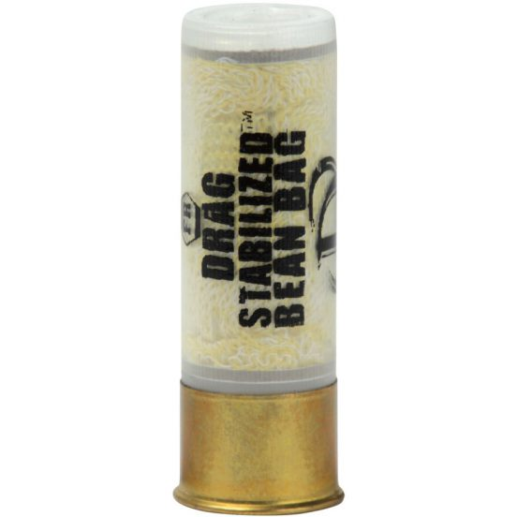
DEFENSE TECHNOLOGY, Drag Stabilized 12-Gauge Round
The Drag Stabilized™ 12-Gauge Round is a translucent 12-Gauge shell loaded with a 40-Gram tear shaped bag made from a cotton and ballistic material blend and filled with #9 shot. This design utilizes four stabilizing tails and utilizes smokeless powder as the propellant. This round has a velocity of 270 fps with a maximum effective range of 75 feet.
Quantity Expiration Cost Per Round
523 Expired $4.55
The Defense Technology Less Than Lethal round is not deployed or used for law enforcement purposes other than training. This round is retained and used for training due to the expense of un-expired rounds.

Slide 40
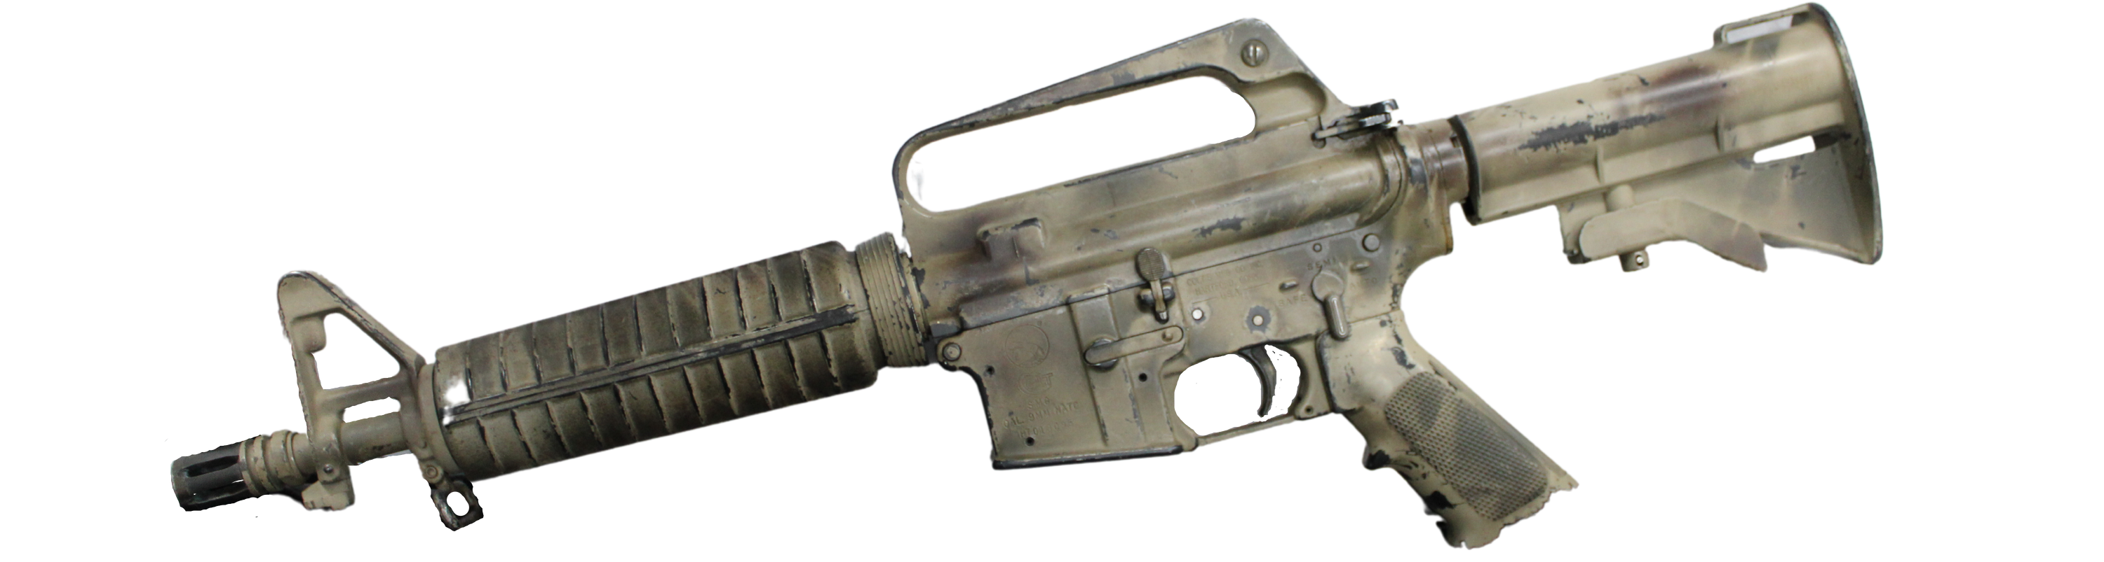
Quantity: 6
COLT Model 635 9MM SMG
The Colt 9mm SMG which is also known as Colt Model 635 , is a 9×19mm Parabellum submachine gun manufactured by Colt, based on the M16 rifle.
Cost: $780.25/ea
Purchased: 2000
These SMG’s are not deployed or used by the Lake County Sheriff's Office for law enforcement purposes other than training. They are stored in the LCSO armory and access is restricted to firearms instructors.

Slide 41
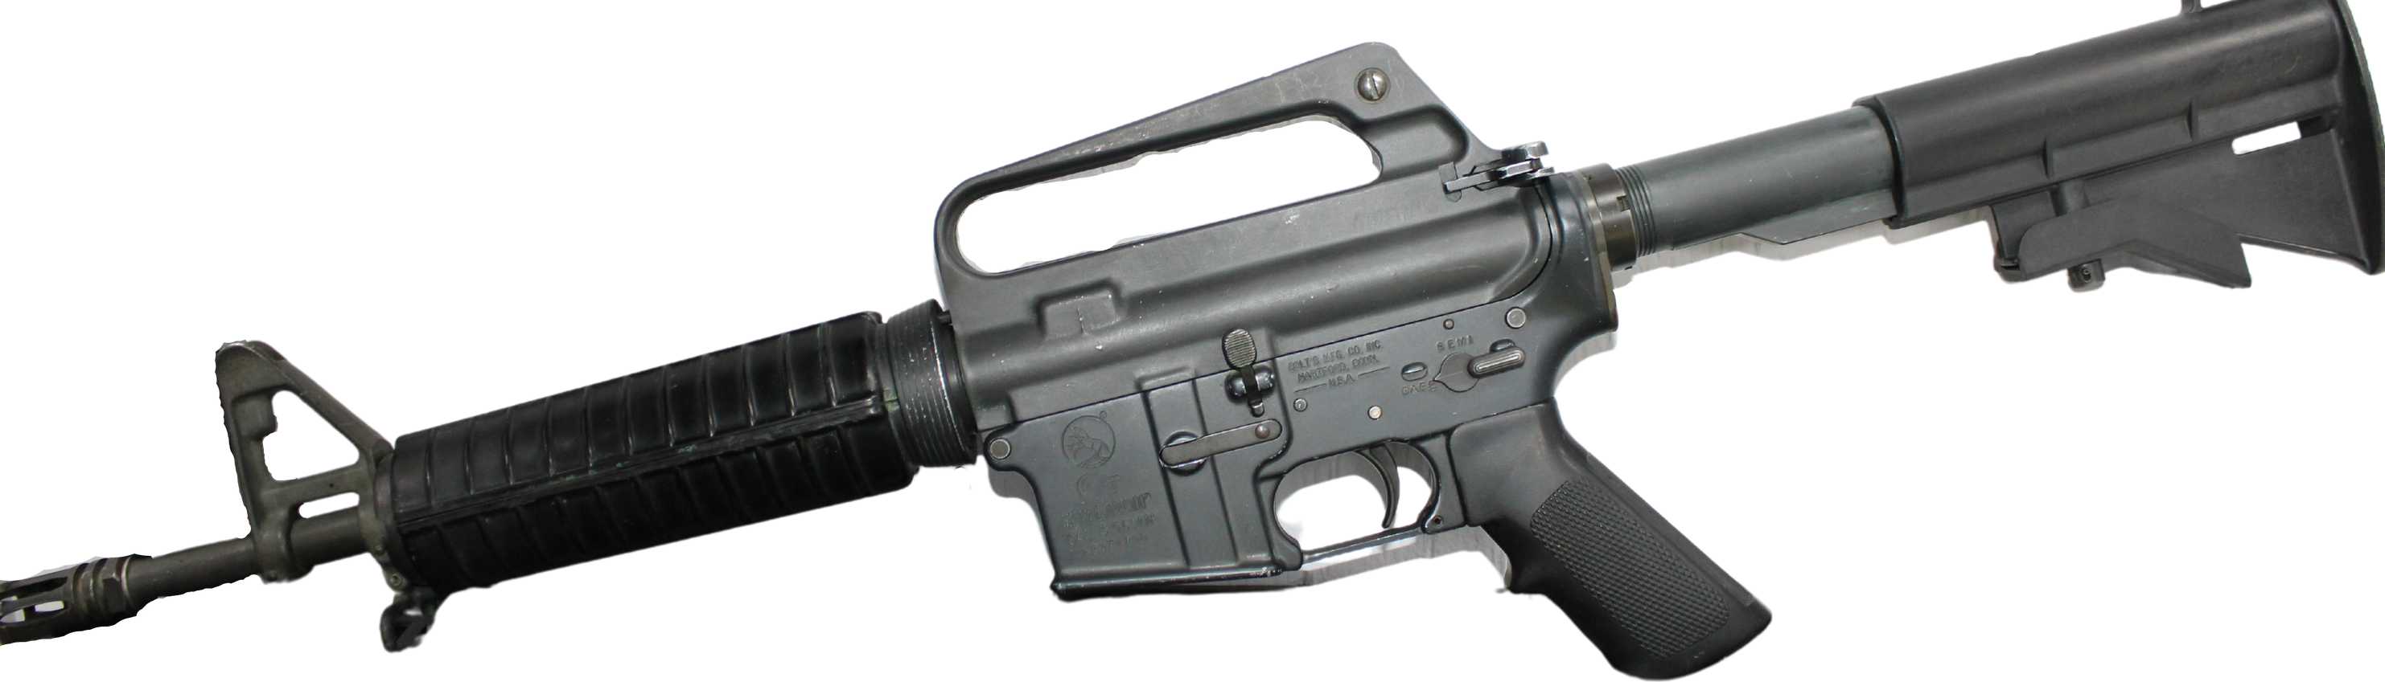
Quantity: 1
The Colt Commando 5.56mm semi, full-automatic carbine manufactured by Colt, based on the M16 rifle.
COLT M16A2
Commando 5.56mm
Cost: $778.00/ea
Purchased: 1998
The Colt Commando is not deployed or used by the Lake County Sheriff's Office for law enforcement purposes other than training. It is stored in the LCSO armory and access is restricted to firearms instructors.

Slide 42
Firearms obtained from the Sheriff’s Office evidence division and retained for training purposes.
Penal Code 34005(b), Any law enforcement agency that has custody of any firearms, or any parts of any firearms, which are subject to destruction as required by any of the provisions listed in Section 16580 , may, in lieu of destroying the weapons, retain and use any of them as may be useful in carrying out the official duties of the agency

Slide 43
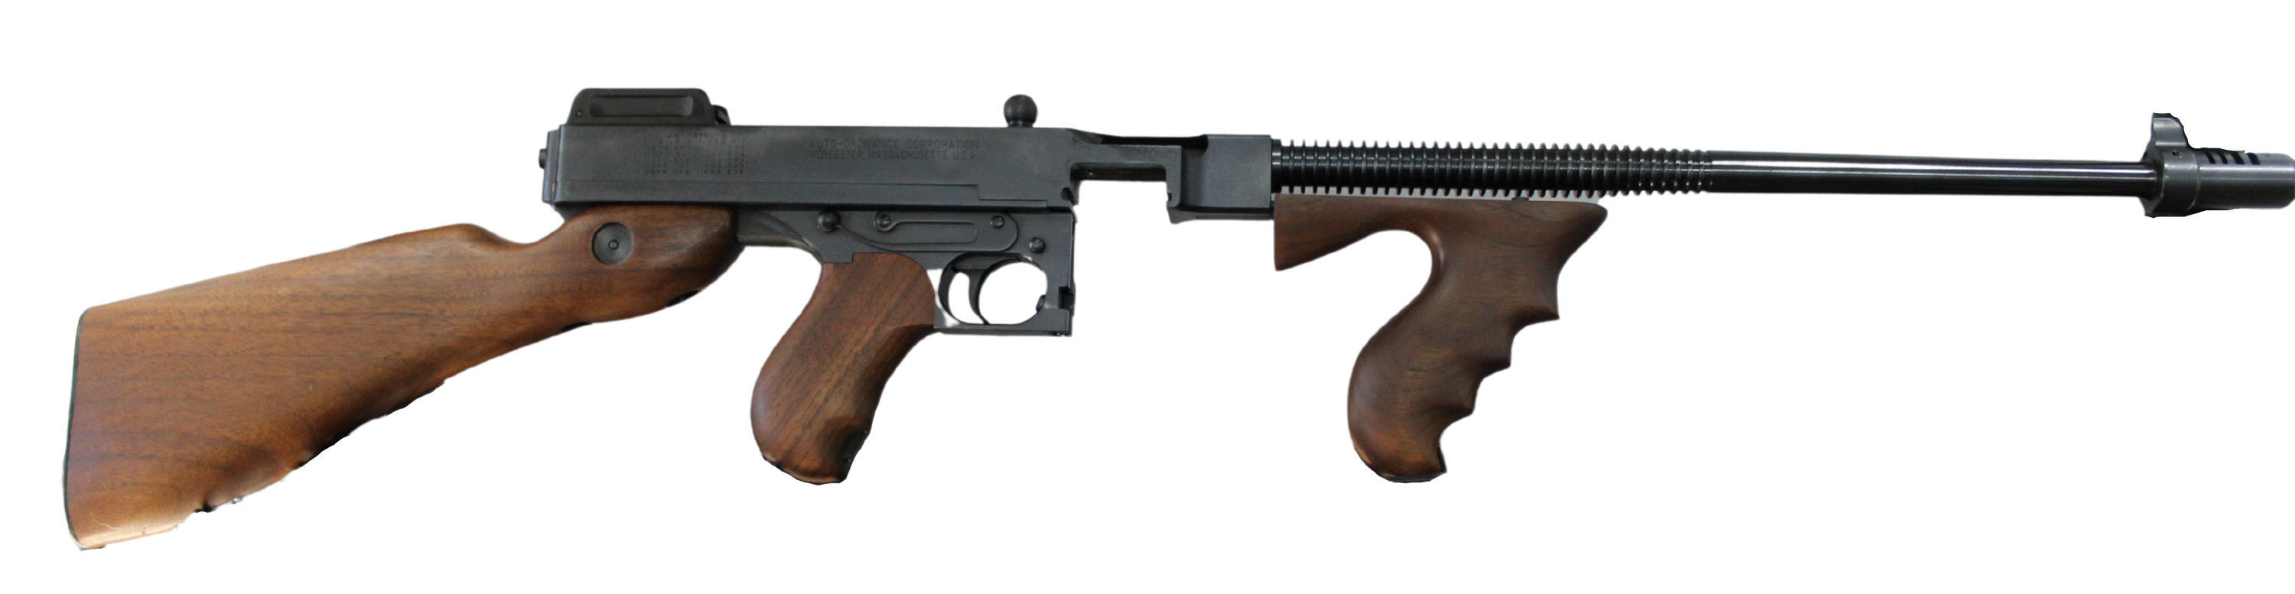
Quantity: 1
AUTO-ORDNANCE (KAHR ARMS) .45
.45 Caliber semi-automatic reproduction of the Thompson sub-machine gun, better
known as the "Tommy Gun". Though the original firearm was fully automatic, this
modern reproduction does not have such a feature.
ACP 1927A-1
Thompson Rifle
Firearm is for demonstration and training purposes only. Access and use are restricted to firearms instructors.

Slide 44
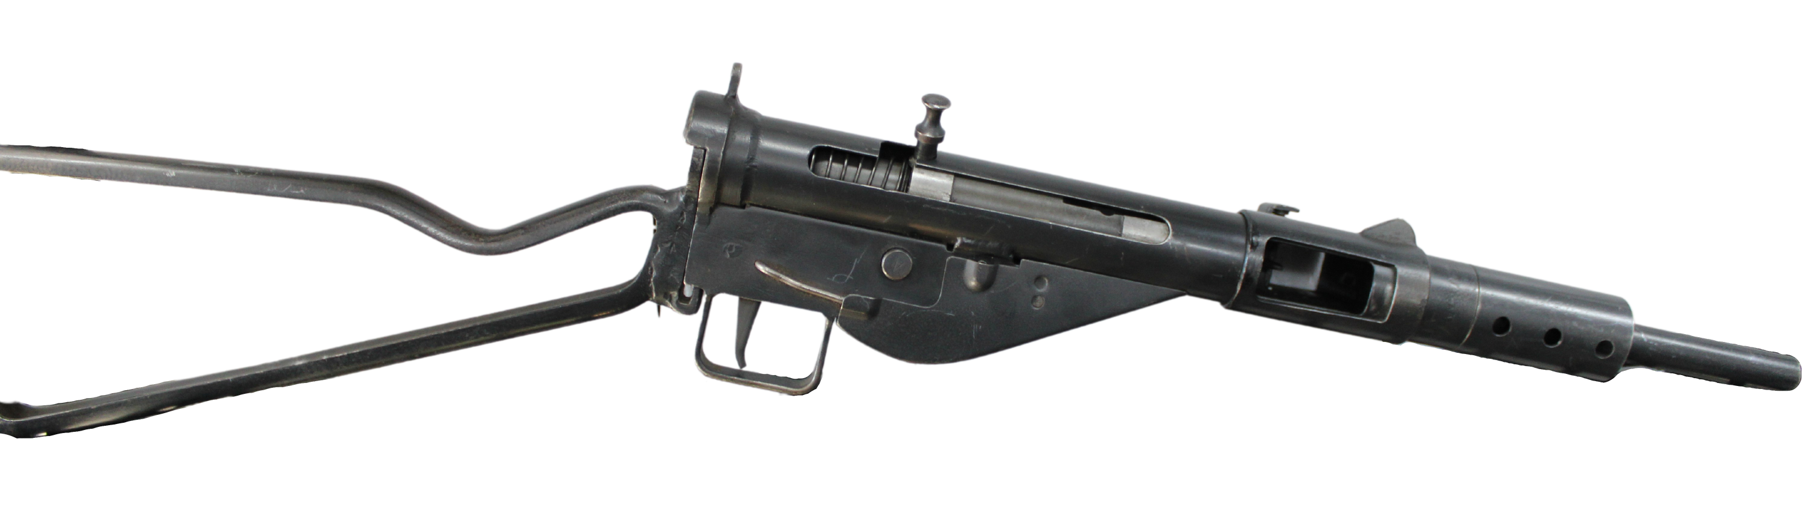
Quantity: 1
The Sten was a blowback-operated submachine gun firing from an open bolt with a fixed firing pin on the face of the bolt. This weapon is fully automatic and is chambered in 9x19mm.
STEN MKII 9x19MM SUBMACHINE GUN
Firearm is for demonstration and training purposes only. Access and use are restricted to firearms instructors.

Slide 45
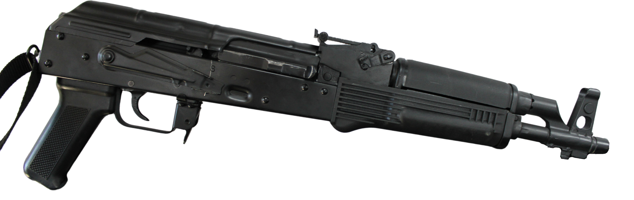
Quantity: 1
D.C. INDUSTRIES NDS-3 7.62X39MM AK47 TACTICAL PISTOL
DC Industies model NDS-3 semi-auto AK47 Pistol, chambered in 7.62x39.
Unlike the original well known design, this specific model is semi-automatic.
Firearm is for demonstration and training purposes only. Access and use are restricted to firearms instructors.

Slide 46
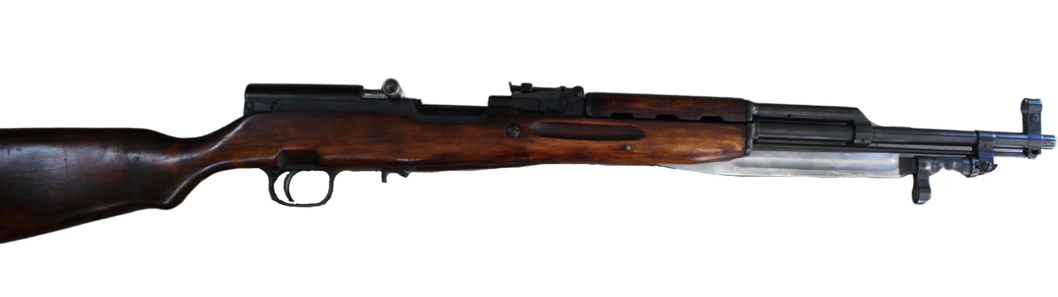
Quantity: 1
NHM CO. 1951 RUSSIAN SKS 7.62X39MM
The SKS is a Soviet style semiautomatic, self-loading, carbine, chambered for the 7.62x39mm round.
Firearm is for demonstration and training purposes only. Access and use are restricted to firearms instructors.

Slide 47
Questions?

