Slide 1
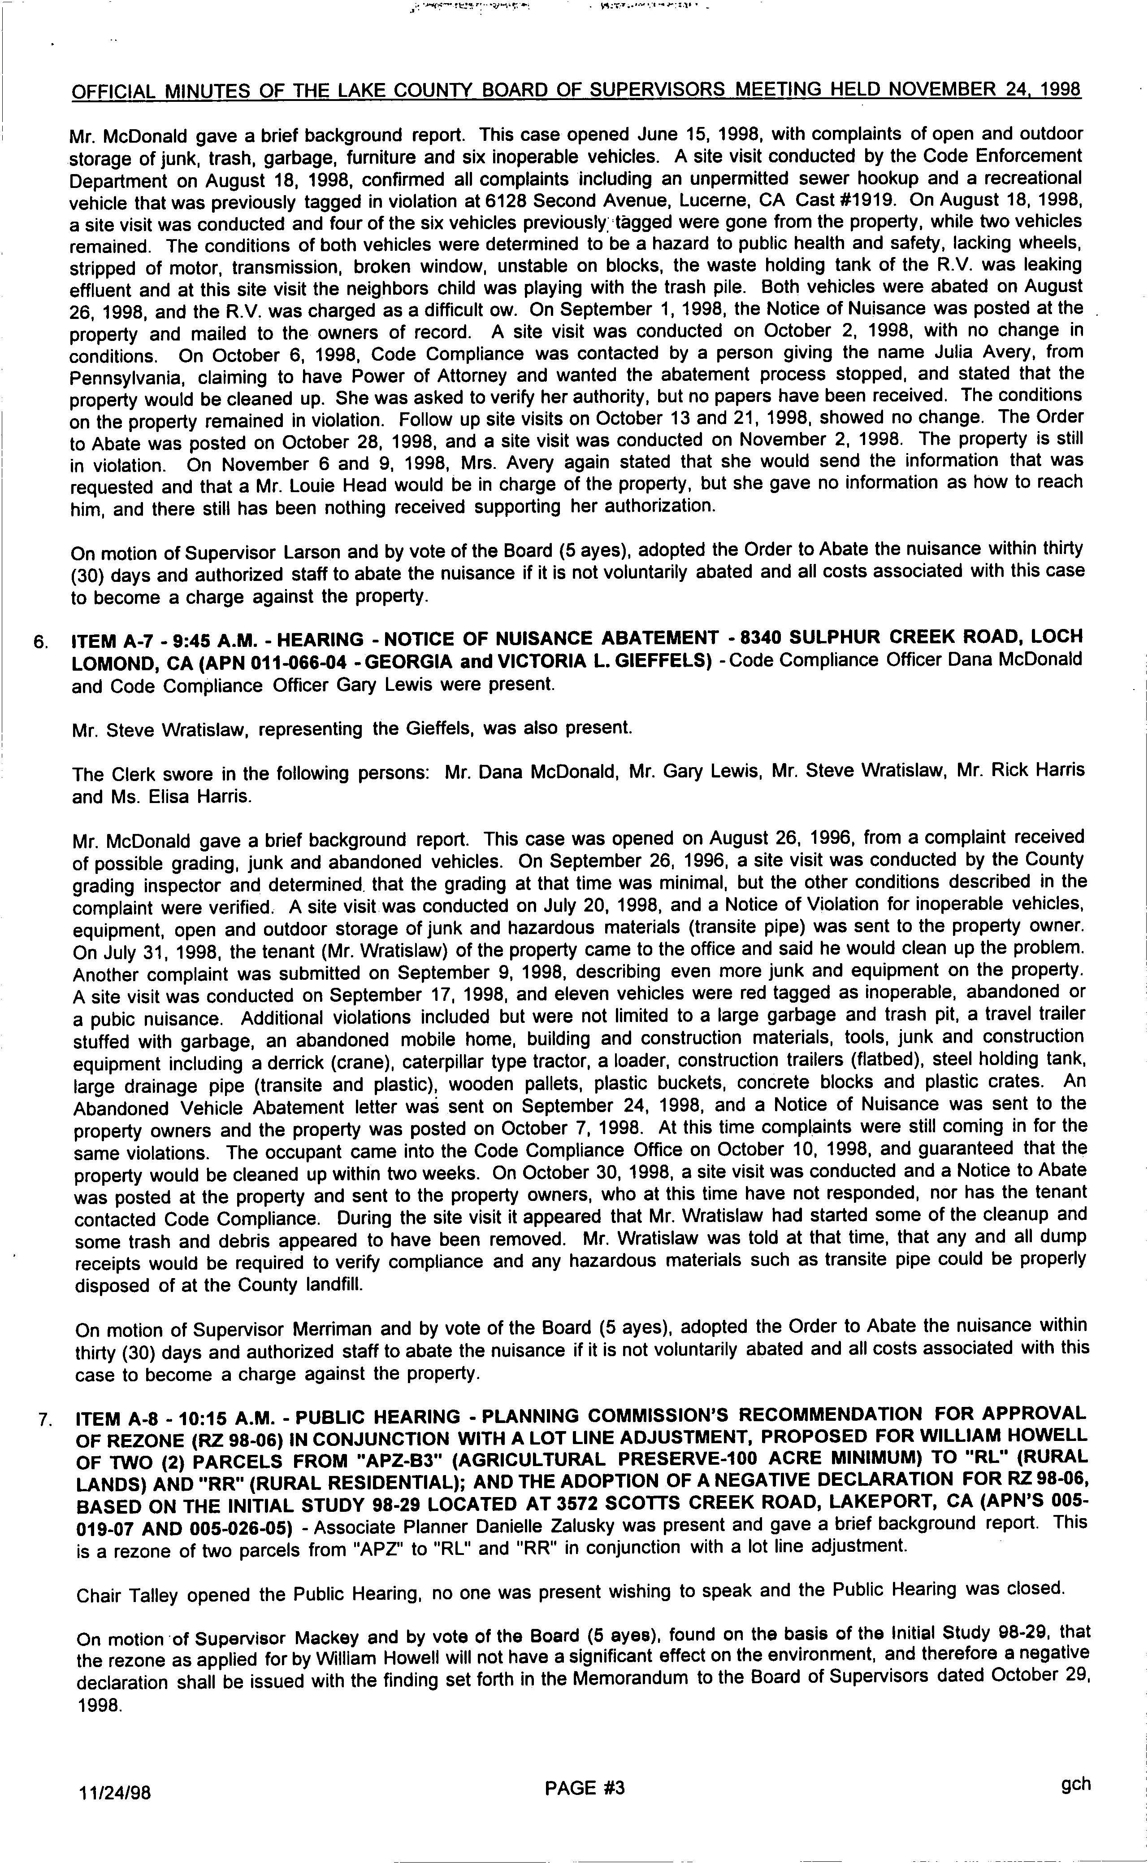
r.,..... r_.. .. _{yam t:.. .. .:} ª
OFFICIAL MINUTES OFTHE LAKE COUNTY BOARD OFSUPERVISORS MEETING HELD NOVEMBER 24, 1998
Mr. McDonald gaveabriefbackground report. ThiscaseopenedJune15, 1998, withcomplaints ofopenandoutdoor
storage of_{junk,} trash, _{garbage,} furniture and six inoperable vehicles. Asitevisitconducted bytheCodeEnforcement
DepartmentonAugust18, 1998, confirmedallcomplaintsincludinganunpermittedsewerhookupandarecreational
vehiclethatwaspreviouslytaggedinviolationat6128SecondAvenue, Lucerne, CACast#1919.OnAugust18, 1998,
asitevisitwasconducted andfourofthesixvehiclespreviously,°taggedweregonefromtheproperty, whiletwovehicles
remained. Theconditionsofbothvehiclesweredeterminedtobeahazardtopublichealthandsafety, lackingwheels,
stripped ofmotor, transmission, broken window, unstable onblocks, thewaste holding tankoftheR.V. wasleaking
effluentand atthis site visit the neighbors child was playing ^{with the trash} pile. Bothvehicles wereabated onAugust
26, 1998, andtheR.V. wascharged asadifficultow. OnSeptember 1, 1998, theNoticeofNuisance waspostedatthe.
property and mailed to the owners of record. Asite visitwas conducted on October 2, 1998, with nochange in
conditions. OnOctober 6, 1998, Code Compliance wascontacted byaperson giving thename JuliaAvery, from
Pennsylvania, claimingtohavePowerofAttorneyandwantedtheabatementprocessstopped, andstatedthatthe
propertywouldbecleanedup. Shewasaskedtoverifyherauthority, butnopapershavebeenreceived.Theconditions
on the_{property} remained ^{inviolation.} FollowupsitevisitsonOctober13and21, 1998, showednochange. TheOrder
toAbate was _{posted}on October 28, 1998, anda site visit was conducted on November 2, 1998. Theproperty isstill
in violation. OnNovember6and9, 1998, Mrs. Averyagainstatedthatshewouldsendtheinformationthatwas
requested andthataMr. LouieHeadwouldbeinchargeoftheproperty, butshegavenoinformation ashowtoreach
him, andtherestillhasbeennothingreceivedsupportingherauthorization.
Onmotion ofSupervisor Larson ^{and}byvote ofthe Board (5ayes), adopted theOrdertoAbatethenuisance withinthirty
30) daysandauthorizedstafftoabatethenuisanceifitisnotvoluntarilyabatedandallcostsassociatedwiththiscase
tobecomeachargeagainsttheproperty.
6. ITEM A-7 - 9:45 A.M. - HEARING - NOTICE OFNUISANCE ABATEMENT - 8340SULPHUR CREEKROAD, LOCH
LOMOND, CA(APN011-066-04 -GEORGIA andVICTORIA L.GIEFFELS) - CodeCompliance OfficerDanaMcDonald
andCodeCompliance OfficerGaryLewiswerepresent.
Mr. SteveWratislaw, representing theGieffels, wasalsopresent.
TheClerk swore ^{inthe} following_{persons:} Mr. DanaMcDonald, Mr. GaryLewis, Mr. SteveWratislaw, Mr. RickHarris
and Ms. Elisa Harris.
Mr. McDonaldgaveabriefbackground report.ThiscasewasopenedonAugust26, 1996, fromacomplaintreceived
of_{possible grading, junk}and^{abandoned vehicles.} OnSeptember26, 1996, asitevisitwasconducted bytheCounty
gradinginspectoranddetermined. thatthegradingatthattimewasminimal, buttheotherconditionsdescribedinthe
complaint were verified. AsitevisitwasconductedonJuly20, 1998, andaNoticeofViolationforinoperablevehicles,
equipment, openandoutdoorstorageofjunkandhazardous materials (transitepipe) wassenttothepropertyowner.
OnJuly31, 1998, thetenant (Mr. Wratislaw) ofthepropertycametotheofficeandsaidhewouldcleanuptheproblem.
Another complaint wassubmitted onSeptember 9, 1998, describing evenmorejunkandequipment ontheproperty.
AsitevisitwasconductedonSeptember17, 1998, andelevenvehicleswereredtaggedasinoperable, abandoned or
a _{pubic} nuisance. Additionalviolationsincludedbutwerenotlimitedtoalargegarbageandtrashpit, atraveltrailer
stuffedwithgarbage, anabandonedmobilehome, buildingandconstructionmaterials, tools, junkandconstruction
equipment _{including} aderrick (crane), caterpillar type tractor, a loader, construction trailers ( flatbed), steelholdingtank,
large _{drainage pipe (}^{transite and} _{plastic),} ^{wooden} pallets, plastic buckets, concrete blocks and plastic crates. An
Abandoned VehicleAbatement letterwassentonSeptember 24, 1998, andaNoticeofNuisance wassenttothe
property owners andthe property was postedon October 7, 1998. Atthistimecomplaints werestillcoming inforthe
same violations. Theoccupant cameintotheCodeCompliance OfficeonOctober 10, 1998, andguaranteed thatthe
propertywouldbecleanedupwithintwoweeks.OnOctober30, 1998, asitevisitwasconductedandaNoticetoAbate
waspostedatthepropertyandsenttothepropertyowners, whoatthistimehavenotresponded, norhasthetenant
contacted Code Compliance. DuringthesitevisititappearedthatMr. Wratislawhadstartedsomeofthecleanupand
some trashand debris appeared to have been removed. Mr. Wratislaw wastoldatthattime, thatanyandalldump
receiptswouldberequiredtoverifycomplianceandanyhazardousmaterialssuchastransitepipecouldbeproperly
disposedofattheCountylandfill.
Onmotion ofSupervisor ^{Merriman and} byvote oftheBoard (5ayes), adoptedtheOrdertoAbatethenuisancewithin
thirty (30) daysandauthorizedstafftoabatethenuisanceifitisnotvoluntarilyabatedandallcostsassociatedwiththis
casetobecome acharge against theproperty.
7. ITEM A-8 - 10:15A.M. - PUBLIC HEARING - PLANNINGCOMMISSION'SRECOMMENDATION FORAPPROVAL
OFREZONE (RZ98-06) INCONJUNCTION WITHALOTLINEADJUSTMENT, PROPOSED FORWILLIAMHOWELL
OFTWO ( ²⁾ PARCELS FROM " APZ-B3" ( AGRICULTURAL PRESERVE-100 ACRE MINIMUM) TO " RL" ( RURAL
LANDS) AND" RR" (RURAL RESIDENTIAL); ANDTHEADOPTION OFANEGATIVE DECLARATION FORRZ98-06,
BASEDONTHEINITIALSTUDY98-29LOCATEDAT3672SCOTTSCREEKROAD, LAKEPORT, CA (APN'S005-
019-07AND005-026-05) - Associate PlannerDanielle Zalusky ^{was} presentandgave a briefbackground report. This
isarezoneoftwoparcelsfrom "APZ" to "RL" and "RR" inconjunctionwithalotlineadjustment.
ChairTalleyopenedthePublicHearing, noonewaspresentwishingtospeakandthePublicHearingwasclosed.
On motion ofSupervisor _{Mackey} ^{and} byvote ofthe Board (5ayes), foundonthebasisoftheInitialStudy98-29. that
therezoneasappliedforbyWilliamHowellwillnothaveasignificanteffectontheenvironment, andthereforeanegative
declarationshallbeissuedwiththefindingsetforthintheMemorandumtotheBoardofSupervisorsdatedOctober29,
1998.
11/24/98 ^{PAGE # 3 9}
ch

