Slide 1
UC Master Gardener Program of Lake County
Advice to Grow By…Ask Us
Presented by Louise Pagone,
Program Coordinator
September 16, 2025

Slide 2
University of California Master Gardeners of Lake County
Who We Are, What We Do, What’s in the Future

Slide 3
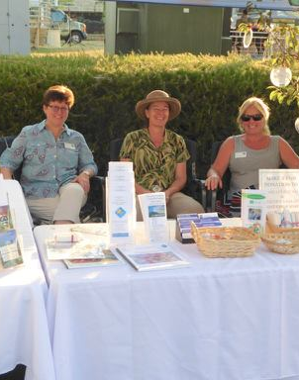
Who We Are
We are you neighbors and friends
We are scientists, teachers, project managers, and more
We love to garden
We love meeting new People
And do we love plants!

Slide 4
What We Do
We love to share our love and knowledge of gardening with our communities
Sharing knowledge is important to us: Invasive Species, The latest information on pest control; What to Grow & When to grow it
We collaborate. With each other and with our clients ~ the citizens of Lake County. We collaborate with Lake County 4-H and their Junior Master Gardener Program and the school gardens around the lake
We collaborate with the Tribal Health Clinics. Teaching gardening classes through the Summer and into the Fall.

Slide 5
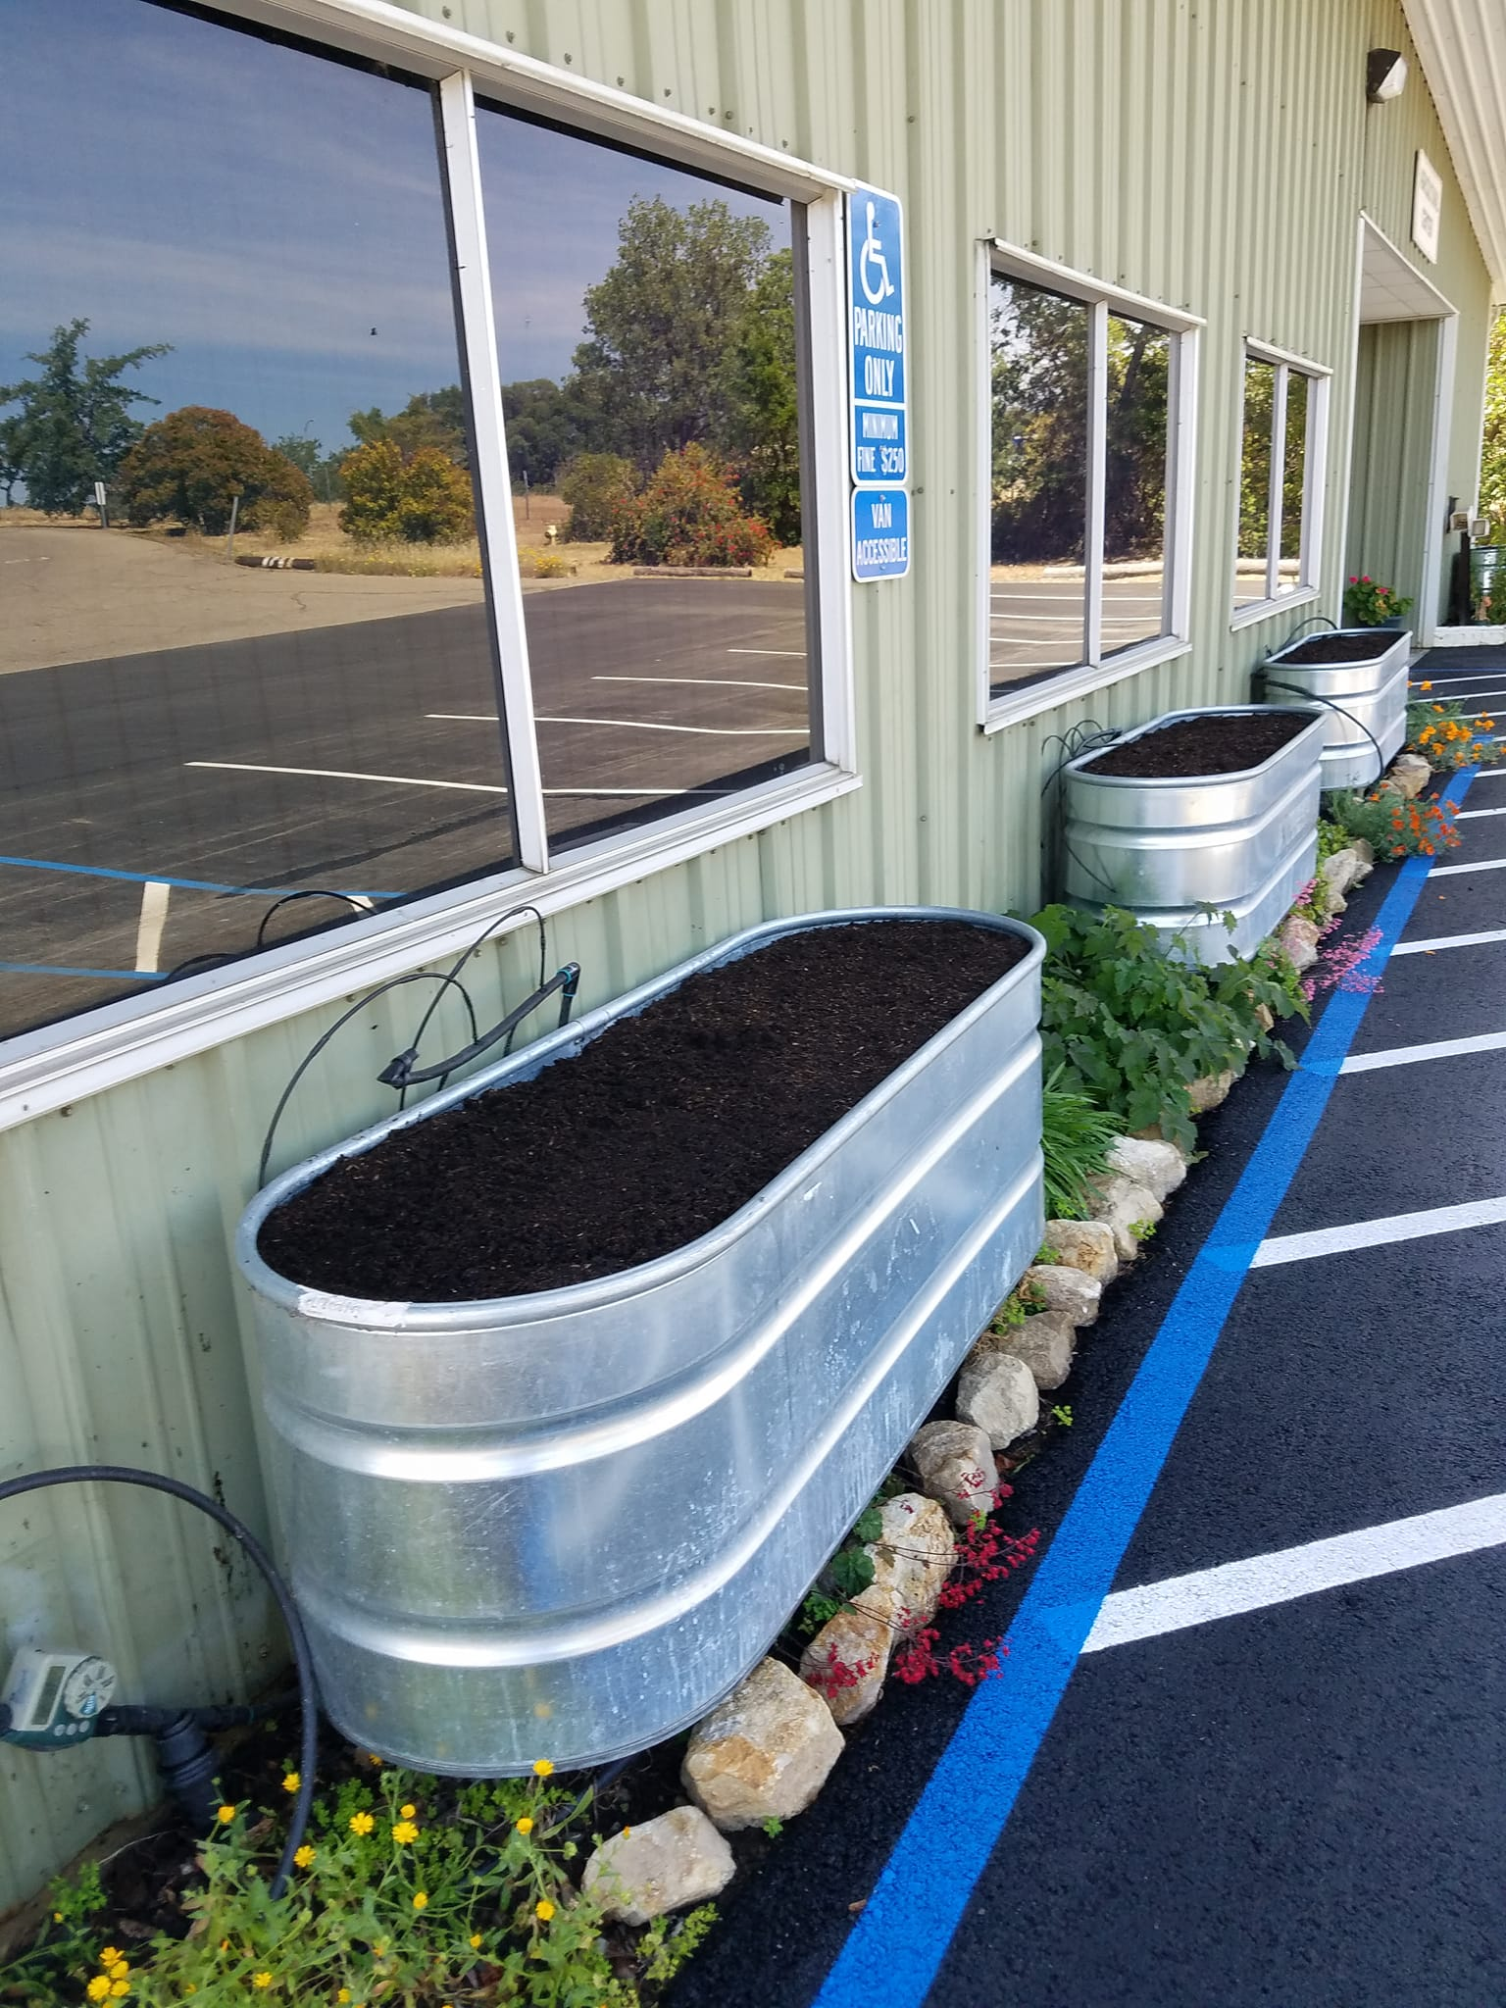
What We Do, con’t
We are in the initial stages of collaboration with Middletown Rancheria and the community garden there.
We care for our demonstration gardens at the UCCE Lake Extension Offices.
We have a radio show on KPFZ 88.1FM. Our show Right Plant Place will be celebrating its third anniversary just in time for Thanksgiving 2025.
We attend festivals and events of all kinds in Lake County: Blackberry Cobbler Festival, Big Valley Small Farms Tours, vision of hope in October, health & wellness fair in lakeport; the Farmers finest farmer’s market at the Mercantile to name a few.

Slide 6
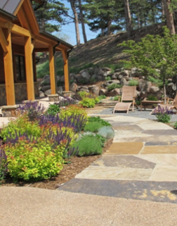
Going Forward
We are learning about Firesafe Landscaping and Home Hardening
Climate Change is on our minds
We are learning to be scouts for all kinds of pests and invasive species: The Tree of Heaven, The Spotted Lanternfly, Pink Mealy Bug, and the Mediterranean Oak Borer to name a few.
All this knowledge will impact our gardens into the future, and we’ll be ready.

Slide 7
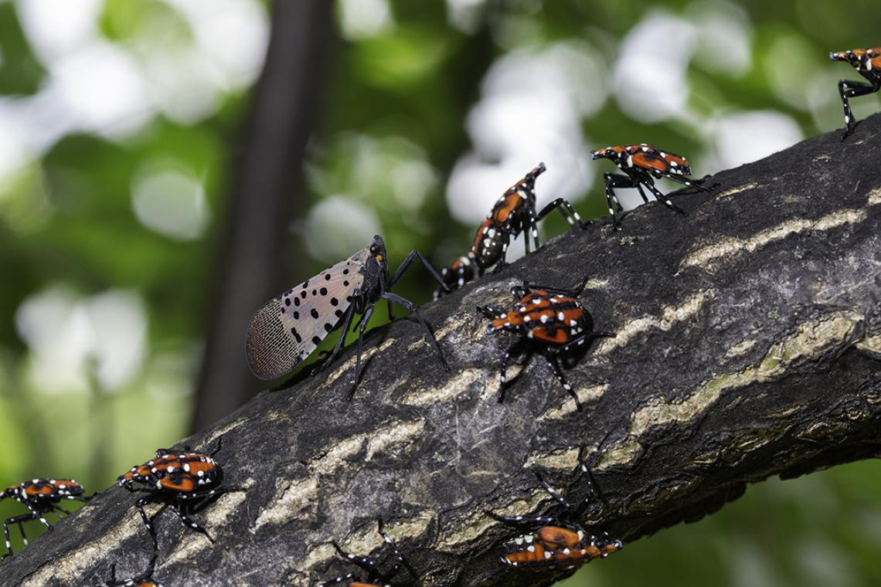
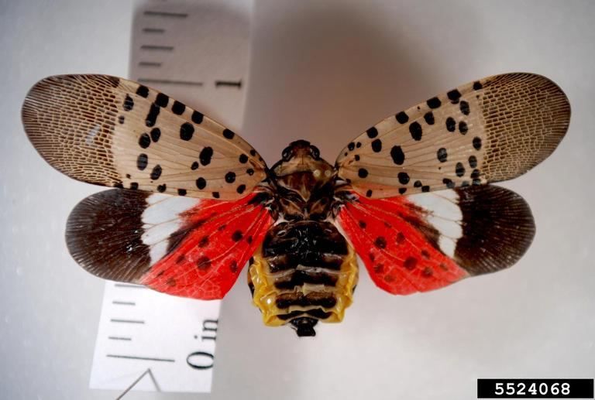
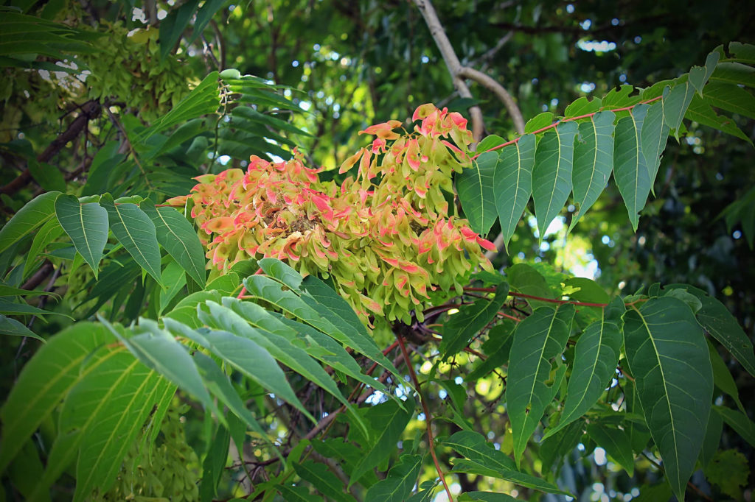
Some Invasives we are learning to Identify
Guess what this is?

Slide 8
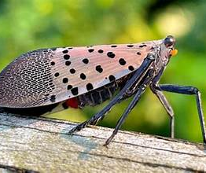
The Tree of Heaven is the host for the Spotted Lanternfly; it is considered a noxious weed.
The fly is not harmful to humans. It doesn't’ sting or bite, but it can destroy agricultural crops all through the state.
The spotted lanternfly is already in 19 states in the US mostly on the East Coast.

Slide 9
But We Try to Maintain Our Senses of Humor
Gardening Cartoons Help

Slide 10
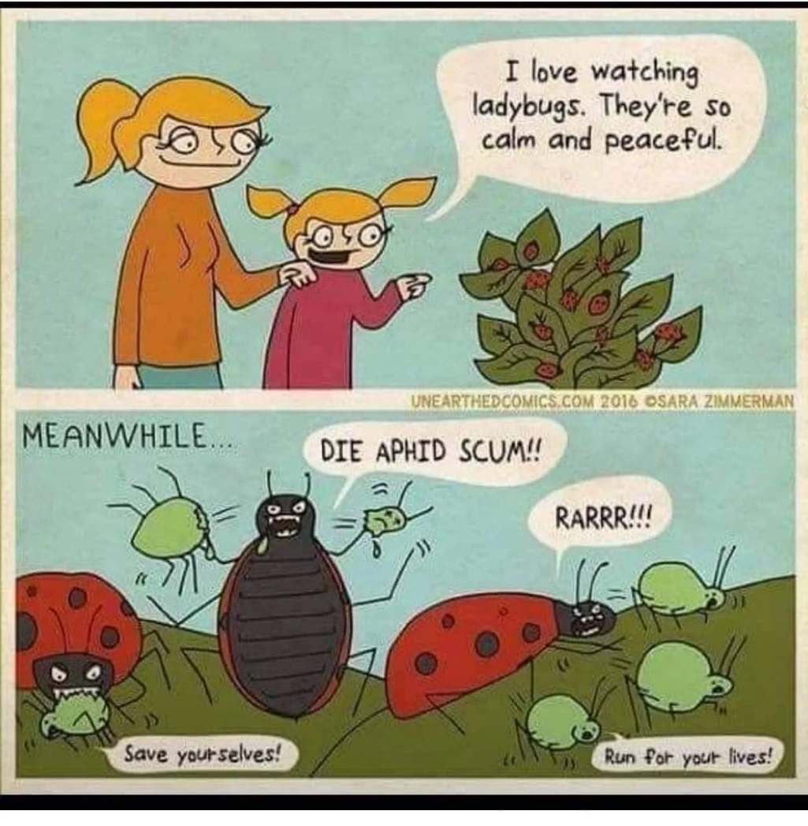
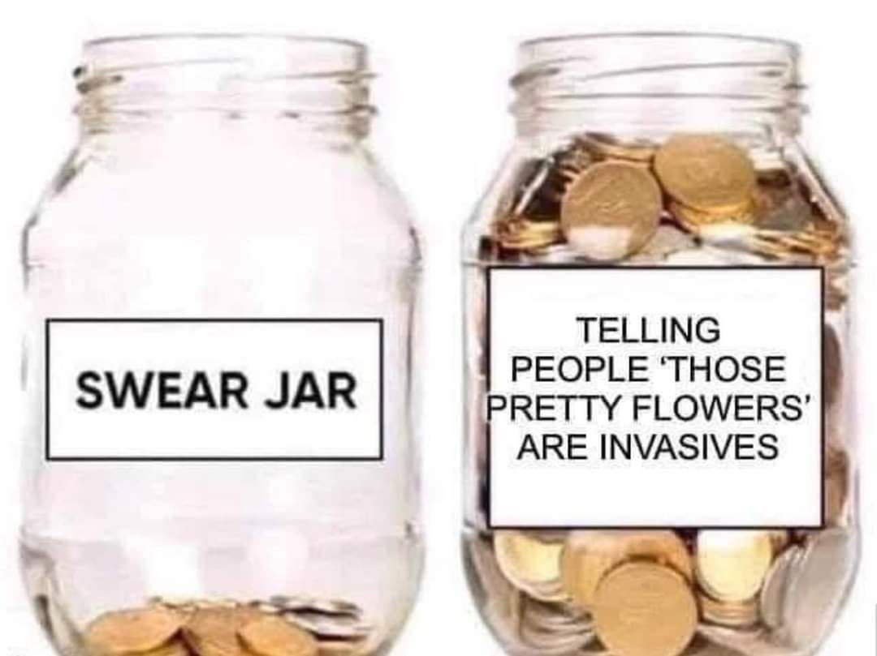
For Example…

Slide 11
Thank you for your time!
If you have any questions, please give us a call.
Louise Pagone, Program Coordinator
Our Office: (707)263-6838

