Slide 1
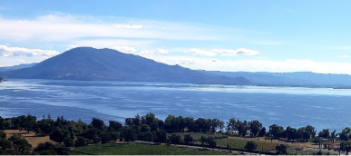
Invasive Mussel Prevention Program
Proposed Quagga Sticker Increase and Special Lake Event Fee
Lake County Water Resources Department
September 1, 2026

Slide 2
Why We Are Here Today
The Board previously directed staff to pursue a financially sustainable Quagga Mussel Prevention Program.
The program has historically relied heavily on grant funding.
Grant funding is not guaranteed and has fluctuated over time.
Staff is seeking approval of fee adjustments to support long-term program sustainability.

Slide 3
What Are The Mussel Species of Concern?
Quagga, zebra (genus Dreissena) and axe-head (genus Xenostrobus)
Golden mussels (genus Limnoperna) were detected in the Stockton area in 2024.
By 2025 they had spread into portions of the Delta and continue to spread
They are unintentionally moved between waterbodies by hitchhiking on watercraft and equipment.
Both adult mussels and veligers (larval mussels) can be moved between waterbodies.

Slide 4
Why This Matters to Lake County
Clear Lake supports tourism, recreation, agriculture, and drinking water systems.
Approximately 66% of Lake County residents rely on Clear Lake for drinking water.
Invasive mussels threaten infrastructure, private property, fisheries, and public access.
Once established, invasive mussels are extremely difficult and expensive to remove.

Slide 5
Economic Risks to Lake County
Reduced boating and fishing activity could hurt tourism revenue.
Agricultural irrigation systems could face expensive repairs and downtime.
Increased cost to maintain water intake infrastructure for public/private water systems.
Businesses tied to recreation and lake access may suffer economic losses.

Slide 6
Threats to Water Infrastructure
Mussels clog intake pipes, pumps, irrigation systems, and treatment equipment.
Infestations reduce water flow efficiency and increase maintenance costs.
Long-term infestations may require chemical treatment or infrastructure replacement.
Annual cost to mitigate invasive mussel damage to infrastructure can cost millions.

Slide 7
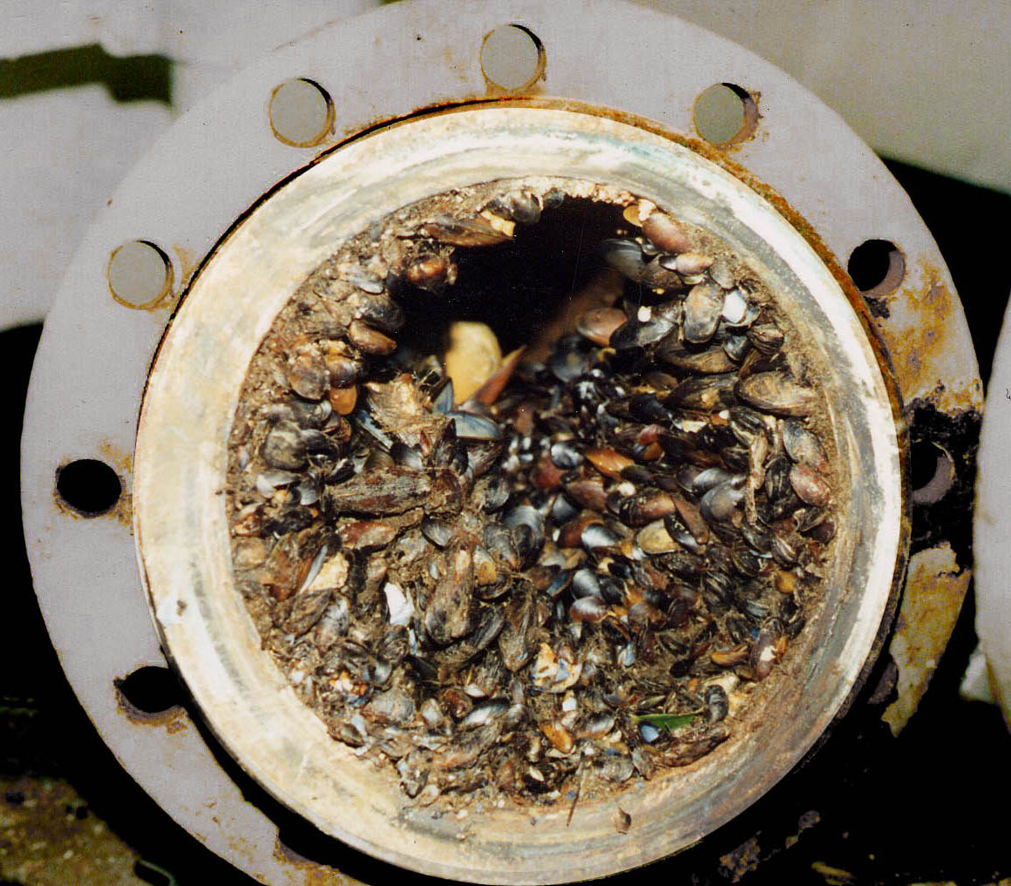
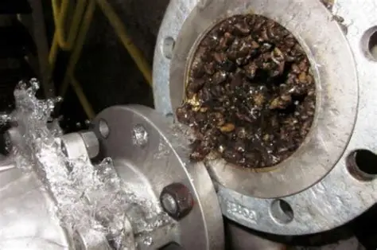
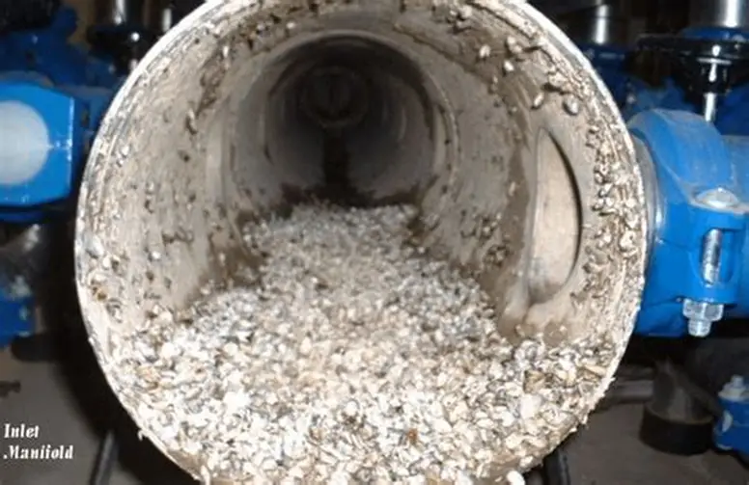
Current state of impacted infrastructure

Slide 8
Threats to Private Property
Mussels can impact private residences by:
fowling up boat engines causing damage and expensive repairs.
Encrusting on boats reducing flow efficiency and boat performance.
Encrusting on docks and private infrastructure requiring expensive yearly maintenance.
Potential reduction in property values.

Slide 9
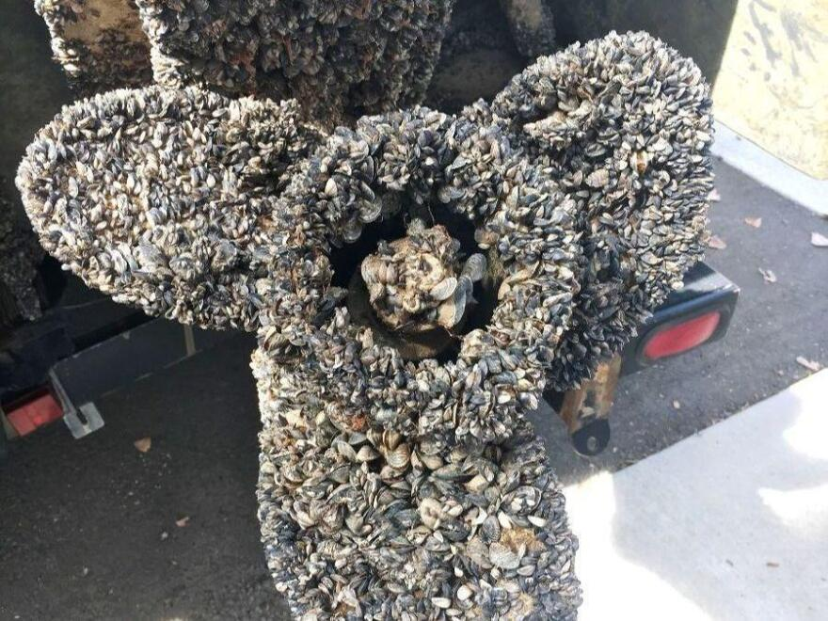
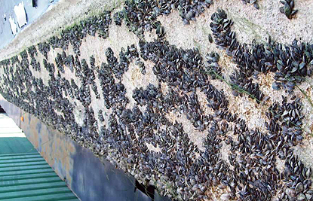
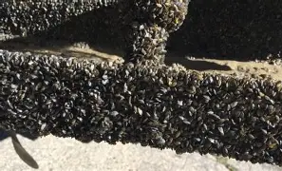
Biofouling becomes increasingly expensive

Slide 10
Threats to Public Access
When invasive mussels die off their shells litter beaches and are extremely sharp.
Mussel die offs also release toxins into the water decreasing water quality and increasing the cost for water treatment plants to treat the water.
Die offs also release noxious odors exacerbating the smell of cyanobacteria in the summer.

Slide 11
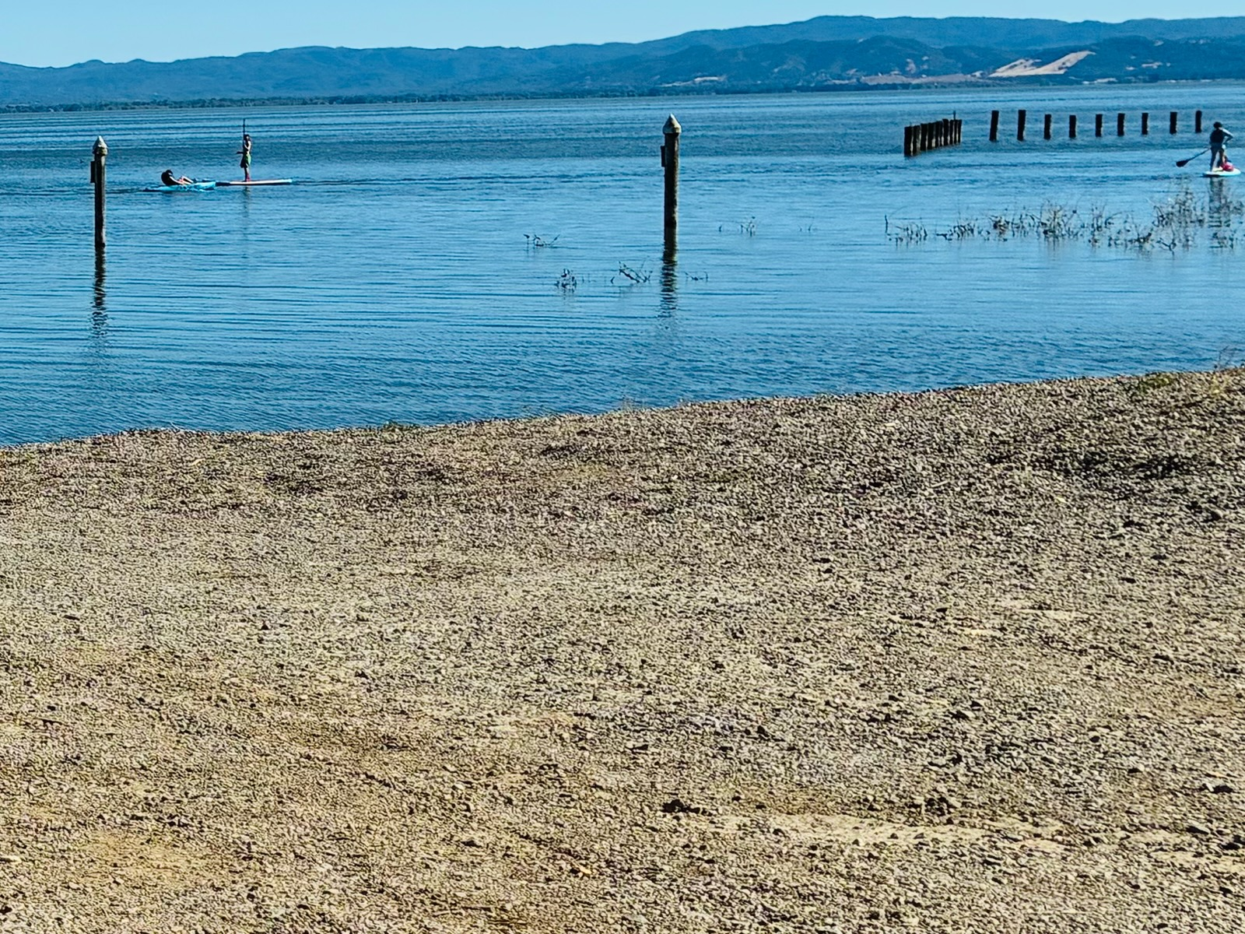
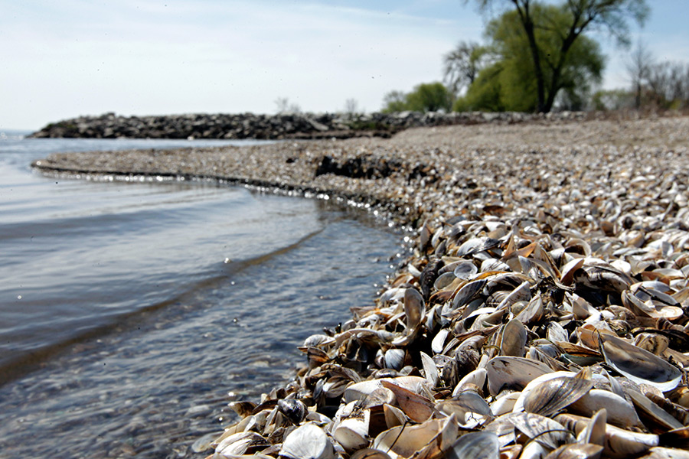
The devastating effect of die off
Current Clear Lake shoreline Potential Clear Lake shoreline without mussels after mussel infestation

Slide 12
Quagga and Zebra Mussel Infestation Prevention Grant Program state funding trend

Slide 13
Estimated Revenue based off five year average
Vendor Sticker Sales- $13 net each
Fiscal Year | Resident Stickers Sold | Visitor Stickers Sold | Total Stickers Sold
2021-2022 | 3249 | 6405 | 9654
2022-2023 | 4912 | 5906 | 10818
2023-2024 | 5032 | 6850 | 11882
2024-2025 | 4559 | 7238 | 11797 | 5yr avg
2025-2026 | 4639 | 7143 | 11782 | 11187
Ramp Monitor Sticker Sales $20 net each
Fiscal Year | Resident Stickers Sold | Visitor Stickers Sold | Total Stickers Sold
2021-2022 | 201 | 637 | 838
2022-2023 | 408 | 627 | 1035
2023-2024 | 353 | 696 | 1049
2024-2025 | 339 | 649 | 988 | 5yr avg
2025-2026 | 469 | 1071 | 1540 | 1090
Based Off Historical Five-Year Average
Current Billing at $20 | Proj. Billing at $60 | Proj. Billing at $80 | Proj. Billing at$100
$145,425.80 | $559,330.00 | $783,062.00 | $1,006,794.00 | VENDOR
$21,800.00 | $65,400.00 | $87,200.00 | $109,000.00 | Ramp Monitor
$167,225.80 | $624,730.00 | $870,262.00 | $1,115,794.00 | TOTAL

Slide 14
Current Program Costs vs Revenue
Item | Annual Cost
Ramp Monitoring (FY27/28) | $481,625.87
Staff Time (FY27/28) | $235,058.45
Operating Expenses | $141,926.70*
Total Program Cost | $858,611.02
Current Sticker Fee Revenue | $167,225.80*
Current Funding Gap | $691,385.22
Expected additional Sticker Revenue after fee increased to $60 | $457,504.20*
Expenses still expected to be covered by the Grants | $233,881.02
Expected additional Sticker Revenue after fee increased to $80 | $703,036.20*
Expenses still expected to be covered by the Grants | $0

Slide 15
Agency | Cost of Quagga Sticker /Daily Launch | Cost of Vessel Decontamination
Clear Lake/Lake County Water Resources Mussel Screening Application | Lake County, CA | No launch fee. Resident Quagga Sticker fee (yearly)- $20 Non-resident Quagga Sticker fee (monthly)- $20 | No fee. Decontamination is free.
Lake Tahoe* Stickers and Fees | Tahoe Boat Inspections | Single In/Out Vessels up to 17’- $65 Vessels over 17’- $95 Unlimited In/Out Vessels up to 17’- $70 Vessels over 17’- $115 | Simple Decon (1-2 system)- $60 Complex Decon (3+ systems)- $100 Attached Mussel Fee- $350
Lake Berryessa/Solano County Water Agency* Lake Berryessa Mussel Prevention Program | Solano County Water Agency | Low Season- $20 High Season- $25 Overnight Parking- $20 Season Launch Pass- $300 | Simple Decon (1system)- $60 Intermediate Decon (2-3 syst.)- $120 Complex Decon (4-5 systems)- $170 Jet-Ski- $30 Additional fees for ballast tank- $30
Folsom Lake* Golden Mussel Prevention Program <br />Mandatory Decontamination, Quarantine and Inspection | $10 daily launch fee. Mandatory 30-day quarantine or decontamination required. | Simple Decon (1system)- $50 Intermediate Decon (2-3 systems)- $120 Complex Decon (4-5 systems)- $175
Sonoma Lake* Lake Sonoma Inspections — Don't Move A Mussel | Hand Launch/Kayak- $15 Boat Launch- $20 | No fee. Boats not clean drained and dry will not be allowed to launch.

Slide 16
Proposed Quagga Sticker Fee Increases
Staff Recommendation
Increase Quagga sticker fees from $20 to $60.
Decontamination remains free.
Predictable and stable funding source.
Simplified administration.
Supports long-term program sustainability.

Slide 17
Why do we Need to Create a Special Event Lake Access Permit with Fees
Tournaments currently only obtain a CDFW permit at $82.
They can modify their events up to three times. These modifications cause Water Resources to have to modify staffing schedules, which cost time and money.
Many tournaments have participants from out of the area and are considered high risk for transporting invasive mussels.
Some events can be extremely costly to the county. A single tournament from 6/27 to 6/28 cost the county $7,000 in mussel dog fees due to an open launch format.
This fiscal year Water Resources spent over $90,000 on mussel dogs to inspect/sniff boats.
Charging events a fee will cover our cost to meet the requirements set forth in the County ordinances.

Slide 18
Proposed Special Event Lake Access Permit Fees
Proposed Fee Structure
$50 Application Fee.
Actual mussel dog and inspection costs for large events (> 100 participants) passed through to event organizers.
Benefits
Cost recovery for County services.
Ensures event-related costs are borne by the event.
Reduces burden on County taxpayers.
Notes:
Actual cost depends on the number of boats, their last event location and/or the number of ramps/locations they are using to launch the event.

Slide 19
What Will the Increased Funds Support
Maintain and expand watercraft inspections.
Maintain free decontamination services.
Maintain and expand invasive mussel monitoring.
Increase public outreach and education.
Improve signage and prevention infrastructure.
Support rapid response planning.
Reduce reliance on General Fund resources.

Slide 20

Key Takeaways
Invasive mussels threaten water reliability, infrastructure, recreation, and the local economy.
Prevention programs require inspections, staffing, monitoring, and public outreach and needs to focus on being self sustainable.
Current fees do not fully support program costs.
Nationwide invasive mussel control costs exceed $1 billion annually.
Early prevention is far cheaper than long-term infestation management.
Once infestation has occurred recreational events such as fishing tournaments and the splash-in event may be limited.
Protecting Clear Lake protects Lake County residents and businesses.

Slide 21
References
California Department of Fish and Wildlife Quagga/Zebra Mussel Prevention Programs https://wildlife.ca.gov/Conservation/Invasives/Mussels/Prevention-Programs
California Department of Fish and Wildlife California’s Invaders:Golden Mussel https://wildlife.ca.gov/Conservation/Invasives/Species/Golden-Mussel
California Department of Water Resources
https://water.ca.gov/mussels
California State Parks Golden Mussel Prevention Program
https://www.parks.ca.gov/?page_id=31843
Lake County Invasive Mussel Prevention Program https://www.nomussels.com/1256/Mussel-Screening Application
Lake Sonoma Inspections
https://www.dontmoveamussel.com/lake-Sonoma-inspections
Lake Tahoe Invasive Species Program
https://tahoeboatinspections.com/stickers-and-fees/
Solano County Lake Berryessa Mussel Prevention Program
https://scwa2.com/lake-berryessa-mussel-prevention-program/
U.S. Bureau of Reclamation
https://www.usbr.gov/mussels/

Slide 22
Thank you!!

