Slide 1




Lake County Integrated Plan FY 2026-2029
Final Integrated Plan Overview
June 23, 2026

Slide 2
Behavioral Health Services Act (BHSA): A Brief Overview

Slide 3

Proposition 1 Overview
What is Proposition 1?
Proposition 1 is a legislative statute intended to “modernize” the Mental Health Services Act (MHSA) and expand housing and treatment options for those with serious mental illness.
Key Priorities for Prop 1:
  A focus on the most vulnerable individuals living with serious mental illness and/or substance use disorders and are at risk of homelessness, unhoused, and/or justice involved.
  Increasing access to permanent supportive housing and residential treatment
  Increasing access to substance use disorder treatment and co-occurring services
  Creating transparency in behavioral health planning, fiscal expenditures, and client outcomes
Full implementation is expected by July 1, 2026 but began in 2025

Slide 4
Proposition 1 Overview
Proposition 1 has two key components:
Behavioral Health Infrastructure Bond Act (AB 531) authorizes ~$6.4 billion
to build or develop behavioral health housing and treatment
    ~$4.4 billion for inpatient and residential treatment beds
    ~$2 billion for permanent supportive housing, including ~$1 billion for veterans
The Behavioral Health Services Act (SB 326) amends the Mental Health Services Act
  Renames the MHSA the Behavioral Health Services Act (BHSA)
  Expands funded services to include substance use treatment
  Revises the distribution of MHSA funding to prioritize housing
  Emphasizes Full-Service Partnerships and evidence-based practices
  Shifts funding for Prevention programs from local level to state level
  Mandates an Integrated Plan for department-wide behavioral health services
  (not just those funded by BHSA)
  Establishes statewide population Behavioral Health Goals to inform county planning and resource allocation
  Requires collaboration and input from a broader group of community partners

Slide 5
BHSA Funding Categories
FSP: Full-Service Partnership (35%)
Comprehensive and intensive care for people at any age with the most complex needs (also known as the “whatever it takes” model).
BHSS: Behavioral Health Services & Supports (35%)
Includes early intervention; outreach and engagement; workforce; education and training; capital facilities and technological needs; and innovative pilots and projects.
Housing (30%)
Behavioral health housing interventions that increase access to permanent supportive housing for people meeting BHSA eligibility who are chronically homeless, experiencing homelessness, or are at risk of homelessness.

Slide 6
Developing the Integrated Plan
Changes from MHSA to BHSA

Slide 7
MHSA Plan vs. BHSA Integrated Plan Overview
Area | MHSA Plan | BHSA Integrated Plan
Reporting Focus | Planned activities and MHSA spending plan only for MHSA-funded programs and services Includes MHSA program expense, service, and outcome reporting for prior fiscal year | Spending plan for entire County Behavioral Health Department programs and services (including MH, SUD, and Housing Interventions) New data reporting requirements at County and program-level Does not include program expense, service, and outcome reporting for prior fiscal year (reported in separate Behavioral Health Outcomes, Accountability, and Transparency Report due January 2028)
Community Program Planning | Required for 3-Year Plan and Annual Updates | Only required for 3-Year Plan but highly encouraged for Annual Updates Expanded list of community partners required in planning process
Plan Format | Plan format at discretion of County as long as met reporting requirements Narrative report format | Standardized Integrated Plan template submitted via online County Portal Format is a combination of narrative text boxes, radio buttons, multiple select answer dropdowns, and optional file uploads
Draft Plan Due | N/A | March 31
Final Plan Due | June 30 | June 30

Slide 8
MHSA Plan vs. BHSA Integrated Plan
MHSA Plan Components
BHSA Plan Components
Community Program Planning Process (CPP)
Community Needs Assessment
MHSA Program Updates for previous fiscal year, including
  Number of individuals served
  Total program expenditure
  Program activities, successes, and outcomes
MHSA Program Plan for upcoming fiscal year(s)
MHSA Expenditure Plan and Prudent Reserve for upcoming fiscal year(s), including funding transfers
Compliance Certifications
  Behavioral Health Director Certification
  Fiscal Accountability Certification
General Information: contact information for several positions / roles in the county
BHSA Exemption Requests: requests for exemption from some BHSA Housing Intervention requirements
BHSA Funding Transfer Requests: requests for funding transfers from one BHSA component to another
Statewide Behavioral Health Goals: county performance on 7 behavioral health goals and plan to address goal areas where county is underperforming the statewide average
Community Program Planning Process: what and how stakeholders were engaged and contributed to the integrated plan
County Behavioral Health Services Continuum: county mental health and substance use programs offered across the continuum of care
County Provider Monitoring and Oversight: information about county Medi-Cal quality improvement plans and BHSA MH and SUD provider locations
BHSA Program Plan: BHSA program descriptions and anticipated numbers for upcoming fiscal year(s), with additional reporting for FSP and Housing interventions
County Workforce Strategy: county workforce strategy and plan to assess and address workforce gaps
Budget and Prudent Reserve: budget plan for county behavioral health programming
Compliance Certifications and Plan Approval: compliance certifications and Board of Supervisor certification of plan approval

Slide 9
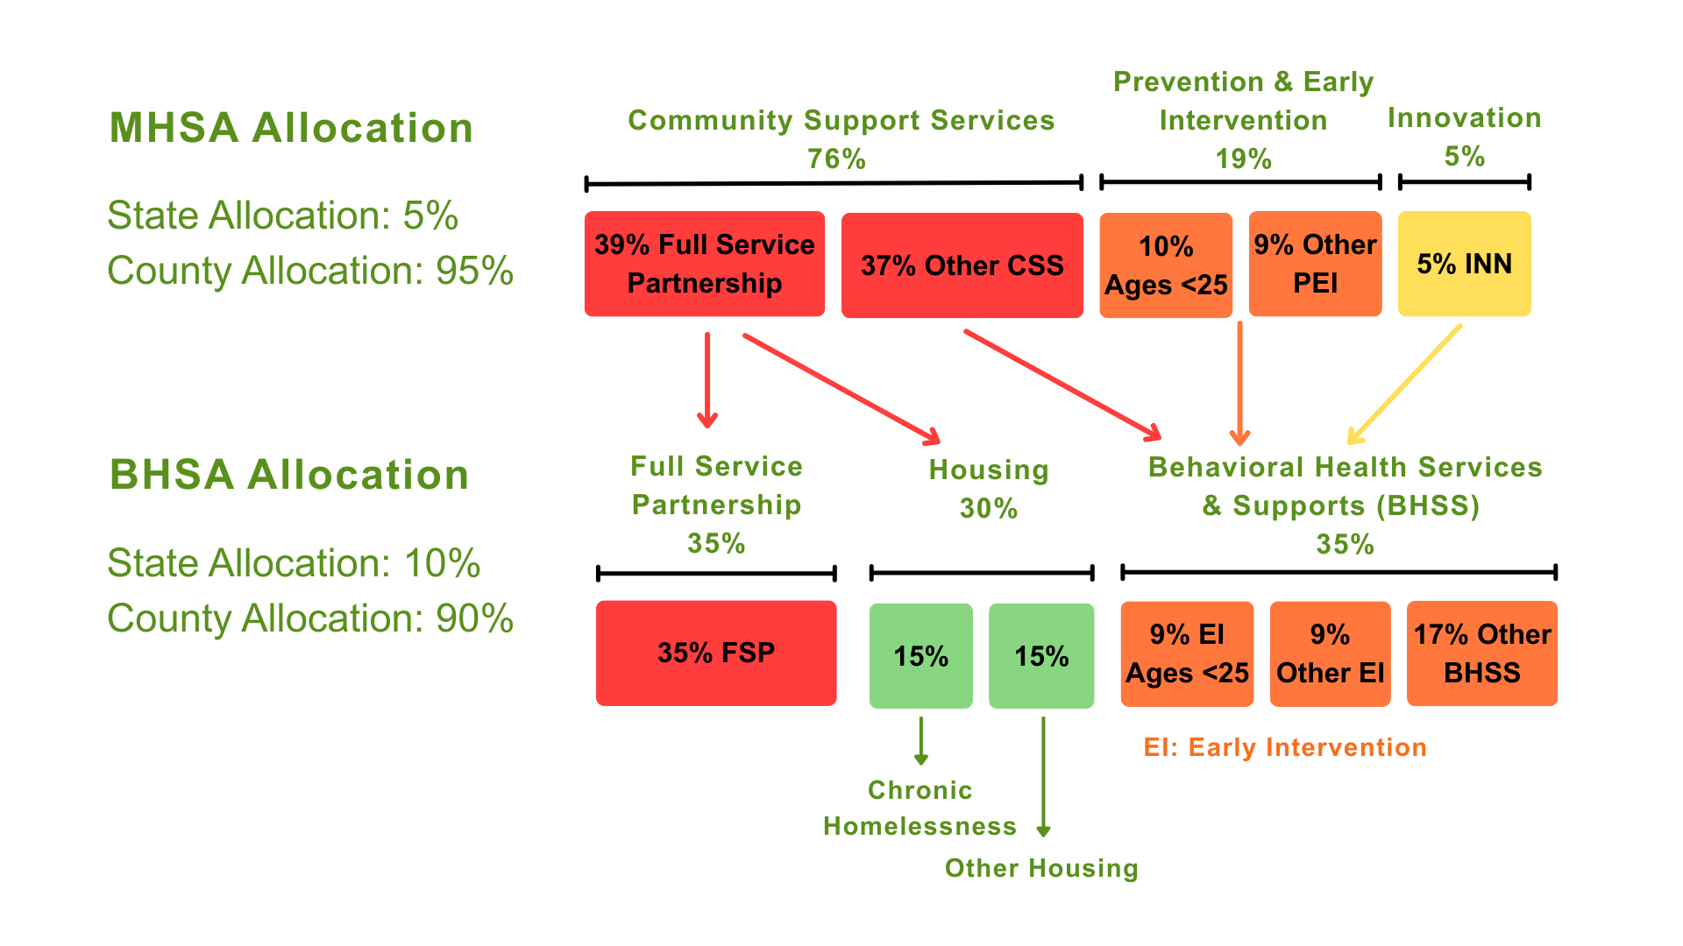
Funding Changes from MHSA to BHSA

Slide 10
LCBHS BHSA FY 2026 – 2029 Integrated Plan (IP)
Budget & Service Overview

Slide 11
BHSA Integrated Plan(IP) Development Timeline
Planning & CPP Readiness
(Jul-Sep ‘25)
Needs Assessment (Oct - Dec ‘25)
Plan Development
(Jan - Mar ‘26)
Public Comment & Submission
(Apr - Jun ‘26)
  Map community partners
  Plan community engagement
  Review new reporting requirements
  Host Community Meetings #1 and #2
  Launch a Community Survey
  Collect Data
  Facilitate focus groups and interviews
  Identify themes from community input
  Community Meeting #3
  Draft Integrated Plan
  Submit the draft plan to the State by March 31, 2026
  Public Comment Period & Public Hearing
  Update from draft to final plan
  BOS reviews final IP
  Integrated Plan submitted to DHCS by June 30, 2026
  Request for Proposal (RFP) process for contracted services
  Ongoing BHSA Learning (Policy Manual Updates, Template Updates) & Navigating Change

Slide 12
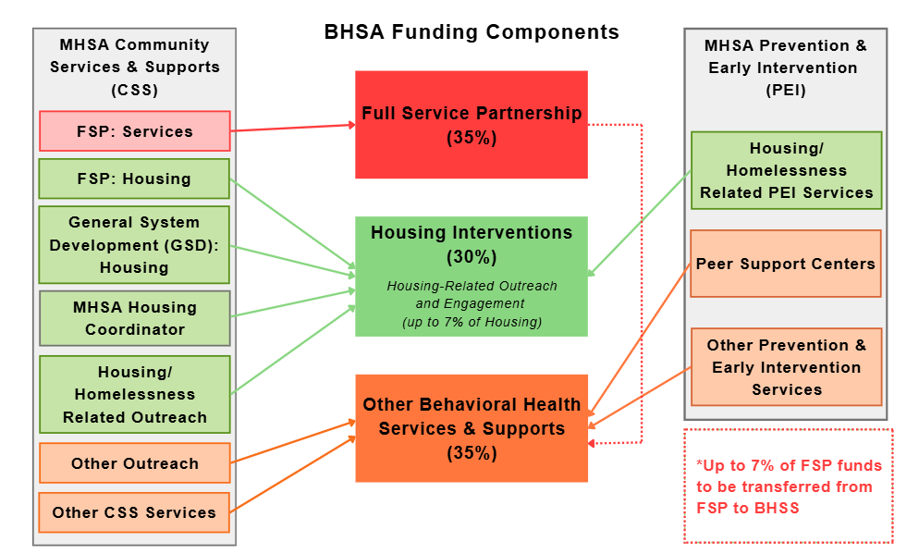
Proposed Funding Shifts from MHSA to BHSA

Slide 13
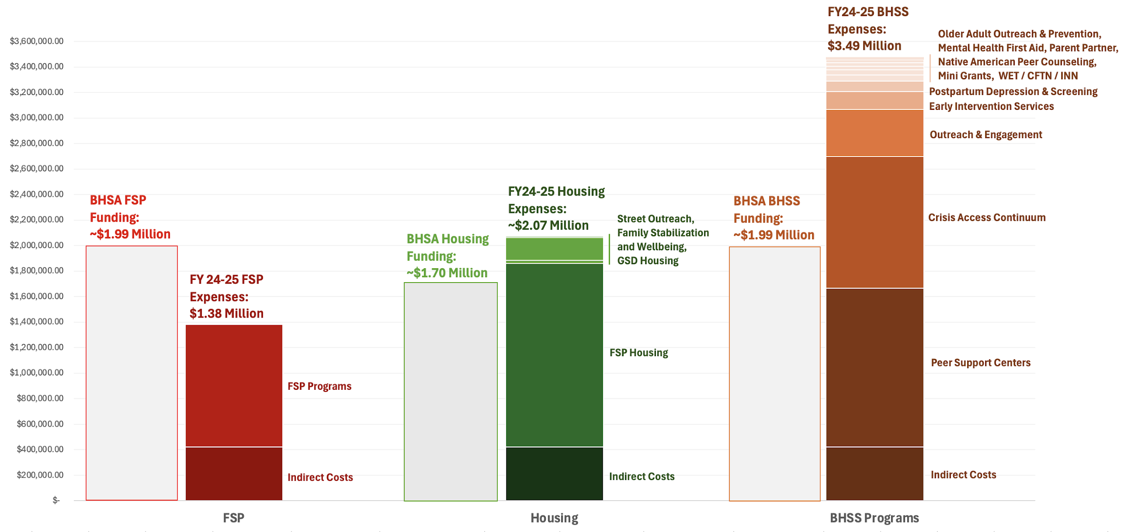
FY24-25 Expenses & Estimated BHSA Funding Allocations
These changes reflect a structural shift from the prior MHSA-supported service model to the new BHSA funding framework; the County is adjusting accordingly to remain compliant and sustainable, not simply redesigning services by choice.

Slide 14
LCBHS BHSA Funding Expenditures FY26-27
Funding Category | BHSA 26-27 Funding
Full Service Partnership (FSP) | $1,963,333
Behavioral Health Services & Supports (BHSS) | $4,025,776
Housing Interventions | $1,802,663
Total | $7,791,772
While the statutory framework allocates 35% to FSP, 35% to BHSS, and 30% to Housing, Lake County is requesting an allowable 3% transfer from FSP to BHSS, resulting in a local allocation of 32% FSP, 38% BHSS, and 30% Housing.

Slide 15
Estimated BHSA Funding Expenditures FY27-29
Funding Category | Estimated BHSA 27-28 | Estimated BHSA 28-29
Full Service Partnership (FSP) | $1,963,333 | $1,963,333
Behavioral Health Services & Supports (BHSS) | $2,233,833 | $2,328,333
Housing Interventions | $1,802,663 | $1,802,663
Total | $5,999,829 | $6,094,329
While the statutory framework allocates 35% to FSP, 35% to BHSS, and 30% to Housing, Lake County is requesting an allowable 3% transfer from FSP to BHSS, resulting in a local allocation of 32% FSP, 38% BHSS, and 30% Housing.

Slide 16
BHSA Funding Categories
Full Service Partnerships
(32%)*
Housing Interventions
(30%)*
Behavioral Health Services & Supports (38%)
  Required high-acuity service and supports*
  Full Service Partnerships
        FSP Intensive Case Management
        Assertive Community Treatment (ACT)
        Forensic Assertive Community Treatment (FACT)
        High Fidelity Wrap Around
        Individual Placement & Support / Supported Employment
        Assertive Field-Based Initiation of SUD Treatment Services
        Peer support and care coordination when tied to FSP service Needs
  FSP Operating Costs
  *Up to 7% of BHSA funds may be transferred from FSP to BHSS; LCBHS requested an allowable 3% transfer.
Required housing supports for BHSA-eligible individuals*
  Rental Assistance & Interim Housing
  Housing Coordination and navigation
  Family Stabilization & Well-Being Housing Supports
  Street Outreach / Housing-Related Outreach
  Coordination with the Lake County Continuum of Care, Coordinated Entry, HMIS, ECM, Community Supports, and Transitional Rent
*At least 50% of Housing Intervention funding must support programs serving individuals who are chronically homeless, as required.
  Required early intervention, access, workforce, and system supports*
  Early Intervention (EI) Services
      Coordinated Specialty Care for First Episode of Psychosis
      Native American Early Intervention
      Youth, Transitional Age Youth (TAY), and Family-focused Supports
      Parent Partner / Family Support Services, where allowable
  Targeted Outreach & Engagement for Access, EI services, Housing, and Care Transitions
  Workforce, Education, and Training Projects
  Capital Facilities and Technological Needs Projects
  Innovation or pilot projects only where allowable
  Peer Support Integrated into SMHS, DMC-ODS, crisis, housing, FSP, youth/family, and justice-involved pathways, where appropriate
  *50% of BHSS funding must be allocated to Early Intervention (EI) Programs, with at least half of EI funding serving children and youth under 25.

Slide 17
FY26-27 BHSA Programs & Significant Modifications
Significant Program Modifications
Peer Support and Recovery Service Restructuring. LCBHS will redesign peer support and recovery services to preserve core peer capacity while aligning services with BHSA requirements, Medi-Cal claiming opportunities, and sustainable service delivery models. This includes shifting away from legacy MHSA-funded stand-alone models and integrating peer support more intentionally across required behavioral health service pathways.
Peer support may be deployed across:
Specialty Mental Health Services
DMC-ODS services
Crisis and post-crisis follow-up
Full Service Partnerships
Housing interventions
Youth, TAY, and family supports
Justice-involved and reentry services
Outreach and engagement activities tied to access, early intervention, or housing

Slide 18
FY26-27 BHSA Programs & Significant Modifications
Significant Program Modifications
Integrating Evidence-Based Practices. LCBHS will prioritize required BHSA/BHT implementation activities, including FSP Intensive Case Management, ACT/FACT readiness, IPS Supported Employment, High Fidelity Wraparound, and Coordinated Specialty Care for First Episode Psychosis. Implementation will be right-sized for Lake County’s rural service system, workforce capacity, fiscal position, SmartCare readiness, and available claiming pathways.

Slide 19
FY26-27 BHSA Programs & Significant Modifications
Significant Program Modifications
Programs No Longer Able to Be Funded Under the Same Model
Due to the transition from MHSA to BHSA and the shift in allowable funding categories, some previous programs are no longer able to continue under the same funding model. These include:
Peer-Run Wellness Centers
Postpartum Depression and Screening Program
Older Adult Outreach and Prevention Program
Prevention Mini Grants
Where possible, LCBHS will explore whether elements of these services can be redirected into allowable early intervention, access, care coordination, or Medi-Cal reimbursable service pathways.

Slide 20
LCBHS Strategies to Accommodate Funding Shifts & Support Community Need
Full Service Partnerships (FSP):
  Strengthen FSP as the required high-acuity service platform.
  Right-size implementation of required BHSA/BHT practices, including FSP Intensive Case Management, ACT/FACT readiness, IPS Supported Employment, High Fidelity Wraparound, and field-based engagement.
  Prioritize individuals with serious behavioral health needs who are unhoused, at risk of homelessness, justice-involved, cycling through crisis or acute care, or experiencing significant functional impairment.
Behavioral Health Services & Supports (BHSS):
  Prioritize Early Intervention requirements, including services for children, youth, and TAY.
  Maintain Coordinated Specialty Care for First Episode Psychosis as a required Early Intervention pathway.
  Redesign peer-based services to support required access, engagement, recovery, housing, crisis, SUD, FSP, and youth/family service pathways.
  Increase focus on Medi-Cal claiming, documentation, and payer routing to maximize Federal Financial Participation and sustain existing services.
  Evaluate optional models, including Clubhouse or other peer-based recovery models, only as future-state options after fiscal, staffing, SmartCare, contracting, and claiming readiness are confirmed.

Slide 21
LCBHS Strategies to Accommodate Funding Shifts & Support Community Need
Housing:
  Maintain required BHSA Housing Interventions investment.
  Strengthen coordination with the Lake County Continuum of Care, Coordinated Entry, HMIS, Partnership HealthPlan, ECM, Community Supports, and Transitional Rent.
  Prioritize housing supports for individuals with serious mental illness and/or substance use disorder who are chronically homeless, experiencing homelessness, or at risk of homelessness.
  Overarching Strategy
  LCBHS will focus BHSA implementation on required services, sustainable funding, Medi-Cal revenue maximization, and partnerships that help preserve access while avoiding overcommitment to optional programs that are not currently required or fiscally sustainable.

Slide 22
Other LCBHS Strategies to Address Community Needs
Access, Outreach, and Awareness | Coordination and Partnerships | Specific Populations | Workforce, Technology, and Infrastructure
Continue refining Access workflows, closed-loop referrals, and timely connection to services. Continue supporting Mobile Crisis services and post-crisis linkages. Focus outreach on access, early intervention, suicide prevention education, housing engagement, and connection to medically-necessary care. Maintain public information tools, including the Department website, newsletter, social media, public radio programming, and community education activities. | Strengthen coordination with Partnership Health Plan, Enhanced Care Management, Community Supports, and Transitional Rent pathways* Coordinate with the Lake County Continuum of Care, Coordinated Entry, HMIS, and housing partners. Continue partnership development with Probation, Child Welfare, schools, hospitals, tribal partners, Managed Care Plan partners, and community providers. | Improve culturally responsive access and engagement for Native American communities, youth/TAY, families, older adults, justice-involved individuals, and people experiencing homelessness. Integrate peer support into required and sustainable service pathways, including SMHS and DMC-ODS, Crisis, Housing, Full Service Partnership, youth/family, and justice-involved services where appropriate. Evaluate optional peer-based recovery models and wellness supports only as future-state options after readiness is confirmed. | Continue workforce development and required BHSA/BHT implementation training. Use statewide scholarship, loan repayment, and workforce pipeline resources where available. Strengthen SmartCare documentation, KPI tracking, and BHOATR/BOTAR reporting capacity. Implement facility, safety, and technology improvements that support required service delivery and operational efficiency. *
*Denotes initiatives using other funding sources beside BHSA funding

Slide 23
To learn more about BHSA, please visit LCBHS’ BHSA webpage:
https://www.lakecountyca.gov/1689/Behavioral-Health-Transformation-BHSA

Slide 24
Thank you!

