Slide 1


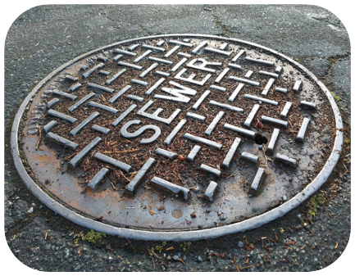

Sewer Rate Study
Southeast Regional Wastewater System
March 24, 2026

Slide 2

Background
The District has implemented annual CPI increases in recent years
Last rate study was done in 2010
Rates need to fund the cost of providing service
  The cost of service includes operating costs and inflation, infrastructure (capital) improvements, and maintaining emergency reserves
  Despite inflationary increases, current rates do not cover these costs
  Additionally, reserves have been fully spent down this year due to the recent sewer spill
The rate structure is also proposed to be adjusted to better reflect current sewer flow patterns
Rate study will cover a 5-year period
  Rates adjusted each August 1 beginning 2026 to 2030

Slide 3
Legal Requirements: Proposition 218
Governs how property-related charges are adopted
  Covers rates over a maximum 5-year period
  Rates must be based on the reasonable cost of service and proportionally recover costs based on how customers take service
Procedural requirements:
  Conduct a rate study
  Mail a notice to property owners in English and Spanish
  Hold a public hearing a minimum of 45 days after notice is mailed
  Rates cannot be adopted if more than 50% of owners submit written protests

Slide 4
Cost of Service Analysis
Financial Status
  Revenues w/ current rates generate about $4.8M do not cover operating costs of $5.9M
  Absent a rate increase, the District will incur a deficit of about $1.1M per year
  Available cash reserves were spent down to address the sewer spill
Rate increases are needed to fund operating expenses, deferred maintenance and accumulate operating reserves
Capital improvement fee increase is needed to fund upcoming projects

Slide 5
Capital Improvement Costs
Current CIP fee is $5.02/month and generates about $430,000/year
Rate Funded Projects | Cost
Land Acquisition #1-7 | $10,000
Septic Hauler Dump Station | $150,000
SL Rat Unit | $37,250
400KW Generator | $255,000
Utility Relocations and Adjustments | $299,000
SCADA - All Districts Evaluation Upgrades and Accessibility | $200,000
Southeast Treatment Plant Headworks Upgrades Pipes | $200,000
Southeast Treatment Plant Headworks Upgrades Screen | $100,000
LS#2 Sealing | $100,000
#1-7 – Lift Station Design | $100,000
Baylis Ave/Alvita Ave Sewer Collection Capacity Upgrade | $543,800
Total Equipment and Upgrades | $1,995,050
Annual Cost over 5 Years | $400,000
Total Annual Project Costs:
Equipment and upgrades $400,000
Pumper truck $165,000
Pipelines and plant upgrades $1,500,000 to $2,500,000

Slide 6
Review of Current Monthly Sewer Rates
BASE RATE | Billing unit | February 15, 2025
Domestic Strength | dwelling unit | $36.28
Low Strength Commercial | each | $54.42
Medium Strength Commercial | each | $126.97
High Strength Commercial | each | $181.38
IN ADDITION TO THE BASE RATES ABOVE
Daycare or school | per student | $1.46
Convalescent/Group Home/Hospital/Detention | per bed | $22.25
Hotel/Motel w/o kitchen | per room | $7.27
Hotel/Motel with kitchen | per room | $16.76
Hotel/Motel (permanently occupied) | per room | $21.77
Laundromat | per machine | $22.25
Theater or Drive-in | per seat/car space | $1.17
Bars and Lounge or Restaurants | per seat over 33 | $1.11
RV & Campgrounds w/o sewer hookup | per space | $3.63
RV & Campgrounds with sewer hookup | per space | $7.27
Splashpad | each | $72.56
ADDITIONAL CHARGES – ALL CUSTOMERS
Capital Improvement Fee | each customer | $5.02

Slide 7
Sewer Rate Design
Proposed monthly fixed rates are based on estimated sewer flows and pollutant loadings of each customer class
Data from the wastewater treatment plant and water use data from the past 3 years are used to estimate sewer flows
Multifamily Residential customers are proposed to be moved to a separate rate category from single family residential customers
  Multifamily customers are proposed to have a lower rate
  Average single family residential flow is 210 gallons per day and average multi-family flow is 160 gallons per day per dwelling unit
Schools and daycares are proposed to be combined into one customer category
New splashpad rate based on last year’s sewer flows

Slide 8
Single Family Residential Sewer Rates
 | FY2025/26 | FY2026/27 | FY2027/28 | FY2028/29 | FY2029/30 | FY2030/31
 | Current | August 1, 2026 | August 1, 2027 | August 1, 2028 | August 1, 2029 | August 1, 2030
MONTHLY RATES
Base Sewer Rate | $36.28 | $54.04 | $64.84 | $66.79 | $68.79 | $70.86
CIP Fee | $5.02 | $31.63 | $32.57 | $33.55 | $34.56 | $35.60
Bond Repayment | $4.16 | $4.16 | $4.16 | $4.16 | $4.16 | $4.16
Total | $45.46 | $89.83 | $101.57 | $104.50 | $107.51 | $110.62
$ Increase |  | $44.37 | $11.74 | $2.93 | $3.01 | $3.11
% Increase |  | 98% | 13% | 3% | 3% | 3%
First base rate increase reverses the deficit (i.e. minimum increase needed to cover operating costs)
Further rate increases are needed to keep up with inflation and rebuild reserves up to the target of 6 months of operating costs
No proposed change to the bond repayment fee

Slide 9
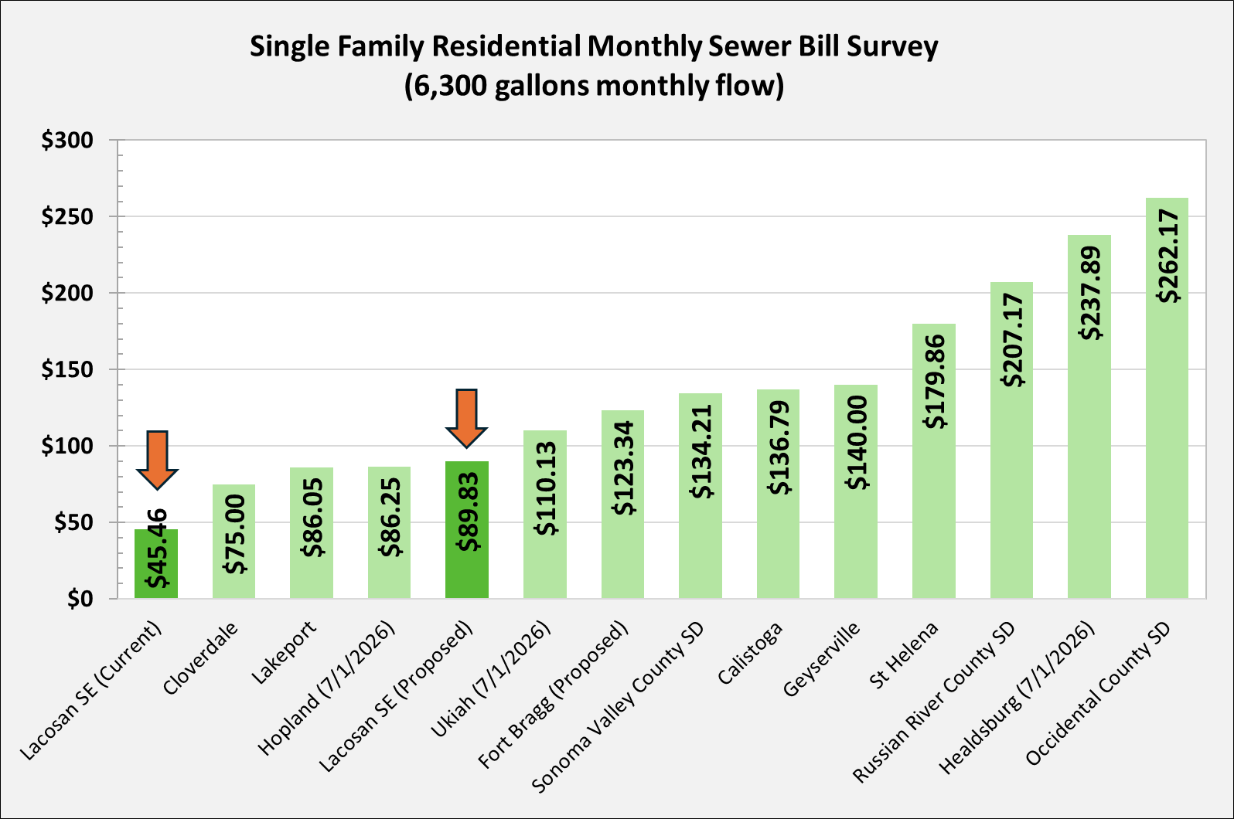
Sewer Rate Survey

Slide 10
Proposed Monthly Sewer Rates
Customer Class | Units | Current Rate | Proposed Rate August 1 | Rate Change | # of Customers
BASE RATE
Single Family Residential | Dwelling Unit | $36.28 | $54.04 | 49% | 3,962
Multifamily Residential | Dwelling Unit | $36.28 | $41.17 | 13% | 1,370
Low-Strength Commercial | Each | $54.42 | $91.05 | 67% | 284
Medium-Strength Commercial | Each | $126.97 | $192.98 | 52% | 63
High-Strength Commercial | Each | $181.38 | $324.07 | 79% | 36
IN ADDITION TO THE BASE RATE
Daycare or school | per student | $1.46 | $2.53 | 73% | 2,973
Convalescent/Group Home/Hospital/Detention | per bed | $22.25 | $41.17 | 85% | 114
Hotel/Motel w/o kitchen | per room | $7.27 | $22.26 | 206% | 171
Hotel/Motel with kitchen | per room | $16.76 | $36.02 | 115% | 66
Hotel/Motel (permanently occupied) | per room | $21.77 | $41.17 | 89% | 23
Laundromat | per machine | $22.25 | $30.35 | 36% | 58
Theater or Drive-in | per seat or car space | $1.17 | $2.43 | 108% | 200
Bars and Lounge or Restaurants | per seat over 33 | $1.11 | $4.05 | 265% | 668
RV & Campgrounds w/o sewer hookup | per space | $3.63 | $10.12 | 179% | 32
RV & Campgrounds with sewer hookup | per space | $7.27 | $36.02 | 395% | 273
Splashpad | each | $72.56 | $1,310.94 | 1707% | 1
Customer Class | Units | Current Rate | Proposed Rate August 1 | Rate Change | # of Customers
BASE RATE
Single Family Residential | Dwelling Unit | $36.28 | $54.04 | 49% | 3,962
Multifamily Residential | Dwelling Unit | $36.28 | $41.17 | 13% | 1,370
Low-Strength Commercial | Each | $54.42 | $91.05 | 67% | 284
Medium-Strength Commercial | Each | $126.97 | $192.98 | 52% | 63
High-Strength Commercial | Each | $181.38 | $324.07 | 79% | 36

Slide 11
Full Rate Schedule
 |  | Current | Proposed
 |  | FY2025/26 | FY2026/27 | FY2027/28 | FY2028/29 | FY2029/30 | FY2030/31
 |  |  | Aug 1, 2026 | Aug 1, 2027 | Aug 1, 2028 | Aug 1, 2029 | Aug 1, 2030
Description | Billing Unit |  | Varies | +20% | +3% | +3% | +3%
BASE RATE
Single Family Residential | per dwelling | $36.28 | $54.04 | $64.84 | $66.79 | $68.79 | $70.86
Multifamily Residential | per dwelling | $36.28 | $41.17 | $49.41 | $50.89 | $52.41 | $53.98
Low-Strength Commercial | each | $54.42 | $91.05 | $109.26 | $112.54 | $115.92 | $119.39
Medium-Strength Commercial | each | $126.97 | $192.98 | $231.57 | $238.52 | $245.67 | $253.04
High-Strength Commercial | each | $181.38 | $324.07 | $388.89 | $400.55 | $412.57 | $424.94
IN ADDITION TO THE BASE RATES ABOVE
Schools | per student | $1.46 | $2.53 | $3.04 | $3.13 | $3.22 | $3.32
Convalescent/Group Home/Hospital/Detention | per bed | $22.25 | $41.17 | $49.41 | $50.89 | $52.41 | $53.98
Hotel/Motel w/o kitchen | per room | $7.27 | $22.26 | $26.71 | $27.51 | $28.33 | $29.18
Hotel/Motel with kitchen | per room | $16.76 | $36.02 | $43.23 | $44.52 | $45.86 | $47.23
Hotel/Motel (permanently occupied) | per room | $21.77 | $41.17 | $49.41 | $50.89 | $52.41 | $53.98
Laundromat | per machine | $22.25 | $30.35 | $36.42 | $37.52 | $38.64 | $39.80
Theater or Drive-in | per seat/car space | $1.17 | $2.43 | $2.92 | $3.00 | $3.09 | $3.19
Bars and Lounge or Restaurants | per seat over 33 | $1.11 | $4.05 | $4.86 | $5.01 | $5.16 | $5.31
RV & Campgrounds w/o sewer hookup | per space | $3.63 | $10.12 | $12.14 | $12.51 | $12.88 | $13.27
RV & Campgrounds with sewer hookup | per space | $7.27 | $36.02 | $43.23 | $44.52 | $45.86 | $47.23
Splashpad | each | $72.56 | $1,310.94 | $1,573.13 | $1,620.33 | $1,668.94 | $1,719.01
 |  |  |  | +3% | +3% | +3% | +3%
Capital Improvement Program (CIP) Fee | each | $5.02 | $31.63 | $32.57 | $33.55 | $34.56 | $35.60

Slide 12
Wrap Up

