Slide 1

UNIVERSITY OF CALIFORNIA COOPERATIVE EXTENSION (UCCE)
Matthew Barnes
Area Director
2025 ACCOMPLISHMENTS
2026 POINTS OF EMPHASIS
DATA POINTS & METRICS

Slide 2


2025 ACCOMPLISHMENTS
UCCE
Delivered research-based education and technical assistance supporting agriculture, forestry, water resources, wildfire resilience, youth development, and community sustainability across Lake County.
Engaged 4,261 Lake County residents through workshops, field demonstrations, educational events, and online resources.
Hosted or supported 135 workshops and events addressing forestry health, fire resilience, diversified agriculture, gardening, water stewardship, and youth leadership.
Supported 4-H Youth Development, leveraging 8,400 volunteer hours, expanding leadership, STEM, agriculture, and civic engagement opportunities for 292 youth.
Advanced Diversified Agriculture research and outreach, supporting specialty crops including pears, walnuts, olives, wine grapes, and emerging alternatives through applied research, pest management, pruning demonstrations, and grower education.

Slide 3
2025 ACCOMPLISHMENTS (continued)
UCCE
Expanded Forestry & Wildfire Resilience programming, providing landowners and Tribal communities with tools for vegetation management, post-fire recovery, prescribed fire capacity building, and invasive pest response.
Strengthened Tribal partnerships, integrating UC science with Traditional Ecological Knowledge (TEK) through collaborative forestry, fire, water, and agricultural initiatives.
Delivered Master Gardener education and outreach, supporting water conservation, sustainable landscaping, fire-wise gardening, and local food production through trained volunteers.

Slide 4

2025 DATA POINTS & METRICS
UCCE
Residents Engaged: 4,261
Workshops / Events Delivered: 135
4-H Volunteer Hours: 8,400
Youth Participating in 4-H: 292
Community Partnerships (Agencies, Tribes, Organizations): Expanded
Applied Research & Extension Focus Areas:
  Diversified Agriculture
  Forestry & Fire Science
  Water & Climate Resilience
  Youth Development

Slide 5
Expand science-based wildfire resilience and forest stewardship programs, with continued emphasis on prescribed fire, post-fire recovery, and invasive pest management.
Advance Diversified Agriculture innovation, including crop diversification, regenerative practices, and climate-adaptive production systems.
Strengthen Tribal collaboration and co-produced research, aligning UC science with Tribal priorities and Traditional Ecological Knowledge.
Enhance youth development and workforce pathways through 4-H, STEM, agriculture, and leadership programming aligned with Lake County workforce needs.
Increase access and equity in Extension services, expanding outreach to underserved and rural communities.
Leverage partnerships to support climate resilience, water stewardship, and sustainable land management across Lake County.
2026 POINTS OF EMPHASIS
UCCE

Slide 6
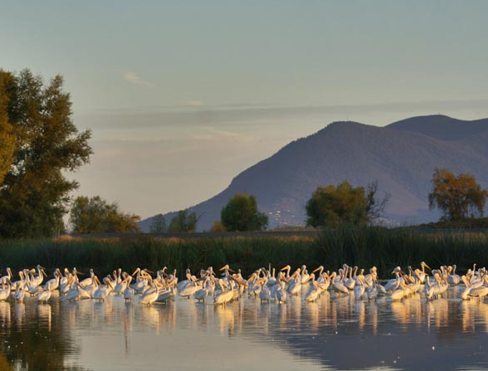
2026 DATA POINTS & METRICS
UCCE
Number of residents engaged through UCCE programs and outreach.
Number of workshops, field days, and educational events delivered.
4-H youth enrollment and volunteer hours contributed.
Number of agricultural producers, landowners, and Tribal partners served through technical assistance and applied research.
Forest stewardship and wildfire resilience activities delivered, including prescribed fire support and post-fire recovery education.
Master Gardener volunteer engagement and community education metrics.
Collaborative partnerships established or expanded with agencies, Tribes, and community organizations.

