Slide 1
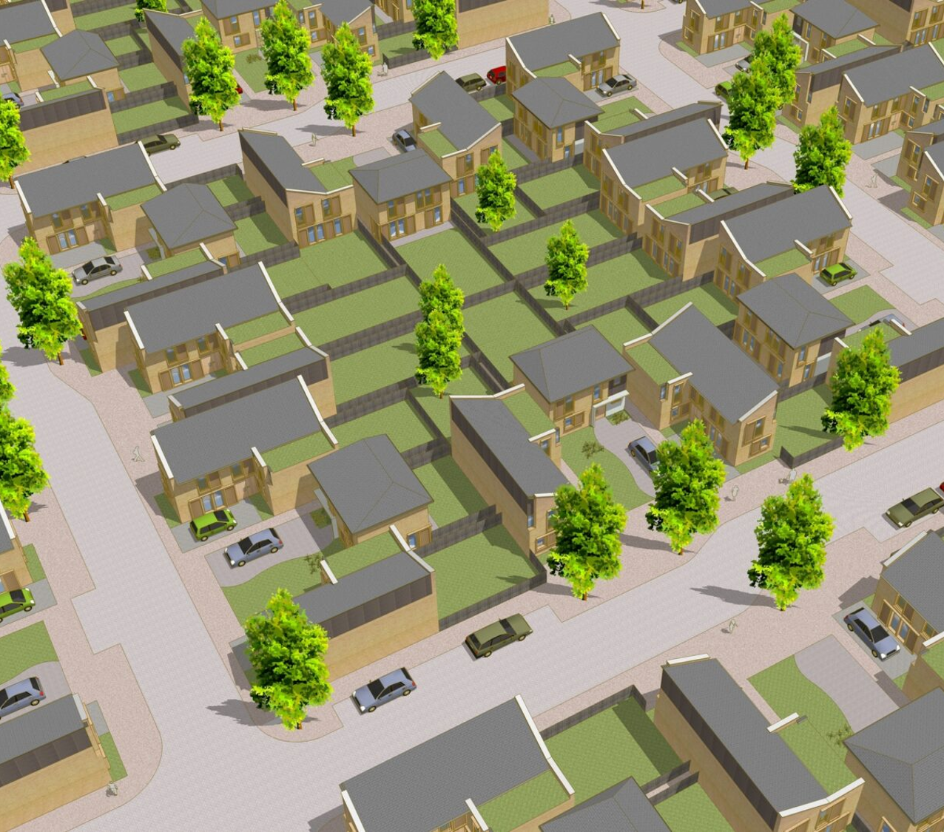

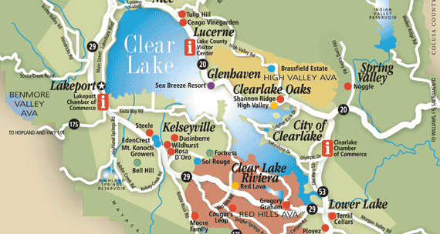

LAKE COUNTY REGIONAL HOUSING TRUST FUND
Homeownership Opportunity Program
Lisa Judd
LCRHTF Administrator

Slide 2

Our Purpose
To promote thriving, sustainable communities in Lake County, CA including the incorporated Cities by providing flexible financing for the development and preservation of housing that meets a range of income levels and fosters environmental responsibility, economic growth, and a high qualify of life for all residents while preserving the rural characteristics of Lake County.
Lake County regional
housing Trust fund

Slide 3

The Basics
Shared equity homeownership is a self-sustaining model that takes a one-time public investment to make a home affordable for a lower-income family and then restricts the home’s sale price each time it is sold to keep it affordable for subsequent low-income families who purchase the home.
The model balances wealth building for families who would otherwise be unable to afford owning a home with preserving the community’s investment.
Lake County regional
housing Trust fund

Slide 4
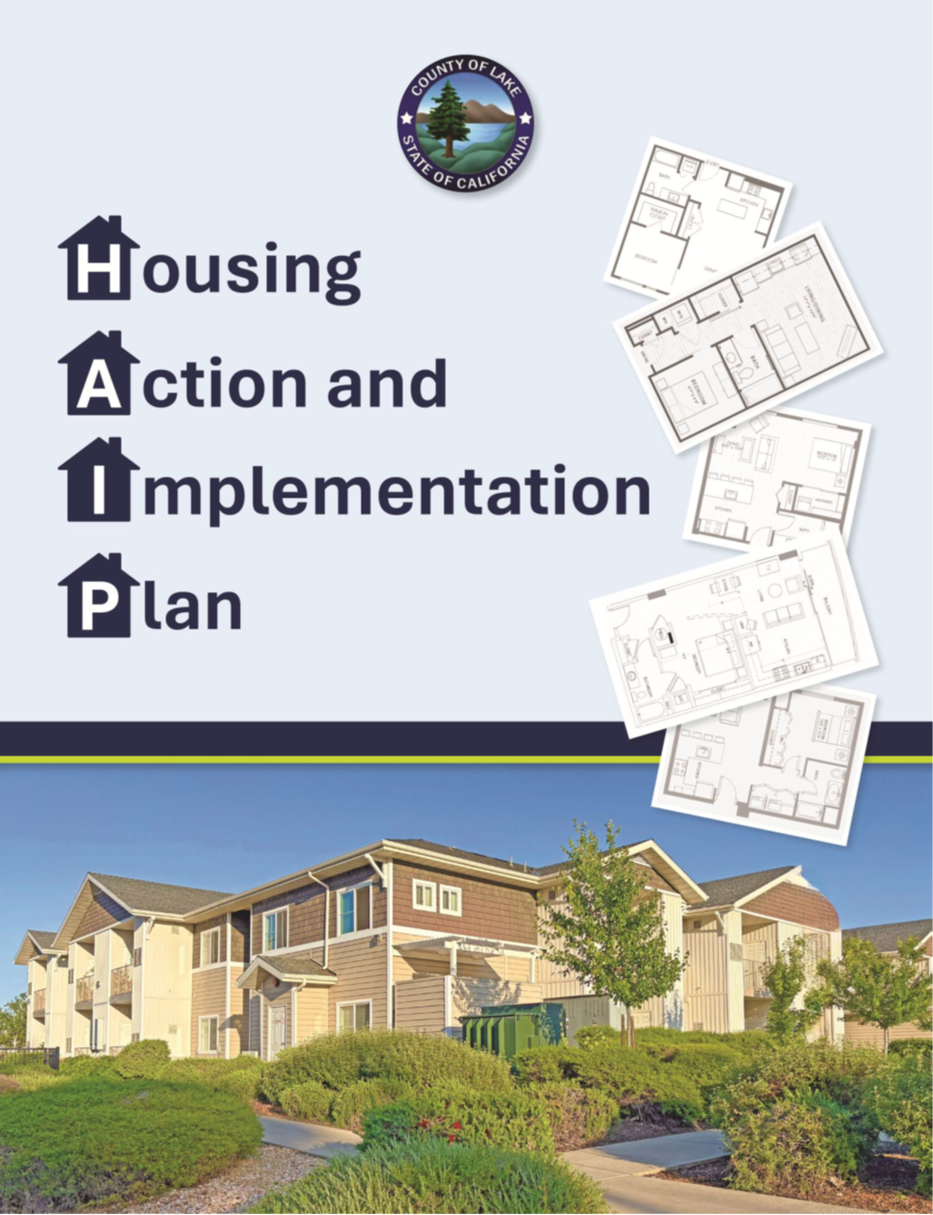
The HAIP Connection
There is widespread strong support for encouraging infill development.
When we asked the community who Lake County should focus on providing housing for – the most frequently selected groups were people who work in Lake County at 52%.
Single family homes were one of the most needed housing types with single-family detached homes on small lots making up 47.1%.

Slide 5
The HAIP Connection
GOAL 1
Create housing for all economic levels and build a variety of housing types.
Strategy 5
Create housing to serve Lake County’s workforce.
GOAL 2
Encourage and facilitate Infill Development Strategy.
Strategy 2.1
Focus the siting and design on infill in fire-safe areas.
Strategy 2.2
Build homes in areas with access to infrastructure, resources, and transportation networks that are walkable and bikeable.

Slide 6
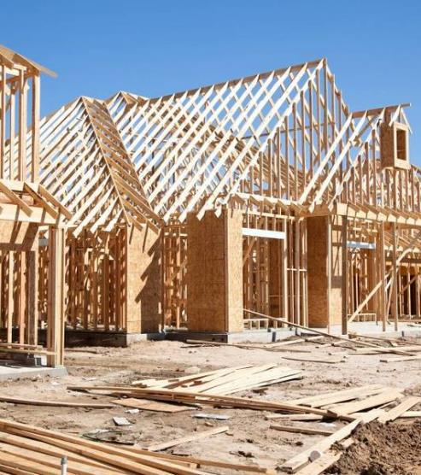



Homeownership Opportunity Program Design
Where? Lakeport
How many? 10 new homes
Type? Manufactured homes
Who? Up to 80% AMI
Subsidy? $125,000.00 per unit
Restrictions? Yes- Deed restricted
Affordability period? 30 years

Slide 7
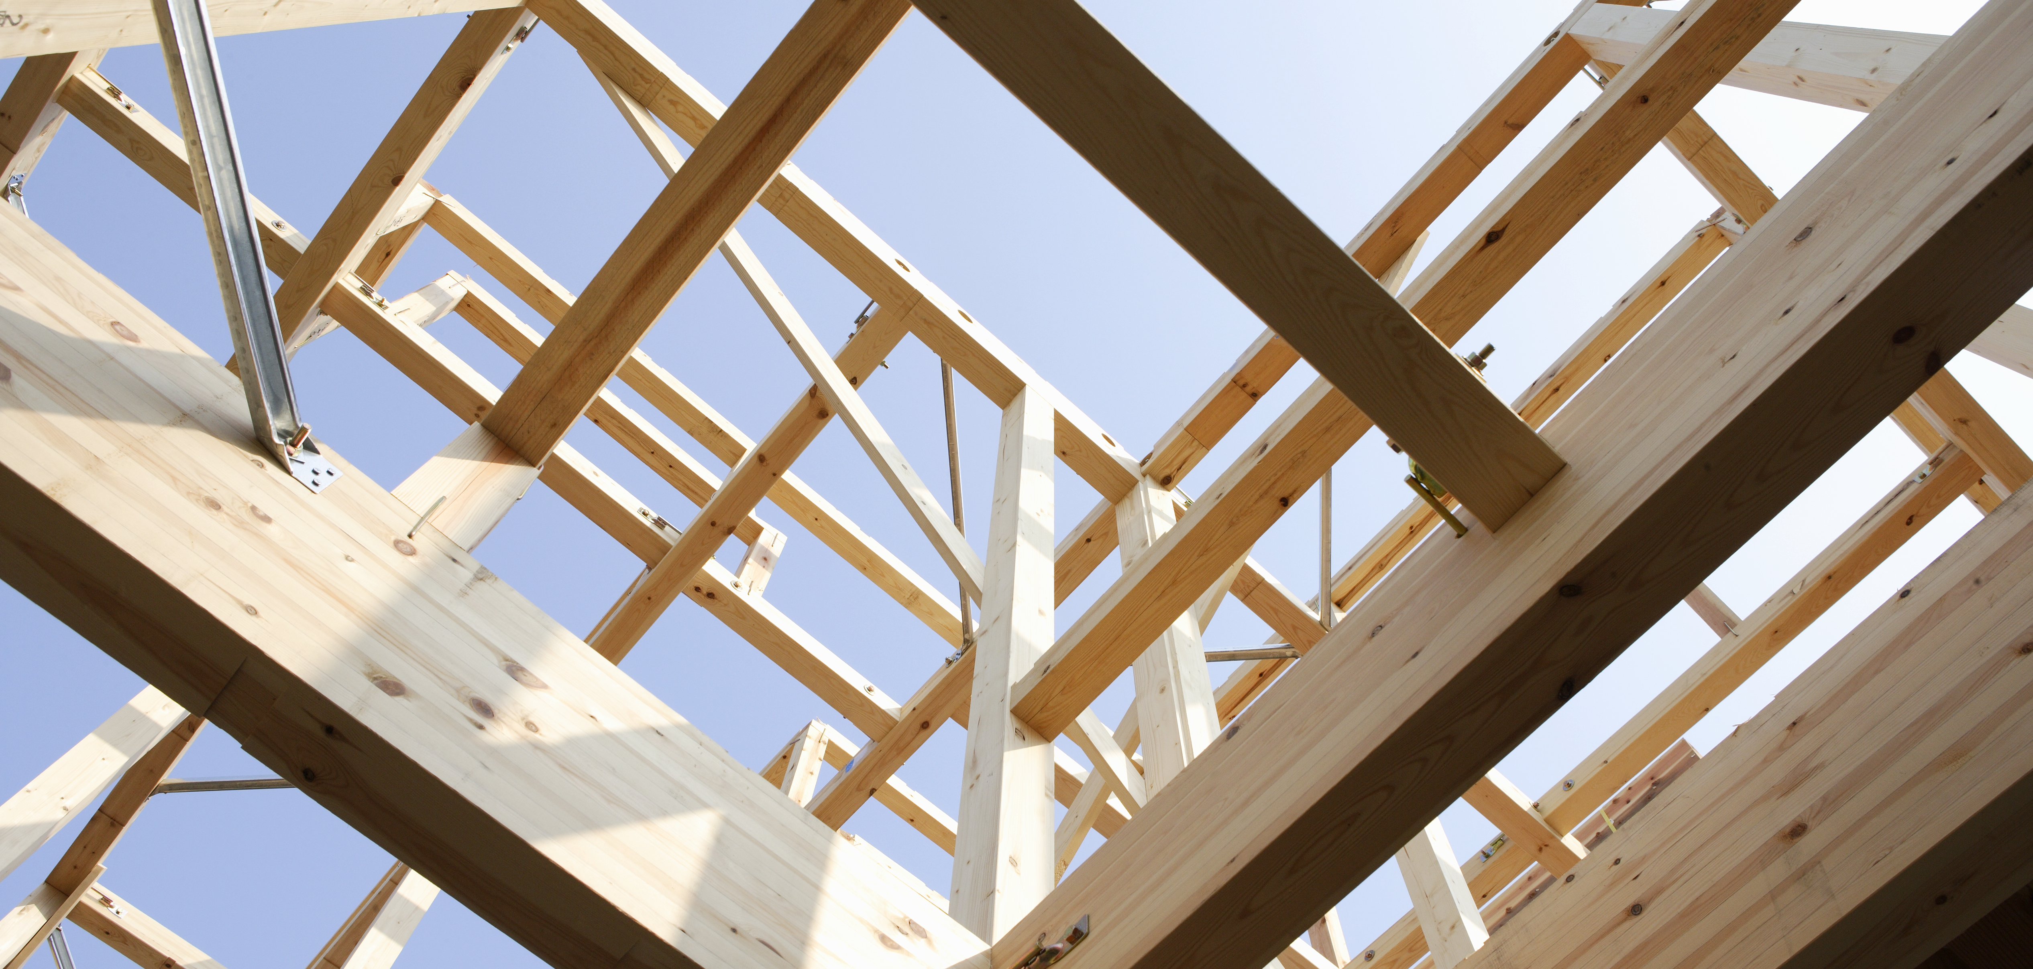


Requirements
The owner must use the residence as their primary residence.
The owner agrees to resell the property to an income-eligible buyer at below market-rate, formula determined price.
The covenant can also grant a first purchase right to a nonprofit or public agency; and
This covenant will bind the present owner and future owners of the affordable unit for a term of 30 years.
LAKE COUNTY REGIONAL HOUSING TRUST FUND

Slide 8
Homeownership Opportunity Program Timeline
Step 1
A one-time investment makes a home affordable for purchase by a working family with modest means, and the home remains affordable for family after family that purchase it for the affordability period of 30 years.
Homebuyer qualifies and purchases deed restricted home below market rate.
Step 3
Homeowner gains wealth as they pay down principle and the home appreciates in value.
Step 4
Current homeowner decides to sell the home to another family and “pays it forward.”
Step 5
Consultant qualifies another family in our pipeline to purchase below market value. Previous owner earns limited equity while remaining equity stays within the program to keep the home affordable.
Step 2

Slide 9
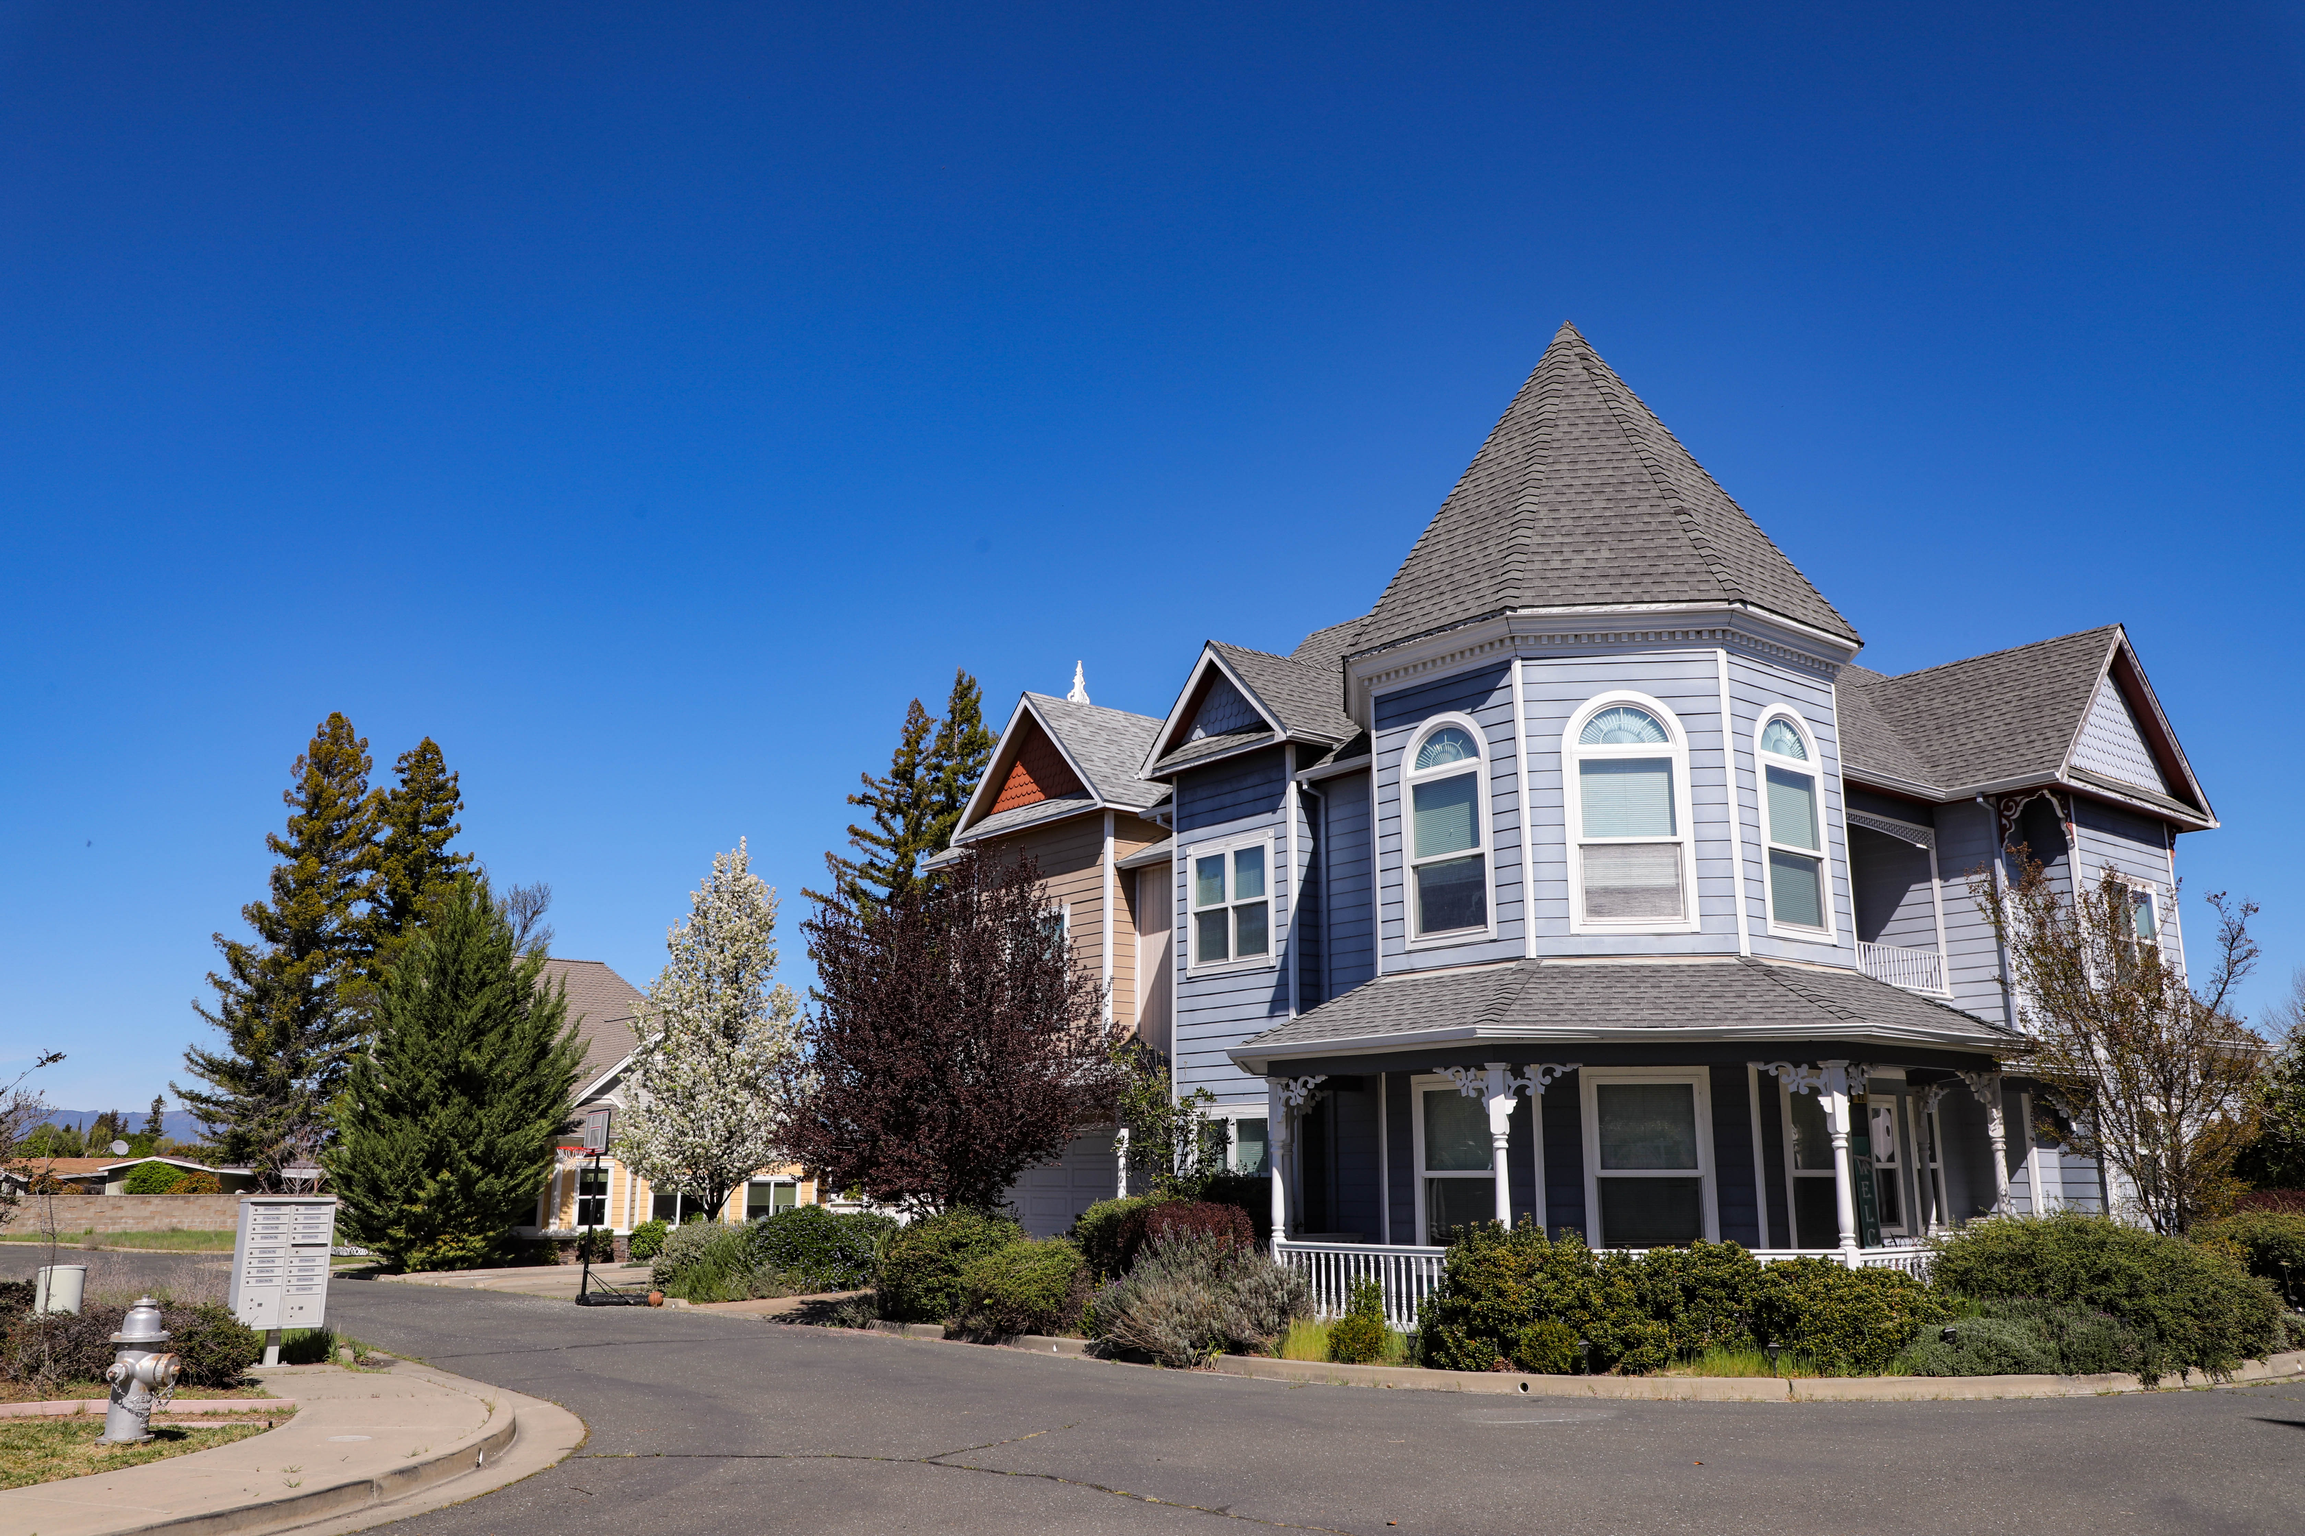
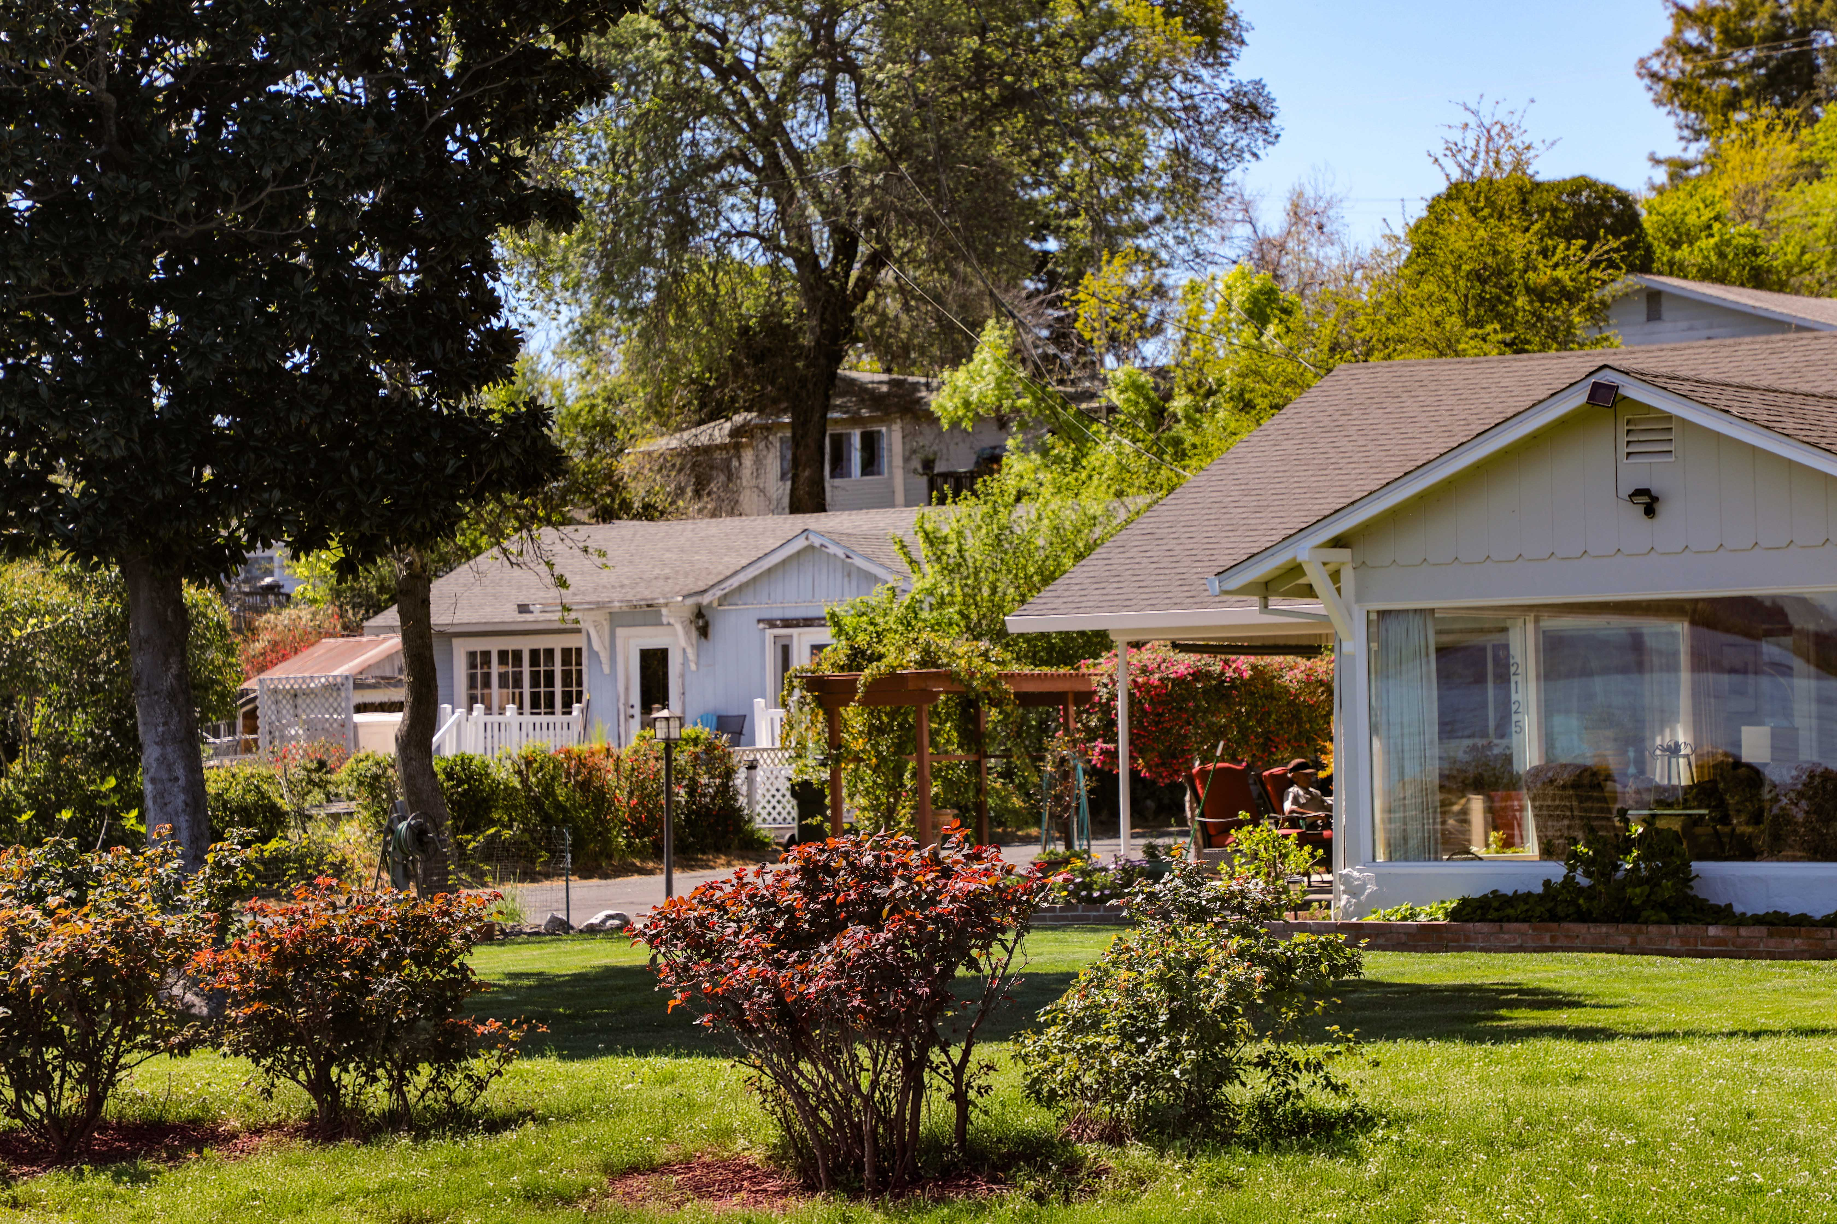

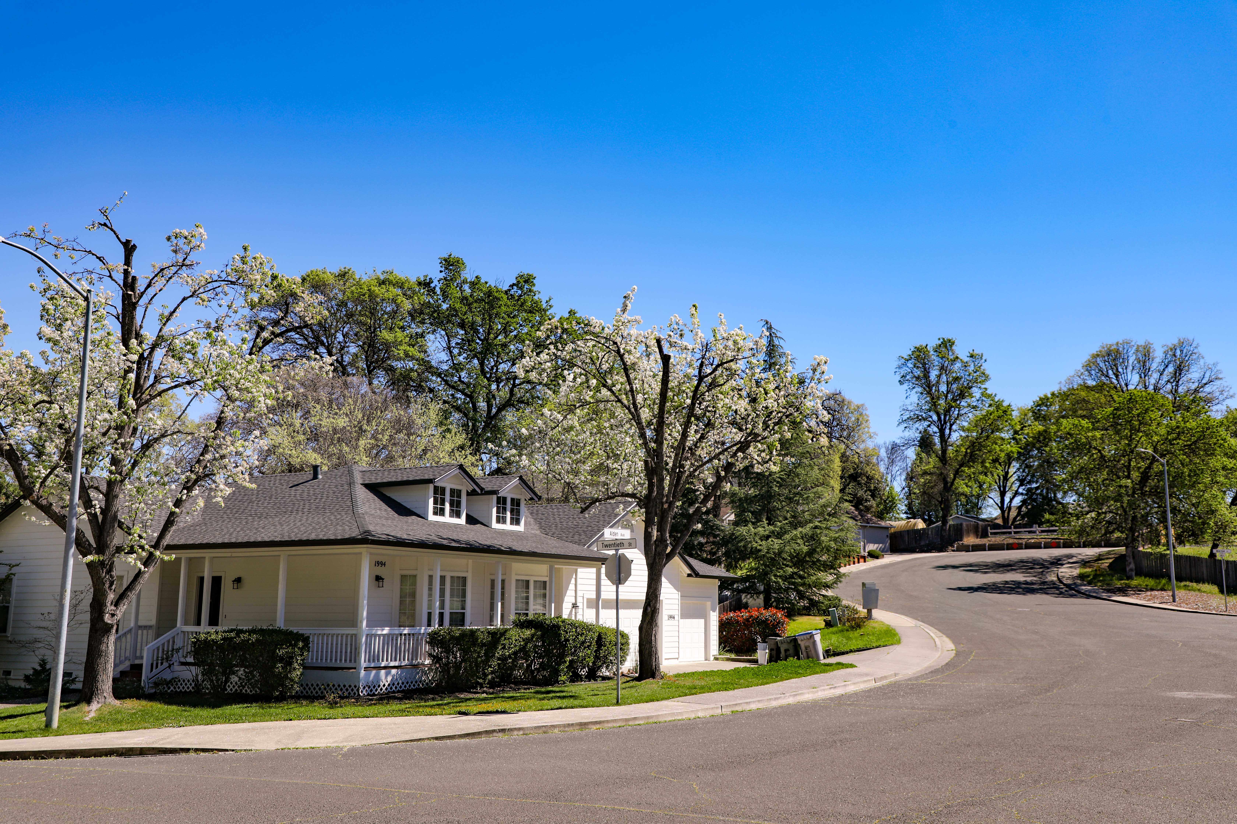
Thank You!
LAKE COUNTY REGIONAL HOUSING TRUST FUND
County Website: lcrhtf@lakecountyca.gov
Website: clearlylakecountyca.com/trust-fund/

