Slide 1
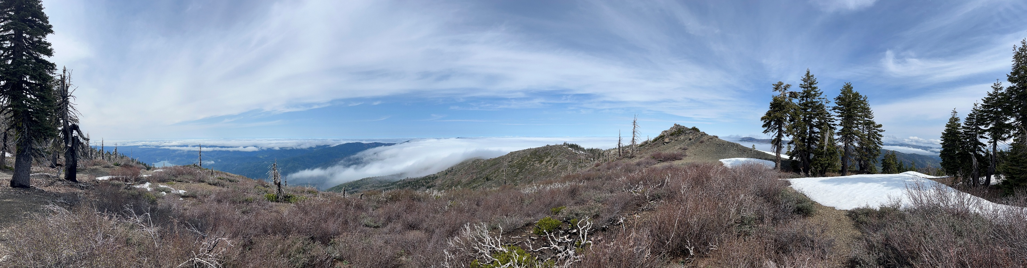
Livestock & Natural Resources Advisor
Serving Lake & Mendocino Counties
Jennie Lane, DVM, MPH

Slide 2
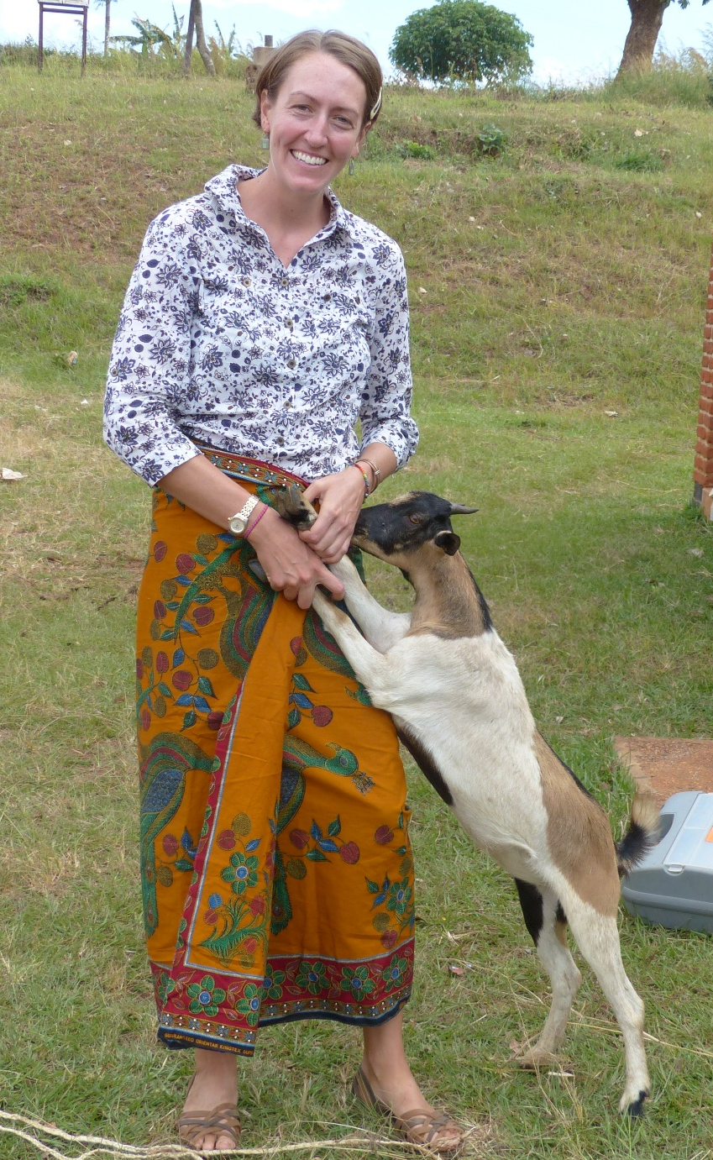
About Me
Grew up in rural Western New York
SUNY Geneseo, BS Biology
Michigan State University, DVM
University of California, Berkeley, MPH
Resident of southern Lake county since 2021
Work Experience
Practicing ambulatory large animal veterinarian, PA & NJ
International Livestock Development experience, East Africa
Food Security policy work, Washington, DC
Livestock disease & wildlife health research, disaster preparedness, One Health education, watershed restoration work, Davis, CA & globally

Slide 3
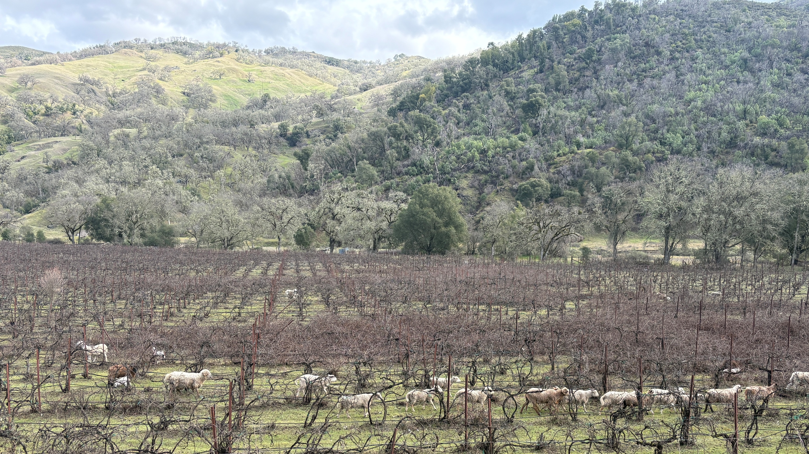

Program Goals & Initial Priorities
Work with livestock producers and land managers to:
1) Collaboratively address local needs and priorities to improve livestock and rangeland health
2) Contribute to a thriving local economy
3) Leverage livestock to improve wildfire resilience
Goals
Priorities
Meet & network with a variety of stakeholders and producers
Thorough, thoughtful needs assessment
Identify top priority topics for next 12-18 months

Slide 4
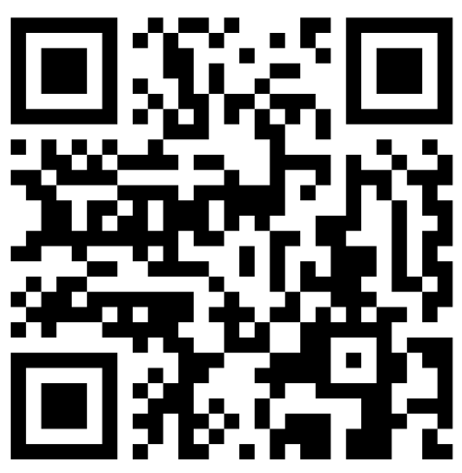
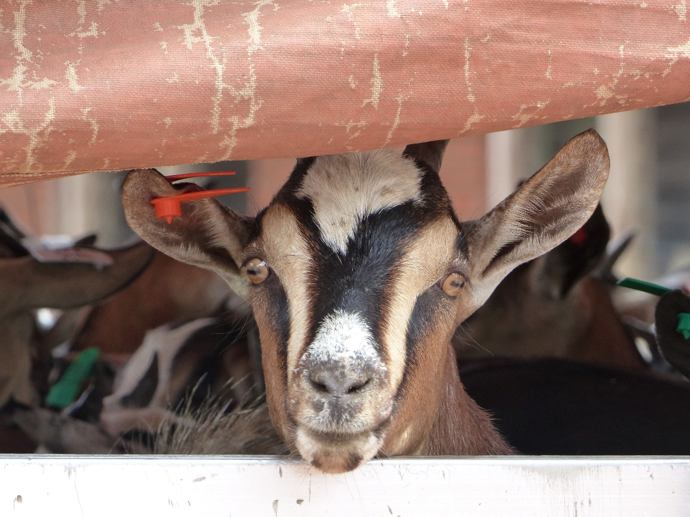
Join the email list for updates from the Lake & Mendocino counties Livestock & Natural Resources program
Questions?
jklane@ucanr.edu

