Slide 1
Lake County Animal Control Advisory Board
Annual Report FY 2025-2026

Slide 2
PURPOSE of the BOARD
Established by the Lake County Board of Supervisors.
Reviews animal control needs, services, facilities, fees, adoption procedures, grant expenditures, hours of operation, public education and outreach, and special problems.
Serves as a liaison between the community, Animal Care and Control, and the Board of Supervisors.
Provides findings and recommendations through its Annual Report.

Slide 3
KEY FINDINGS OVERIEW
Adoption Programs
Public Education & Outreach
Facilities & Infrastructure
Fees & Fiscal Sustainability
Animal Welfare & Enforcement
Grant Funding
Emergency Preparedness

Slide 4
KEY CHALLENGES IDENTIFIED
Limited veterinary access
Animal overpopulation
Volunteer recruitment and retention
Public awareness of available services
Facility and infrastructure limitations
Long-term funding sustainability

Slide 5
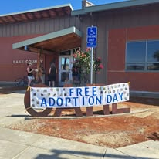
ADOPTION PROGRAMS
Improve website and social media outreach
Expand foster and volunteer programs
Continue adoption events
Strengthen rescue partnerships
Reduce veterinary-related adoption delays

Slide 6

PUBLIC EDUCATION & OUTREACH
Year-round education strategy
Youth engagement
Community events
Digital outreach
Community partnerships

Slide 7
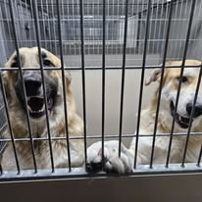
FACILITIES & INFRASTRUCTURE
Medical/isolation expansion
Kennel improvements
Adoption-area improvements
Volunteer and training space
Sustainability projects
Capital improvement funding

Slide 8

FEES & FISCAL SUSTAINABLITY
Periodic fee review
Benchmark neighboring counties
Responsible ownership incentives
Targeted discounts where appropriate
Establish recurring review process

Slide 9
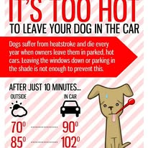
ANIMAL WELFARE & ENFORCEMENT
Continue evaluating standards
Enhance interagency cooperation
Expand humane care education
Review best-practice resources
Improve public understanding

Slide 10
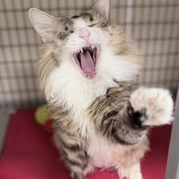
GRANT FUNDING & RESCOURCE DEVELOPMENT
Continue pursuing grants
Support spay/neuter programs
Support veterinary access initiatives Strengthen nonprofit partnerships
Maintain accountability and reporting

Slide 11
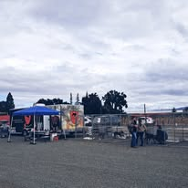
EMERGENCY PREPAREDNESS
Develop a new animal disaster response program
Volunteer disaster network
Regional rescue partnerships
Integrate animal evacuation planning
Public preparedness education

Slide 12
LONG-TERM STRATEGIC PRIORITIES
Strategic planning
Performance measurement
Community partnerships
Volunteer engagement
Innovation
Data-driven decision making

Slide 13
CLOSING/ QUESTIONS
Improve Adoption Outcomes
Expand Public Education
Invest in Facilities
Strengthen Animal Welfare Programs
Pursue Grant Funding
Enhance Emergency Preparedness

