Slide 1
LAKE COUNTY · BOARD OF SUPERVISORS
FLASHES
Microgrid Incentive Program
Boundary Options
Option B4 vs. Option B5
AUGUST 4, 2026
Benjamin Rickelman · Deputy County Administrative Officer
Michael Day · Trane
Notes:
Purpose of this item: seek Board direction on the FLASHES microgrid boundary (Option B4 or Option B5). The MIP Grant Agreement and the Trane Development Reimbursement Agreement were approved June 23, 2026.

Slide 2
DECISION CONTEXT
Why the Boundary Matters
The boundary defines the area FLASHES is designed to serve. Driving infrastructure cost, who receives resilience benefits, and long-term project economics.
1
2
3
Two options on the table
Agreements already approved
A policy decision
Option B4 extends the boundary east to include Lucerne. Option B5 stops short of Lucerne, serving the Upper Lake–Nice corridor.
On June 23, 2026, the Board approved the MIP Grant Agreements with PG&E and the Development Reimbursement Agreements with Trane.
Both boundaries are technically viable. Choosing B4 or B5 is a policy decision for the Board of Supervisors.
Ad Hoc Energy Policy Committee · July 8, 2026
Michael Day of Trane briefed the Committee on both options. The Committee preferred the smaller boundary (B5), due to potential financial impact on project viability.
2
Notes:
Frame the item: the agreements are already approved. What remains is Board direction on the microgrid boundary.

Slide 3
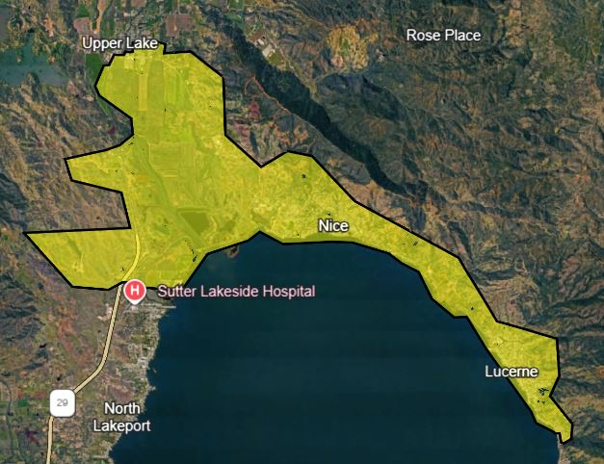
OPTION B4 · INCLUDES LUCERNE
Option B4 — Extended Boundary
20–25%
Trane-projected reduction in cash flow, net of operating and capital costs compared to smaller boundary
Wider resilience footprint
Adds the Lucerne community to the microgrid's resilience footprint.
Higher infrastructure demand
Extending east requires additional distribution and interconnection infrastructure.
Weaker projected economics
Trane projects a 20–25% reduction in net cash flow relative to B5.
Boundary extends east through Nice to Lucerne.
3
Notes:
B4 serves more residents, including Lucerne, but Trane projects a 20-25% reduction in cash flow net of operating and capital costs.

Slide 4
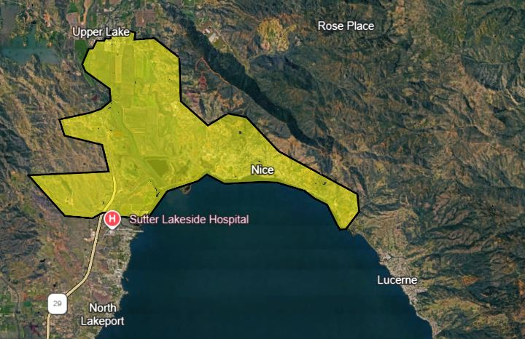
OPTION B5 · EXCLUDES LUCERNE
Option B5 — Compact Boundary
Ad Hoc Committee preference
On July 8, 2026, the Committee expressed a preference for B5, due to potential financial impact on project viability.
Stronger projected economics
B5 is the baseline against which Trane's 20–25% reduction is measured.
Smaller resilience footprint
Lucerne would not be served by the microgrid under this boundary.
Equity considerations
The Board may weigh whether excluding Lucerne fits County resilience priorities.
Lucerne falls outside the served area.
4
Notes:
B5 excludes Lucerne, producing stronger projected project economics but a narrower resilience benefit. The Ad Hoc Committee preferred this option.

Slide 5
ISLAND MODE DURATION · PRELIMINARY TRANE PROJECTIONS
Projected Island Mode Duration
Preliminary Trane modeling. Both boundaries reach the 96-hour maximum April–October and diverge in winter.
73.6 hrs
92.5 hrs
Option B4 — Extended Boundary
12-month average
Option B5 — Compact Boundary
12-month average
Projected hours in island mode, by month
B4 — Extended
B5 — Compact
96
96
96
96
96
96
96
96
96
96
96
96
96
96
96
96
96
76
74
47
54
50
32
28
Jan
Feb
Mar
Apr
May
Jun
Jul
Aug
Sep
Oct
Nov
Dec
Preliminary Trane projections (July 24, 2026). Bars at 96 hours are modeled at four days or longer.
5

Slide 6
RECOMMENDED ACTION · AUGUST 4, 2026
A Policy Decision for the Board
1
Select the microgrid boundary
Direct staff to proceed with Option B4 (including Lucerne) or Option B5 (excluding Lucerne). Both are technically viable; the choice is a policy decision for the Board of Supervisors.
2
B5 is not a permanent exclusion
Selecting the compact B5 boundary would not foreclose Lucerne. The boundary could be expanded to include Lucerne in the future. The MIP Grant Agreement with PG&E and the Development Reimbursement Agreement with Trane were approved by the Board on June 23, 2026.
The trade-off in one line
B4 extends resilience benefits to Lucerne; Trane projects it reduces cash flow, net of operating and capital costs, by 20–25%. B5 preserves stronger project economics with a narrower service area.
Notes:
Ask the Board for direction on the boundary. Note that B5 can be expanded to include Lucerne in the future.

Slide 7
LAKE COUNTY · BOARD OF SUPERVISORS
FLASHES
Microgrid Incentive Program
Boundary Options
Option B4 vs. Option B5
AUGUST 4, 2026
Benjamin Rickelman · Deputy County Administrative Officer
Michael Day · Trane
Notes:
Purpose of this item: seek Board direction on the FLASHES microgrid boundary (Option B4 or Option B5). The MIP Grant Agreement and the Trane Development Reimbursement Agreement were approved June 23, 2026.

