Slide 1

COUNTY OF LAKE
2025 road Projects
Construction, Design, and Grant Pursuits

Slide 2
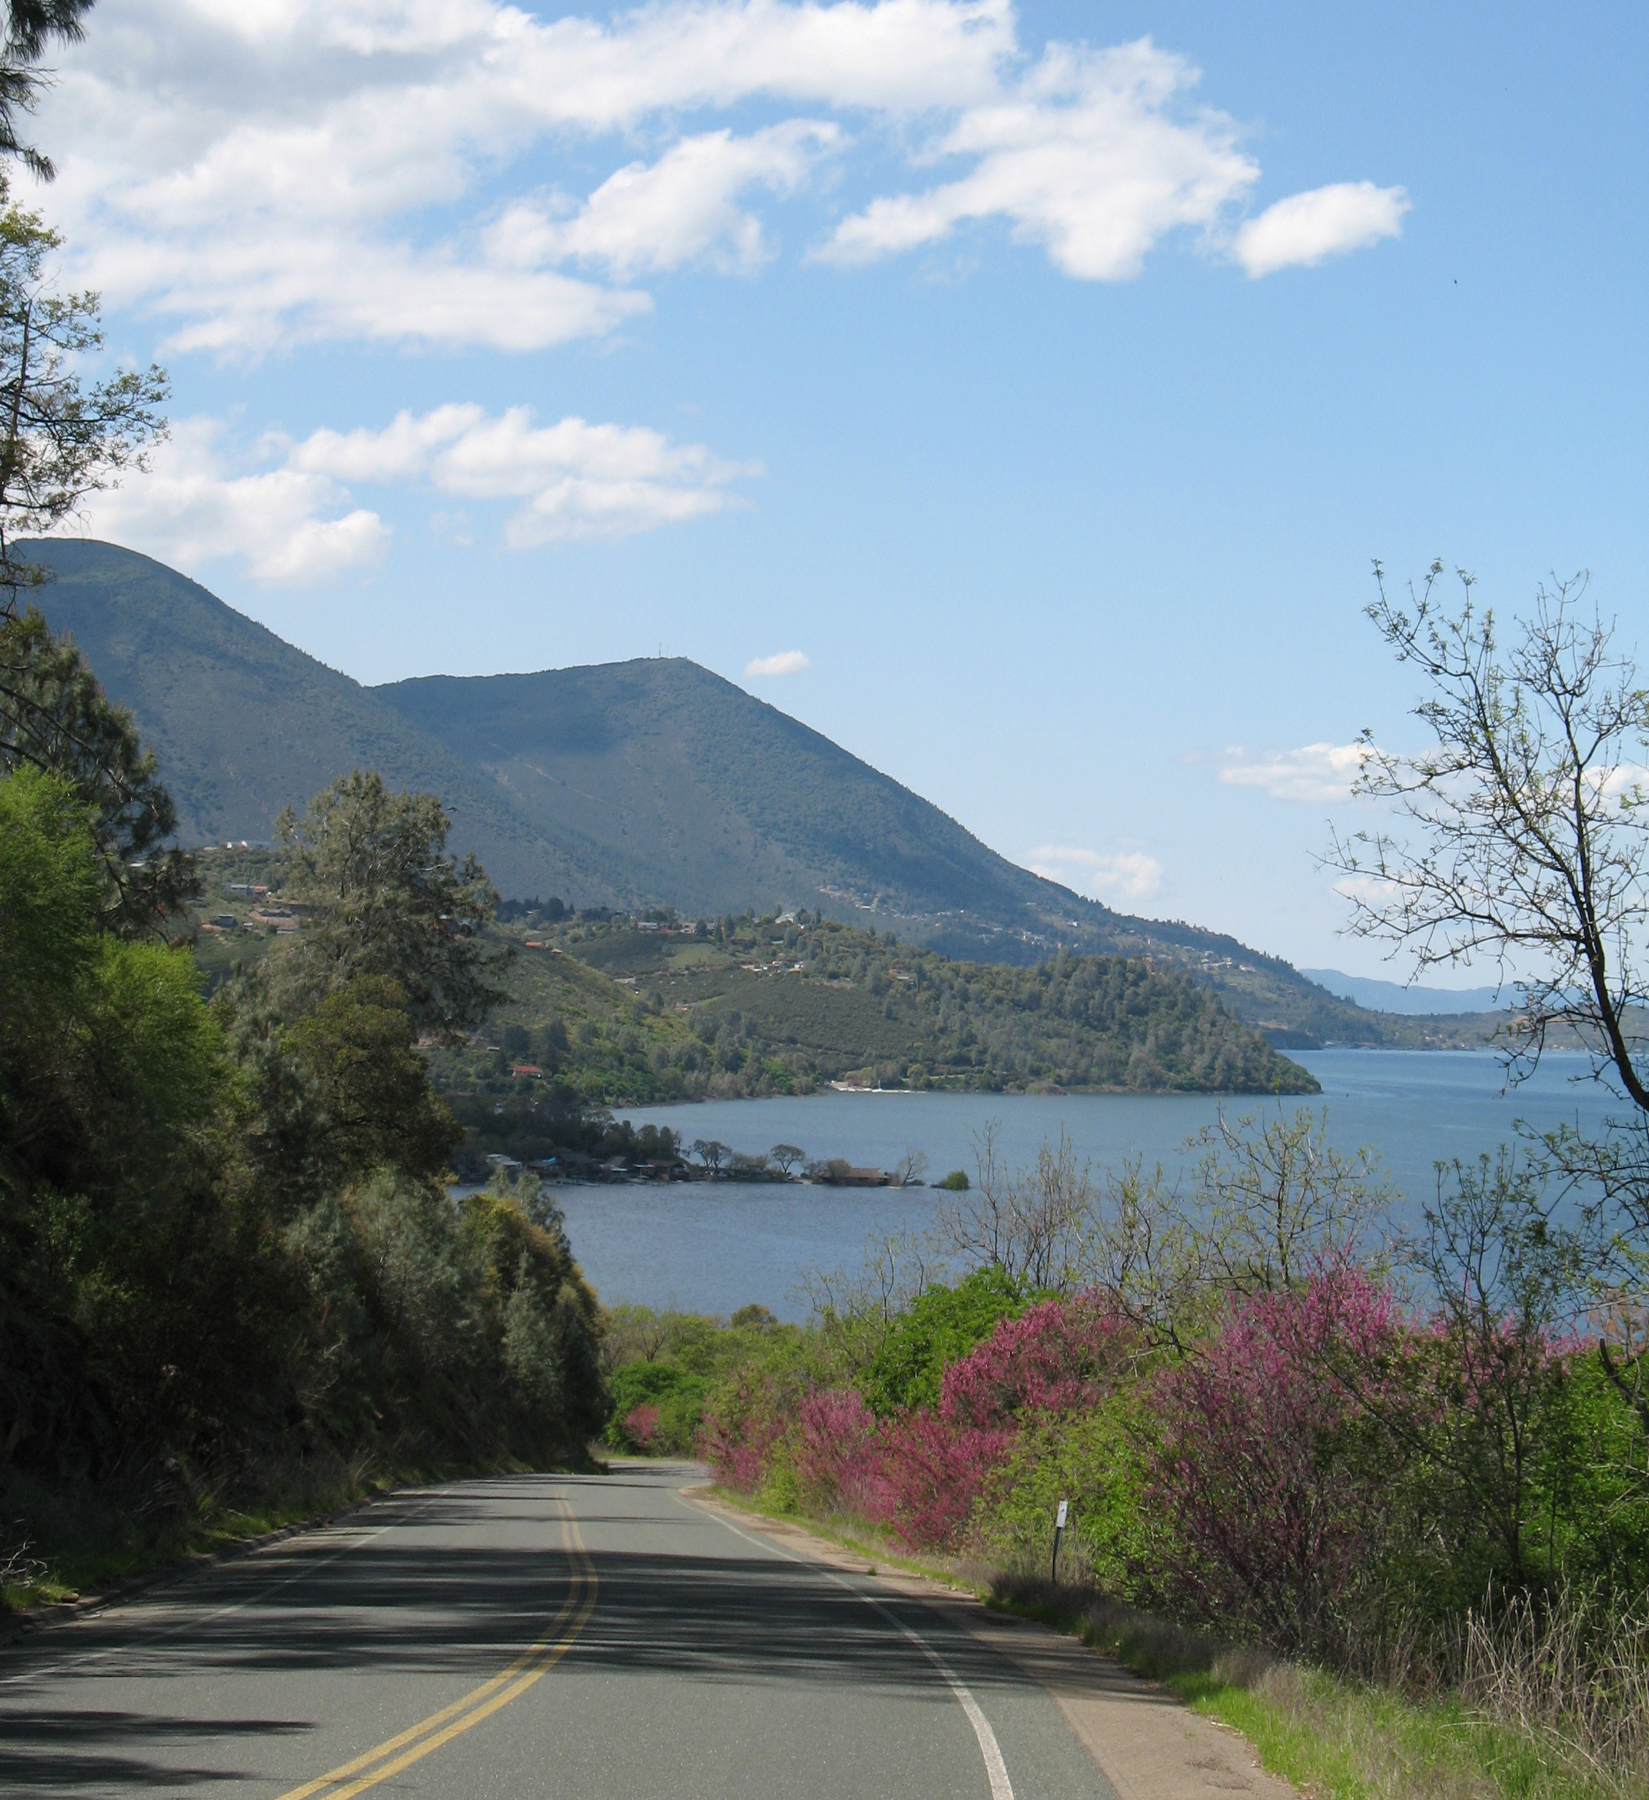
2025 ROAD construction
    Public Works Road Division
        37 miles of chip sealing Lower Lake / Kelseyville
    2024 Pavement Rehabilitation Project
        16 miles of pavement rehabilitation in Cobb Area
    Kelseyville Sidewalk Project
        1/3 miles of sidewalk near Kelseyville High School
    Dynamic Variable Speed Feedback Signs
    11 locations throughout the County

Slide 3
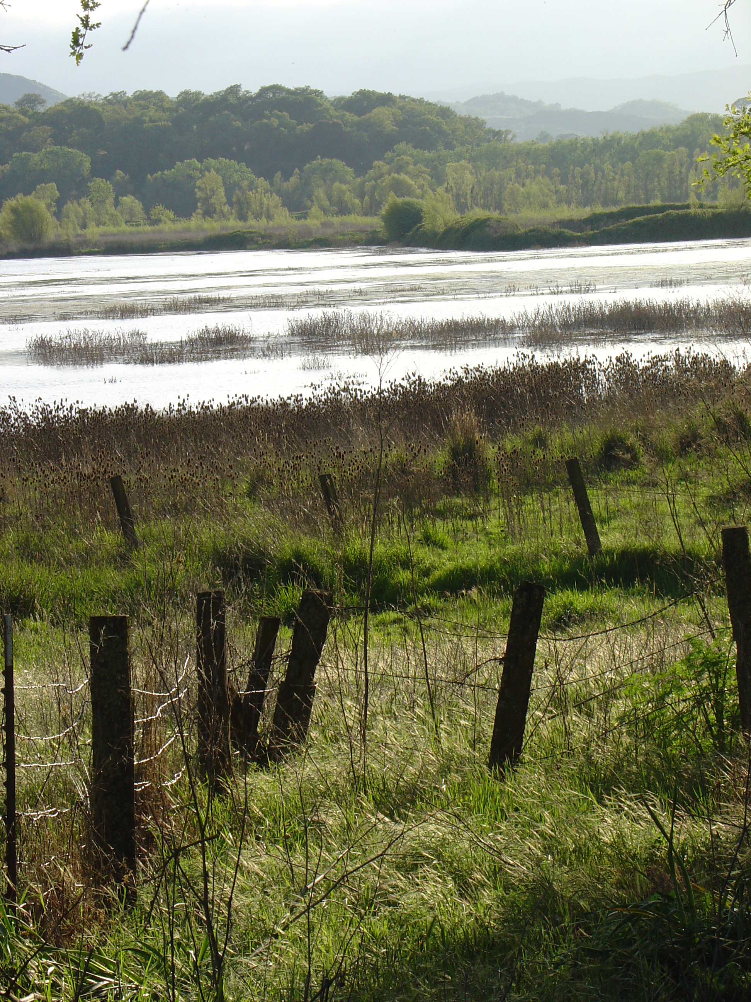
2025 ROAD Designs
Road Improvements
    South Main Street Widening and Bike Lanes
    Soda Bay Road Widening and Bike Lanes
Road Reconstruction and Rehabilitation
      Nice Lucerne Cutoff (East Portion) Pavement Reconstruction
      2025 Pavement Rehabilitation Project
    School Areas and Business Districts Signage and Pavement Marking Improvements Survey

Slide 4
2025 ROAD Designs
Landslide Repair Projects
Bridge Replacement / Repair Projects
Temporary Bridge Repair Projects
Remove Bailey Bridges and construct new bridge deck on Highland Springs Road and Merritt Road
Pedestrian Crossing at Various Schools and Main Street in Lower Lake

Slide 5
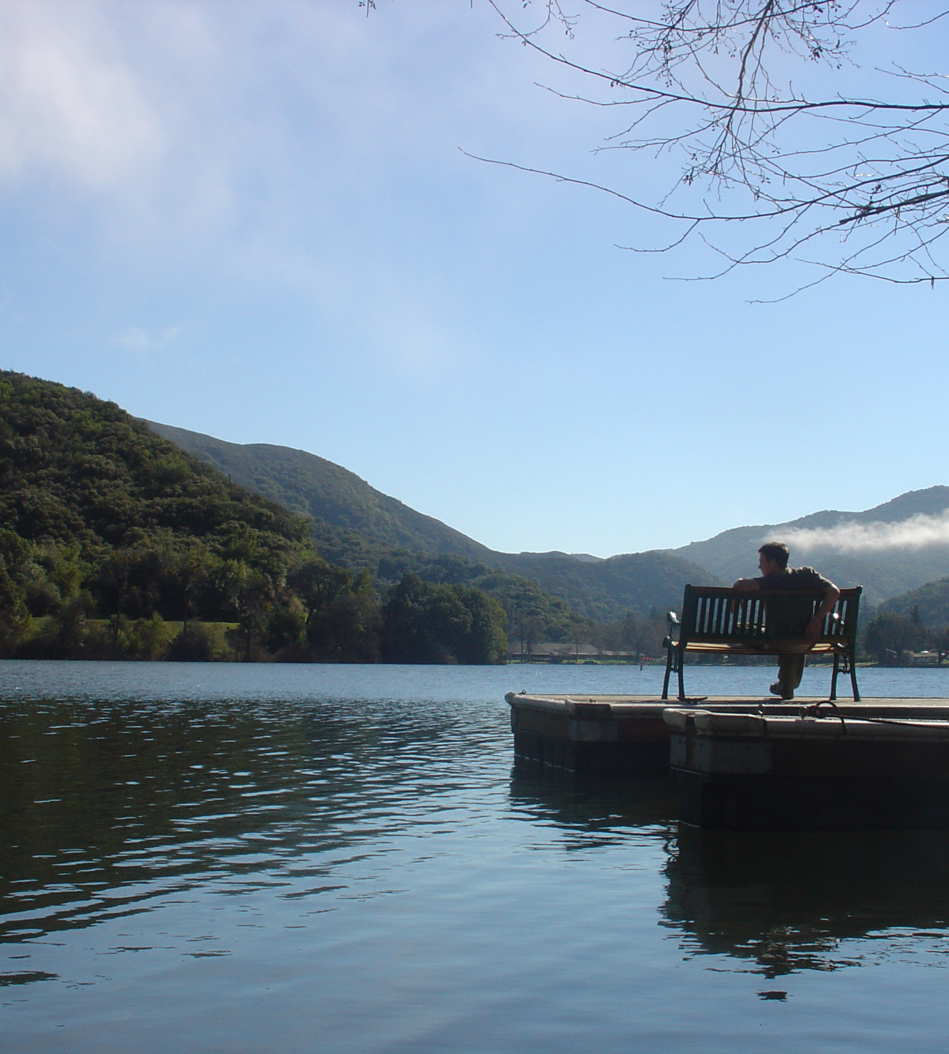
2025 PLANNED GRANT PURSUITS
Better Utilizing Investments to Leverage Development (BUILD) Grant
  South Main Street Widening and Bike Lanes
  Soda Bay Road Widening and Bike Lanes
Community Development Block Grant (CDBG)
  2025 Pavement Rehabilitation Project
State Transportation Improvement Program (STIP) Grant
  Nice – Lucerne Cutoff (East Pavement Reconstruction

Slide 6
COUNTY OF LAKE
2026 Regional transportation plan / active transportation Plan Update

Slide 7
What is the purpose of the plans? planning documents that identify the County’s most important projects as determined by the Community
WhY are the plans Important?
Obtaining Grants for the community’s most important projects
What do the plans not Do? the plans do not prioritize projects

Slide 8
What are types of REGIONAL Transportation Projects
Identifies the County’s most important projects to promote safe and efficient multi-modal transportation as determined by OUR Community
What are types of active transportation projects?
Projects that encourage increased use of active modes oF transportation, such as walking and biking

Slide 9
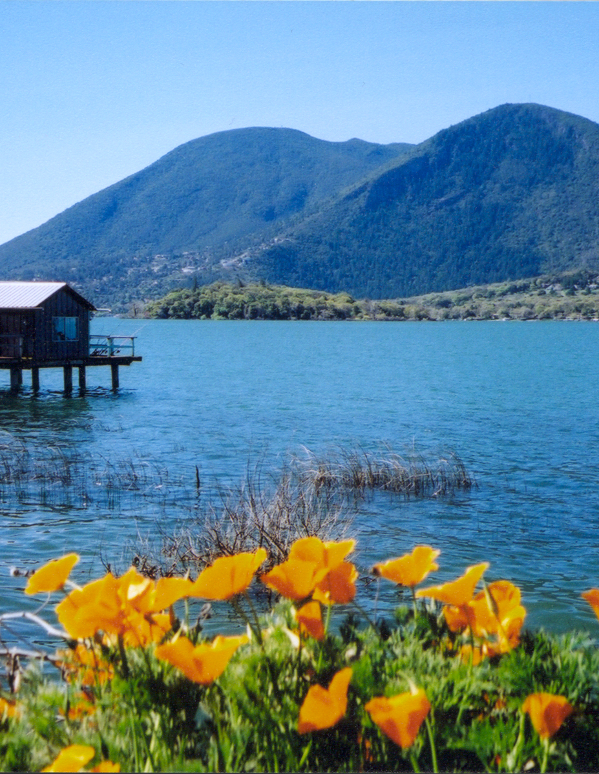
2022 Regional transportation plan Projects (Existing plan)
South Main Street Widening and Bicycle Lanes (South Lakeport)
Soda Bay Road Widening and Bicycle Lanes (South Lakeport)
Pavement Reconstruction / Rehabilitation (Countywide)
Bridge Replacement / Repair (Countywide)

Slide 10
2026 Regional transportation Plan ADDITIONAL Proposed Projects
    What Projects should be added to the Plan?
    Reconstruct Arterial and Collector Roads
    Landslide Repairs
    What other projects should be added?

Slide 11
2022 Active transportation program
Projects (Existing Plan)
  South Main Street Widening and Bike Lanes (South Lakeport)
  Soda Bay Road Widening and Bike Lanes (South Lakeport)
  Middletown Multi-Use Trail (Middletown)
  Kelseyville Road Safe Routes to School Pedestrian Improvements (Kelseyville)
  Bridge Arbor Bikeway (North Lakeport)
  Rainbow Road Complete Streets Improvements (North Lakeport)

Slide 12
2022 active transportation plan Projects (continued)
  Pedestrian Improvement Projects
    North Lakeport
    Lakeshore Boulevard
    Lucerne
    Country Club Drive , 3rd, 9th , 10th , 14^{th,} ,15th , 16th , 17th
    Lower Lake
    Lake Street
  Middletown
  North of Highway 175, South of Highway 175, Bush Street / Pine Street
  Kelseyville
  Live Oak Drive / Main Street, Main Street / 3rd Street, Bell Hill Drive / Main Street

Slide 13
2026 Active transportation plan UPDATE - proposed Projects
Active Transportation Projects are typically multi-modal Projects (walking, biking, transit)
What projects should be added to the Plan?
Complete Streets Projects
Downtown Kelseyville
Downtown Lower Lake
Safe Routes to School Projects

Slide 14
2026 Active transportation plan UPDATE - proposed Projects
Multi-Modal Projects – Pedestrian / Bicycle / Transit
Lake Street Pedestrian and Bikeway Improvements (Lower Lake)
Country Club Drive Pedestrian and Bikeway Improvements (Lucerne)
Lakeshore Boulevard Pedestrian and Bikeway Improvements (Nice and North Lakeport)
What other projects should be added?

